Slide 1
PREPARING FOR THE 2026 REVALUATION
Overview of board options, taxpayer impact, implementation, and considerations for Manchester
Presented by: Kimberly Lord, Director of Finance
and Tami Nomack, Director of Assessment
Notes:
Tonight’s purpose is to explain what revaluation does, what choices are available to the Board to address the tax changes revaluation may bring, and how those choices could affect taxpayers and Town operations. We are providing information for discussion, with the understanding that final revaluation results are not yet known.

Slide 2
Purpose of revaluation
Required under Connecticut State Statute
Ensures assessments reflect current market values
Promotes fairness and equity across taxpayers
NOT a revenue increase tool
Notes:
Revaluation is required by state law and updates assessments to reflect the current real estate market. It does not determine how much revenue the Town raises; that is decided through the budget process. Revaluation itself is revenue neutral, It does not determine how much the Town collects, but it can change how the tax burden is distributed among taxpayers.

Slide 3
Reality of revaluation
Revaluation redistributes the tax burden
Some taxpayers will see increases, others decreases
Impact varies significantly by property and location
Residential values are expected to increase based on current market
Commercial values expected to remain flat
Certain sectors, including retail, may experience value declines
Revaluation does not determine the total amount of revenue raised
Notes:
Revaluation changes how the existing tax burden is distributed. Because different property types and neighborhoods do not change in value at the same rate, some taxpayers will pay a larger share and others a smaller share.

Slide 4
Existing Tax relief programs
Senior and disabled homeowner tax credit- low-income limits
H.E.L.P tax deferral program
Renter’s rebate program
Veteran Exemptions, including enhanced benefits
Senior volunteer tax credit- small program
Notes:
Manchester already offers several programs for seniors, people with disabilities, veterans, and renters. Each program has its own eligibility rules and serves a specific purpose..

Slide 5
Limitations of current programs
Programs are targeted by design
Do not address broad tax shifts from revaluation
Limited support for moderate-income households
Do not address perception of tax increases
Notes:
The existing programs were intentionally targeted and were not designed to offset revaluation changes. They also do not reach every household that may have difficulty absorbing a tax increase.

Slide 6
What to expect – fy28 budget
Faster-appreciating properties will see tax increases
Residential values may outpace commercial
Revenue-neutral mill rate still results in tax changes
Impacts will vary by neighborhood
Revaluation does not increase total tax revenue- it changes how the tax levy is distributed
Notes:
Even if the new mill rate raises the same total revenue, individual tax bills will change. The result for each property will depend on how its value changed compared with the rest of the Grand List.

Slide 7
Policy and budget options available to the board
Reduce Budgeted Expenditures
Mill Rate Adjustment
Enhance Existing Programs
Use of Fund Balance
Phase-in of Assessments
Homestead Exemption
Notes:
The Board has several ways to respond to the overall budget and tax impact. Tonight we are focusing mainly on phase-in and the homestead exemption, but those choices should be considered alongside the other options shown here. The options are listed from top to bottom, beginning with those that offer the greatest budget flexibility and moving toward those that involve more targeted relief, tax shifts, or administrative complexity.

Slide 8
phase-in assessments
• Spreads assessment increases over a period of up to 5 years
• Used by 4.73% of municipalities in past 5 years*
• Reduces immediate tax shock- but extends it over several years
Notes:
A phase-in spreads assessment changes over several years instead of applying the full new value at once. It can soften the first-year impact, but it delays rather than removes the remaining adjustment.
There were only 8 phase-in towns out of 169 towns over 5 years, including Waterbury, Bloomfield, Hamden and Torrington. Canton, Norwalk, Wethersfield and Windsor were the others.

Slide 9
Trade-offs
Creates temporary inequities between similar properties
Taxpayers may pay different taxes for similar homes
Large increases vs small increases treated differently
Notes:
A phase-in can cause similar properties to be taxed differently during the transition because their increases may be phased in by different amounts. That temporary difference is one of the central trade-offs the Board would need to consider.

Slide 10
Policy constraints
Delays full market-based assessments
Limits flexibility in future budgeting
Can complicate response to economic changes
actual grand list growth is muted in subsequent budgets
Multi-year commitment- limits future board decisions
Notes:
Once adopted, a phase-in becomes a multi-year commitment that affects future budgets as well as the current one. It can also make the underlying growth in the Grand List less visible during the phase-in period.

Slide 11
Phase-in: shifting the tax burden
A Phase-In Temporarily Shifts Taxes to Property That is Not Phased In
Same Revenue Required:
A phase-in does not reduce the Town budget or the
amount of taxes needed.
The Real Estate Shift:
Lowering the residential tax impact in Year 1 means
the general mill rate must be set higher to cover the
difference.
Higher General Mill Rate
Delaying residential increases requires a higher mill rate
to raise the same revenue.
Impact on Businesses
Motor vehicles are capped, so the shift falls on
commercial property and business equipment.
Notes:
As explained, a phase-in spreads the changes of residential assessments over time, but it does not reduce the amount of annual revenue needed. Because Manchester's motor vehicle rate is already at the state cap, car taxes can’t absorb any of this shift. Commercial real estate and taxable personal property would be impacted by the increase.

Slide 12
Phase-in:
Feedback from recent phase-in towns
What Connecticut Assessors Reported After Implementing a Phase-In
Year 1: A Softer Landing
Taxpayers expected a larger increase and
welcomed the smaller first-year impact.
Year 2: Continued Increases
Many were surprised and frustrated when
value and taxes increased again.
Planning and Communication:
Towns reported ongoing challenges
explaining the phase-in and planning
around phased values.
Notes:
We personally reached out to towns that have recently done a phase in. Bloomfield, Hamden, Torrington, Wethersfield, Windsor consistently reported that taxpayers had prepared for the full revaluation increase and were pleasantly surprised by the softer landing in Year 1. They also reported more confusion and frustration in later years when values and taxes continued to rise, along with ongoing communication and budgeting challenges. By Year 2, many taxpayers had forgotten the phase-in explanation and did not expect another automatic increase. Annual notices from their mortgage companies about increasing their escrow also drive a lot of inquires and frustration.

Slide 13
Phase-in: annual notices and public questions
Annual Costs
Printing, mailing, and postage costs continue throughout the phase-in.
Annual Questions
Each notice is likely to generate another round of calls, emails, and explanations.
Annual Notices
New assessment notices must be sent to affected properties each year of the phase-in.
Notes:
Standard operations only require mailing assessment notices to properties with active changes (such as new permits). A phase-in requires mailing a new assessment notice to all residential accounts every single year of the cycle. Another point of confusion for taxpayers is the timing between the assessment notices in January, the June/July tax bills, and the October escrow notice from their mortgage company. They become confused about which year is being taxed, particularly when you add the application dates for exemption programs, and which year they applied to.

Slide 14
Phase-in: market changes during the cycle
The Schedule Is Set
A phase-in follows a fixed, multi-year schedule.
The Market May Change
Scheduled increases may continue even if the real estate market slows or declines.
More Questions and Appeals
Taxpayers may question rising assessments when current market conditions appear weaker.
Notes:
A phase-in schedule is established at the beginning of the program, but the real estate market may change before the schedule ends. If the market weakens while phased values continue to rise, the Town should expect additional questions and possible appeals.

Slide 15
Phase-in:
Manual Permit and Construction Process
Separate Computer Required
Pre-revaluation values are preserved on one stand-alone computer throughout the phase-in.
Every (Value-Adding) Permit Requires a Manual Calculation
Staff retrieves the old value, subtracts it from the new revaluation value, and calculates the phased amount of the difference.
For example, a four-year phase-in would calculate 25% of the difference be manually added each year for 4 years.
No Automated Updates
Each calculation is then hand-keyed into each property account every year of the phase-in.
Staffing Impact
Two of our staff members currently perform real estate work. Additional staff would need technical training and oversight while continuing their regular duties.
Notes:
From an operational standpoint, there is no automated software feature. Adjustments for any value-changing residential building permit would be manually keyed every year. It’s a complicated and labor-intensive process, and then requires an explanation to our taxpayers. One assessor shared a specific example of this complicated process using a real example from their phase-in.

Slide 16
REAL EXAMPLE:
For partial construction on a new home at the time of revaluation. The taxpayer wants an explanation for how to calculate their current tax bill in year 2 of the phase-in. Facts:
2023 GL (Old/before Reval) 2024 GL (New/Reval)
Land Asmt $78,000 $130,000
Bldg Asmt $0 $114,030 (30% Complete Construction)
Total Asmt $78,000 $244,030
To calculate the phase-in assessment for a partially complete building, follow these steps:
New Asmt - Old Asmt = Difference THEN DIVIDE Difference by # Phase-In Years
$244,030 - $78,000 = $166,030 ÷ 4 = $41,508 Phased-in Adjustment
Old Asmt + Phased-In Adjustment (Yr1) = 2024 Phased-in Assessment
$78,000 + $41,508 = $119,508
Old Asmt + Phased-In Adjustment (Yr2) = 2025 Phased-in Assessment
$78,000 plus $83,016 ($41,508 x 2) = $161,016
The tricky part arises because the house is now 60% complete in Year 2; you must recalculate everything using the new percentage of building completion.

Slide 17
Phase-in Considerations
Learn from comparable municipality’s experiences with phase-in
Emphasize increases are delayed, not eliminated
Consider shorter duration (3 years vs 5 years)
Monitor impacts annually
Focus on public communication and manage expectations
Notes:
While a phase-in aims to smooth out sudden residential real estate spikes for homeowners, it immediately distorts other parts of Manchester's Grand List. Because a phase-in temporarily suppresses the full growth of the real estate portion of the Grand List, the Town must artificially inflate the mill rate for assets that are not phased-in to generate the same required revenue. If the Board wishes to consider a phase-in, the length of the program, communication plan, and experience of other towns should all be reviewed.

Slide 18
Homestead exemption
• Reduces taxable value of owner-occupied homes
• 5%-35% available under CGS § 12-81oo
• Potential future $50k flat exemption
Notes:
The percentage option is applicable to owner-occ single-family and two-family dwellings as well as condos and the like. The $50k flat exemption, enacted by PA 26-68, Sec 224-5 is an option available starting in the 2027 grand list year (2029 FY), it’s not applicable to two-family dwellings, and has a November 1 deadline for the OPM prescribed annual form. These options work differently and cannot both be offered for the same assessment year.

Slide 19
Policy Design Options
Fixed exemption: $50,000 (effective FY29)
Percentage exemption: 5% to 35%
Eligibility criteria, determined by Board, must include:
Primary residence (with proof requirements)
Length of residency
Property value cap
Filing deadline and proof requirements must be established
Annual application and verification process must be established
Notes:
The percentage exemption favors higher valued properties while the fixed exemption favors lower valued properties. There is no established way to determine which residential properties are owner-occupied. The owner-occupancy statistics were based on census data compiled by CCM DataHub. Actual verification criteria would need to be established by the Board. This verification would not be without its own challenges.

Slide 20
Factors to consider
Percentage of owner-occupied vs renter-occupied. What type of housing exists within the community?
How would exempting a portion of owner-occupied residential value affect the distribution of the tax levy?
What resources and ongoing administrative processes would be required to implement and maintain the exemption?
Notes:
Manchester's mix of homeowners and renters is important because the direct benefit goes only to qualifying owner-occupied properties. The Board should also consider who would carry the remaining tax burden and what resources would be required to administer the program.

Slide 21
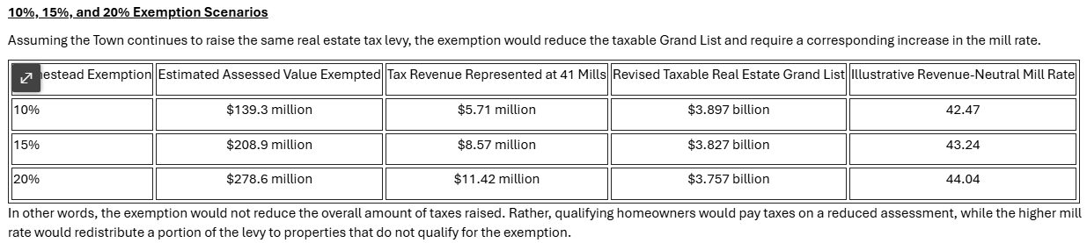
FISCAL IMPACT – MANCHESTER ESTIMATES
Using the 52% owner-occupancy assumption, approximately $1.393 billion of residential assessed value is used as the illustrative* potentially eligible homestead base.
*The 52% owner-occupancy assumption above is using 52% of the residential grand list for the examples. The owner-occupancy rate is measured by number of housing units owned, not the grand list value.
Notes:
These are illustrative estimates, not final projections. For purposes of these examples, we applied Manchester’s 52% owner-occupancy rate to the residential Grand List to estimate a potentially eligible homestead base. The actual owner-occupied assessed value could be higher or lower because the 52% rate measures housing units, not assessed value.
The table shows the same pattern at three exemption levels. As the exemption increases, more assessed value is removed from the taxable Grand List. If the Town continues to raise the same real estate tax levy, the mill rate must increase to make up the difference.
At a 10% exemption, the illustrative revenue-neutral mill rate increases from 41 mills to approximately 42.47. At 20%, it increases to approximately 44.04 mills.
Qualifying homeowners would pay taxes on a reduced assessment, but the higher mill rate would apply to the property that remains taxable. The exemption therefore does not reduce the total amount collected. It redistributes part of the tax burden.

Slide 22
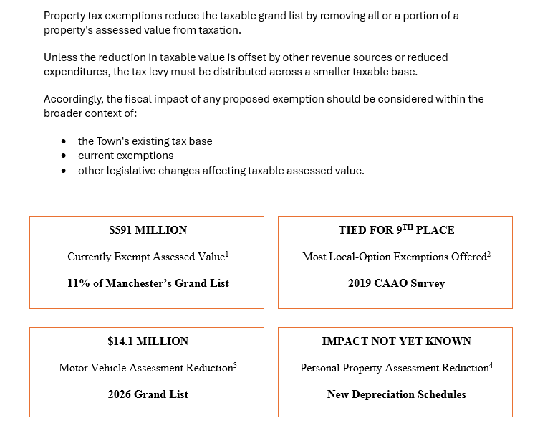
fiscal Impact-Existing Exemptions
¹ Source: Town of Manchester Grand List: ($591.4M exempt ÷ $5.538B total assessed value, rounded to 11%.)² Source: Municipal Option Statutes Municipal Survey Responses Updated 2019³Public Act 25-2⁴ Public Act 26-114 Section 10
Notes:
Manchester already exempts a substantial amount of assessed value through state-required and locally adopted programs. This provides context for considering how another exemption would further reduce the taxable base and shift costs to the property that remains taxable.

Slide 23
Taxpayer Impact
Homeowners: tax reduction
Apartments: tax increase
Commercial: tax increase
Potential indirect rent increases
Notes:
The direct benefit would go to qualifying homeowners. To raise the same revenue, apartment and commercial properties would generally pay more, and some of the apartment increase could ultimately be reflected in rents.

Slide 24
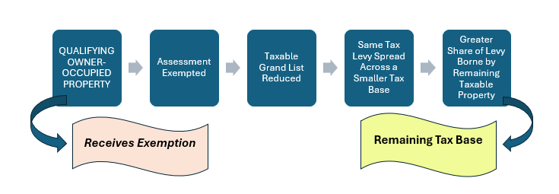
does a homestead exemption target the population the board intends to assist?
Homeowner ($300K assessed): saves ~$876
Apartment ($10M): +$12,000 tax
Small business ($1M): +$1,200 tax
Notes:
This example shows the distributional question for the Board. The homeowner receives the direct reduction, while apartment and business properties contribute more through the higher mill rate; the policy choice is whether that result matches the population the Board intends to assist.

Slide 25
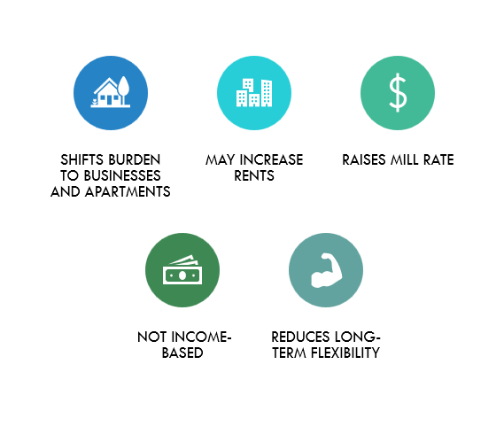
Timing, ADMINISTRATIVE, AND OTHER CONSIDERATIONS
10/1/26- REVALUATION- FULL EFFECTS UNKNOWN UNTIL HEARINGS HAVE TAKEN PLACE AND GRAND LIST IS SIGNED
FULL IMPACT OF PERSONAL PROPERTY AND MV LEGISLATION NOT YET DETERMINED
DEFERRING A DECISION UNTIL REVALUATION RESULTS ARE KNOWN WOULD ALLOW THE BOARD TO EVALUATE IMPACTS USING A COMPLETE PICTURE OF THE TAX BASE
ADMINISTRATIVE BURDEN
Notes:
The full results of the 2026 revaluation will not be known until hearings are complete and the Grand List is signed. Waiting would allow the Board to evaluate actual revaluation results together with the still-developing effects of motor vehicle and personal property legislation.

Slide 26
Implementation Considerations
Adoption Required by Board
Define Eligibility Criteria
Create Application and Define Verification Process
Complex Manual Implementation of Assessment Adjustments
Public Communication and Expectations
Notes:
Adoption would be the beginning of the process. The Board would still need to establish eligibility rules, create applications and establish the verification process, prepare staff and systems, and explain both the benefit and the resulting tax shift to the public.

Slide 27
What, if any, action is needed now?
• No immediate action is required, wait until revaluation results are known (our recommendation)
• Consider a percentage exemption after results are known
• Consider the $50,000 flat exemption for FY29
• Form a board subcommittee to consider future implementation
Notes:
These options do not require an immediate decision. The Board can wait until the revaluation is complete and the actual tax-base impacts are known. At that point, it would have better information to determine whether any additional policy response is needed.

Slide 28
Setting Expectations
Not a tax cut overall – redistribution of tax burden
Visible homeowner benefit with corresponding shifts
Important to communicate impacts to business community
Understand owner-occupancy relevance
Notes:
A homestead exemption would provide a visible benefit to qualifying homeowners, but it would redistribute rather than reduce the total tax burden. Manchester’s owner-occupancy rate is low, ranking 18th lowest among Connecticut municipalities in the data used for this analysis. That means a large share of Manchester residents are renters and would receive no direct benefit. In addition, a percentage exemption is not based on income and provides a larger dollar reduction to higher-assessed homes. These factors are important when considering whether the program would reach the population the Board intends to assist. East Windsor recently adopted a 15% exemption, but its 69% owner-occupancy rate and housing characteristics are very different. Its experience may be informative, but the scale, housing mix, administrative workload, and distribution of the tax burden would not be comparable to Manchester.

Slide 29
Final considerations
Revaluation is necessary and unavoidable
Highly visible and sensitive process
Requires a thoughtful and balanced approach
Changing values through phase-in or new exemptions adds confusion
Notes:
Revaluation is already a significant and sensitive change for taxpayers. Any phase-in or new exemption should be evaluated not only for its immediate benefit, but also for the tax shifts, administrative work, and added complexity it would create.

Slide 30
Questions?
Notes:
That concludes our overview. We are happy to answer questions or provide additional analysis as the Board considers these options.

