Slide 1
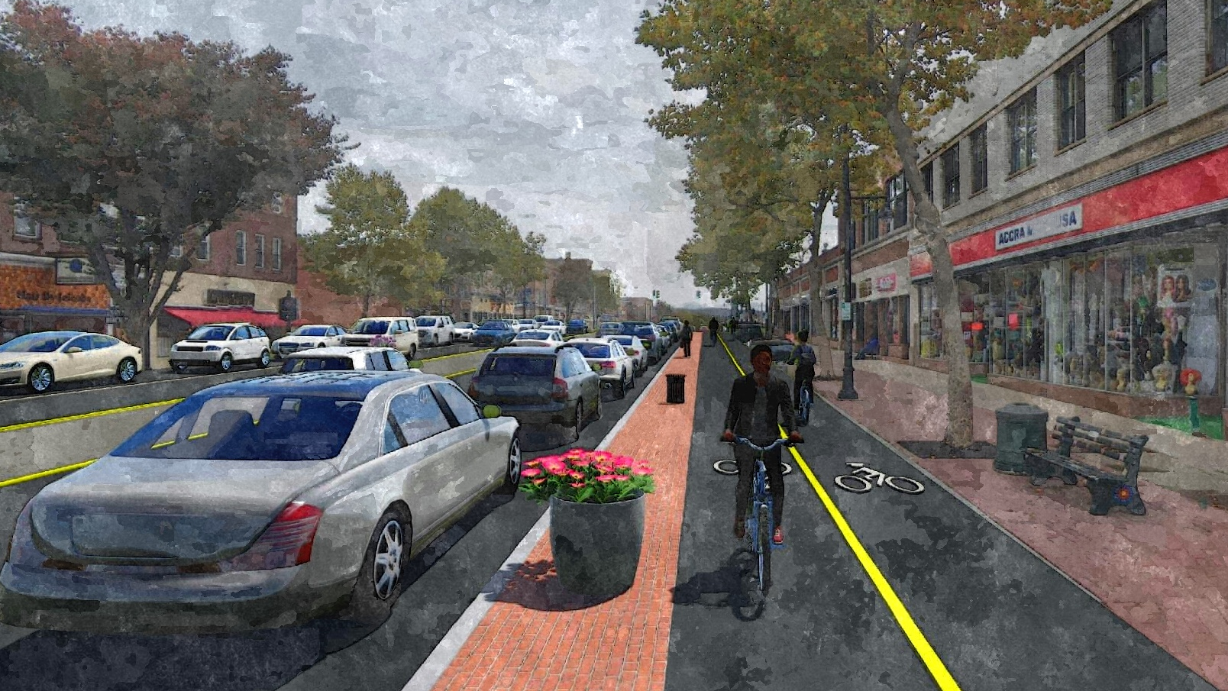
Project Purpose
Public Safety
Economic Impact and Vibrancy
Costs not borne by Manchester taxpayer
Notes:
Optional Agenda Slide

Slide 2
Public Safety
PROVEN SAFETY COUNTERMEASURES
  Road Diet
    4-Lane to 3-Lane, Road Diet Conversions 19-47% reduction in total crashes.
  Roundabouts
    78% Reduction in fatal and injury crashes when converting signalized Intersection to a Roundabout
  Cycle Tracks
    Bicycle Lane Additions can reduce crashes up to 49% for total crashes on urban 4-lane undivided collectors and local roads.
Notes:
Optional Agenda Slide

Slide 3
Economic Impact and Vibrancy
Road Diet improves economic vitality by changing the corridor from a place that people “drive-through” to one that they “drive-to.”
Road diets actually increase and enhance business activity by reducing traffic speeds (which helps motorists notice the shops, eateries and businesses they’re driving alongside) and by accommodating pedestrians and bicyclists (who tend to spend more money at local businesses than drivers do).
Several cities have quantified their Road Diet’s effect on economic growth.
  Brookyn, NY – doubled retail sales in three years following complete streets
  Charlotte, NC
  Indianapolis, IN
Notes:
Optional Agenda Slide

Slide 4
Financial Benefits to Manchester
Public investments required regardless of design, a liability of at least $10 million
Town successfully granted $8.35 million in funding for the project precisely because it includes proven safety and economic development measures.
  objective measures of success of road diets, bike lanes, and roudabouts for and economic benefits
The state and federal agencies are only going to fund projects that have these components.
If we change the plan tor remove the main components- road diet, bike lane, and bike lanes- we will lose the current funding and essentially eliminate any chance of other grants.
  Also risk CIF grant for library ($11 million total)
Notes:
Optional Agenda Slide

Slide 5
Downtown Manchester Improvements Project
January 2025 Update
Notes:
Briefly introduce the project.
Mention the goal: improving safety, accessibility, and economic vitality in the downtown area.

Slide 6
Project Review
Design Updates
Funding Updates
Next Steps
Notes:
Optional Agenda Slide

Slide 7
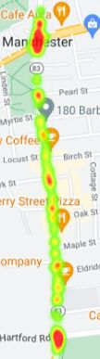
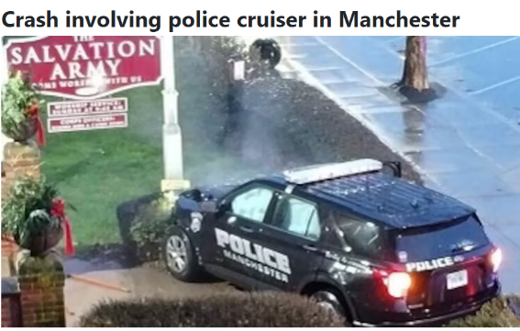
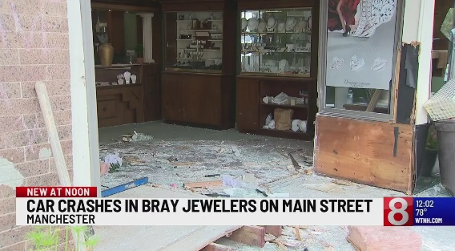
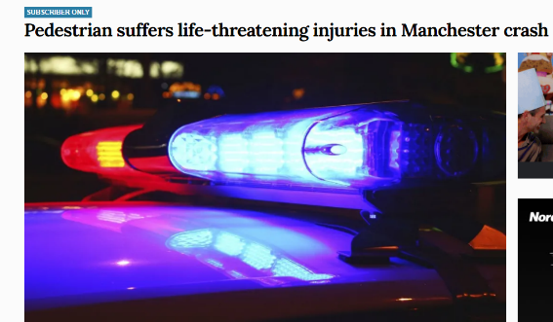
Road Safety Must Be Addressed
Main Street has highest rate of Pedestrian & Cyclist (non-motorized) crashes in the Capitol Region.
A significant number of these crashes are happening at intersections.
Over 31 Crashes Since Last BOD Presentation in May 2024
Notes:
This section of Main Street is ranked #1 in the Capitol Region (out of 38 municipalities) for non-motorized crashes (involving bikes/pedestrians) in CRCOG’s Regional Transportation Safety Plan.
The intersections at Main Street/Center Street and Main Street/Hartford Road are in the top 3% of the region’s intersections (ranked #260 and #264 out of 8,000) in the CRCOG Roundabout Screening Study.
Ranking factors included:
Injurious and fatal crashes
Traffic volumes
Available right of way
Safety Improvements:
Road Diet: Can reduce crashes by 19-47%
Dedicated Turn Lanes: Can reduce crashes by 28-48%
Roundabouts (not rotaries): Can decrease severe crashes by ~78%
High-Visibility Crosswalks: Can reduce pedestrian injury crashes by up to 40%

Slide 8
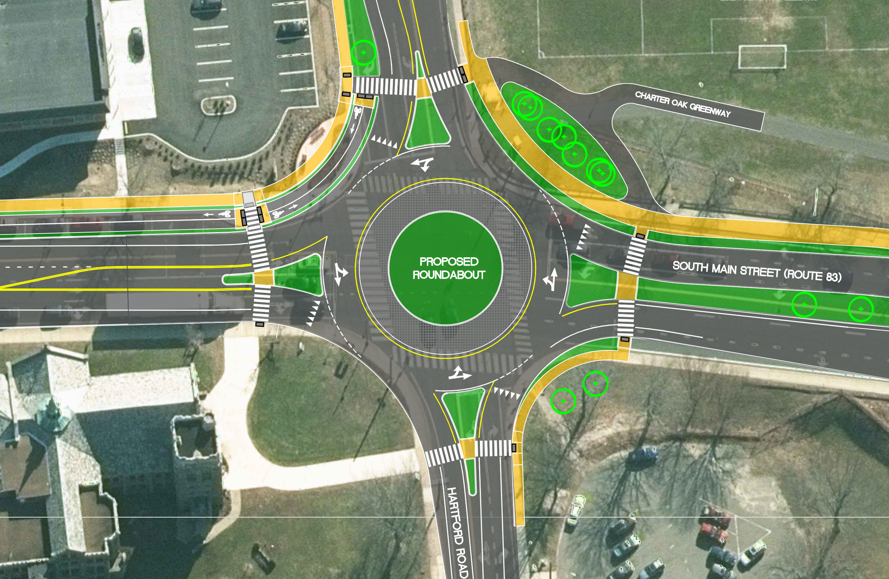
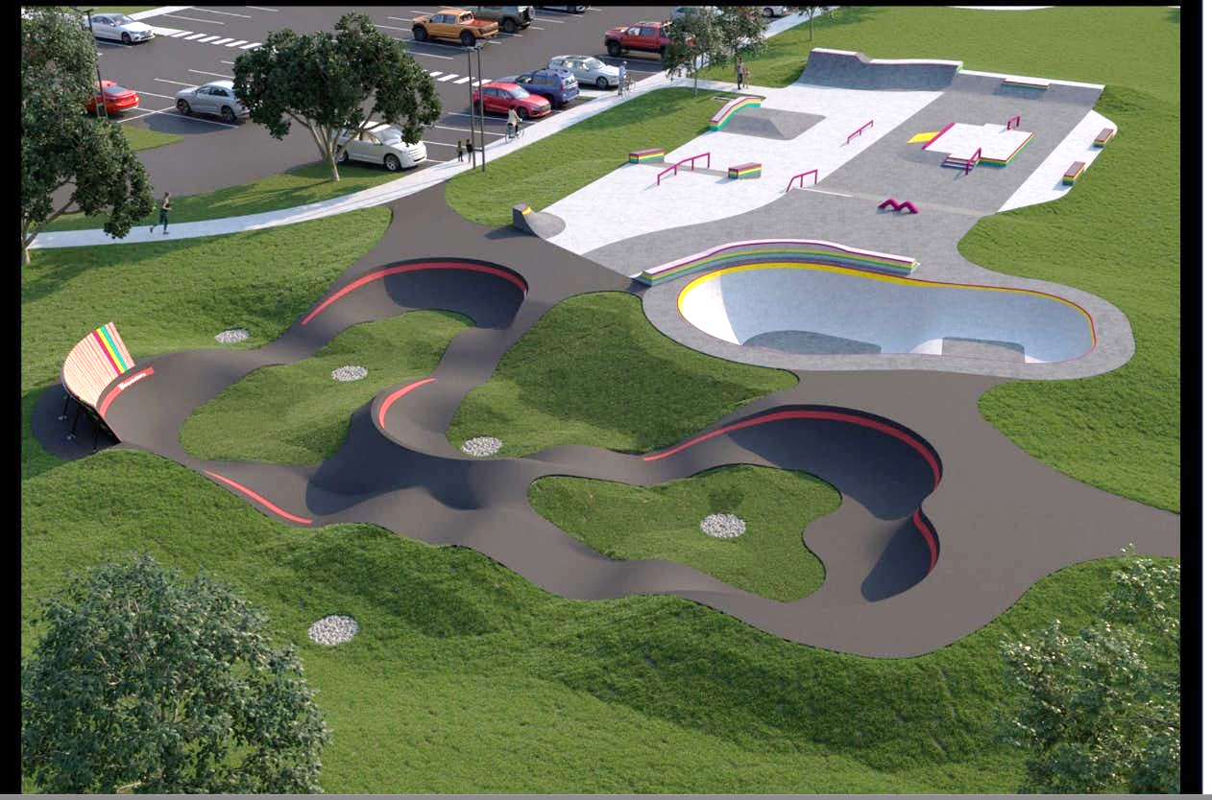
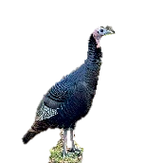

Charter Oak Park Improvements
Roundabout Demonstration to Test Road Race Compatibility
Roundabouts can reduce crashes & emissions, improve traffic, & support pedestrian access.

Slide 9
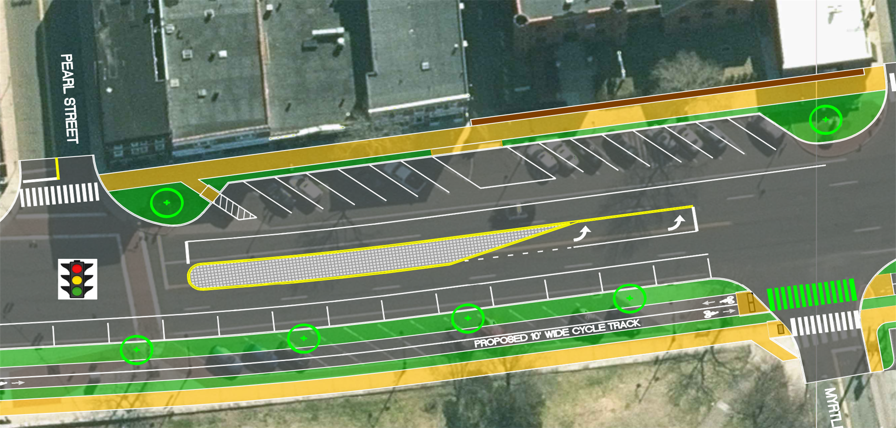
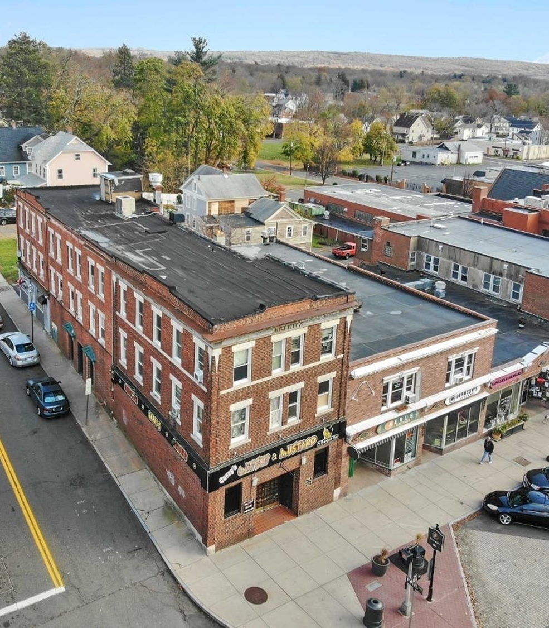
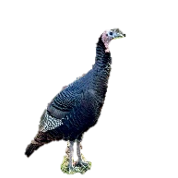
2 Pearl St. Renovation
Road diets are shown to reduce lanes to calm traffic, reduce weaving & make crossings safer.
Notes:
Because they are DESIGNED FOR PEOPLE, NOT CARS!
(While flipping through these slides, I would describe how the design of the street intentionally creates a sense of place and makes people want to spend time there, which is what actually makes a downtown successful.)
Safety Focus: Reducing lanes from four to two, adding dedicated left-turn lanes to slow vehicle speeds.
Benefits: Improved traffic flow, opportunity for safer spaces for pedestrians and cyclists, fostering foot traffic and private investment.

Slide 10
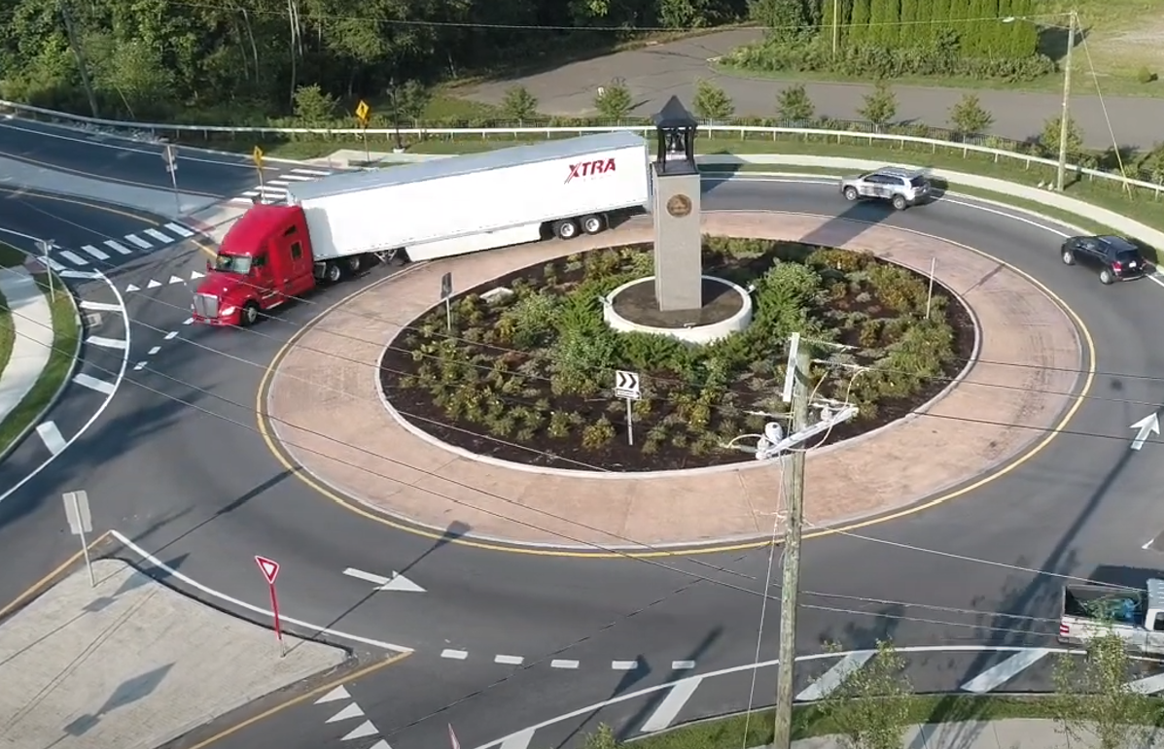
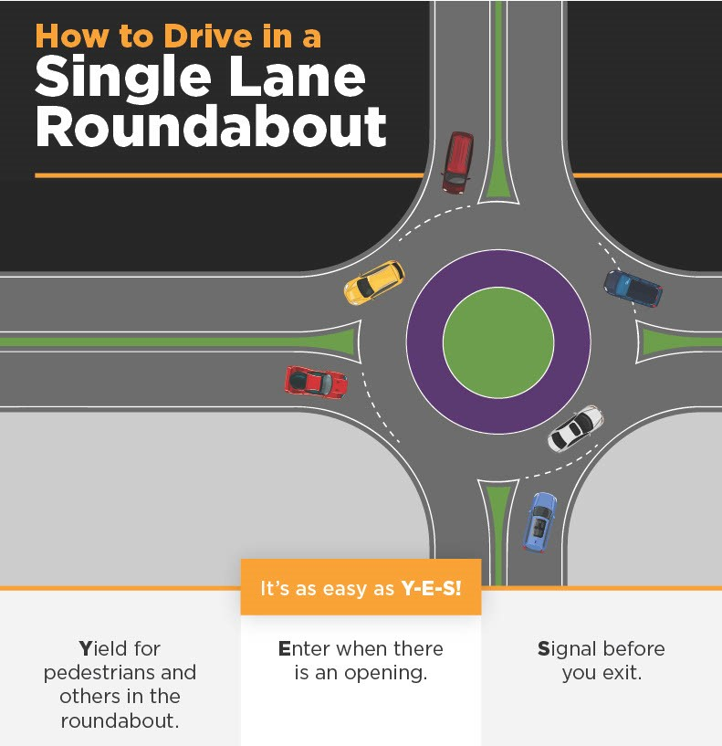
“Truck Apron” designed to accommodate large vehicles.
Photo: CTDOT
Photo: Watch for Me CT
Design is simple to navigate as traffic moves slowly.

Slide 11
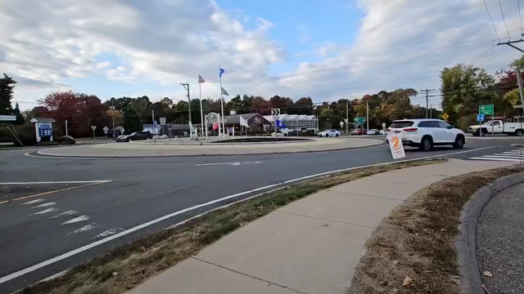
Five Corners Roundabout (Ellington, CT)
Source: Manchester Resident
Notes:
Video of different types of vehicles navigating Ellington 5-way Roundabout.

Slide 12
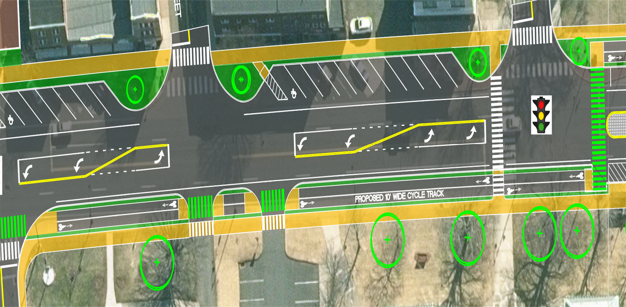
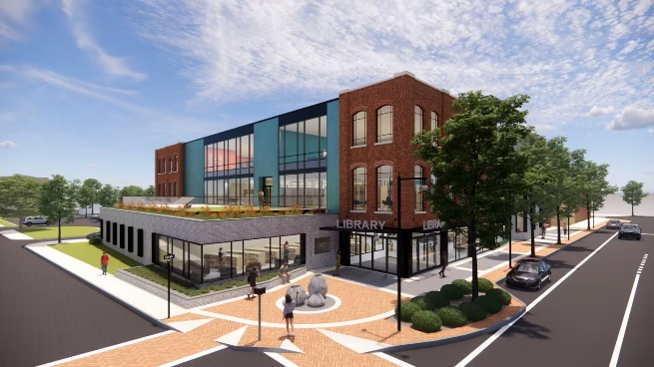
New Library Construction
Cycle track further reduces traffic conflicts & supports economic growth by connecting neighborhoods & trails.

Slide 13
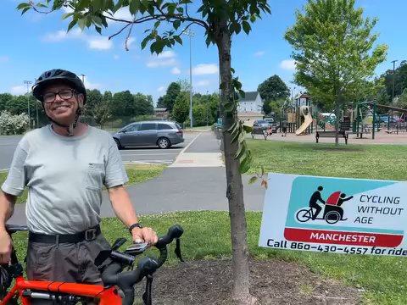
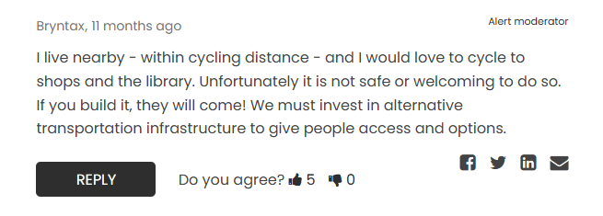
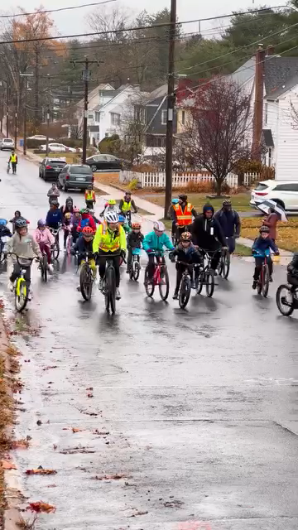
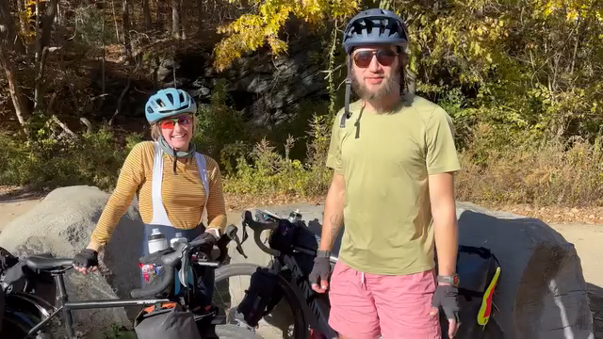
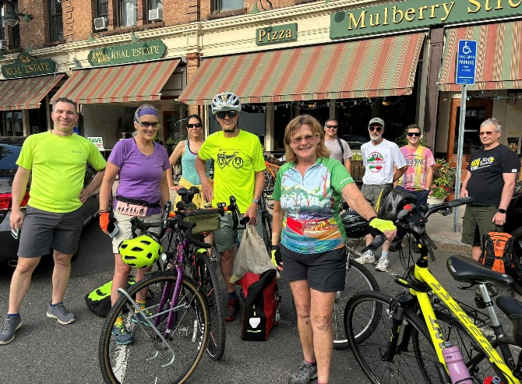
Who Might Use the Cycle Track?
Regional Cyclists
Source: UR Community Cares
International “Thru-Bikers”
Source: Improve Main Street
Bike Meet Up Group
Source: Improve Main Street
Elementary School “BIKE BUS”
Source: Manchester Public Schools

Slide 14
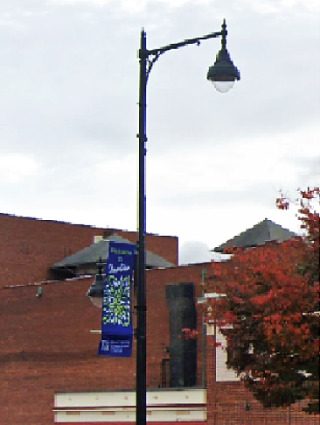
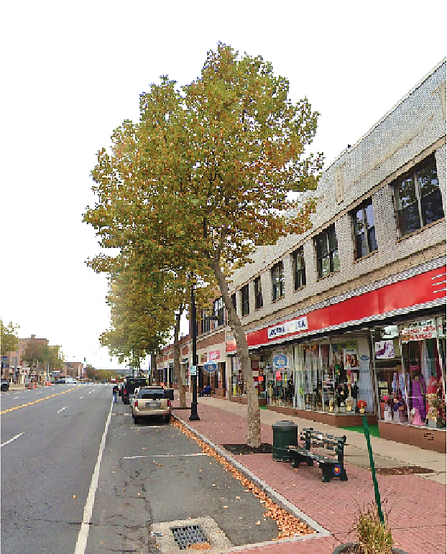
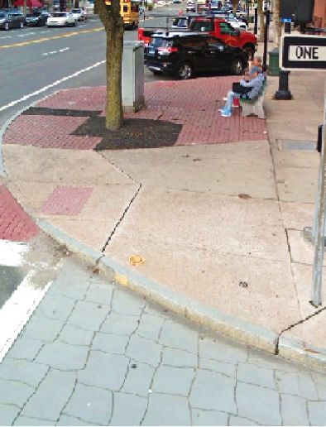
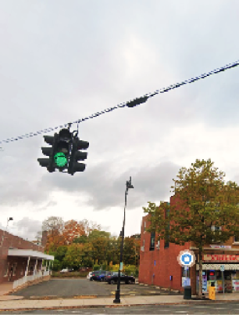
Updated Downtown Infrastructure Needed.
Downtown infrastructure is now over 30 years old!
… and needs major upgrades to maintain functionality, stabilize maintenance costs.
Notes:
Most infrastructure was last upgraded about 32 years ago
Outdated electrical equipment
Overgrown and mismanaged street trees
Cracked and uneven pavement
Traffic signals at the end of their useful life

Slide 15
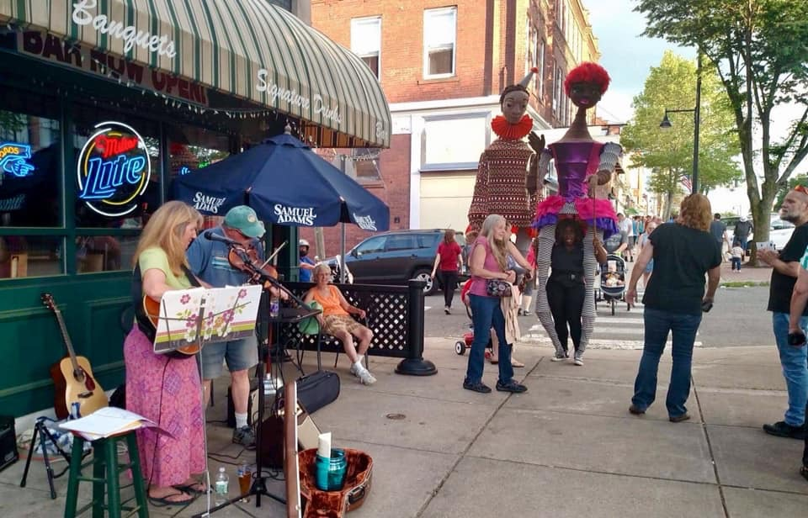
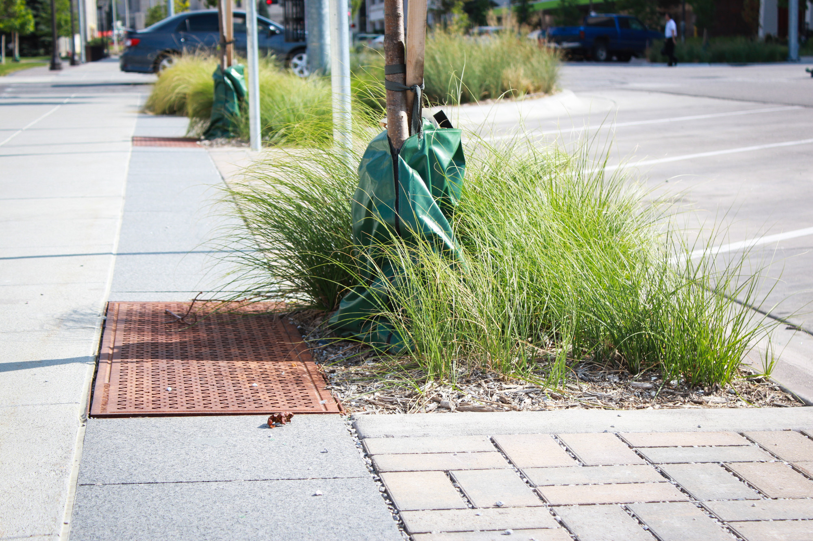
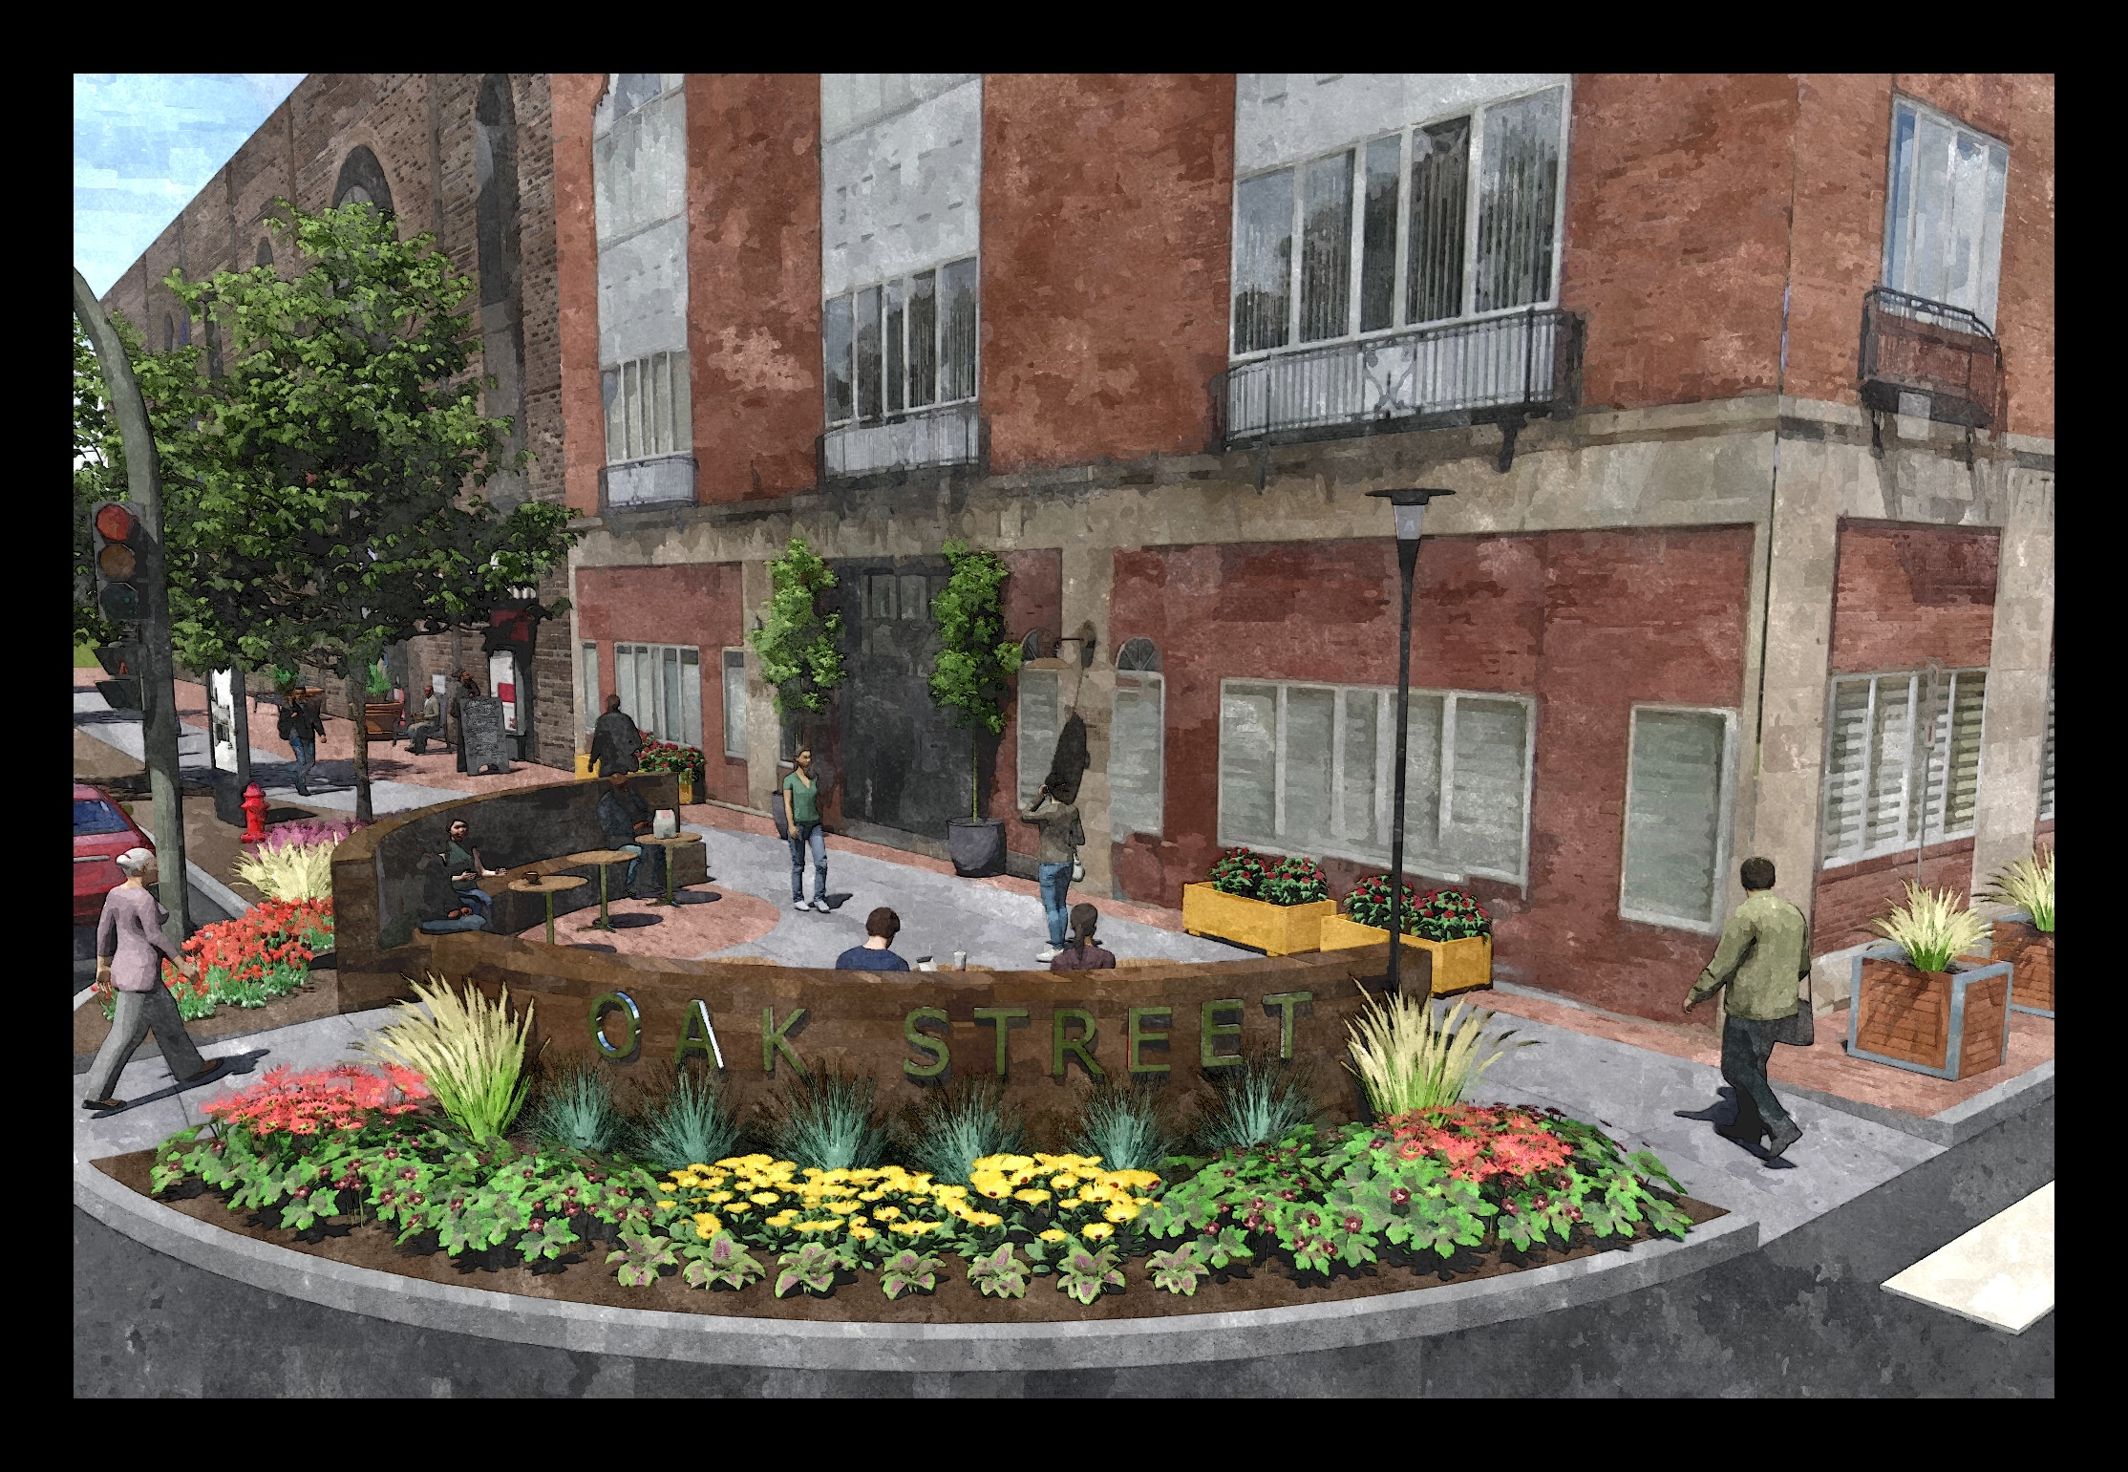
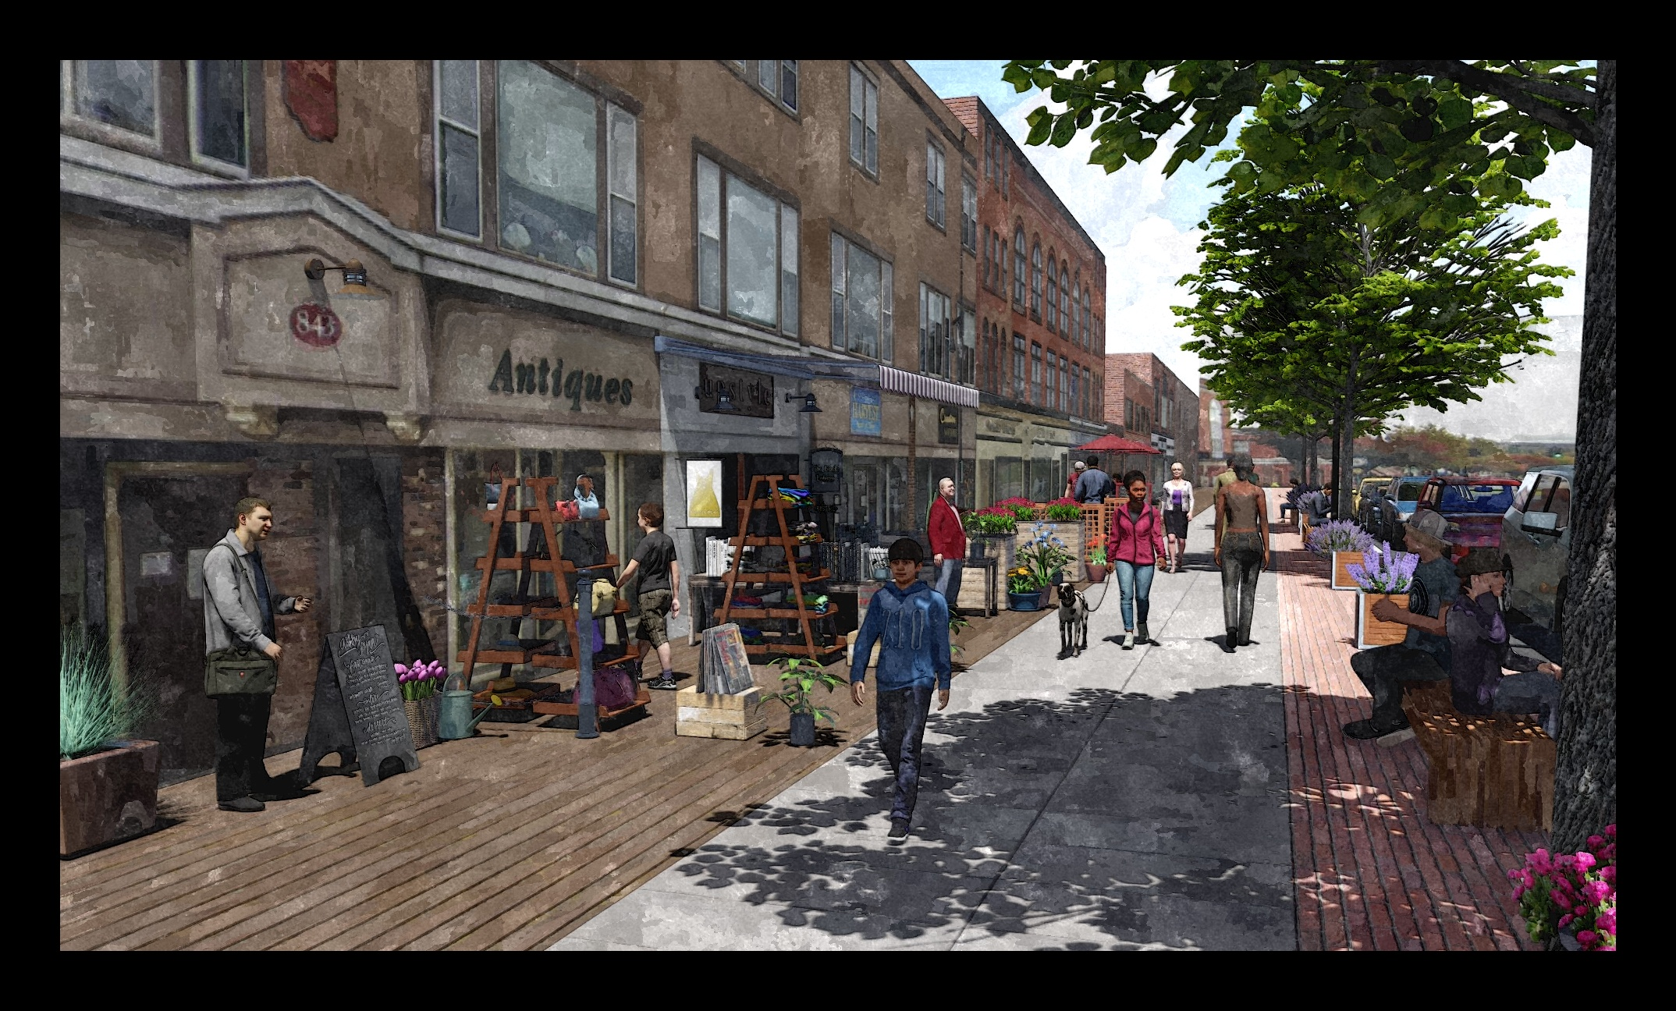
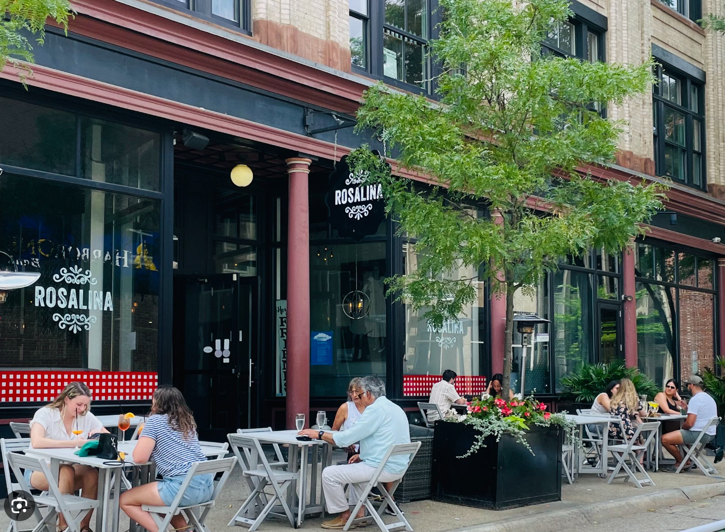
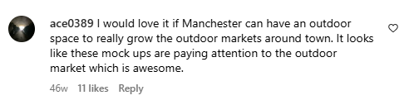
Replacing infrastructure opens opportunities to...
Notes:
Widen sidewalks to accommodate outdoor dining, vending, public amenities and activities that contribute to “ground floor activation” and add to culture and economic growth of downtown district
Allow for now only functional replacement of street streets but addition of landscaping that adds to beauty and stormwater management function
Sustainable Features and Stormwater Management
Low Impact Development (LID) Landscaping: Improvements that contribute to stormwater management and enhance urban resilience.
Eco-friendly Infrastructure: Making the downtown more climate-resilient through green infrastructure.
Integration of stormwater management solutions to reduce runoff and enhance climate resilience.
Low-impact Development (LID): Stormwater management solutions to reduce runoff and improve climate resilience.
Urban Heat Island Mitigation: Landscaping and trees to combat heat buildup in downtown.
Economic Vitality: Investing in these features helps keep Manchester competitive in attracting businesses.
Widen Sidewalks: Create space for outdoor dining, vending, public amenities, and activities that promote "ground floor activation," fostering cultural and economic growth in the downtown district.
Street Improvements: Focus on functional street replacement, while incorporating landscaping that enhances beauty and improves stormwater management.
Sustainable Features and Stormwater Management:
Low Impact Development (LID): Stormwater management solutions that reduce runoff and boost urban resilience.
Eco-friendly Infrastructure: Enhance downtown's climate resilience with green infrastructure.
Stormwater Solutions: Integrate features that manage stormwater and reduce runoff, contributing to climate resilience.
Urban Heat Island Mitigation: Use landscaping and trees to combat heat buildup in downtown areas.
Economic Vitality: Investing in sustainable infrastructure keeps Manchester competitive in attracting businesses.

Slide 16
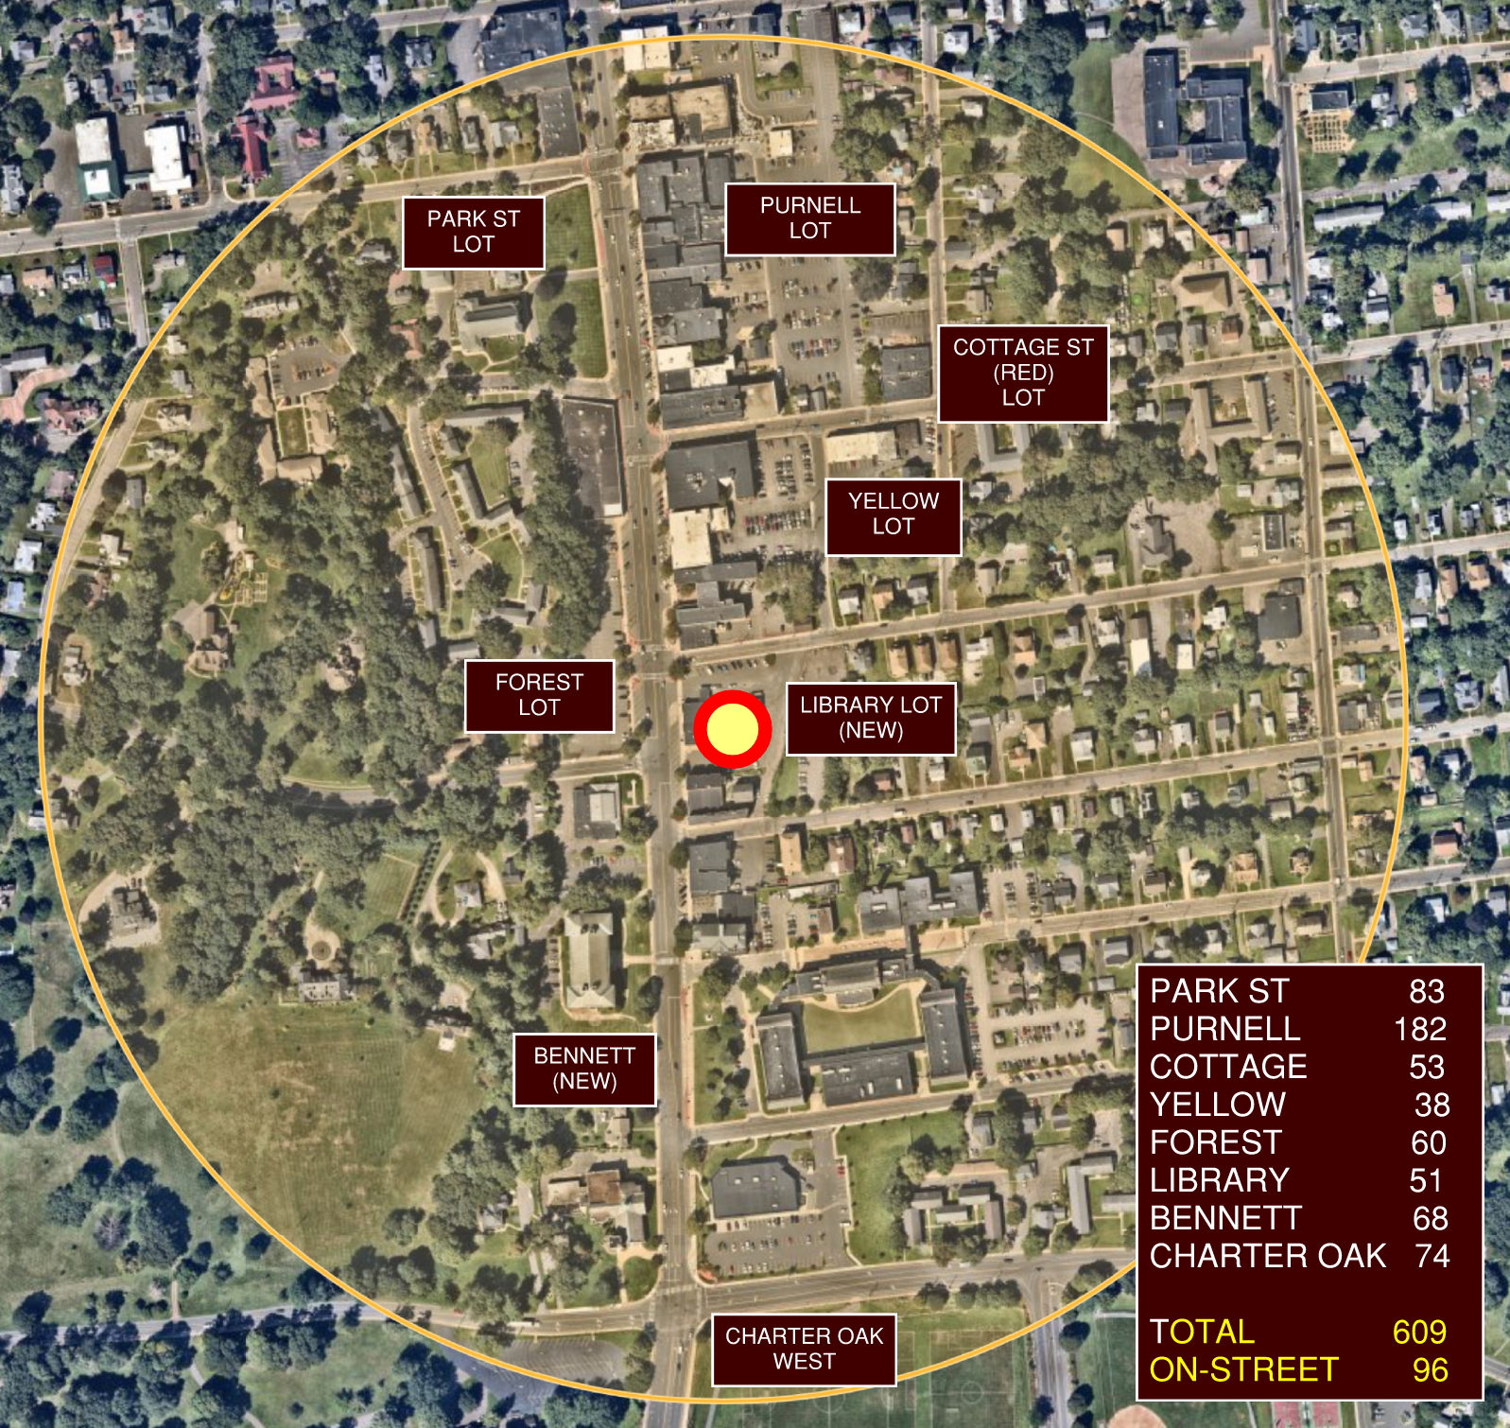
Downtown Manchester is similar in size to the Shoppes at Buckland Hills, making it a walkable distance.
8 public off-street lots
96 on-street parking spaces
3 bus routes
Minutes from Hartford, off I-384
Between the East Coast Greenway & Cheney Rail Trail
Notes:
There will be 8 off-street public parking lots with over 600 stalls and 96 on-street, lined parking stalls within a quarter mile radius of the new library To walk from one end of the Shoppes at Buckland Hills to the other is one third of a mile

Slide 17
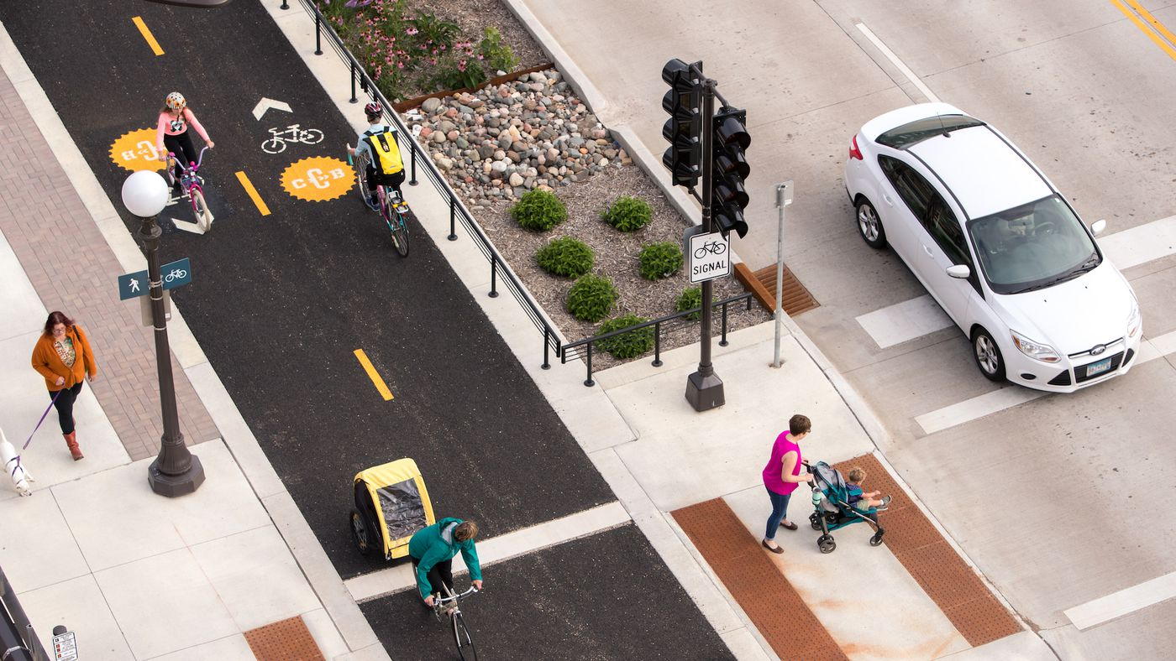
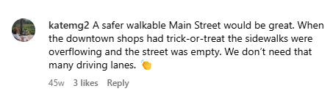
Complete Streets supports safer foot traffic.
Links Downtown to Regional Destinations
Encourages Safer Walking and Biking for Visitors
Improves Downtown for Events and Activities
Notes:
Connections to Key Areas:
East Coast Greenway
Charter Oak Park
Center Springs Park
Cheney District
Cheney Rail Trail
North End
East and West Sides
Cheney Bennett Academy
Bike/Pedestrian Enhancements:
Cycle Tracks and Wider Sidewalks: Align with Complete Streets commitments to improve accessibility and safety.
Safety Focus: Rising crashes downtown have increased vulnerability for vulnerable road users (VRUs), necessitating safer infrastructure.
Public Space Expansion: A road diet will free up space for new pedestrian and bike areas, making downtown more walkable.
Transit and Access:
Major Bus Line runs through downtown, serving the community.
12.5% of area households do not have vehicle access.
Events draw thousands of visitors walking through downtown.
Complete Streets Policy Commitments:
Bike/ped enhancements align with the town’s policy commitments made nearly 10 years ago.
Cycle tracks can be incorporated now, and a road diet will further enhance the public realm.
Crash data shows that VRU crashes are on the rise downtown, highlighting the need for better protection.
Pedestrian and Cyclist Infrastructure Enhancements:
Separated Cycle Track: A dedicated, protected space for cyclists to ensure safer biking.
Widened Sidewalks & ADA-Compliant Features: Enhancing accessibility for people with disabilities.
Accessible Pedestrian Signals (APS) & Rectangular Rapid Flashing Beacons (RRFBs): Improving visibility at key intersections.
Additional Pedestrian Safety Features: Enhanced crossings with RRFBs or other traffic-calming devices to improve safety.
Connectivity Beyond Main Street:
Expanding project boundaries to improve connections to adjacent areas, enhancing overall downtown accessibility.

Slide 18
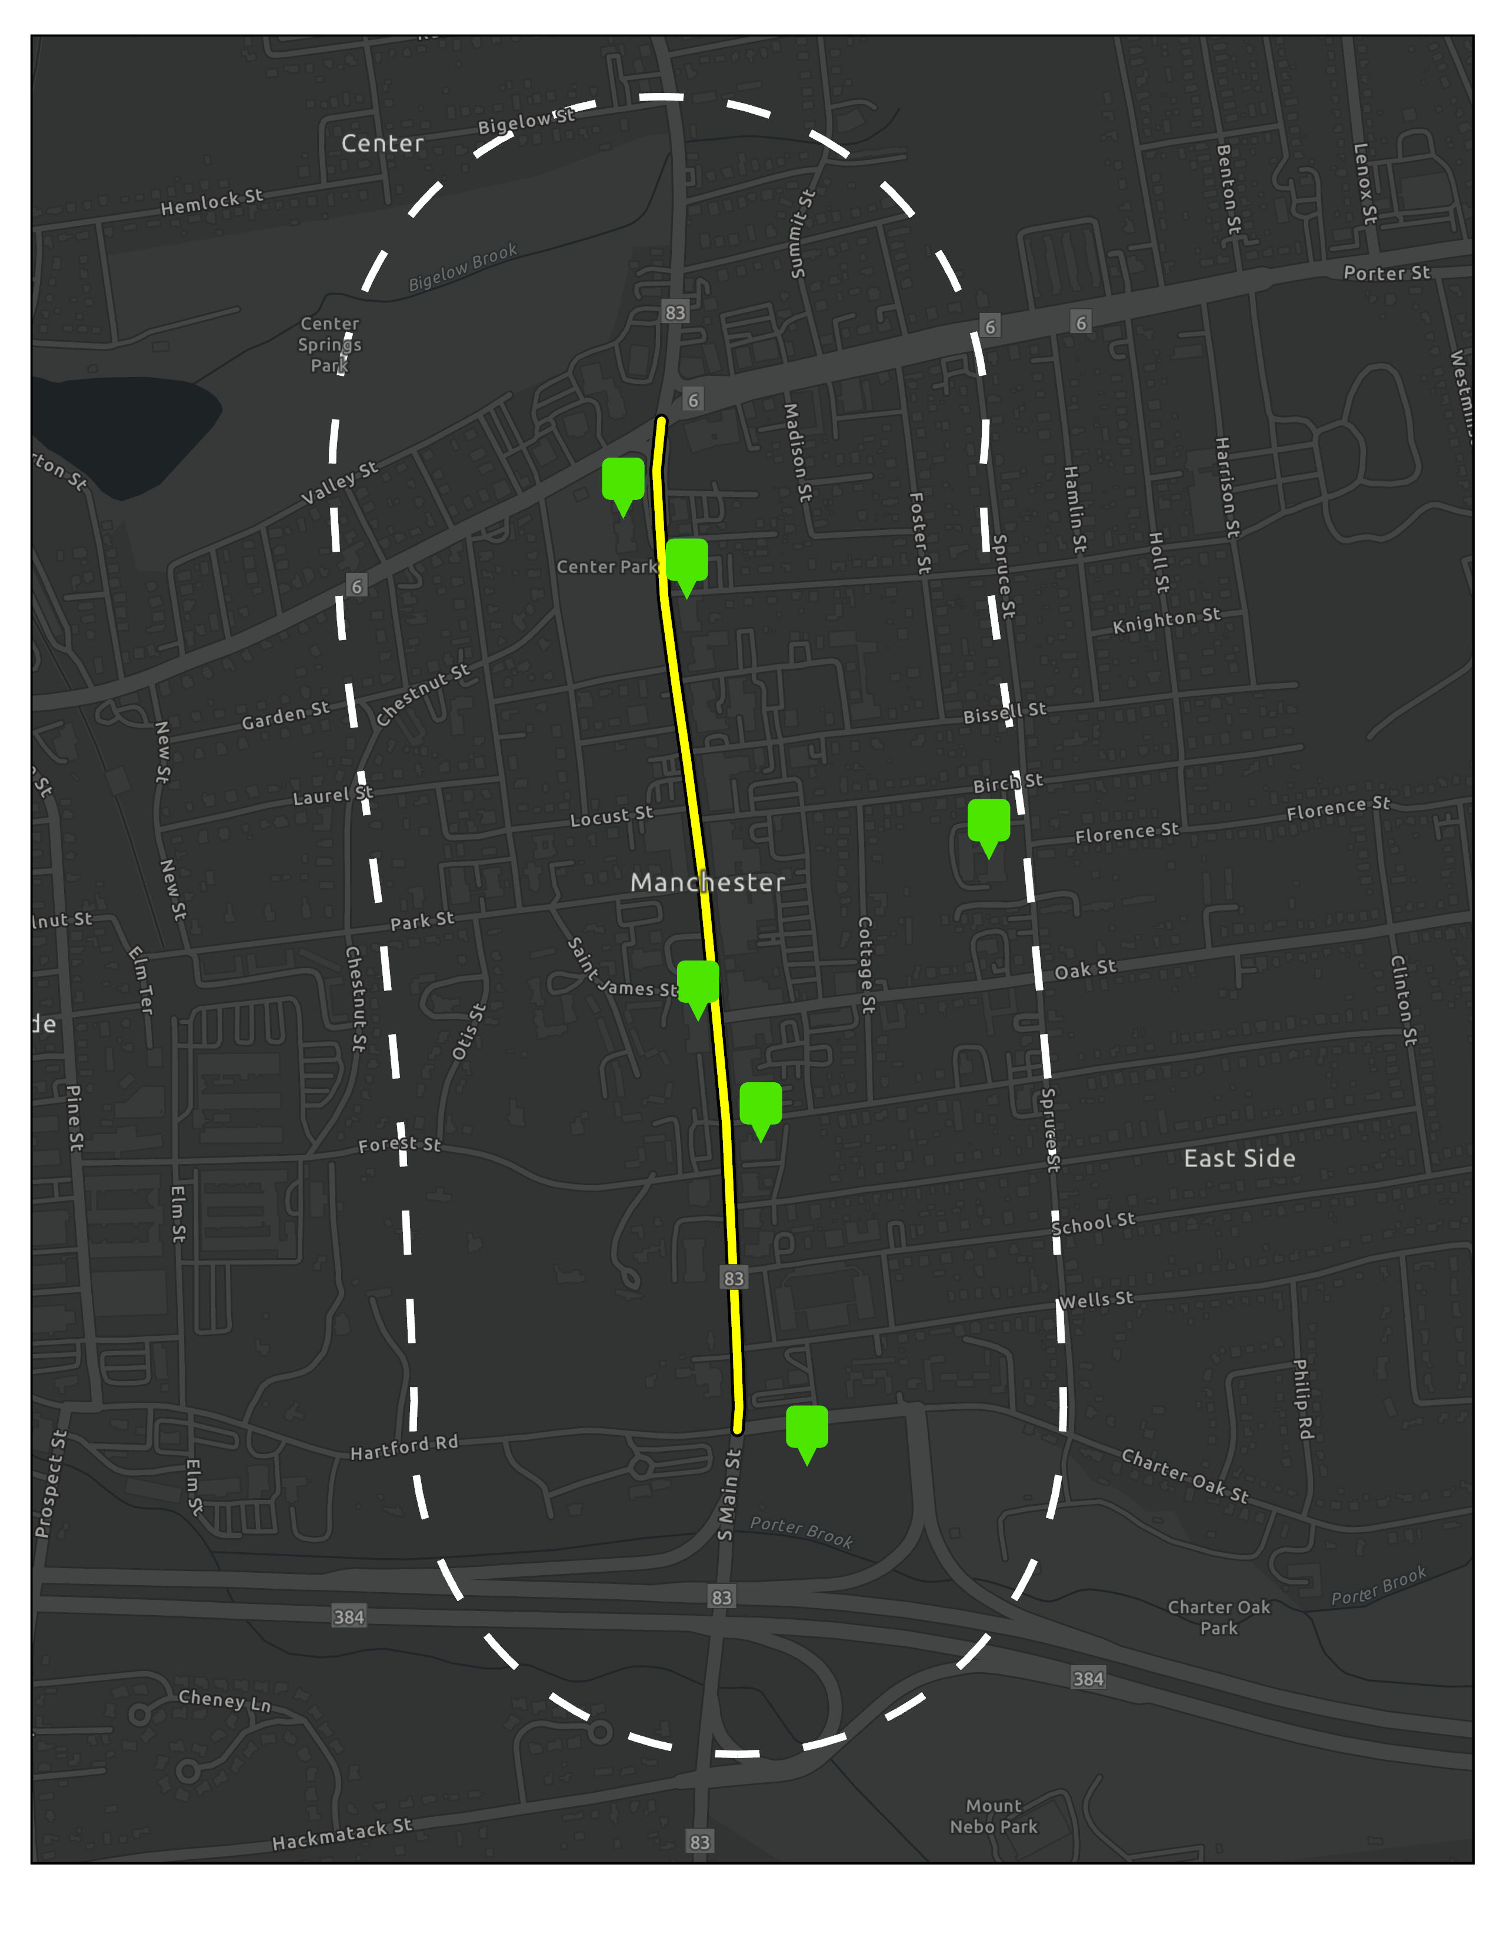
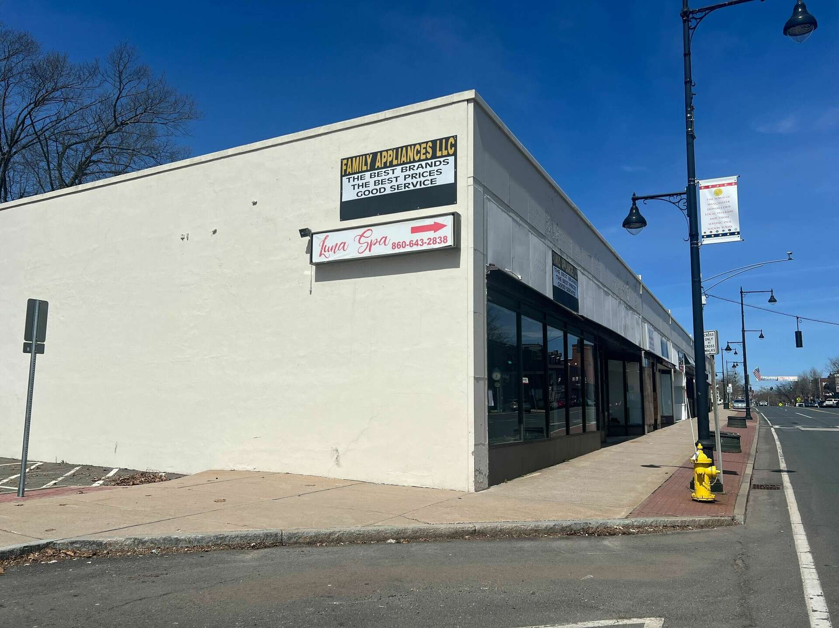
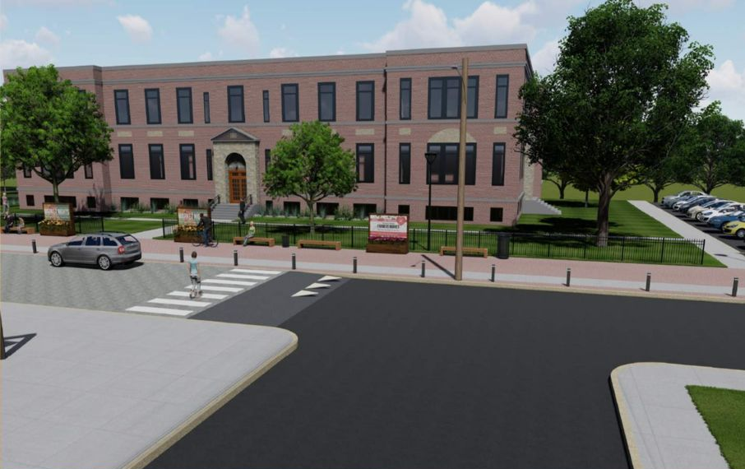

Improvements Support
Continued Investment

Slide 19
A Town Committed to Advancing Connectivity
2021
2023
2024
2017
2017
Complete Streets Policy
Downtown Strategic Planning Workshop
Multi-Use Trail & Connectivity Plan
Manchester NEXT Plan
Sidewalk & Curb Plan

Slide 20
Many Communities
Already Benefiting from
Complete Streets Designs

Slide 21
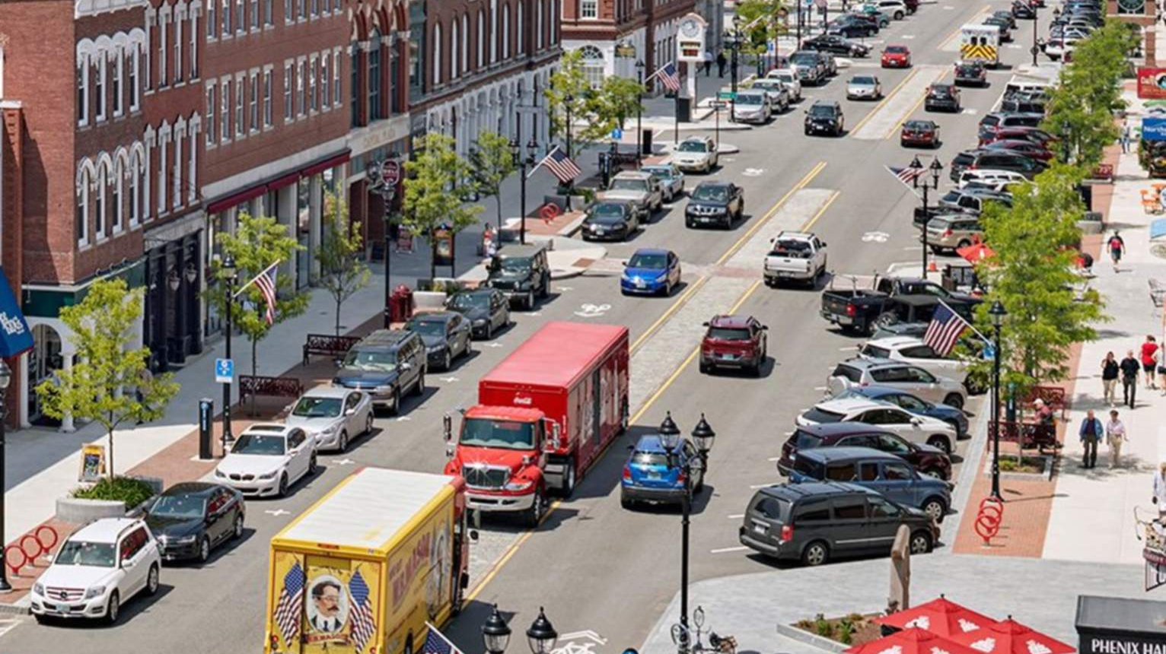
Concord, NH
“Downtown is humming,” “Even at my most adamant with concerns about the project, there was never a question in my mind that we needed to do something with the downtown.”
Businesses downtown described the changes to Concord’s Main Street as drawing more younger people downtown, attracting people from outside the city and allowing for redevelopment, with planned residential units in the works and vacant storefronts now filled. “It’s changed the social scene — you come down to hang out,” said Emily Galvin, the manager of the Viking House,
Fears about traffic caused by narrowing the street during the planning stage turned out to be unfounded. “The traffic is slower, but safer,” she said. “People who aren’t planning to visit downtown don’t stop here.”
“During a two-day visit to Concord, the Gazette looked for business owners dissatisfied with the results of the Main Street makeover but could not find any.”

Slide 22
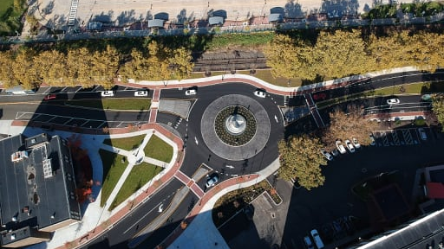
New Britain, CT

Slide 23
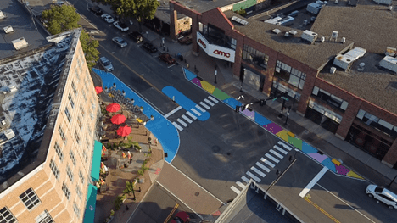
Norwalk, CT

Slide 24
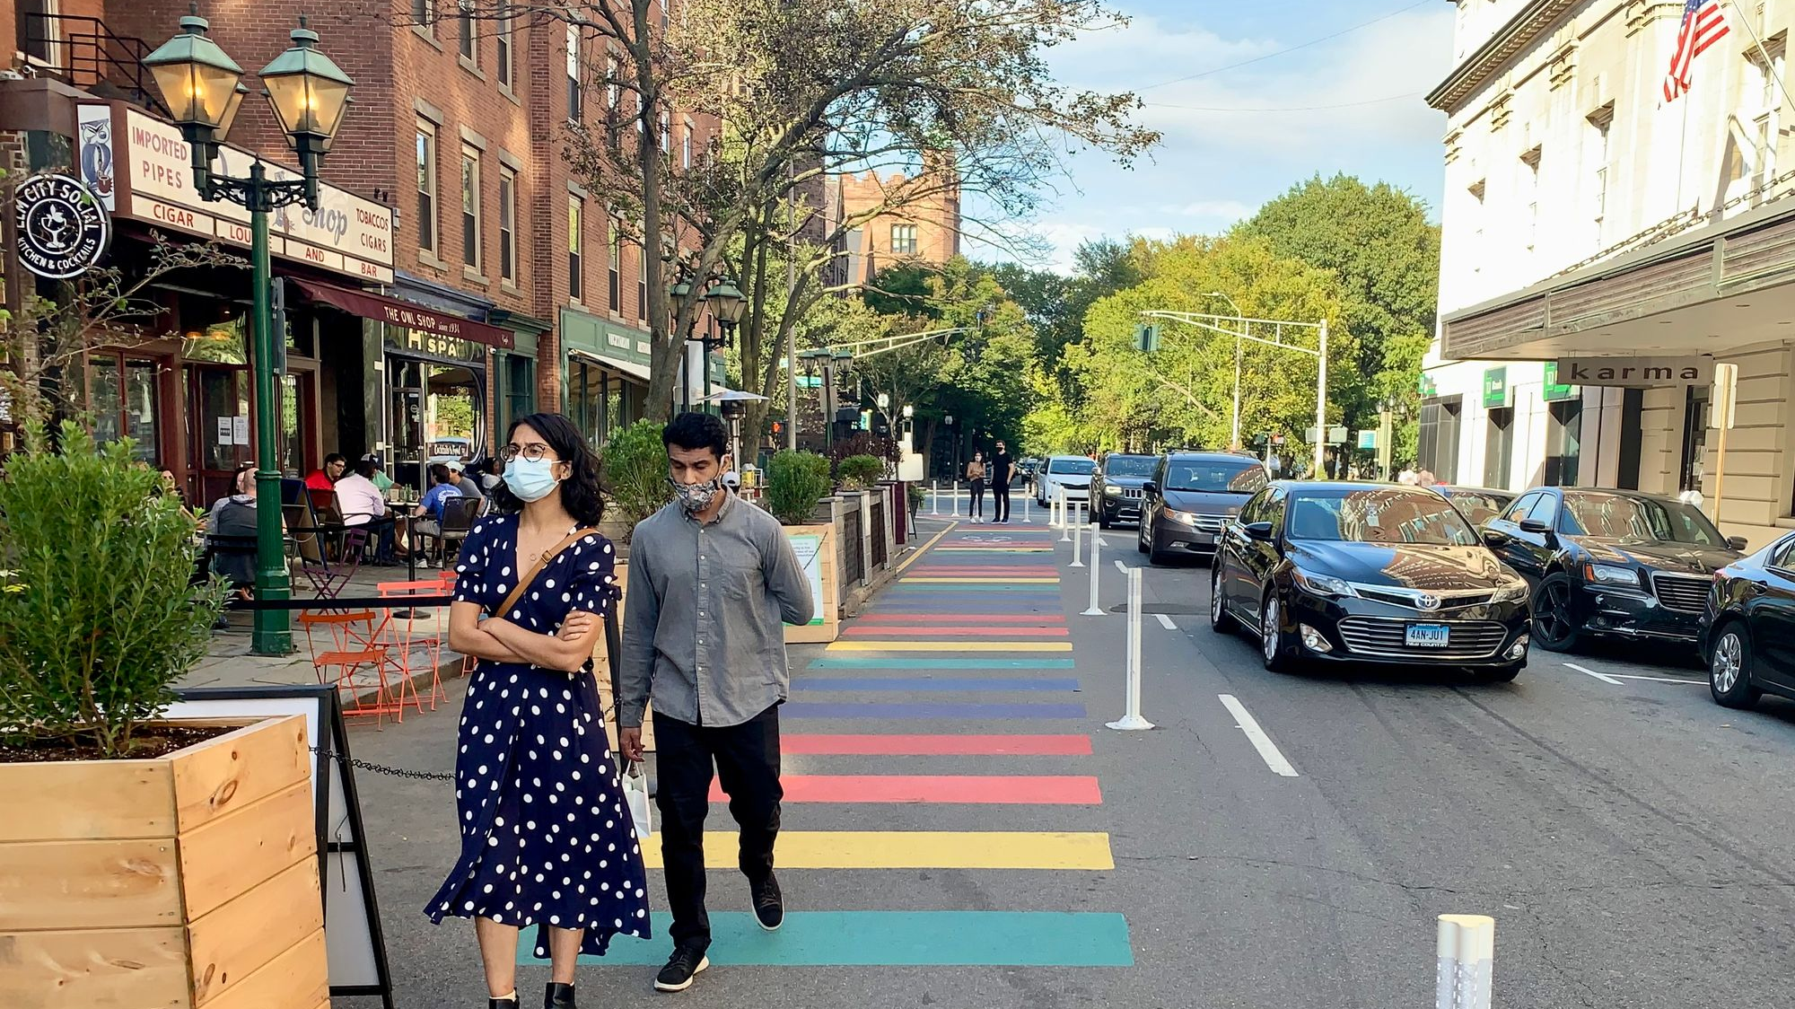
New Haven, CT

Slide 25
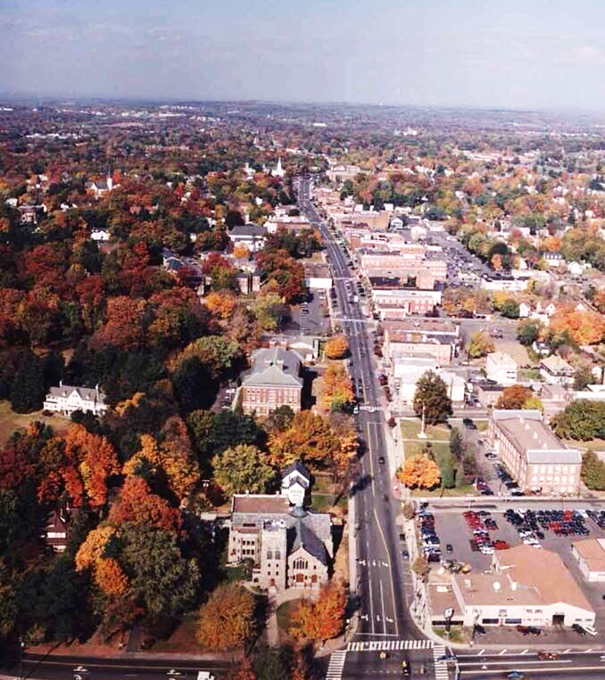
Project Vision
To create a safe, accessible, and vibrant "Complete Street" from Center Street to Hartford Road to address infrastructure challenges, enhance safety, and further elevate Downtown’s appeal.
Notes:
Briefly introduce the purpose of this presentation: to update the Board on the current status of the project, specifically regarding the design updates, phasing, and funding strategy.
"This project aims to enhance the safety of pedestrians and cyclists, reduce traffic congestion, and foster economic growth in Downtown Manchester. The project will include infrastructure improvements, including roundabouts, ADA-compliant sidewalks, separated bike lanes, and green landscaping."
"It’s a multi-year project, starting in 2026, and we’ve already secured $7.5 million in funding from the Connecticut Department of Economic and Community Development."

Slide 26
Why are we doing this?
Reduce crashes and protecting vulnerable road users.
Align with the 2017 Complete Streets Policy.
Informed by best practices and regional examples.
Notes:
Downtown is one of Manchester’s greatest assets
Downtown can be even better than it is today!- Safer and more inviting for people of all ages and abilities
Over the past 10-20 years the community has told us it wants an even more vibrant Downtown
Downtown’s infrastructure is aging
We want to support existing Downtown businesses and property owners while encouraging new investment and new business activity
Complete Streets Policy: Adopted in 2017, prioritizes multi-modal safety and environmental sustainability.
Data-Driven Analysis: Crash data, traffic flow models, and community input guided design decisions.
Best Practices: Solutions based on proven approaches from successful projects in Connecticut and beyond.

Slide 27
Public Engagement
^{Open Houses}
^{Online Engagement}
Design Process
^{Public Feedback}
^{Data-Driven Analysis}
^{Best Design Practices}
Concept Drafted
^{Community Events}
^{Stakeholder Meetings}
^{FINAL DESIGN APPROVAL}
The Planning Process
2025
2024
2022

Slide 28
Stakeholder Engagements
Army Navy Club
Bennet Academy
Bike & Trail Advocates
Conservation Commission
Economic Development Commission
Manchester Road Race
Special Services District
St. James Church
Sustainability Commission
Youth Commission
In addition to 6 open house events, 10 tabling events, and 8,500 online interactions.

Slide 29
Design Updates

Slide 30
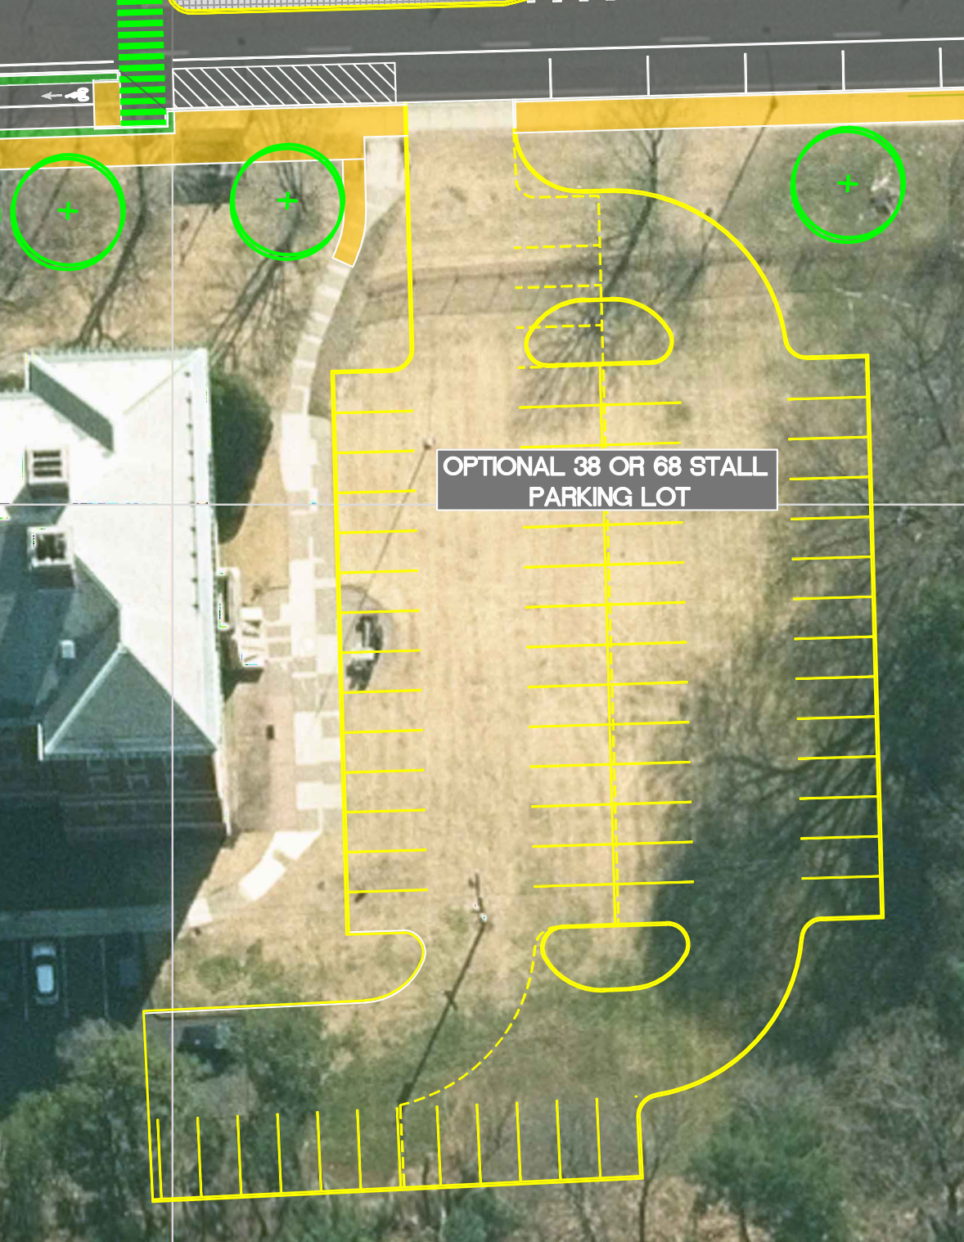
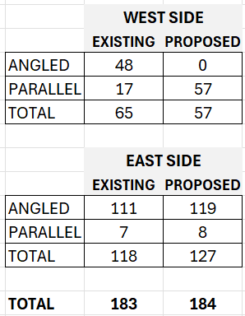
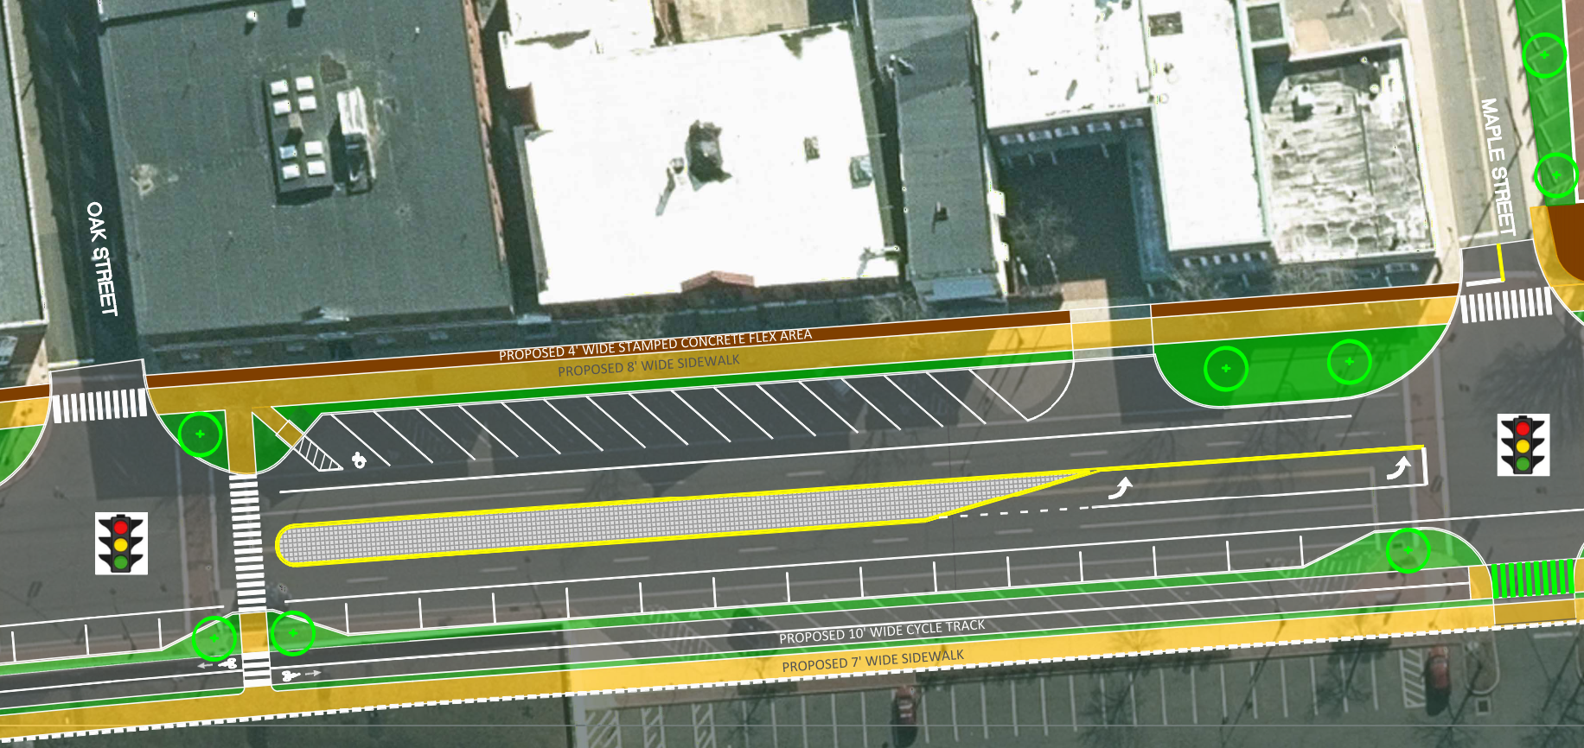
Angled Parking on East Side
Additional Off-Street Parking
Road Race Accommodations

Slide 31
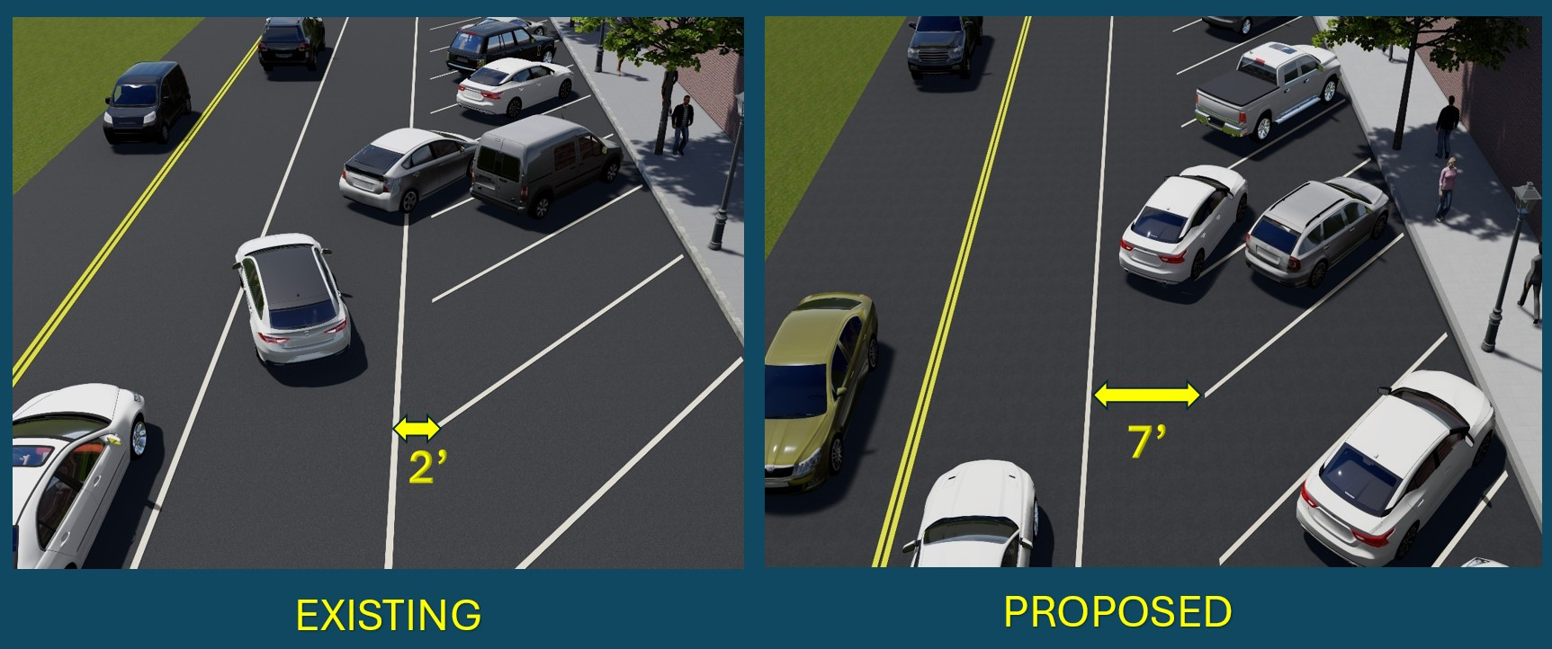
Current Conditions
Proposed Design

Slide 32
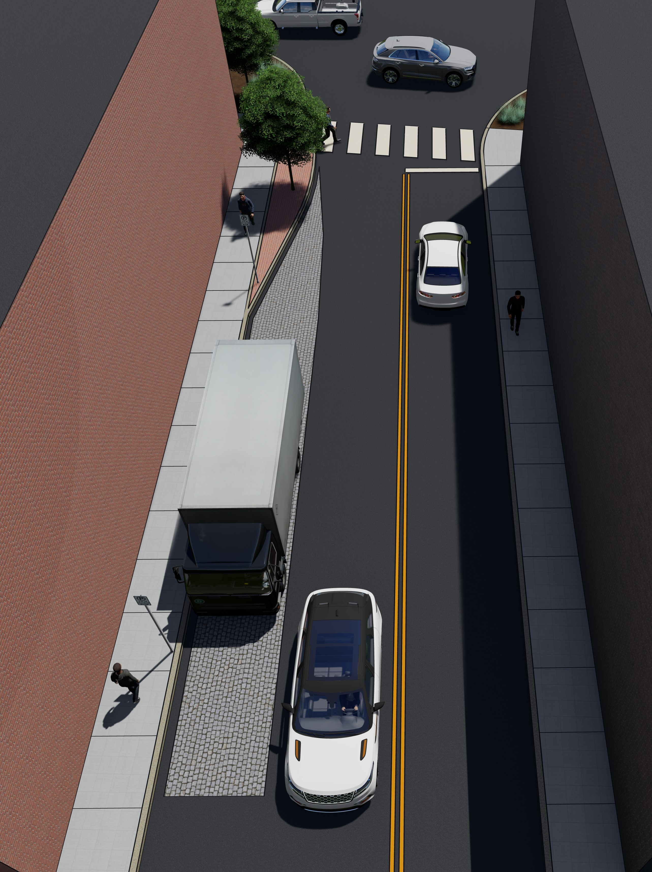
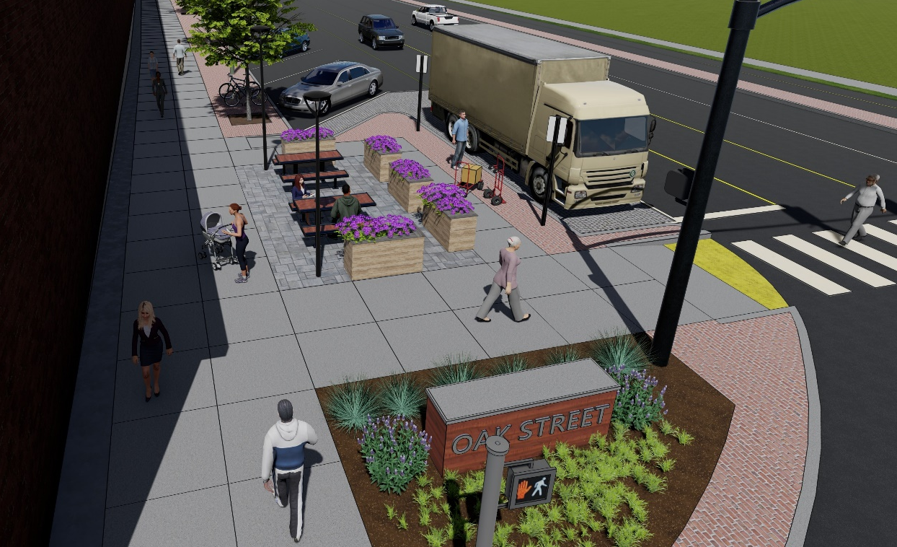
Designated Pull-Off Zones
Delivery Loading Zones
Rideshare Pickup/Drop-Off Zones

Slide 33
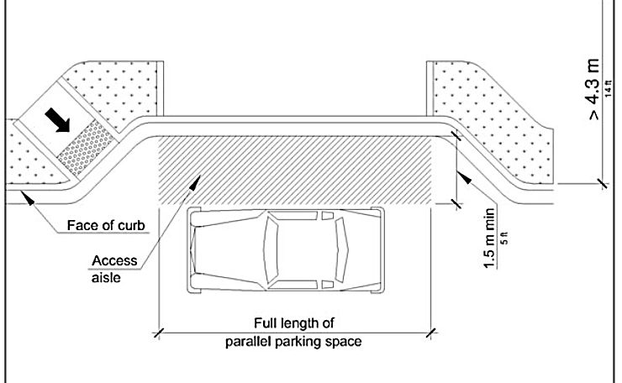
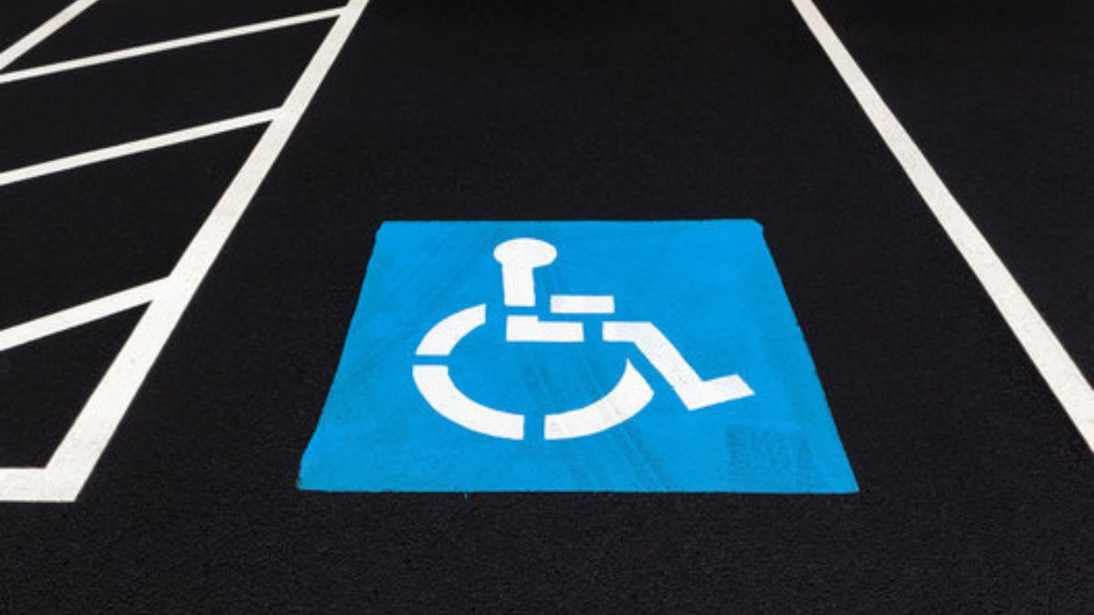

More Handicap Accessible
On-Street Parking Spaces
Notes:
Add image of accessible parallel space

Slide 34




Improve Rear Lot Access
Notes:
Add image of accessible parallel space

Slide 35


Add Bike "Depots“ &
Side Street Connections
Notes:
Bike Pods (tools, parking)

Slide 36




Add Amenities Based on Feedback

Slide 37


Downtown Amenities Informed by Public Feedback

Slide 38

Safer Crosswalk Placements
Notes:
Add image of accessible parallel space

Slide 39

Funding Progress
Secured Funding: $8.35M in grants ​
Total Project Estimate: $20M​

Slide 40
Future Grant Opportunities
Community Connectivity Program
Local Transportation Capital Improvement Program
Urban Forest Equity Grant Program
Rebuilding American Infrastructure with Sustainability and Equity (January 30, 2025)
Congestion Mitigation & Air Quality Improvement
Notes:
RAISE Grant:
Present active grant opportunities being pursued to close the funding gap.
Emphasize the importance of these programs in funding critical project elements.
Stress the urgency of applying, especially for RAISE, with a fast-approaching deadline in January 2025 (NT: January 30, 2025).
Commitment to Grants:
The town is fully committed to securing grants for the project.
Diversified Funding Approach:
Pursuing multiple competitive, localized grants for specific project components (e.g., active transportation, climate resilience).
Gap Funding:
Considering applying for gap funding in future CIF rounds to expedite construction while securing additional grants for later phases.
Other Grant Opportunities:
CMAQ (Congestion Mitigation & Air Quality Improvement): New NOFO expected late 2024/early 2025.
LOTCIP (Local Transportation Capital Improvement Program): Regular communication with CRCOG for updates.
Urban Forest Equity Grant Program: 2025 details expected by December 2024.
Community Connectivity Program: Expected NOFO opening in early 2025.
Rebuilding American Infrastructure with Sustainability and Equity (RAISE): Deadline January 30, 2025.

Slide 41
What’s Next?
Pursue active grants to close the funding gap.
Advance preliminary designs to final stages.
Notes:
Alternative funding opportunities are being explored to avoid burdening residents with downtown infrastructure maintenance costs.
It’s critical that we get permission to pursue these immediate grant opportunities.

Slide 42
Action Item
Board authorization needed to pursue additional grant funding.
Notes:
Request board approval of the plan to demonstrate unity and commitment to potential grantors based on preliminary work to date.
Emphasize that obtaining permission to pursue grants is a crucial step in securing additional funding.
Reinforce that maintaining project momentum is vital for avoiding taxpayer burden.

Slide 43

Utilizing Available Funding
Current Funding ($8.375M)
Key Components: Road Diet, Critical Infrastructure
Focus: Safety and infrastructure improvements using available funding.
Additional Funding Required
Focus: Roundabouts (LOTCIP), Cycle Tracks (CTDOT), Pedestrian Enhancements (Multiple), Urban Forestry (DEEP)
Funding Approach: Pursuing multiple grants to cover these additional components.
Notes:
Discuss what can be accomplished in Phase 1 with the available funding (emphasize the road diet and traffic signal replacements).
Highlight the importance of starting with these core components for the success of the project.
Construction of separated cycle tracks and expanded pedestrian pathways, deferred to future phases if additional funding is secured.
Priority without Additional Funding:
Road Diet: Replacing outdated signals, improving intersection safety.
Roundabouts: Conversion of high-crash intersections at Hartford Road and Center Street.
Traffic Coordination: Improved traffic flow and reduced greenhouse gas emissions.
Future Phases: Smaller funding opportunities to enhance cycle tracks and public spaces post-foundational improvements.

Slide 44

Questions

