Slide 1


Personal Property Declaration Information Session
Presented by the Town of Manchester Assessment Office

Slide 2

Table of Contents
Slides 3-14 | Introduction to Personal Property
Slides 15-21 | ABC’s to Filing Declarations
Slides 22-36 | Codes
Slides 37-50 | How to File: A Step-By-Step Guide
Slides 51-58 | FAQ & Additional Information
Slides 59-66 | Sample entries & practice declaration

Slide 3

01
INTRO TO PERSONAL PROPERTY

Slide 4

What is a Business?
A business involves a person or entity performing an activity or trade or providing a product or service with the intent of making a profit.
Normally, the start date for a business is when the business is registered.
Notes:
Your business may have a registered trade name with the town or be an LLC, Corporation or other business formation that is registered with the Secretary of State. No matter how you register, this is often when you are classified as a business for taxation purposes and are therefore responsible for reporting certain details of that business. For the Assessment office, filing your personal property is one of those details. If you didn’t register a trade name or file with the Secretary of State, you should. It ensures a business operates within the legal framework of the state and makes a business official.

Slide 5

WHAT IS CONSIDERED PERSONAL PROPERTY?
Notes:
We often hear from small business owners that tell us they have no personal property. Jack has only an online presence and only uses his computer and cell phone to operate his business and he uses the same computer and phone for his personal use. He thinks he doesn’t have to declare these as personal property for his business. Jill called and complained that her business isn’t profitable yet, so she shouldn’t have to file. Mike said he is doing carpentry work out of his old truck. He inherited most of his tools from his Dad 25 years ago. He thinks he shouldn’t have to file because they aren’t worth anything and he didn’t pay for them, so they don’t really count. Melanie is a hairdresser but only rents a chair at a local salon, but doesn’t own it, why did she get a declaration? Do these business owners need to file? What IS considered personal property? We are going to answer these questions.

Slide 6
WHAT IS PERSONAL PROPERTY?
INCLUDES:
Furniture (computers, office chairs, desks)
Unregistered motor vehicles
Computer, printers, cell phones
Signs
Vending Machines
Leasehold Improvements
Tools
Machinery
Any other equipment used in the course of business or to earn income.
CT STATE STATUTES:
Section 12-71
Section 12-41
Section 12-43
Notes:
Your personal property declaration has a lot of boxes. We use the same forms for all sizes and types of businesses, with only a few exceptions. No matter the type of business, these are the types of things that need to be declared on your form.

Slide 7
WHAT IS PERSONAL PROPERTY?
WHAT ARE LEASEHOLD IMPROVEMENTS?
Commercial building upgrades or finishes that serve the needs of the tenant. While a property may require both internal and external upgrades during a tenancy, only interior modifications to a specific tenant’s space are considered leasehold improvements (and added as personal property in code 24 on the form). Any improvements made to the exterior of the building, its foundation or that serve multiple tenants are considered building improvements (value may be added to the real estate).
(Leasehold Improvements do not apply to home-based businesses. Commercial buildings only.)

Slide 8
WHAT IS PERSONAL PROPERTY?
Leasehold improvements, continued:
Examples of leasehold improvements to declare on personal property:
Cubicles, including installation
Lighting, including installation
Building out new walls and floors
Shelving and partitions, including installation
Electrical and technical updates in the tenant’s space
Interior and exterior signage
Examples of leasehold improvements that would NOT be personal property:
HVAC installation or upgrade
Enlargement of the building
Escalator or elevator installation or upgrade
Parking lot
Roof repair/replacement

Slide 9
WHAT IS NOT PERSONAL PROPERTY?
EXCLUDES:
Real Estate
Anything (mostly) permanently affixed to the land
Registered motor vehicles
Notes:
There are exceptions to the permanently affixed to the land, for example, gas pumps. They are affixed, but are personal property. They are periodically upgraded. Included with gas pumps are the underground tanks and all of the underground piping and connections. These are all personal property.

Slide 10
How Is Personal Property Assessed?
What is the assessment year?
Personal property acquired from October 2 of last year up to October 1 of the current “reporting” year goes in the box for this year for each category (code).
The other years listed on the form in each category are for the total value of items acquired during each of those years, up to October 1. They are carried forward annually on the form, depreciating each year until the maximum depreciation.
Notes:
This year’s reporting would be for anything you acquired or disposed of from October 2, 2024, through October 1, 2025.

Slide 11

Don’t Forget to Declare DISPOSALS!
Dispose= No longer have in possession because it was sold or discarded.
I DON’T HAVE THAT _________ ANYMORE!
When you dispose of something, record it under the disposals list on the form.
The value of disposals comes off of the year and code in which they were acquired and reported on prior year forms.
Notes:
Why is it important to declare disposals? If you don’t list your disposals, but you have subtracted the value of the disposed items from the code box that you had them in, how will we know you were accounting for the disposed items? We will look at prior filings and see that your math is different for code 20. But you didn’t list any code 20 items for disposal. So we will CHANGE YOUR FILING to what it had been the prior year for that year and code. Essentially you will continue to be taxed for things you no longer have, unless you include the itemized disposal list.

Slide 12
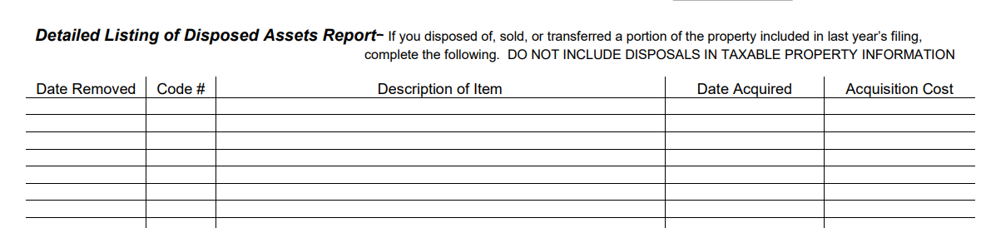
This section of the form is where you record the disposed assets. This is on page 2 of the short form or page 4 of the long form.
If you have a longer list of items or if it’s just easier, you can attach a page or spreadsheet with these items. Please put a prominent label that these are disposals if using a separate page.
Notes:
We suggest that you keep a record of your personal property on a spreadsheet with columns for the date you acquire something, the original cost, the code under which you will include it on your declaration, a brief description, and date disposed. If you want a template to follow, it’s available on our website, and we’ll show it in a few minutes here in our presentation. Keeping a spreadsheet that you update every time you purchase or dispose of something for your business is a great business tool to make it easier to file your tax return, your personal property declaration, and much more. If you use a program like Quickbooks, you may have a good record of acquired property dates and costs, but not the disposals.

Slide 13

How is the Assessment Calculated?
We add the depreciated values of all declared business assets, subtract disposed assets, and then multiply this total by the assessment rate of 70%.
(Sum of Depreciated Assets - Disposals) X 70% = Assessment
Notes:
This final assessment is multiplied by our mill rate, which fluctuates annually, and this generates your annual personal property tax bill.

Slide 14

Is this a lot of information to process in one session?
Yes, but our staff can help you.
This power point will be on our website so you can review at your own pace.
You can email questions to personalproperty@manchesterct.gov
We will review the declaration, but lets start with important basics…

Slide 15

02
ABC’S TO FILING DECLARATIONS

Slide 16

Declaration Information
Due Date: November 1st
Must be filed annually.
If the declaration is not filed on or before the deadline, there will be a penalty added to the assessment.
If a declaration is not received, the Assessor’s office will estimate the personal property and then add the penalty for not filing.
The penalty for late or non-filing is
25% of the assessment.
(CGS Ch.203 Sec 12-42)
Notes:
If November 1st falls on a weekend, we make the due date on the following Monday. This year November 1st is a Saturday, so the due date is November 3rd. Not all towns do this. Not all Assessors do this. Some will cling to that date and you should have it in during their business hours on the Friday before. If they are even open on Friday, some are not. Some close at 1 on Fridays, like Manchester. These are details that you should make yourself aware of to avoid the penalty.

Slide 17

The ABC’s
Submit Complete Forms
Submit Early
An incorrect or incomplete form will be returned to the business for proper correction and completion and may be subject to the penalty.
Avoid risking the 25% penalty. Fully complete and sign your declaration, don’t wait until the last minute.
Notes:
We send out more than 3500 declarations. What percentage of folks do you think decide to send theirs in or drop it of or email it on the last day it’s due? More than 20%. That is more than 700. There are only 3-4 people on our staff that are primarily receiving and processing these via email, online filing, snail mail and at our counter. What if you have questions? What if you forgot to sign your declaration? What if you need help completing your form?

Slide 18

Help Us Help You.
If you need help or have questions, please… don’t wait until the last minute.

Slide 19
A is for Assessment
The total value of your assets is depreciated. That total is multiplied by 70% (the assessment rate) and the result of that is multiplied by the mill rate/1000. This result is the amount of your tax bill.
Depreciated assets
X 70%
Assessment
X (Town Mill Rate/1000)
Tax Bill
If this is confusing, consider watching the short video on our website: Assessment Office Town of Manchester (manchesterct.gov)
Notes:
We already explained this, but it bears repeating. We want to be sure you understand that the valuation you wind up with on your declaration is not the amount of a tax bill. It is the assessment only. Part of the total calculation.

Slide 20
Methods of Submitting the Declaration:
1. Online filing is the quickest, easiest filing method. Each business receives a secure online filing code on the mailed declaration or you may call us for the code. A confirmation is returned upon filing.
2. Email is the next best filing method. Your email timestamp is proof of timely filing and it’s an easy way to retain a copy of what you filed.
3. Drop off in person, or in our outdoor drop box. We recommend you keep a copy for your records. We must charge for copies and can only take cash.
4. Mail is the final method of submitting a declaration. If you must submit via mail, we recommend obtaining a receipt from the USPS or other carrier for proof of mailing.
Notes:
We try to accommodate the taxpayers by providing options for submission. The first two are preferred, but not everyone is comfortable using a computer.

Slide 21

No Longer in Business?
If the business moves out of town, is sold, or permanently closes, PLEASE let us know!
If the business closes, complete the affidavit on the declaration. If you don’t have a declaration, complete an Affidavit of Termination (available on our website) with our office at time of closure. A final disposition of assets is required.
If you believe you have received a declaration in error. DO NOT IGNORE IT!
Call or send us an email detailing why you think there was an error.
Failure to return the declaration without an explanation
will result in the 25% penalty on your assessment.

Slide 22
03
PERSONAL PROPERTY CODES
Notes:
And now on to the declaration and codes! On page 3 you are going to complete your basic information, your business name, contact information, description of your business, the ones you know all the answers to. First we will talk about the most commonly used codes and which types of business use which codes. What type of equipment belongs to which code?

Slide 23

Code #9
Unregistered Motor Vehicles
Campers
RV’s
Trucks
Snowmobiles*
ATV’s*
Examples
Construction Vehicles
Passenger Cars
Tractors
Commercial trailers
INCLUDES any car registered in another state but garaged in Connecticut.
* Only commercial use are taxable. Personal use exempt as of 10/1/2024

Slide 24
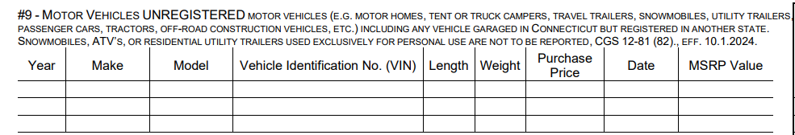
Code #9 (continued)
Use the data directly from the title document to fully complete the vehicle information.
The MSRP Value should be available online with a VIN decoder, NADA or other publicly available tool. If you purchased new, you may also find it on your bill of sale.

Slide 25

Code #10 (Only on Long Form)
Machinery & Equipment
Industrial manufacturing machinery & equipment
CGS 12-81 (72,76,78) –Not eligible for an exemption
Examples:
Tools
Dies
Jigs
Patterns

Slide 26
Code #13 (Long Form Only)
Manufacturing Machinery & Equipment
CGS 12-81 (76) – Eligible for Exemption
Manufacturing machinery & equipment used in research or engineering devoted to manufacturing; or used for the significant servicing or overhauling of industrial machinery or factory products.

Slide 27
Code #13 (Long Form Only) (continued)
Examples: Conveyor belt Boring Machine Lathe Plasma cutting machine Embroidery machine
Exemption form must be COMPLETE and include itemized detail sheet.
5 year/7 year life equipment ONLY,
moves to CODE 10 after 5 years of exemption.
Notes:
We are not going to spend a LOT of time on manufacturing here. If you have questions or want more detailed information, we can help you.

Slide 28

Code #17
Farm Machinery
Farm machinery used in the operation of a farm.
CGS 12-91- Eligible For Exemption
Examples:
Tractors
Harrows
Bush Hogs
Hay Bines
Hay Rakes
Hay Balers
Corn Choppers
Milking Machines
Milk Tanks
Coolers
Chuck Wagons
Dozers
Back Hoes
Hydroponic Farm Equipment
Aquaculture Equipment
Notes:
There is a separate form for the farm machinery exemption that needs to be completed and submitted with your declaration.

Slide 29
Code #18
Farming Tools
Examples:
Rakes
Pitch Forks
Shovels
Hoses
Brooms
Exempt to a total value of $500
CGS 12-81 (38)

Slide 30

Code #19
Mechanic Tools
Examples
Wrenches
Air Hammers
Jack Sockets
Exempt to a total value of $500
CGS 12-81 (37)

Slide 31

Code #16
Furniture, Fixtures, and Equipment
Furniture, fixtures, and equipment, of all commercial, industrial, manufacturing, mercantile, trading, and all other businesses, occupations, and professions.
Ladders
Scaffolding
Chairs
Tables
File Cabinets
Partitions
Display Racks
Coolers/Freezers
Kitchen Equipment
Weights
Treadmills
Calculators
Copy Machines
Telephones
(including mobile phones)
Postage Meters
Cash Registers
Portable Air
Conditioners
Desks
Tools, not exempt
Notes:
Code 16 encompasses a lot of your tangible assets and equipment. Virtually everything that is physically moveable. The leasehold improvements we talked about earlier are usually included in Code 24 and your computer equipment & software would be Code 20, but most everything else goes here if your business doesn’t fall under the exemptions.

Slide 32

Code #20
Electronic Data Processing Equipment
Examples
Computers/Laptops
Printers
Peripheral Computer Equipment
Any other computer-based equipment acting as a computer as defined under Section 168 of the IRS Code of 1986 (many copiers/printers)
Bundled software IS taxable and must be included

Slide 33

What is bundled software?
CODE #20 (continued)
Bundled Software: software that is sold together with hardware, other
software, or services at a single price.
EXAMPLES:
The Windows operating system that comes preloaded on your computer at purchase.
A golf simulator, the computer, screens, and equipment work together as a package.
Dental office software that works with the specialized tooth cameras and the x-ray equipment.
Notes:
These are examples. If you are unsure, send us an email with your specific situation and we can help you determine if it should be declared.

Slide 34
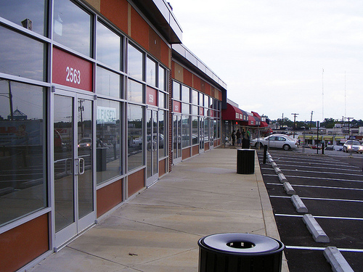
Code #24
Other Goods, Including Leasehold Improvements
Any other taxable personal property not previously mentioned, or which does not appear to fit into any of the other categories.
Examples
Salon sinks & stations
Cabinets & counters
Partitions, cubicles
Signage
Billboards
Light fixtures
Leasehold Improvements (other than realty)

Slide 35

Code #23
Average Supplies
The average monthly quantity of supplies normally consumed in the course of business.
This code does not need to be broken down by year – it is an average monthly/yearly total
Examples:
Office Supplies
Cleaning Supplies
Toner, Paper
Mechanic/Plumber/Carpenter, etc - rags, booties, gloves, flux, Teflon tape, sandpaper…
Medical and Dental Supplies
Maintenance Supplies
Inventory is not taxable. If you itemize it on your customers’ invoices, it is inventory.

Slide 36
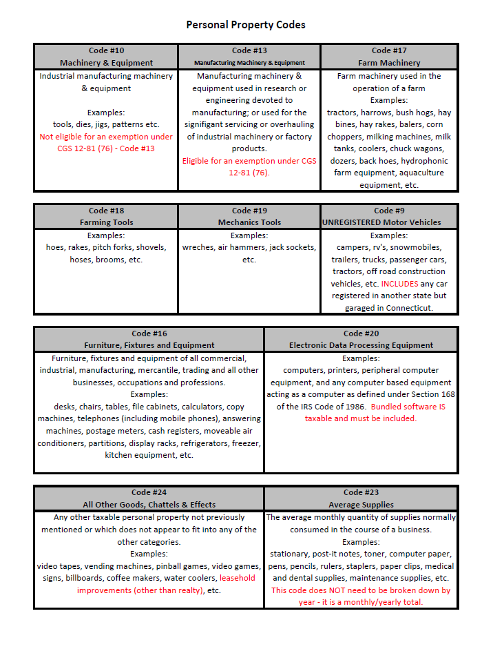
Code Form
On our website, we offer a code form to keep your assets organized. It is helpful for when you dispose of an asset and for future declarations.
If you would like to use this tool, you can print one from our website, under miscellaneous forms, look for Asset Worksheet
Notes:
The back of this has a template for a spreadsheet to track your acquisition and disposal dates and costs that we talked about earlier.

Slide 37
04
STEP-BY-STEP GUIDE TO FILING

Slide 38
LONG FORM DECLARATIONS

Slide 39
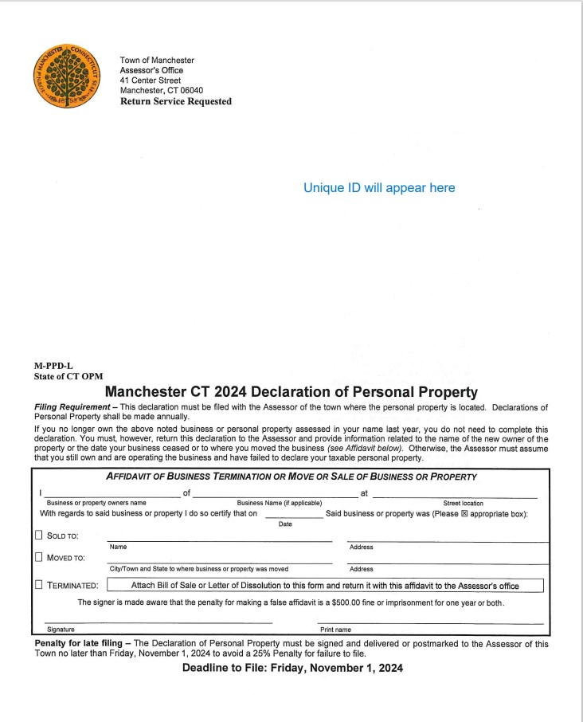
LONG FORM DECLARATION FILING
This is what the form looks like when you receive it in the mail.
In the top right hand corner it will show the Unique ID of the business, the name of the business, and the address.

Slide 40
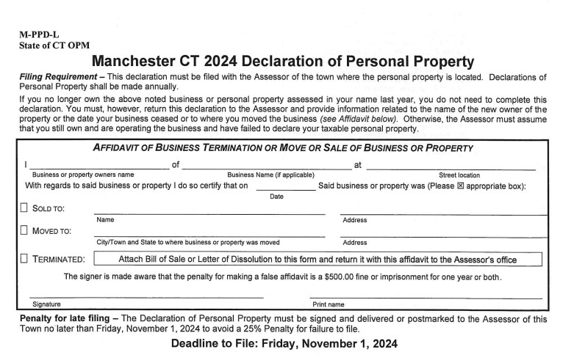
PAGE 1
Dissolution Information
This section is ONLY filled out when the business has been moved, sold, or terminated.
Until our office gets this information, your account will stay open and liable to taxation.
If your business has been terminated, DO NOT IGNORE THE FORM

Slide 41
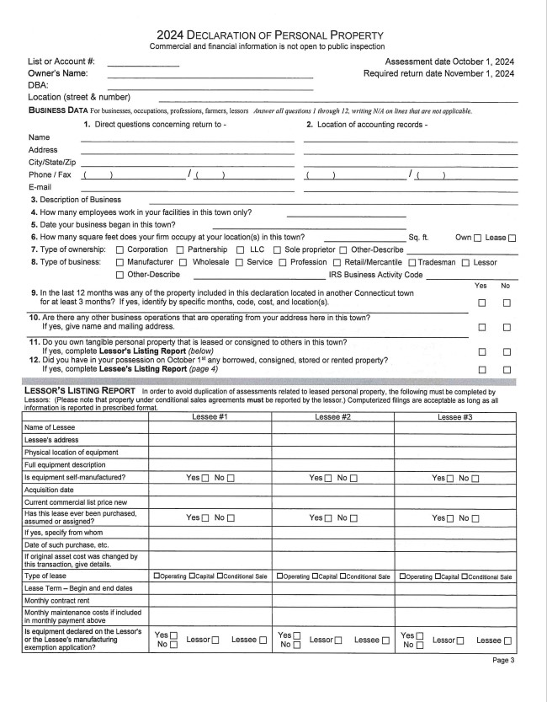
PAGE 3
Business Data:
Please answer all questions and fill in all spaces. If not applicable please put N/A
Lessor’s Listing Report:
This area is completed only if you have leased any property to others.
Please round to nearest dollar amount
(Page 2 has written instructions)
Notes:
Most leasing companies will have an attached spreadsheet with details of items leased, the terms, the location of the leased equipment, etc.

Slide 42
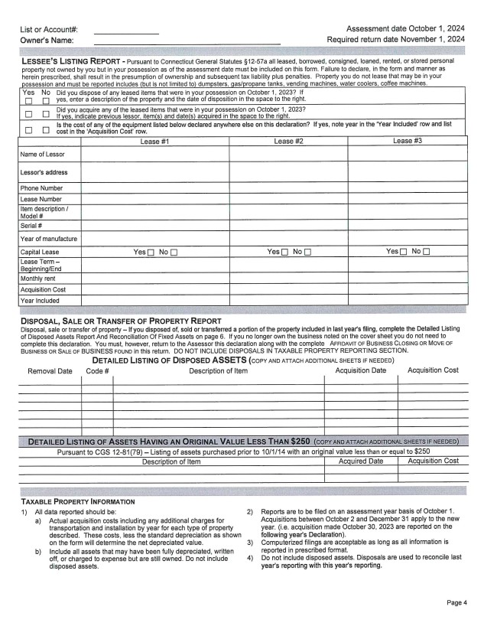
PAGE 4
Lessees Listing Report:
Complete if you have any leased, consigned, loaned, stored, or rented equipment in your possession.
Disposal, Sale, or Transfer of Property Report:
If you have disposed of any asset from October 2nd 2023 to October 1st 2024
Assets purchased prior to 10/1/15 with an original value under $250 are exempt. (Items over 10 yrs old)
NOTE: When filling out Acquisition Cost, this is the original cost to original owner including delivery & installation.
Please round to nearest dollar amount
Notes:
Remember that the acquisition cost and date should correspond to a space on the declaration.

Slide 43
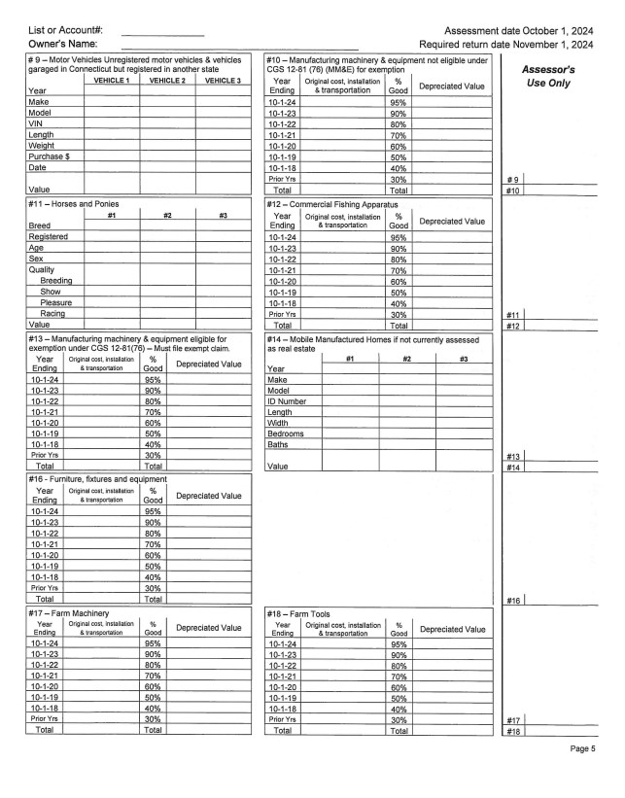
PAGE 5
Taxable Property Information:
This section is where you will fill out all your owned assets organized by code.
NOTES:
This is where the Asset Worksheet handout comes in handy.
Make sure to total the depreciated values of each asset.
Make sure asset is filed by YEAR OF PURCHASE
Original Cost includes transportation (delivery), installation and the sales tax.
It is the TAXPAYERS responsibility to correctly depreciate their assets, NOT THE ASSESORS OFFICE.
Please round to nearest dollar amount

Slide 44
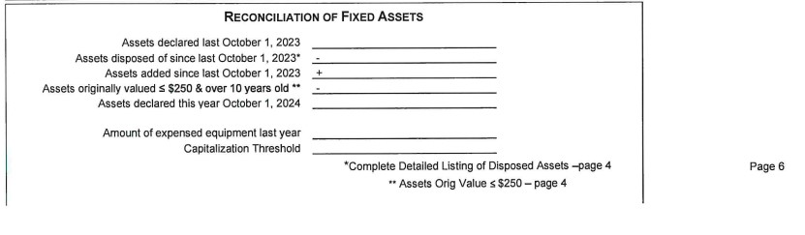
PAGE 6
Reconciliation of Fixed Assets:
Fill in information to calculate the total assets declared this year October 1, 2025
Refer to the next slide for Capitalization Threshold explanation
This is for your own reconciliation and records, Assessor’s may reference it, but we do not rely on this to verify accuracy of filing.
Please round to nearest dollar amount

Slide 45
CAPITALIZATION THRESHOLD
The total value of an asset a company uses to depreciate the value of an asset over several years as opposed to an expense in a single year, on the company’s federal tax return.
On your personal property declaration, the asset is not depreciated out to a zero value after 3 years, for example, as may be reflected on your tax return.
As long as the item is still in use, it still has a value and must follow the depreciation schedule on our declaration. The TOTAL VALUE is still used as original value, even if your tax return spreads that expense over several years.
Notes:
This is an important distinction to explain to your accountant if you use one for your declaration. This is a critical difference between what you may deduct as an expense on your tax return and what you must declare as personal property.

Slide 46
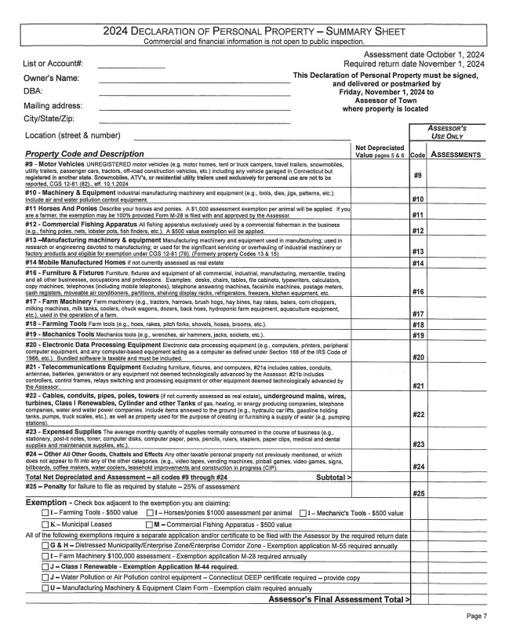
PAGE 7
Property Code & Description
From pages 5 & 6, use the TOTAL amounts of depreciated value and add all of the values together to get the total net depreciation.
The Assessment staff will calculate the 70% assessment in the right column after all other asset boxes have been reviewed.
Please round to nearest tenth amount
Exemptions:
If you are claiming an exemption, check the box next to the one that applies to you.
NOTE: Some exemptions require additional forms and documentation. Please see our website or our office to get the correct documents.

Slide 47
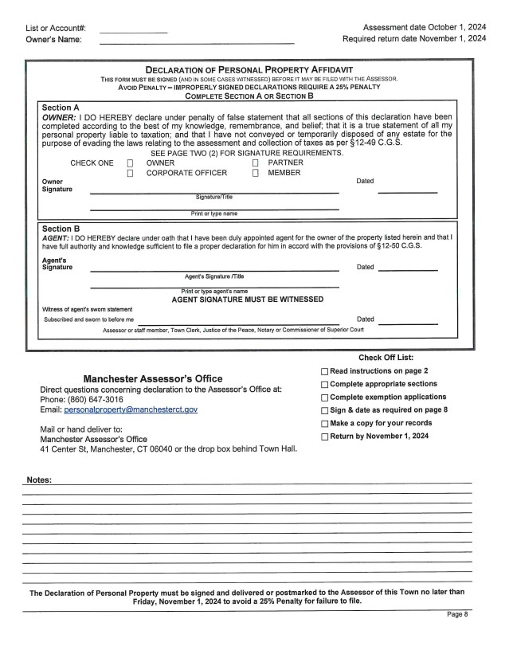
PAGE 8
Declaration of Personal Property Affidavit
Owners or designated agent submitting the personal property declarations are required to fill out and sign this section. If it is not, it will be returned for proper completion.
***If it is not returned by November 1st it will receive a 25% penalty.***
Note: There is a checklist and notes area. We encourage you to use them.

Slide 48
SHORT FORM DECLARATIONS

Slide 49
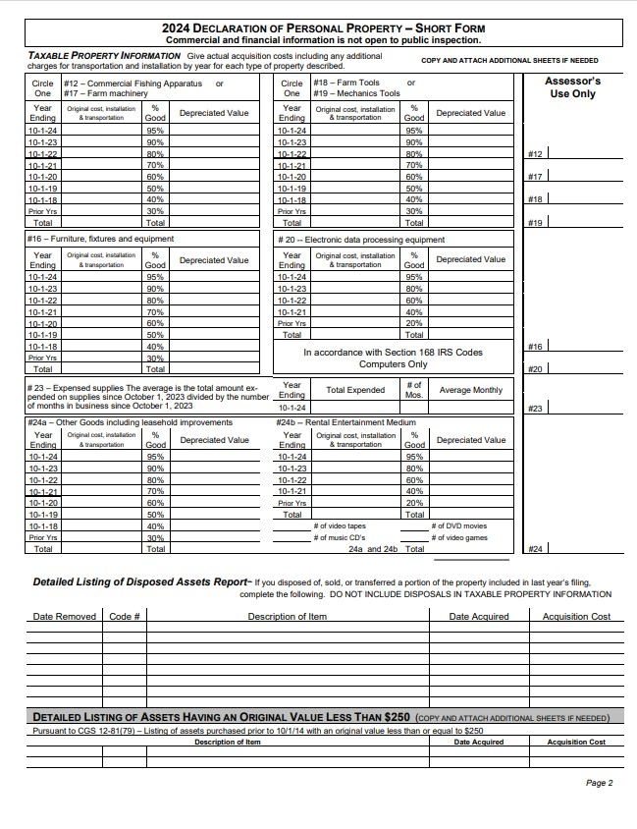
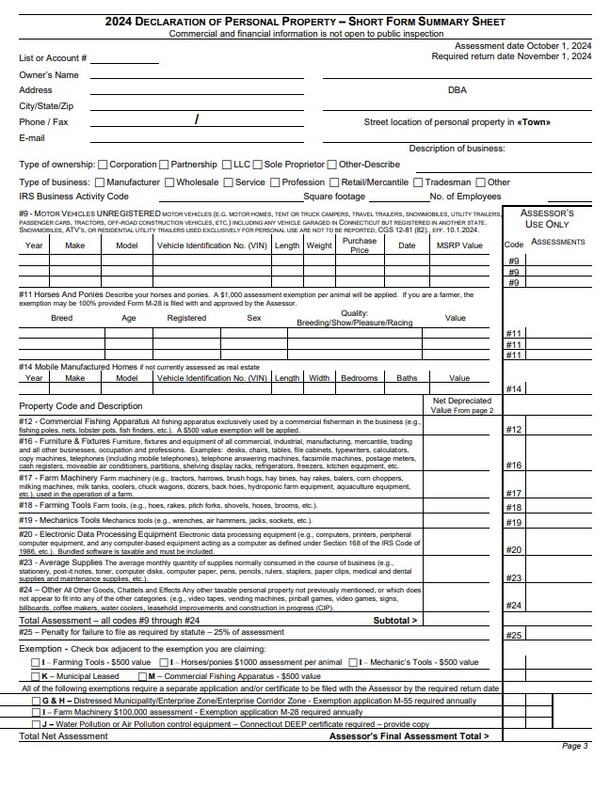
SHORT FORM
MOST BUSINESSES WILL BE RECEIVING SHORT FORM DECLARATIONS
Codes 10 and 13 are not included on the short form declarations. (for manufacturing)
Code 24 is split into A (Other goods including leasehold improvements) and B (Rental entertainment medium)
Code 9 is only present on the summary sheet (page 3).
Lessors will receive the long form.

Slide 50


Use the checklist on the back of the form to be sure your declaration is COMPLETE!
Eliminating multiple back and forth communications is more efficient, so get it right the first time.

Slide 51
05
ADDITIONAL INFORMATION & Q&A

Slide 52
Jack has only an online presence and only uses his computer and cell phone to operate his business and he uses the same computer and phone for his personal use. Jill’s business isn’t profitable yet, so she thinks she shouldn’t have to file. Mike said he is doing carpentry work out of his old truck. He inherited most of his tools from his Dad 25 years ago. He thinks he shouldn’t have to file because they aren’t worth anything and he didn’t pay for them, so they don’t really count. Melanie is a hairdresser but only rents a chair at a local salon, but doesn’t own it, why did she get a declaration? Do these business owners need to file?
Have we learned the answers for these business owners?
YES!
Notes:
Remember our business owners we talked about at the beginning? Jack has only an online presence and only uses his computer and cell phone to operate his business and he uses the same computer and phone for his personal use. He thinks he doesn’t have to declare these as personal property for his business. Jill called and complained that her business isn’t profitable yet, so she shouldn’t have to file. Mike said he is doing carpentry work out of his old truck. He inherited most of his tools from his Dad 25 years ago. He thinks he shouldn’t have to file because they aren’t worth anything and he didn’t pay for them, so they don’t really count. Melanie is a hairdresser but only rents a chair at a local salon, but doesn’t own it, why did she get a declaration? Do these business owners need to file?

Slide 53

REQUESTING AN EXTENTON
CGS 12-42 &12-81K
The Assessor may grant a filing extension for good cause. “I forgot”, “I didn’t receive a declaration”, and “I was on vacation”, are not good cause.
Extensions must be requested it in writing on or before November 1st (PA 19-200) for the request to be considered.
Notes:
WE CAN ACCEPT THESE VIA EMAIL. IF YOU DON”T GET A RESPONSE, DO NOT ASSUME YOUR REQUEST HAS BEEN GRANTED.

Slide 54
AUDITS
CGS 12-53
The Assessor is authorized to audit declarations, within 3 years of the date of the required filing. Substantial penalties are applicable if such an audit reveals property not declared as required by law.

Slide 55

APPEALS
CGS 12-111
Appeal forms will be available on our website or in our office by Feb 1st and it must be filled out completely.
The due date for appeals is February 20th and will be stated on the form and our website.
The Board of Assessment Appeals will hold hearings in March and appointment information will be provided by email and/or mail.
Submit any documentation or proof of value for the Board to consider when submitting appeal form.
A decision letter by mail will be sent stating the outcome of your appeal.
Per CGS 12-117a, within 2 months of the mailing of your decisions you can file an appeal to the Supreme Court.

Slide 56
REVIEW IMPORTANT DATES
Due Date: November 1st
Granted Extensions are due December 15th
If you do not file by Nov 1, you will have a 25% penalty added to your assessment
If you do not file, the Assessor will have to estimate the assessment of the personal property assets along with adding the 25% penalty

Slide 57

BEST PRACTICES
Do not write “no change” or “same as last year” on your form. This is considered incomplete and will be estimated and penalized 25%.
If you need assistance or clarification, we are a phone call or email away. Do not wait until the last week of filing to ask for help.
If you claim your personal computer on your Federal Tax Return as a business asset, you need to put it on your declaration. This goes for all business assets.

Slide 58

Do you still have questions?
We can help you!
personalproperty@manchesterct.gov
(860) 647-3016
Assessors Office

Slide 59
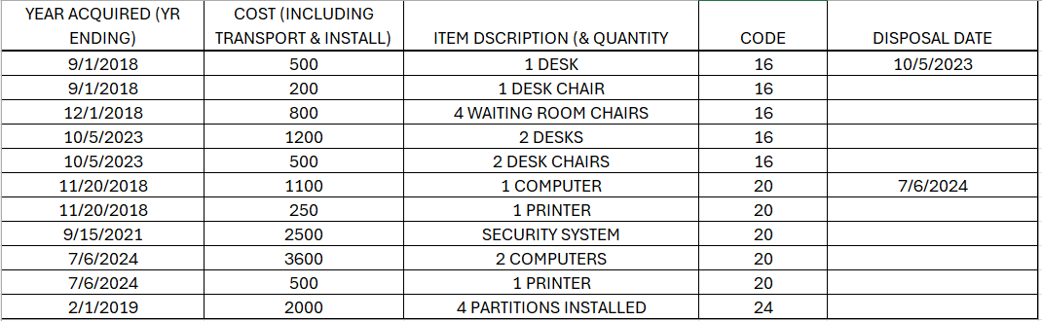
Here is a sample business if you’d like to practice completing a declaration.
Remember that the assessment year is 10/2/prior year – 10/1/reporting year. For items acquired after 10/2, they are reported under the following year on the declaration. 10/5/2023 is reported for 2024, for example.
(Because we don’t have a prior year declaration to compare for this practice example, we don’t have a place to subtract the disposals. But to get into the habit of recording a disposal, we have included them here. Remember that you don’t add or included disposed assets in the code boxes.)

Slide 60
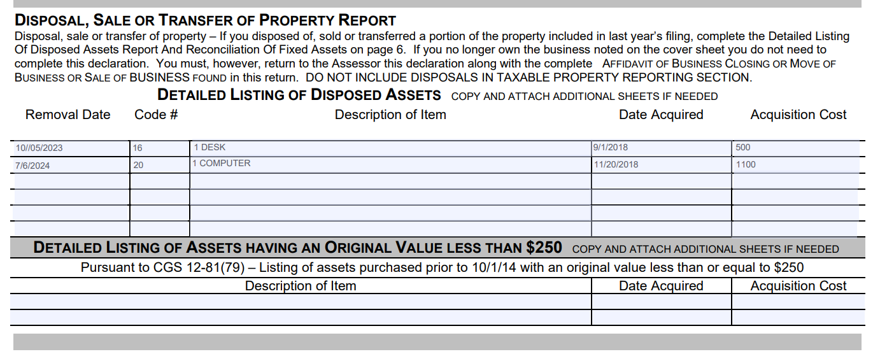
Disposed assets are reported in the year they are disposed
(and subtracted from their corresponding code and year,
where you reported them on last year’s declaration).

Slide 61
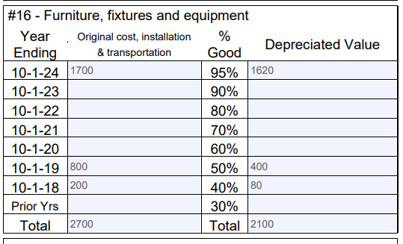
Let’s check your work! Did you record the Code 16 items
in the left column?
Calculate the depreciated value by multiplying by the % Good and put the total in the right column.

Slide 62
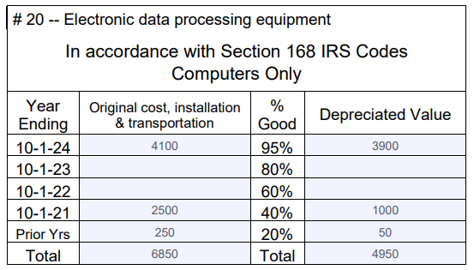
Your code 20 should like this when you are done.

Slide 63
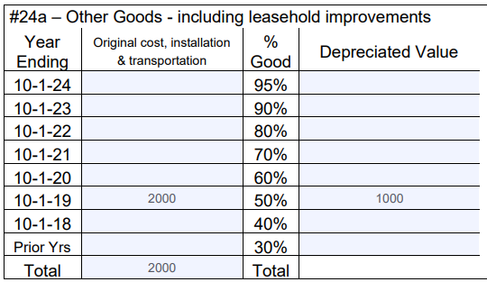

Slide 64
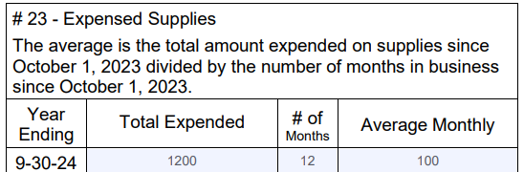
We talked about expensed supplies back on slide 32. We can peek at that again.

Slide 65
Code #23
Average Supplies
The average monthly quantity of supplies normally consumed in the course of business.
This code does not need to be broken down by year – it is a monthly/yearly total
Examples:
Office Supplies
Cleaning Supplies
Toner, Paper
Mechanic/Plumber/Carpenter, etc - rags, booties, gloves, flux, Teflon tape, sandpaper…
Medical and Dental Supplies
Maintenance Supplies
Inventory is not taxable. If you itemize it on your customers’ invoices, it is inventory.
Notes:
Reminder of what those supplies would be.

Slide 66
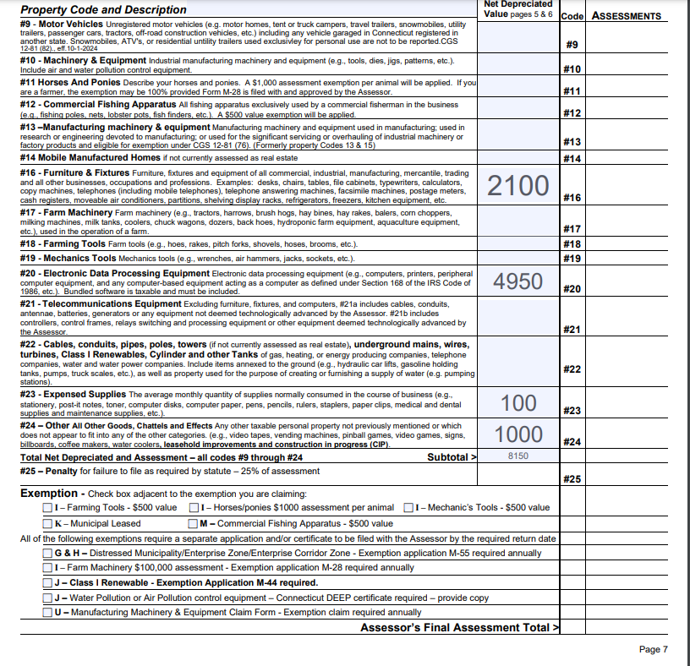
Now you will take the total depreciated amount from each code and put them in the corresponding code on the summary sheet at the end.
The Assessment staff will review your declaration, recheck your math. Hopefully they won’t add a penalty because your dec is complete and filed on time, right?
The subtotal at the end times 70% (the assessment rate) will equal your assessment. If you qualify and filed for any exemptions, they are also calculated here for a final assessment total.

Slide 67


