Slide 1
Proposed Sale of 901/903 Main Street

Slide 2
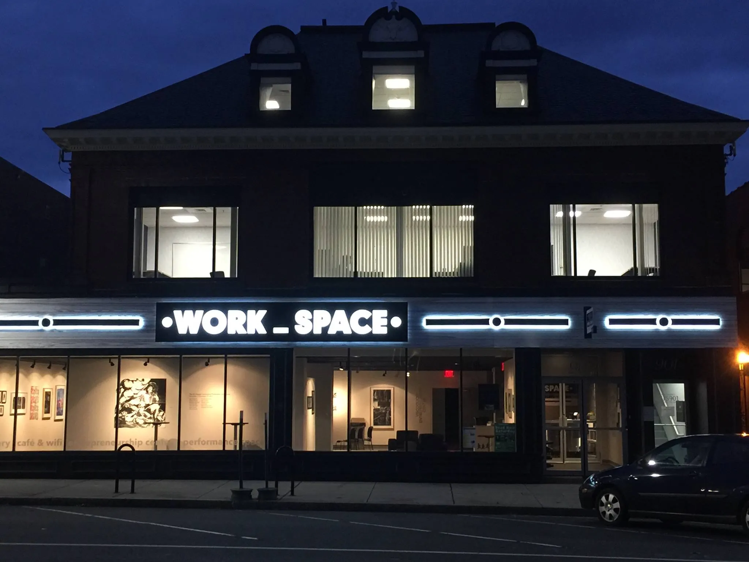

Slide 3
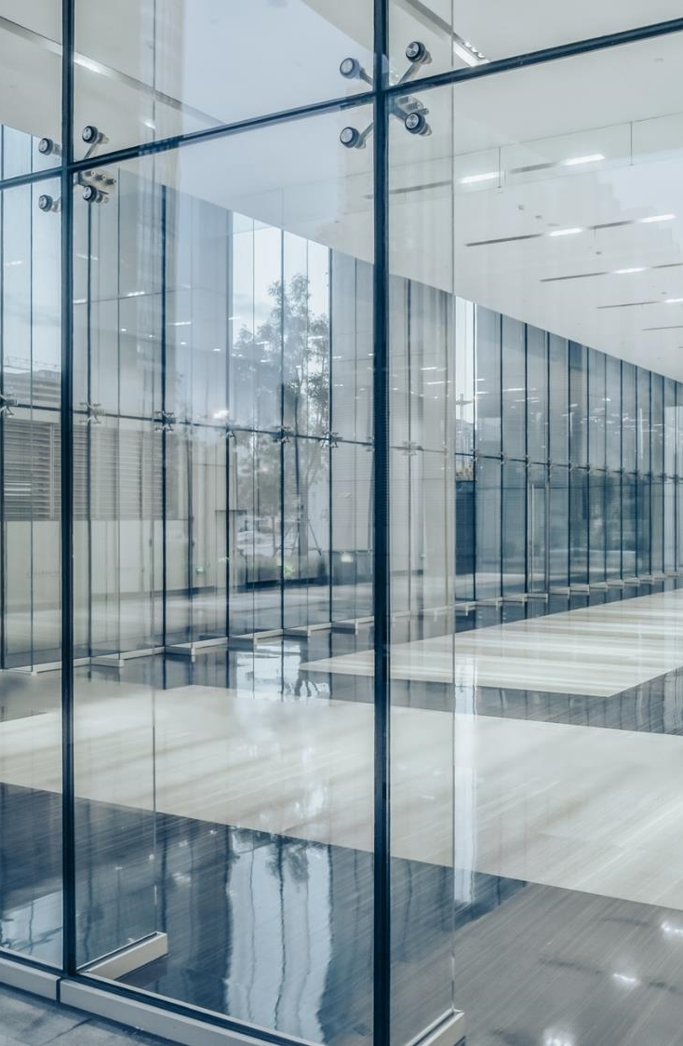
Benjamin Williams, Owner
ARSOME Technologies

Slide 4
Terms
Building to be used as Entrepreneurial Hub
Two-year transition period for gallery space
$1,510,710 purchase price
Buy-back option if use changes
Purchase and sale to take place on or around July 1, 2025.

Slide 5
Terms- Two Year Transition
  No property tax paid during transition period
  Town operates gallery and contributes toward costs
  Town moves gallery space to new location
  Focus on facilitating the private operation being successful

Slide 6
Terms- Post-transition
Full property taxes paid by owner
Town has rights to hold meetings at no cost for an additional 13 years
Buy-back option if use changes

Slide 7
Benefits
Continuation of building mission + activity
Property tax revenue after year 2
Elimination of ownership/maintenance costs
Additional downtown meeting space

Slide 8
Near-Term Challenges
Gallery relocation
Coordination between Town and new owner
Communication with existing members

Slide 9
Benjamin Williams, Owner
ARSOME Technologies

Slide 10
THANK YOU
March 3, 2025
Manchester, CT Board of Directors

