Slide 1


Winter Warming for the Unsheltered
2025-2026 Update
Board of Directors Meeting | November 2025

Slide 2
The Growing Need and Complexity
Local Homeless Population: Estimated 60+ peopleunhoused daily in Manchester, a drastic increase over the last 6 years.
Statewide Increase: The total number of homeless individuals in CT reached 3,735 in 2025 (up from 3,410 in 2024).
Aging Population: 25% of the statewide unhoused population now over the age of 55.
Severe Needs: We are seeing increases in the complexity and needs of the unhoused, including mental health needs and complex family dynamics that make shelter and housing difficult.
Regional Impact:The lack of resources in neighboring towns means Manchester and other communities like Hartford, Enfield, East Hartford and Vernon are increasingly relied upon as a regional service hubs.

Slide 3


Statewide Data: By the Numbers (2025)
2,902
833
3,735
Total Sheltered
Total Unsheltered
Total Homeless

Slide 4
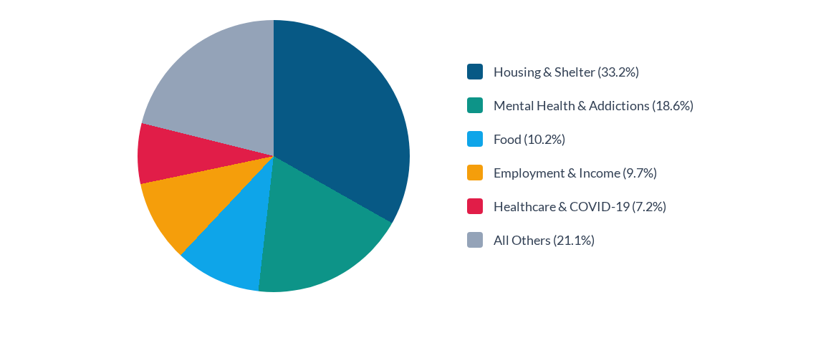
Top 211 Service Requests in Manchester
(Nov 2024 - Nov 2025)
Housing and Mental Health/Addiction services make up over 50% of all requests.

Slide 5
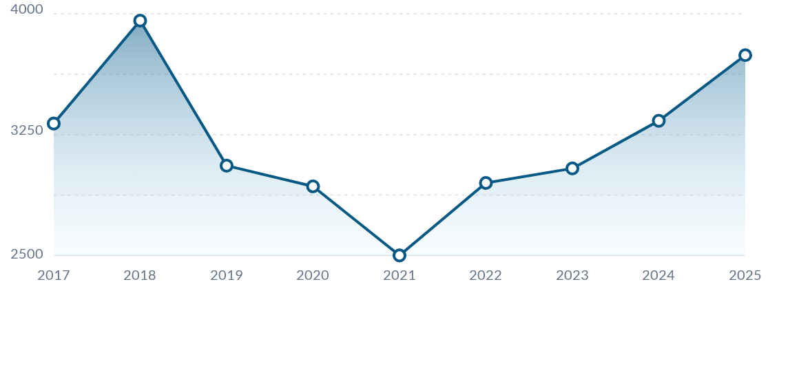
Statewide Data: Total Homeless Trend (2017-2025)
After a significant dip in 2021, the total number of unhoused individuals in the state has seen a steady and sharp increase over the last four years.

Slide 6
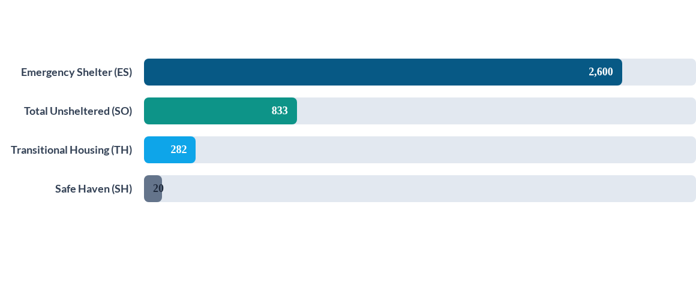
Statewide Data: Homeless Breakdown by Type (2025)
(Total values based on a max of 3,000 for visual scaling for comparative purposes)

Slide 7
Winter Warming Center Program Evolution
During the 2020-2021 winter season, the Town of Manchester partnered with Cornerstone and others to operate a congregate model warming center at the Community Y, daily from 7PM - 7AM.
Beginning the winter season of 2021-2022, the Town partnered with MACC to operate a non-congregate model at the Manchester Inn which provided 24 hour sheltering for those in need. This pilot program was funded using a mix of local and state funds.
Using the lessons learned during the pilot, MACC and the Town of Manchester replicated the hotel model for subsequent winters, which were entirely funded using ARPA dollars.
2021-2022
2025-2026
Pilot Program: Non-congregate 24h model at Manchester Inn. Partner: MACC.
Upcoming Season: MACC at Manchester Inn. ARPA funds + $25k from Journey Home.
2020-2021
2022-2024
Congregate warming center at Community Y. Partner: Cornerstone.
Replicated hotel model. Funded by ARPA dollars & MACC supplemental services.

Slide 8
Recap: Winter 2024-2025
Key Operational Highlights
The program operated for 121 days (Dec 1 - Mar 31):
51
Funded using Board-allocated ARPA dollars
Staffing: Over 3,000 Shelter Staff/Monitor Hours utilized for 24/7 coverage.
Client Support: Over 3,000 Meals Provided to Clients (daily service).
Unduplicated Clients Served
Service Referrals: Direct connections to Housing, Mental Health/Addiction, Medical, and Job services.
Crisis Response: Coordinated with the CAN and regional partners to activate more resources during Severe Cold Weather activations.

Slide 9
Plan for Winter 2025-2026
Site: MACC will operate the non-congregate site at the Manchester Inn.
Timeline: December 1, 2025, to March 31, 2026, offering 24/7 accommodation.
Capacity: 24 rooms will be utilized, housing 25-30 people at a time. (We may add capacity prior to 12/1)
Funding: Approx $240k secured via Board-allocated ARPA funds, and includes $25k from Journey Home.
Services: Daily meals, case management and resource navigation (along with SAFS staff), and connections to housing, employment, mental health and other supports.
Other important things to note:
Weekly outreach will continue to be provided in partnership with MACC and the Manchester Police Department.
Due to the numbers of those unsheltered, Manchester WILL have higher numbers of visibly homeless in our community this winter. Efforts will continue to be made to connect those people with services.

Slide 10
Additional Considerations for Beyond This Winter
Planning for next winter and beyond: The town will have to make a significant commitment of resources and funding to provide services next winter. MACC & Human Services are working to develop formal recommendations for the Board of Directors.
Advocacy and other Needs
Regional Strategy: Greater advocacy and efforts are needed to create better regional infrastructure and partnerships.
Shared Responsibility: The state must create ways for municipalities must be to bear their share, otherwise the burden continues to shift to resource-rich towns.
State/Federal Housing Resources: More resources must be devoted to affordable/supportive housing and effective rapid rehousing.

Slide 11
Thank You
Prepared by:
Joel Cox, Assistant Town Manager/Dir. of Human Services
With many thanks to our partners:
Shannon Baldassario, CEO, MACC Charities
Timothy D. Bohr, Community Outreach & Emergency Services Manager, MACC

