Slide 1


MANCHESTER
2026 Revaluation

Slide 2
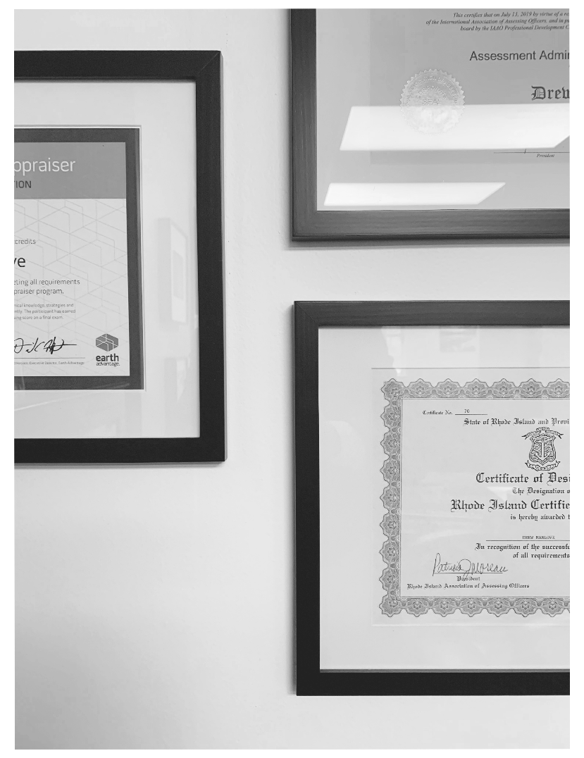
Who?
The 2026 revaluation project is headed by Tami Nomack, Director of Assessment for the Town of Manchester, who leads a staff of dedicated professionals in Manchester’s Assessment Office.
The Town has also contracted with Tyler Technologies to assist the Assessment Office with this project, led by Project Manager Drew Manlove. Drew is recognized as an Assessment Administration Specialist (AAS) and Residential Evaluation Specialist (RES) by the International Association of Assessing Officers (IAAO) and is certified by the State of Connecticut’s Office of Policy and Management as a Revaluation Supervisor. He is supported by Tyler’s team of experienced professionals who will contribute to the project in a variety of roles.
Tami Nomack
Director of Assessment
Town of Manchester
Drew Manlove
Senior Project Manager
Tyler Technologies

Slide 3
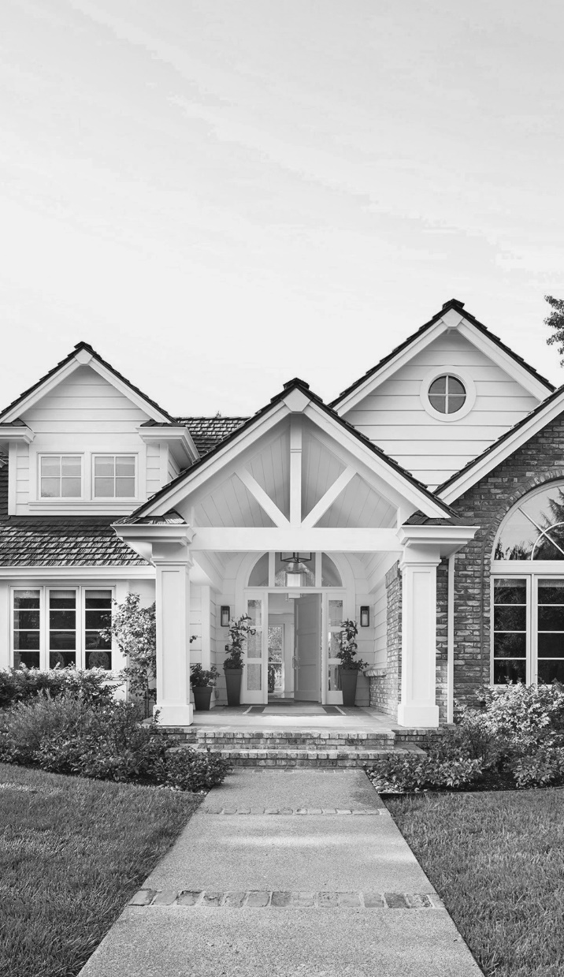



First, data collection & verification processes are employed to ensure the accuracy and completeness of parcel data.
What?
The goal of this revaluation project is to estimate the current market value of all real estate in the Town of Manchester. This includes all single-family homes, as well as condos, multi-family homes, apartments, commercial & industrial properties, and vacant land.
Once market value estimates are established, the Assessment Office will then use this information to calculate the assessed , or taxable, value for all real estate parcels.
Then, market analysis is performed using sales data from the Town of Manchester over a 12-month period.
Finally, mailers are sent to every property owner indicating the new assessed value for their property.

Slide 4
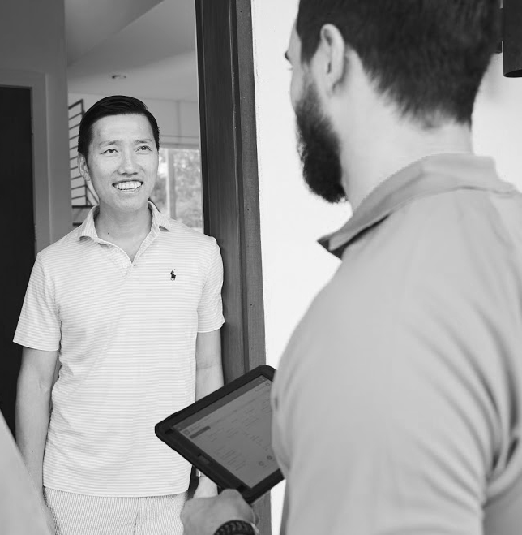
Where?
Though much of the administrative and analytical work on this project will be performed in both the Town Assessment Office and Tyler Technologies staff offices, there will also be data collectors visiting a portion of the real estate parcels in Manchester to confirm physical data, such as exterior measurements, bedroom and bathroom counts, and property condition. Data collectors will carry proper identification and knock on doors to verify property information with occupants.
Data collectors may ask questions like:
“How many bedrooms/bathrooms are in your home?”
“Is your basement finished?”
“Have you recently completed any remodeling?”
Notes:
Starting over the next couple of weeks, data collectors will begin to visit properties in the town for the purpose of collecting and verifying property information. So, homeowners can expect to receive a knock on their door from a data collector who will be carrying identification. That data collector will then ask some questions about the home, for example:
Then the data collector will take measurements of the exterior of all structures on the property, including the house and any outbuildings.
A couple of important things to note here:
These data collectors are not there to value your home. That is not what they are trained to do. So, they’re not on your doorstep thinking about dollars and cents, they’re thinking about what are the number of bedrooms, what is the condition of the property, etc.
Also,
Although it is typically a part of the data collection process, this year, data collectors will not ask to enter your home because of COVID protocols. So, this year, more than ever, we appreciate homeowners being candid and cooperative with this data collection process, as it is a very important part of making sure that the results of the revaluation are accurate.

Slide 5
When?
APR
NOV
DEC
Data Collection
Data collection will begin in April or May of 2026, and this process will carry on through the summer. Occupants will not receive advanced notice of a visit to their home.
Value Notices
Property owners will receive a mailed notice in November of 2026. This notice will inform the property owner of the new proposed assessed value for their property.
Informal Hearings
Property owners may choose to schedule a hearing to discuss the assessed value of their property. These informal hearings will take place in December of 2026.

Slide 6

Why?
The 2026 revaluation project in the Town of Manchester is mandated by state law and is carried out for the sole purpose of ensuring fairness and equity in property taxation. Current and accurate assessed values serve to ensure that each property owner pays no more and no less than their fair share of local property taxes.
Did you know that property revaluations do not raise taxes?
As a taxpayer, the assessor is your advocate for fairness in taxation, not a fundraiser for the town.
The results of this project will have no effect on the total taxes levied by the town.

Slide 7

Questions?
Manchester’s assessing staff takes pride in being a source of transparency and clarity in the process of assessment in the town. Do not hesitate to contact the Assessment Office if you have any questions regarding the 2026 revaluation or any other assessment-related concerns.
Call Us:
(860) 647-3016
Email Us:
Assessor@ManchesterCT.gov

