Slide 1


BOD Health Equity Update
January 13th, 2026
Precious Edwards

Slide 2

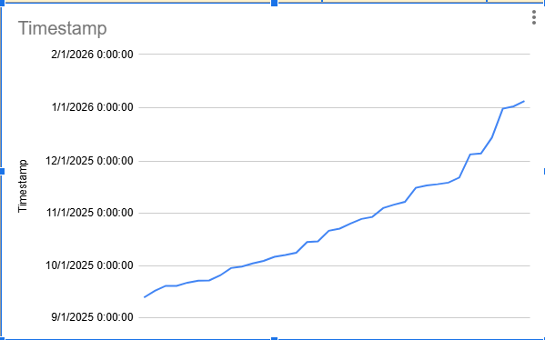
ITAV Launch and Highlights
It Takes a Village launched on September 15th, 2025.
Strong engagement
Steady stream of applications
Consistent enrollment growth
Bridge of services strengthened – Connections grown
**Word of Mouth/Flyer Outreach

Slide 3

Program Timeline
It Takes a Village will serve a total of 100 families!
To ensure we have the capacity to serve all 100 families, enrollment is implemented in five sessions, with each cohort enrolling 25 families at a time.
Each family has a procedural 12-week tracking window to provide flexibility during a highly unpredictable period.
We anticipate the program will extend beyond 2026 into mid-2027.

Slide 4
Program Operations
Program tracking supported by 5 volunteer Program Facilitators, who provide six weeks of peer-to-peer support to pregnant/postpartum mothers and, when applicable, fathers who opt-in to fatherhood support.
Data is inputted on our in-house tracking system and serves as a centralization for all program information.
Weekly notes summarizing conversations with participants and tracking usefulness of program benefits
Ensuring data is consistent, measurable, and actionable.
**In Partnership with Karen and Brock

Slide 5

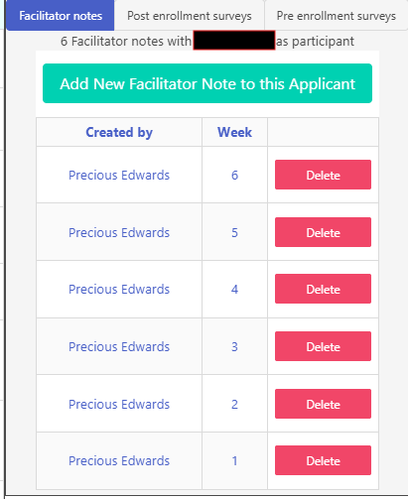
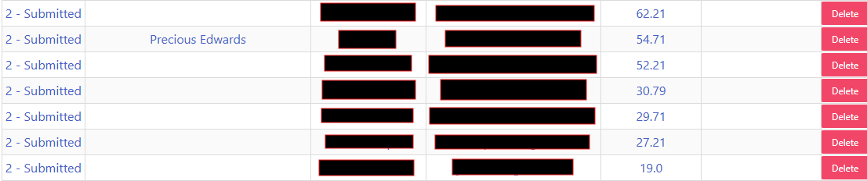
Dashboard Visual

Slide 6
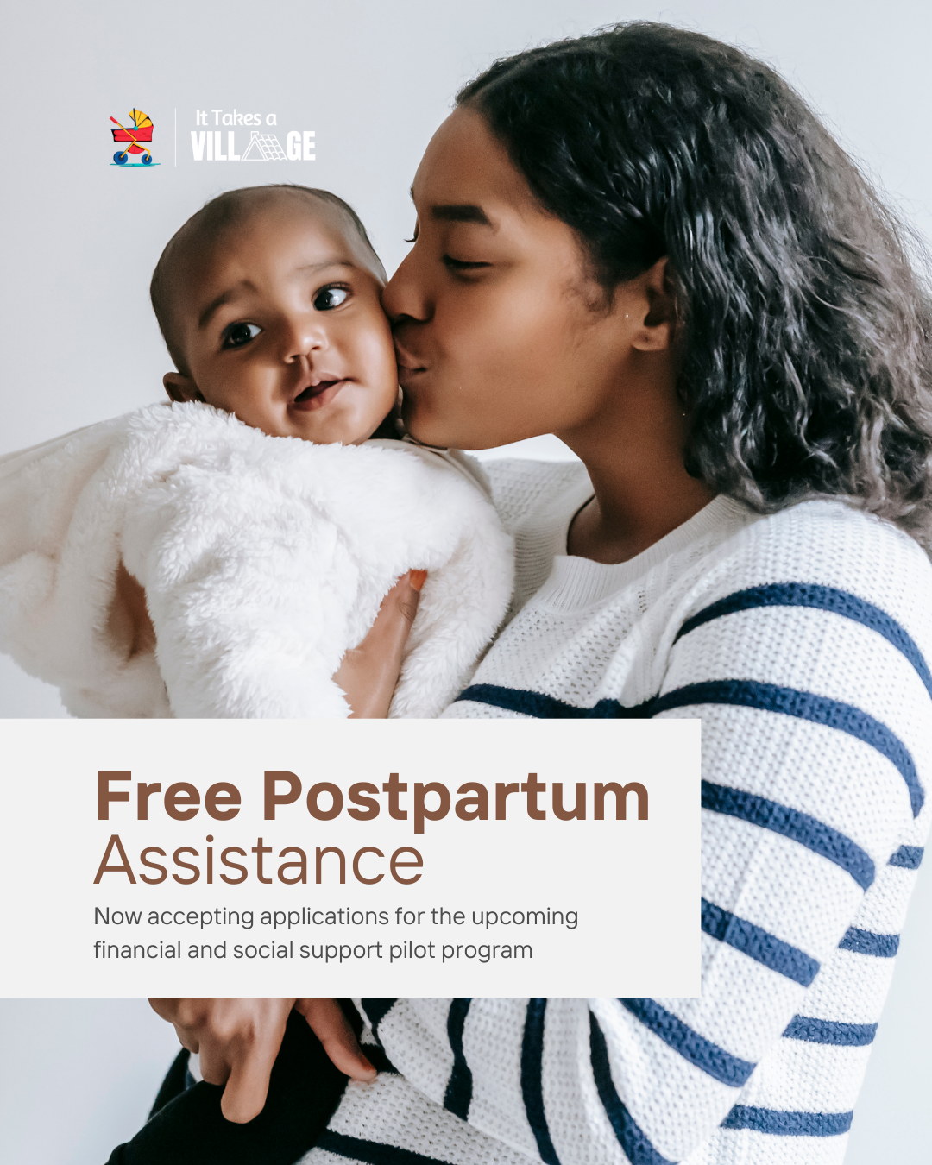
Enrollment and Facilitator Role
Session 1 enrollment began November 5th
We currently have 10 families enrolled, 7 families successfully closed out of the program, and enrolling the final 8 participants this week.
Session 1 is expected to conclude in March 2026.
I provide ongoing supervision and support to all facilitators to ensure successful implementation.
Facilitator caseloads are intentionally capped at 2-3 families to prevent burnout and support high-quality engagement.
Facilitators are required to discuss caseload during bi-weekly meetings and attend mandatory professional development trainings to enhance service delivery for future sessions.

Slide 7
Professional Development Opportunities
As part of It Takes a Village strategic action plan, we launched a professional development component for the program to be conducted in February, March and April.
These trainings are intended to enhance health equity competency and skills during the postpartum period for healthcare professionals, doulas, social workers, community leaders/advocates and anyone working with pregnant/postpartum families.

Slide 8


Slide 9
Session 2 Planning
(April/May 2026)
Conduct survey from Program Facilitators on what to enhance/improve in current program model and dashboard.
Recruiting more participants through a final press release out to media.
Increasing grassroots outreach with Town website page and “office-hours” for future partners, stakeholders, and participants to pop in and ask program-related questions or inquiries.
Quicker turnaround time from initial assignment to final week in program.

Slide 10


Thank you!

