Slide 1

Manchester Veterans Advisory Committee
2024-Year-End Review

Slide 2
Message from the Chairman
As the Chairman of the Manchester Veterans Advisory Committee, I want to express my heartfelt appreciation to each committee member and our town liaisons, Peter and Joel. Your dedication and collaboration are instrumental in improving the lives of veterans in Manchester and across Connecticut.
Your commitment and contributions ensure that our Nation’s Heroes receive the support and recognition they so richly deserve. Thank you for being an essential part of this mission.

Slide 3
Veteran Service Metrics 2024
Compensation Benefits Assistance: 32
Resource Referrals: 29
Homeless/or At Risk - Veterans Assisted: 2
Widowers Supported: 4
Voicemail Inquires: 34
Total Serviced: 101

Slide 4
Veteran Coffee House Initiative Impact
Launched May 2023 (Coffee House TaskForce): Advocated by Paul S. and Initiated and Supported by Manchester Veterans Advisory Committee and partners (Army Navy, Elks Lodge, DAV, VFW).
  Third Thursday of Every Month @ Army Navy Club:
  Day time Months are 10a-1230p
  March and October Coffee Houses are Evenings 6p to 830p
*1-Year Anniversary Achievement (May 2024): We Successfully accomplished our 2023 goal of hosting a Veterans Benefits Event (PACT ACT) on the 1-year anniversary in May 2024, Coordination with Federal and State VA and other Veteran Service Lines, to include VA claims assistance, and VA Health Care Enrollment, this Event serviced 150+ veterans.
Outreach Impact FY2024:
Avg Coffee House Attendance: 20-30 attendees.
*May 2024: 150+ veterans serviced.
*October 2024 Evening Event: 50+ veterans serviced.

Slide 5
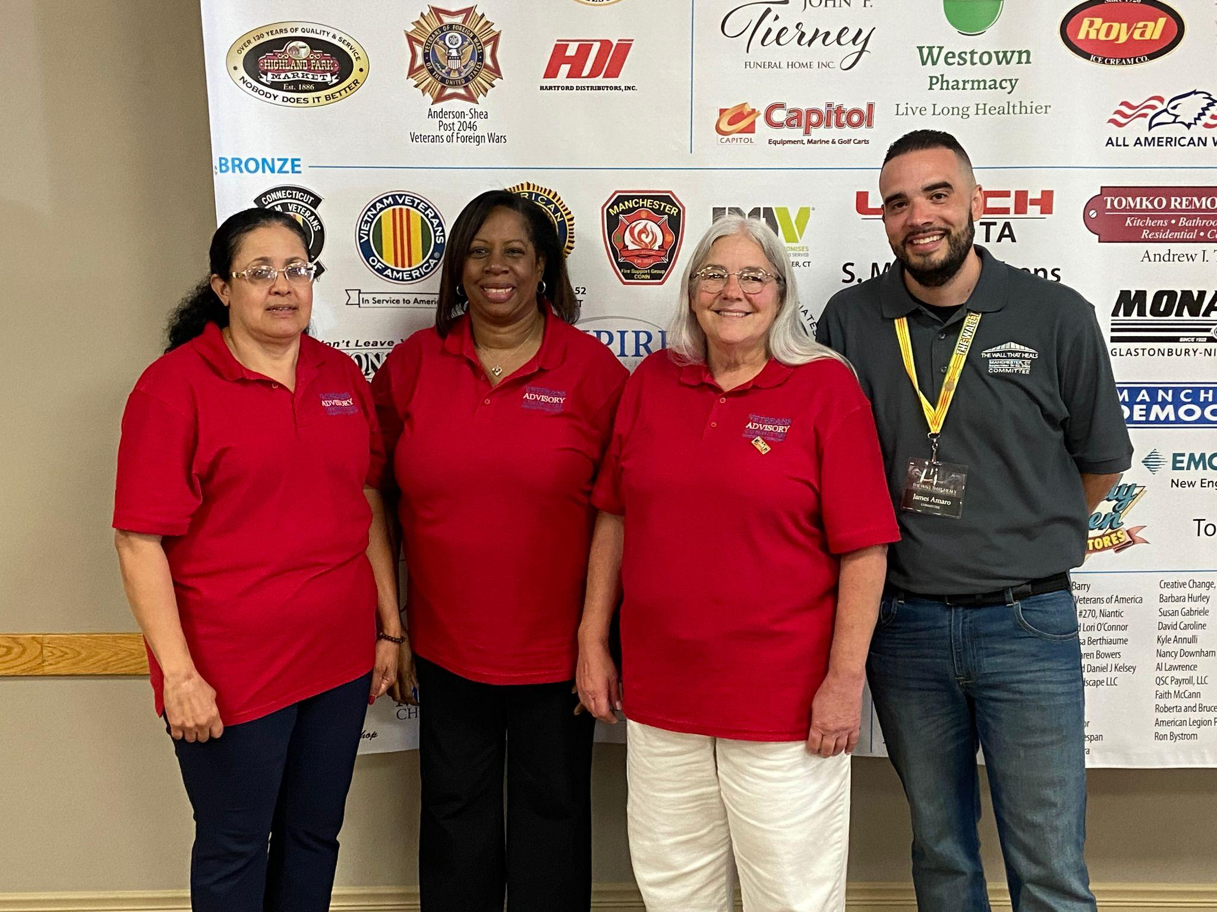
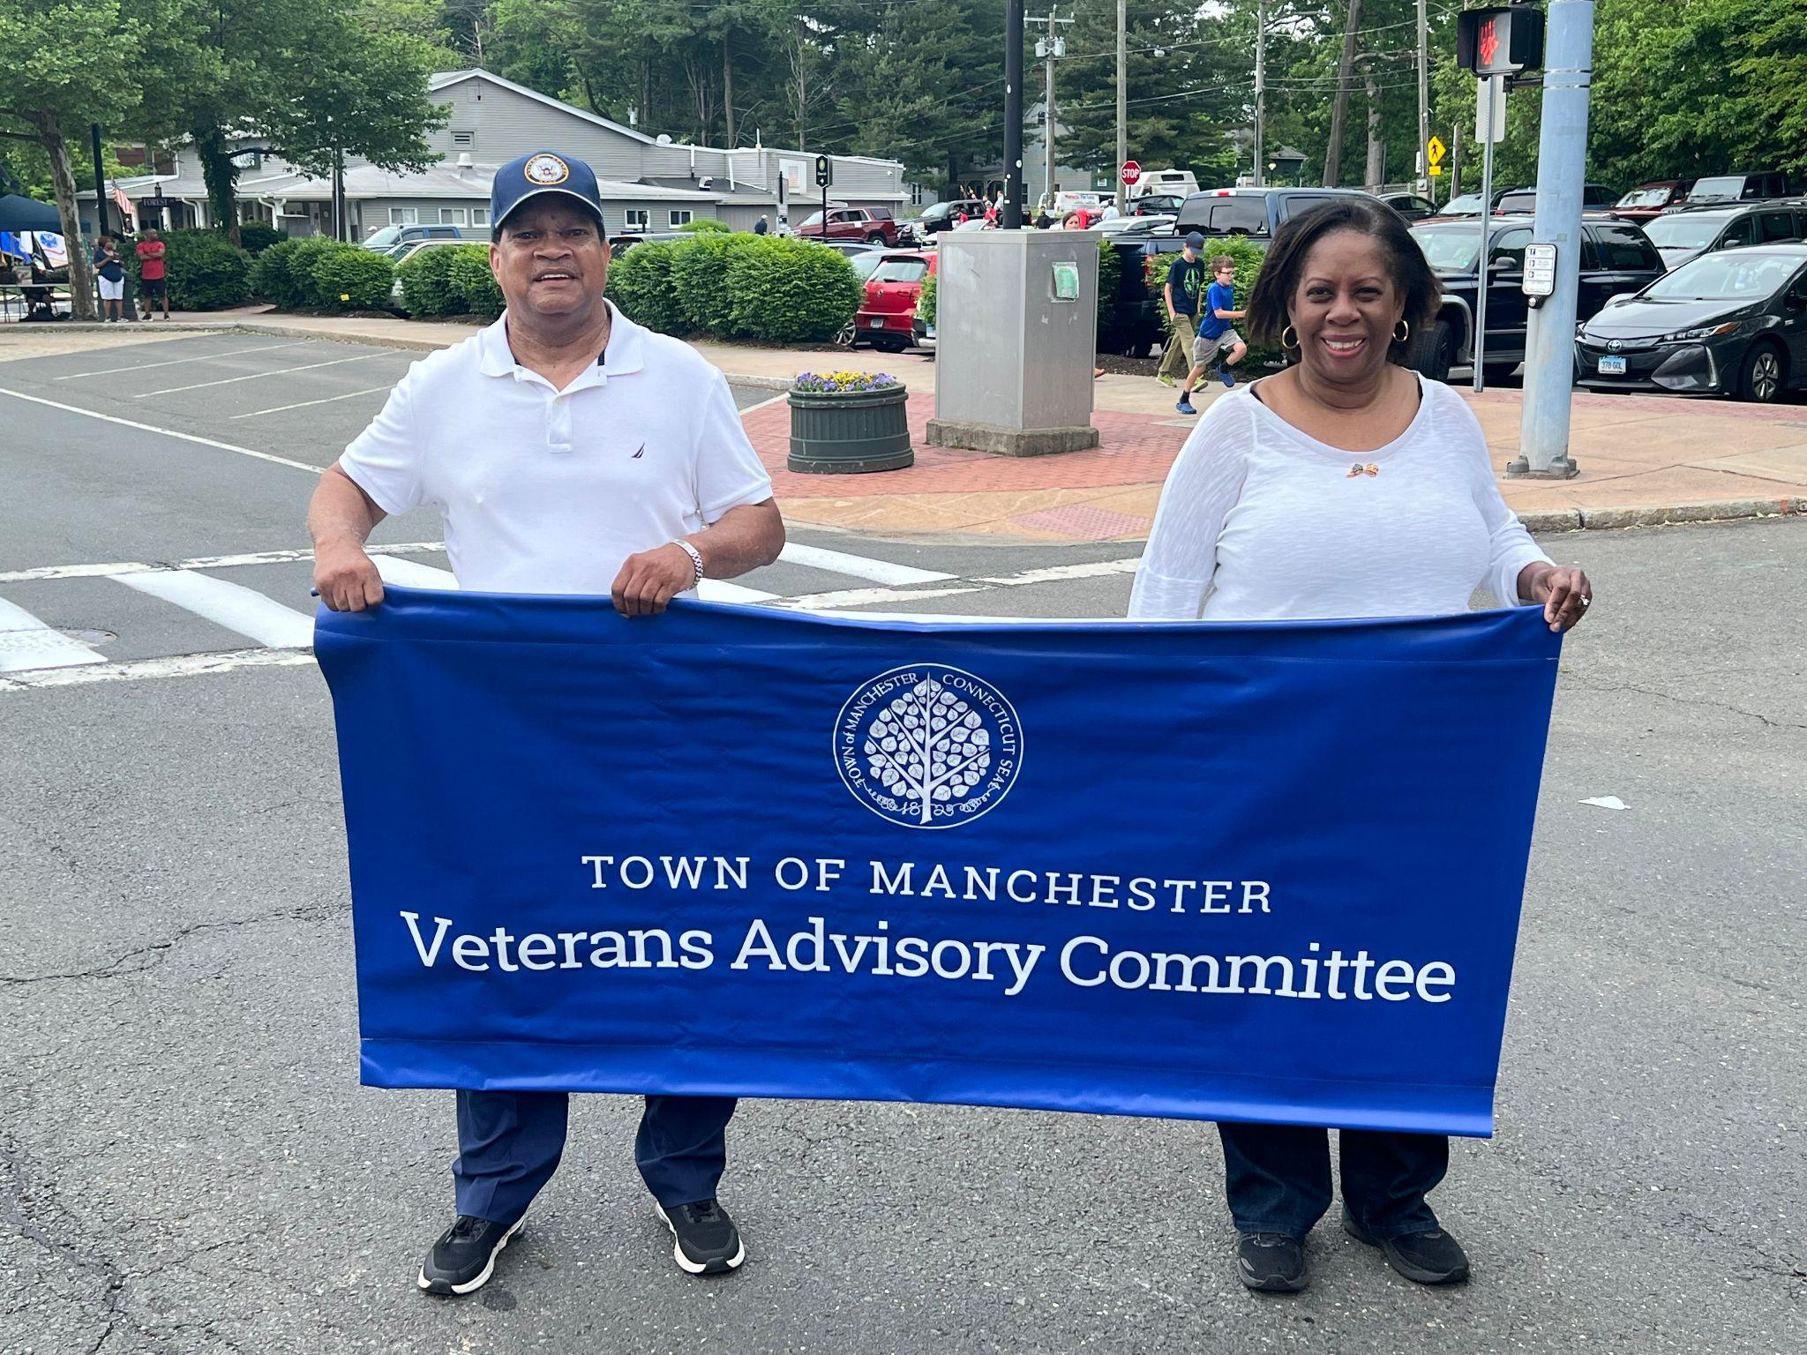
2024 Veterans Advisory Committee: Involvement
Gold Sponsorship of The Wall That Heals: The committee was proud to serve as a Gold Sponsor for The Wall That Heals during its visit to Manchester, providing both financial and volunteer support to honor Vietnam veterans and foster community remembrance.
Manchester Memorial Parade Involvement: Committee Members participated in the Manchester Memorial Parade, honoring veterans and fostering community spirit.

Slide 6










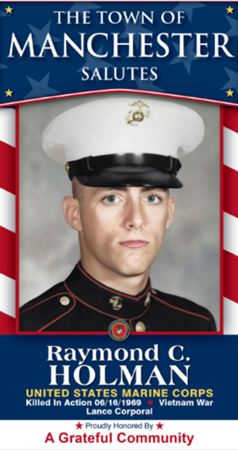
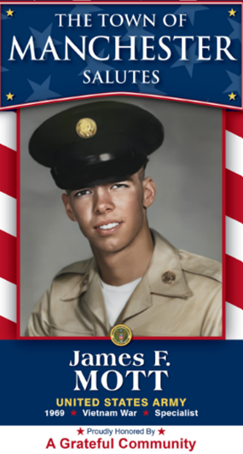


Manchester Veteran Banner Program
Veterans Banner Program: Manchester Veterans Banner Program, inspired by and in collaboration with South Windsor Veteran Banner Founder:
This Year, In conjunction with The Wall That Heals Visit to Manchester, we honor the 14 Vietnam veterans from Manchester who were killed in action by featuring them on this year’s banners. In a heartfelt gesture, the banner vendor waived the cost for these 14 banners in recognition of their sacrifice. This initiative reflects our commitment to preserving the legacy of our local heroes and engaging the community in meaningful remembrance.

Slide 7
2024 Impact Story
In our 2023 report, we shared the story of a veteran who was initially denied a VA claim for cancer. Referred to us for assistance, we helped guide him through a higher-level appeal by pointing out key aspects of the new PACT Act law related to toxic military exposure during his service. We explained what documentation and evidence were needed to strengthen his case, ultimately leading to a successful resolution. The veteran was able to witness this victory before his passing.

Slide 8
Update on Impact Story
We are now pleased to provide an update on his surviving spouse. Initially denied Dependency and Indemnity Compensation (DIC), she sought our help. We guided her through the appeals process, clearly explaining the requirements and assisting in submitting the necessary documentation. As a result, she successfully secured her rightful surviving spouse benefits. This reflects our ongoing commitment to supporting veterans and their families by ensuring they receive the benefits they deserve.

Slide 9
Looking Ahead: 2024 Goals
Outreach and Marketing Initiative
Expand outreach efforts by distributing marketing materials that inform veterans on how to contact us and get involved. This will include printed and digital campaigns to increase awareness of our mission and programs.
Community Cookout for Veterans
Plan and host a summer cookout aimed at connecting local veterans with the Veterans Advisory Committee. This event will foster camaraderie while providing an opportunity to share information about resources and support available to veterans in the Manchester area.
Veterans Discussion Invitations
Organize dedicated discussion sessions with local veterans in Manchester to hear directly from them about pressing issues they face in the community. These sessions will guide our advocacy efforts and ensure we are addressing the most significant challenges veterans encounter.

Slide 10
Closing Message
As we reflect on the past year, I want to express my heartfelt gratitude to our Board of Directors and Committee Members for your outstanding dedication and support. Your efforts have been instrumental in achieving meaningful outcomes for Manchester’s veterans and their families.
Looking ahead to 2025, I am inspired by the opportunities before us. Together, we will build on our successes, addressing new challenges with the same passion and commitment that drive our mission.
Thank you for an incredible year. Let’s move forward with renewed energy and determination, ensuring we continue making a lasting impact in the lives of those we serve.

