Slide 1
2025 Public Works Bond Referendum Discussion
July 1, 2025
Manchester Public Works Department
Tim Bockus, Director of Public Works
Jeff LaMalva, Town Engineer
Mark Rizzo, Field Services Superintendent

Slide 2
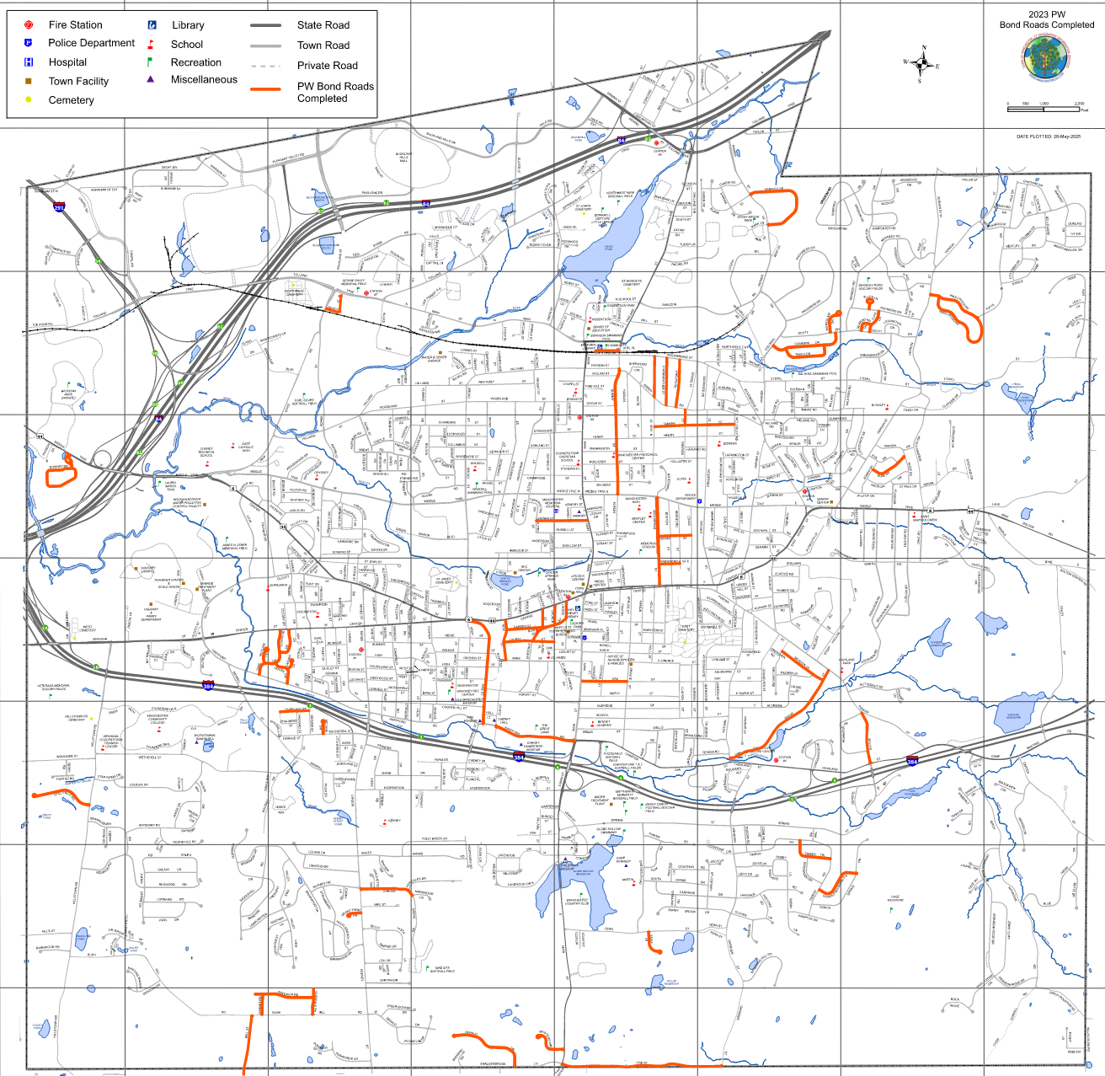
2023 Public Works Bond Status
Road Resurfacing
  53 roads completed
Sidewalks
  Lydall St. complete
  Santina Dr. complete
  Prospect St. complete
  Parker St. pending
Traffic Signals
  Buckland/Tolland Tpk
  Middle Tpk/Tower
  Middle Tpk/Green Manor
Case Mountain Dam
  In Design
Tolland Turnpike LOTCIP
  In Design

Slide 3
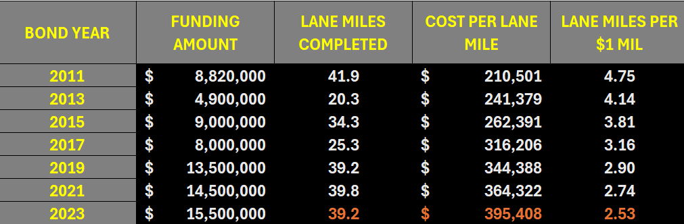
Cost History

Slide 4
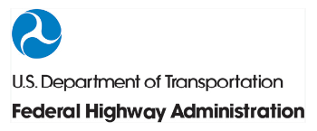



Inflation Impact
Consumer Price Index Inflation Rate: 5.6%
ENR Construction Cost Index Inflation Rate: 4.1%
Asphalt Paving Mixture Producers Price Index: 7.2%
USDOT Highway Construction Cost Index: 13.6%
Note: Data based on May 2023 compared to May 2025

Slide 5
2025 Recommended Projects
Road Resurfacing $ 14,500,000
Storm Drainage Upgrades $ 3,000,000
Town Offices Consolidation $ 1,000,000
Sidewalk Repairs $ 500,000
Roof Replacements $ 250,000
Contingency/Debt Service $ 250,000
Total Request $ 19,500,000
*2023 Public Works Bond total = $19,000,000 (2.6% increase)

Slide 6
Federal and State Grants
LOTCIP (State of CT DOT)
  Hartford Road @ Mckee St/Keeney St intersection
  Sidewalk Installations @ Deming St./Tolland Turnpike
  Tolland Turnpike (Chapel Rd to Buckland St)
Community Development Block Grant (US HUD)
  Sidewalk Installations @ Charter Oak Street
Community Investment Fund (State of CT DECD)
  Main Street
Community Connectivity Grant Program
  Keeney Street Sidewalks
Local Accident Reduction Program (State of CT DOT)
  Tolland Turnpike/Adams St./Buckland St. Intersection
Grant awards total over $20 million

Slide 7
Road Evaluation Process
Townwide road scan and rating by third party independent vendor specializing in pavement management;
Visual validation of ratings by Town staff;
Review upcoming utility projects/priority areas;
Evaluate best method (mill/overlay, full depth) based on PCI rating and expected life span;

Slide 8
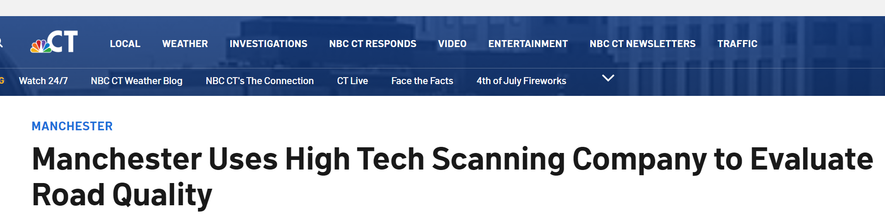
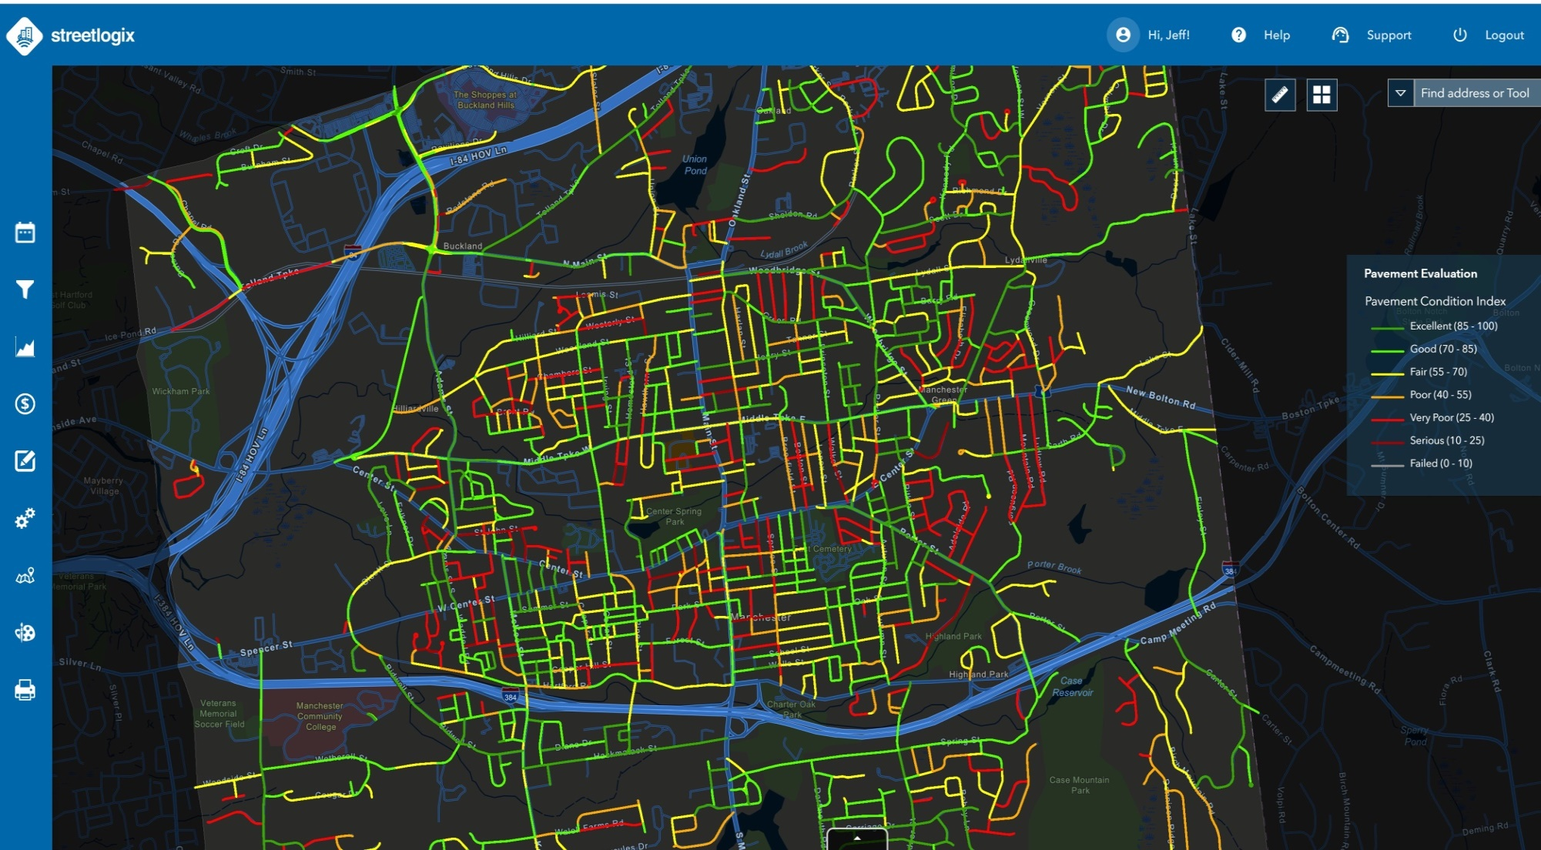
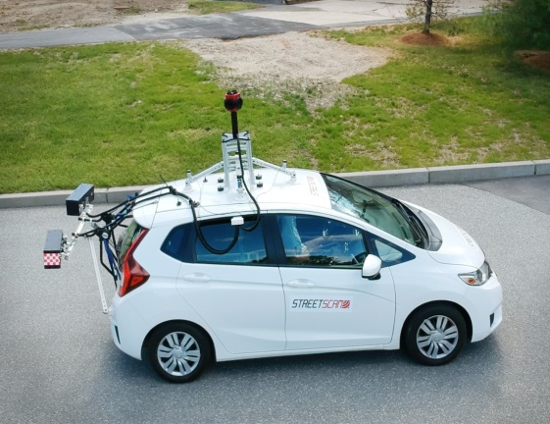
Road Scan/Rating
Road conditions assessment performed by StreetScan

Slide 9
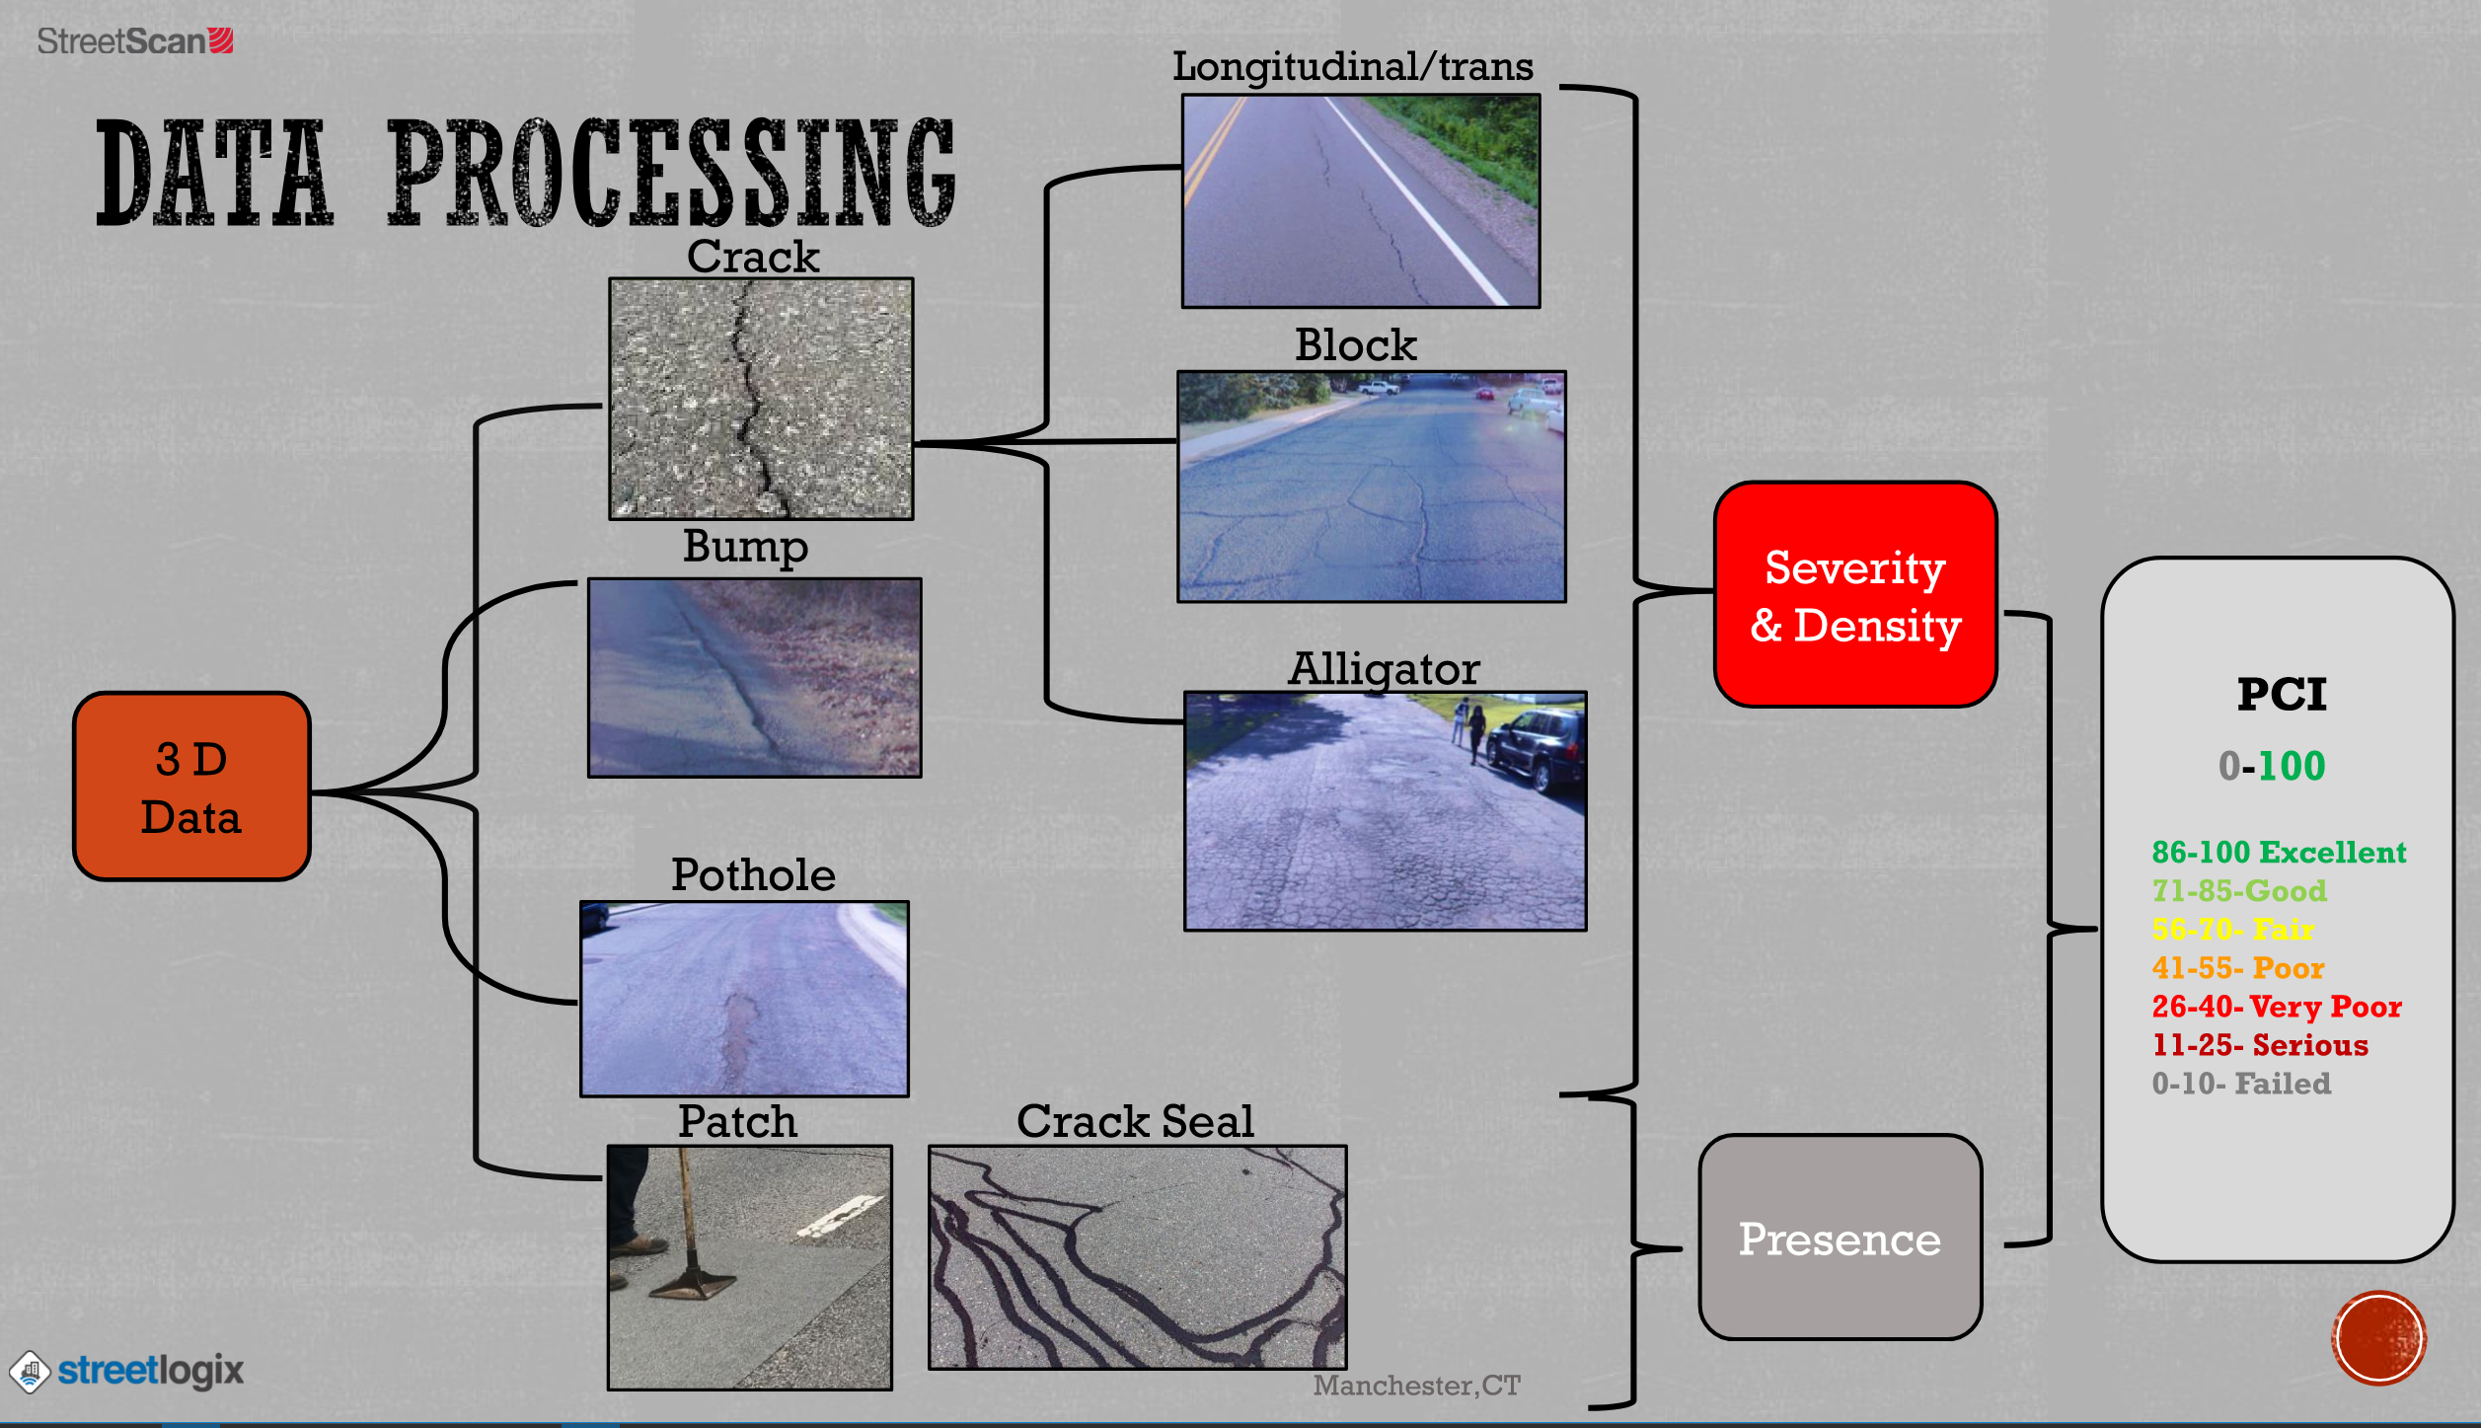
Pavement Condition Index (PCI)

Slide 10
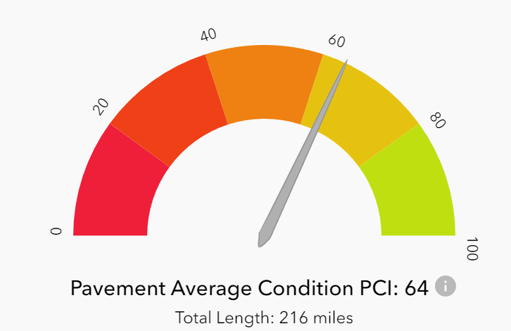
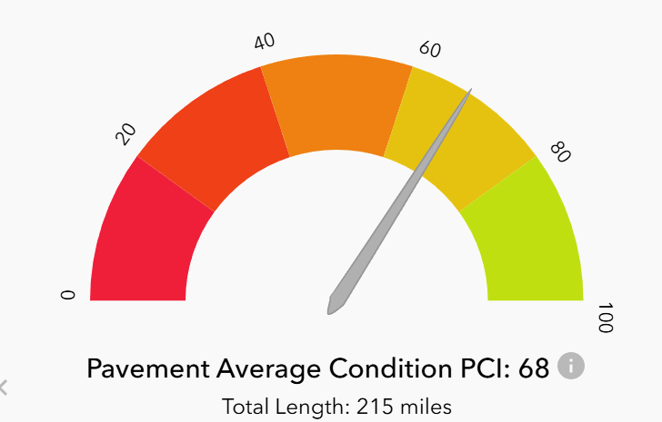
Road Resurfacing
Town average PCI (Pavement Condition Index) = 68
Average PCI increased by 4
2023
2025

Slide 11
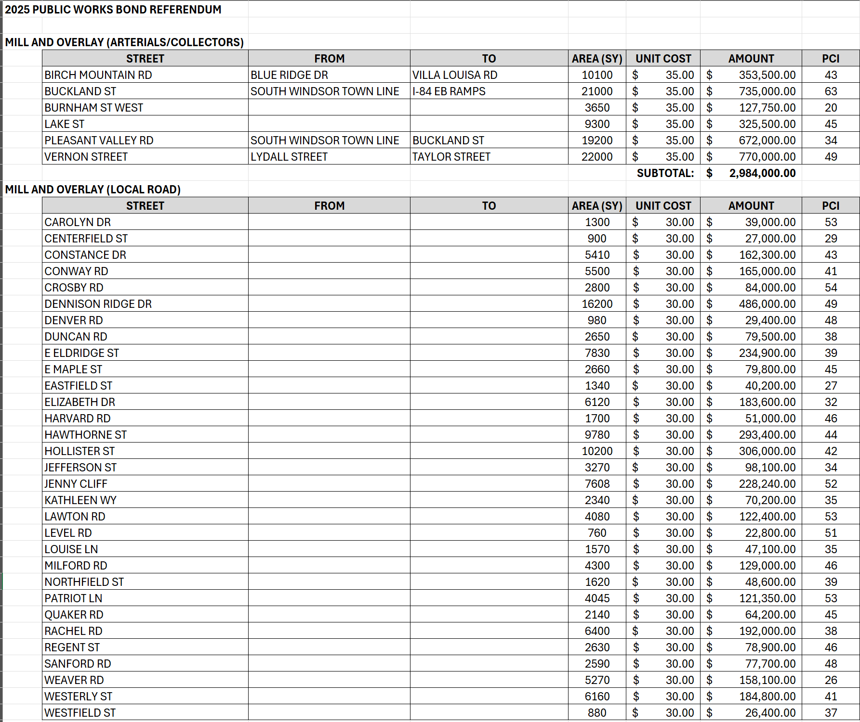
Road Resurfacing ($14,500,000)

Slide 12
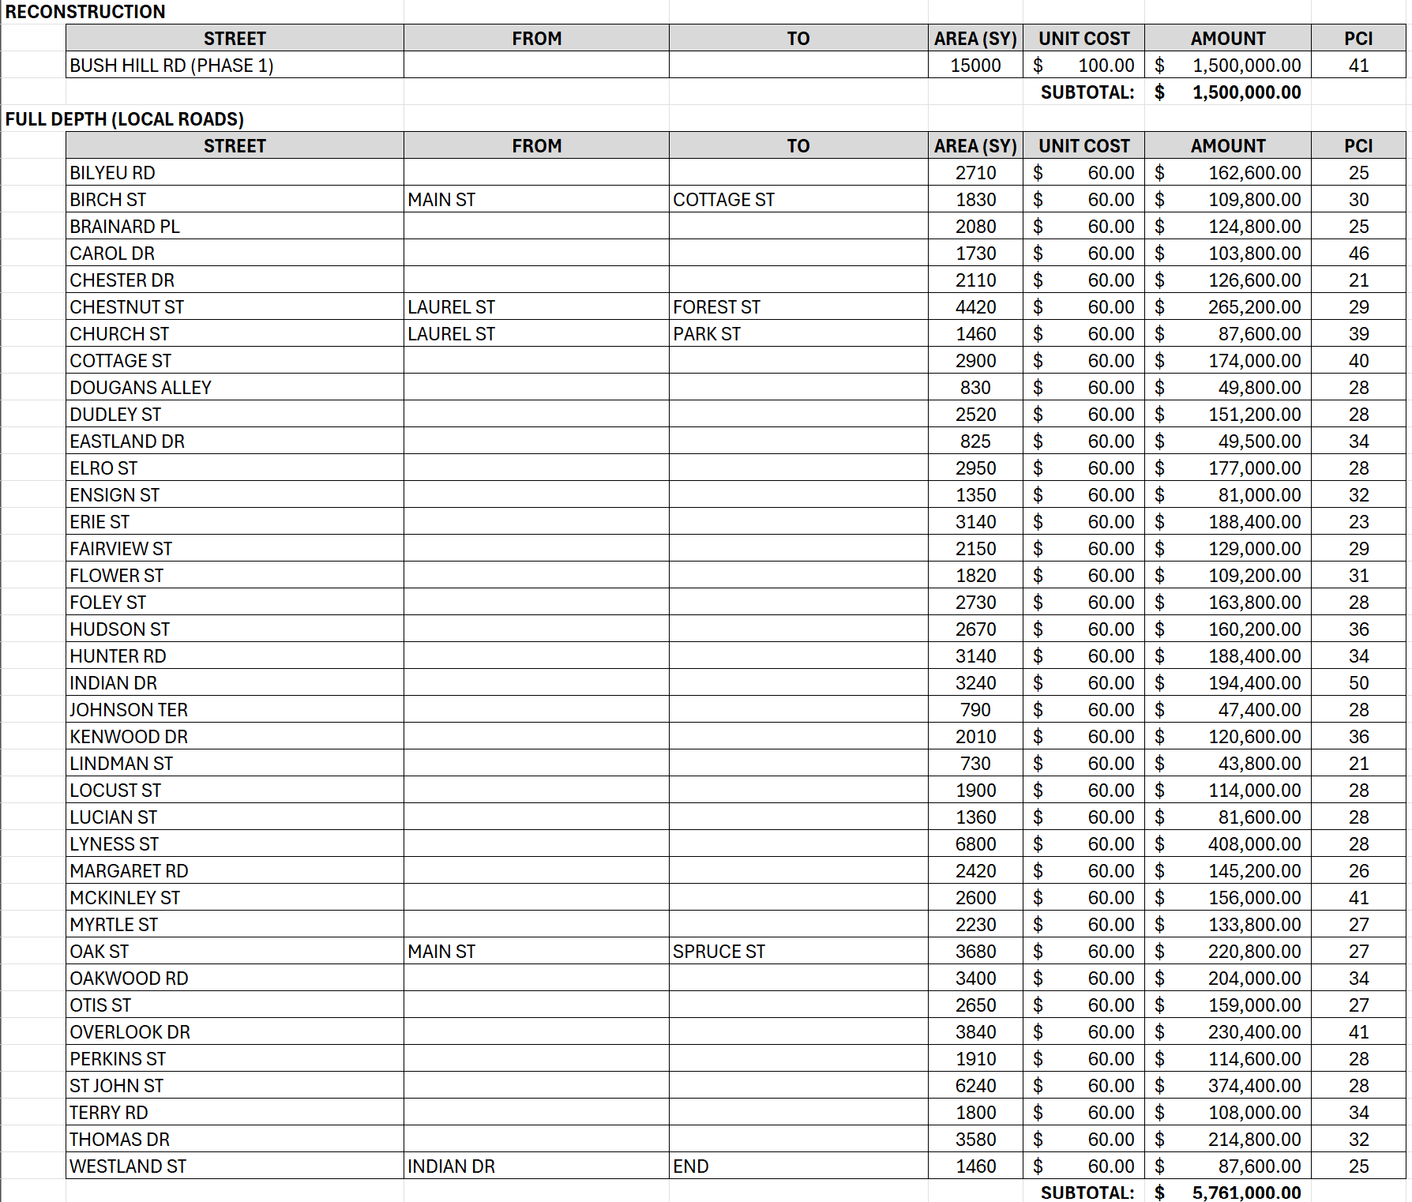
Road Resurfacing ($14,500,000)

Slide 13
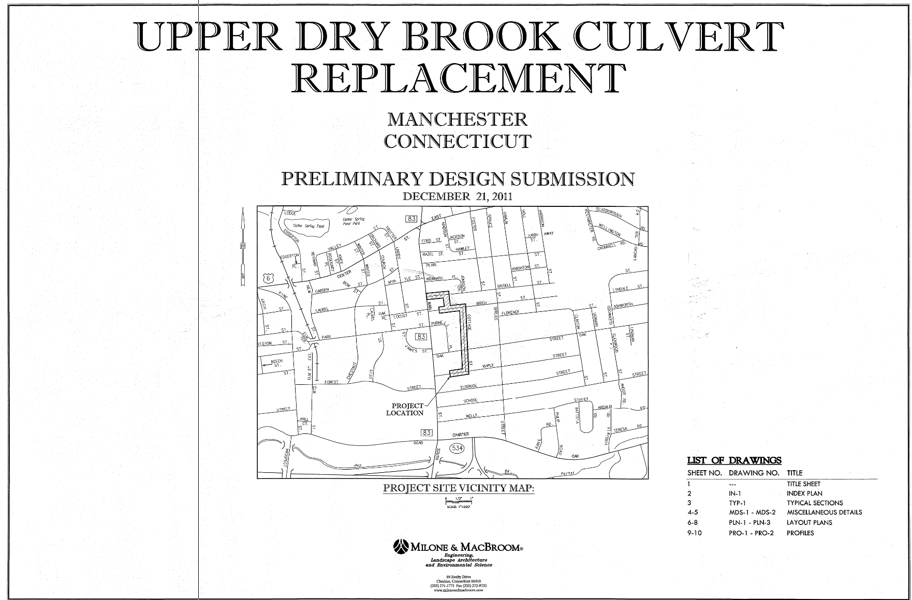
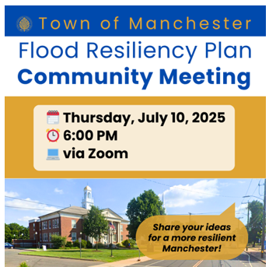
Storm Drainage ($ 3,000,000)
Dry Brook Culvert Bypass
Projects identified in Townwide Study
Date TBD

Slide 14
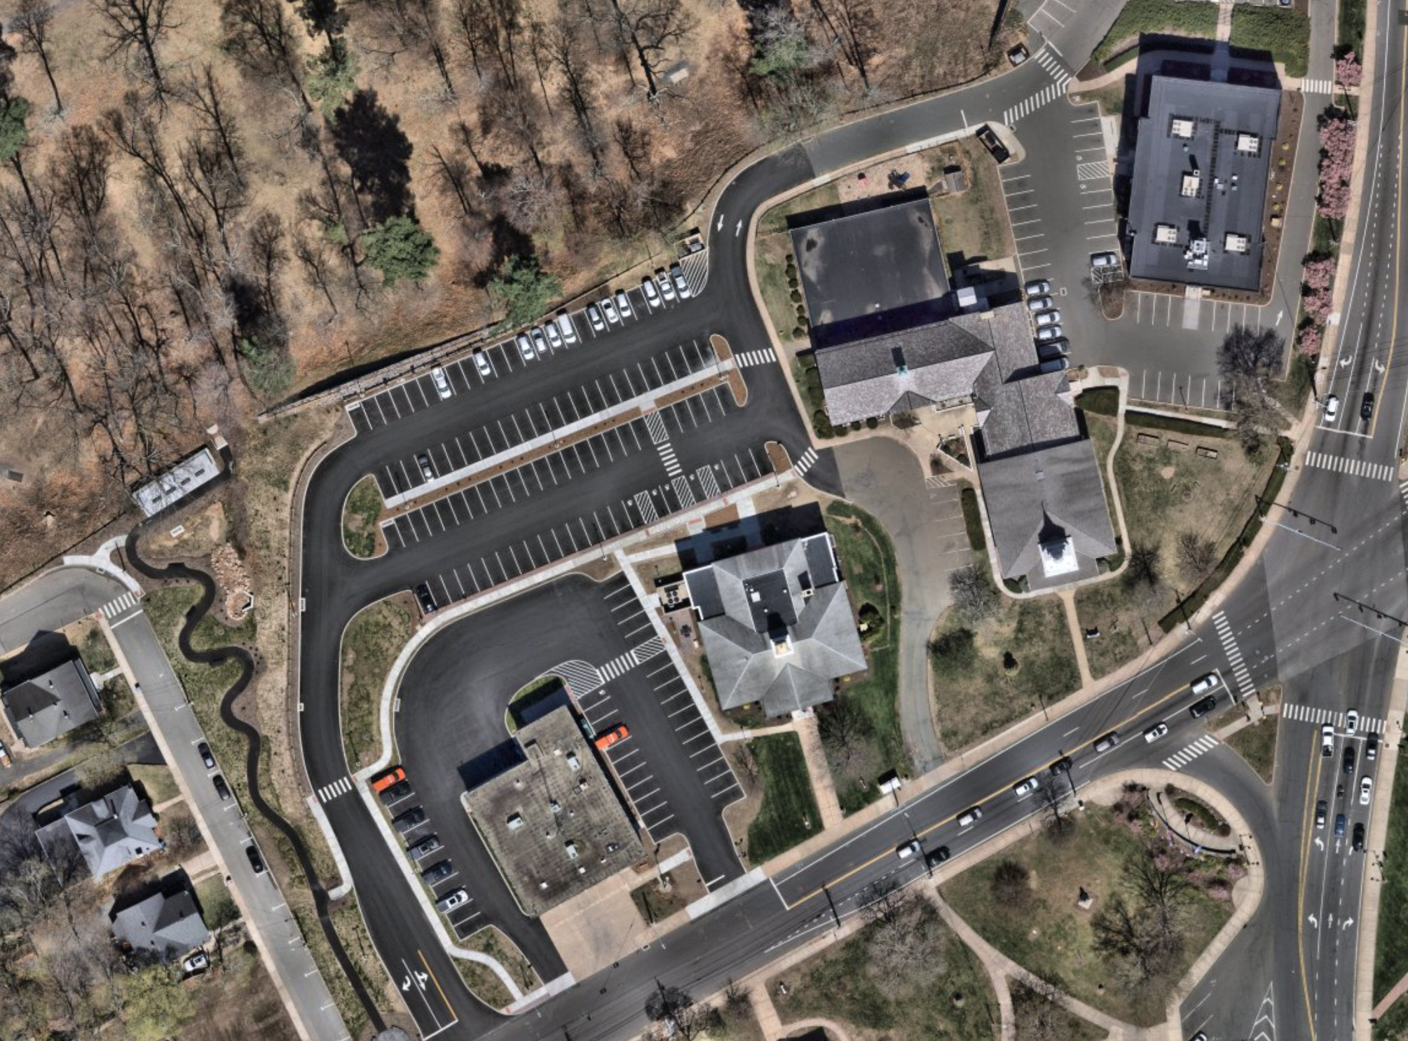
Town Offices Consolidation
($ 1,000,000)
To provide a more intuitive and efficient campus layout for an improved user experience

Slide 15
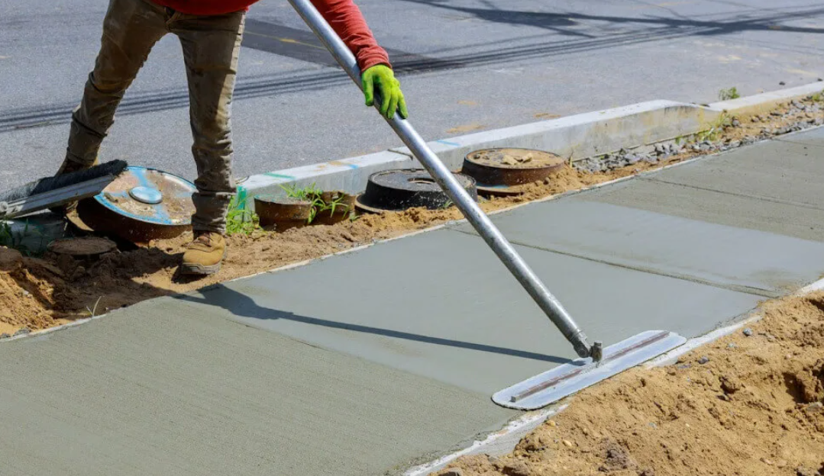
Sidewalk Repairs ($500,000)
  1990 Sidewalk Priority List Completed
  Shift to Isolated Repairs based on condition
  Town owns/maintains 218 miles (~5 million sf)
  5 million sf x $15/sf = $75,000,000 asset
  $500,000/$75,000,000 = 0.66%

Slide 16
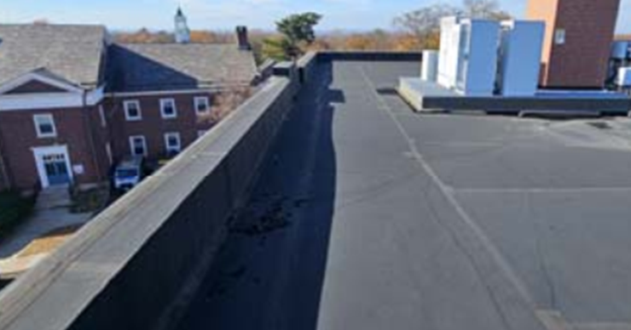
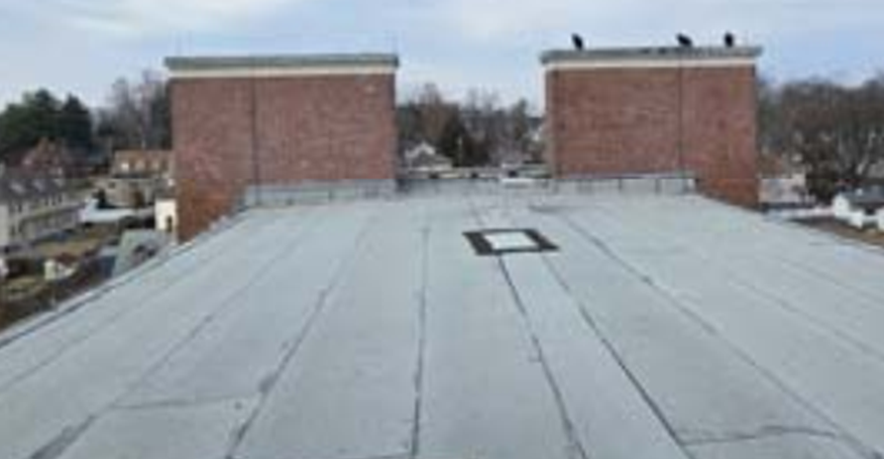
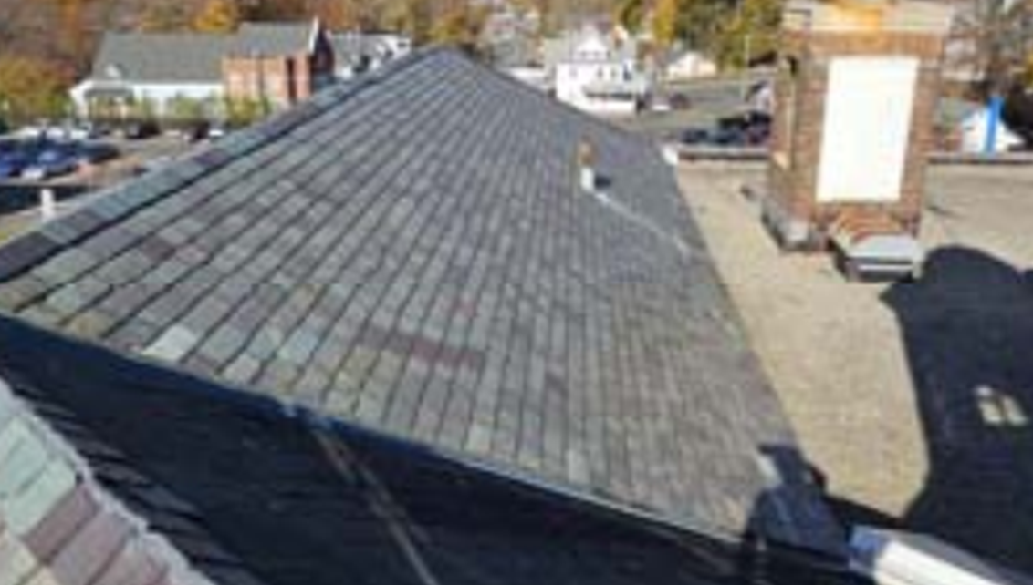
Roof Replacements ($250,000)
Lincoln Center
Mary Cheney Library
Fire Stations #1, #2 and #3
Fleet Garage
Washington/Mahoney

Slide 17
2025 Recommended Projects
Road Resurfacing $ 14,500,000
Storm Drainage Upgrades $ 3,000,000
Town Offices Consolidation $ 1,000,000
Sidewalk Repairs $ 500,000
Roof Replacements $ 250,000
Contingency/Debt Service $ 250,000
Total Request $ 19,500,000
*2023 Public Works Bond total = $19,000,000 (2.6% increase)

