Slide 1

Carol Fellenstein, 5th & 6th Social Studies
Sally Dastoli, Executive Director
Lisa Kimyachi, Director of Student Services
Michelle Bashaw, Co-Principal
Jessica Swann, Co-Principal

Slide 2


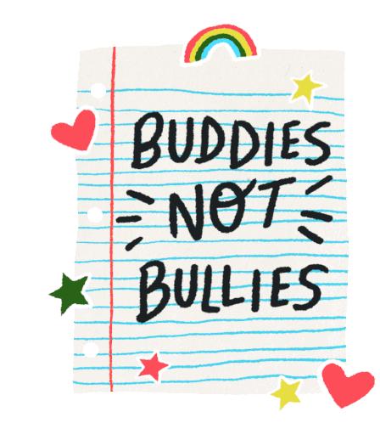


Bullying Platform
Presented by Thara
My platform is Bullying because I am passionate that kids should not feel unsafe and unable to be their best self.
1) The Helping Box: Write your thoughts on paper and place it in the box. The teacher will check it at the end of the day and you will be invited to stay after school to talk. You can choose to talk or just spend some calm time together.
2) The Creative Outlet Club: We provide a safe and positive space for you to explore your creativity through activities like: crafts and art projects, coloring and drawing, listening to calm music, singing and dancing or just relaxing conversation. All are welcome to join!
3) Know Your Rights: Students will create an impactful awareness poster: Talk Bullying Simply, confirming every individual's right to safety. Focus on strong figures and simple language, and keep the message clear to provide solid steps for getting help, addressing bullying directly and make positive change..
My three point platform is:
No bullying
What I learned most through the Kid Governor Program was how to be a leader and show up for myself and to have the courage to do everything expected. I learned how important it is to be helpful and supportive to my running mates.

Slide 3
Homelessness Platform
Presented by Yanae
I chose homelessness because I think every boy and girl should be able to sleep in a warm bed and have comfy clothes. Also, I think teaching people about how homelessness can impact someone’s life will help inspire people to realize the need for all to take action and fight homelessness.
My 3 point platform is:
Make love boxes and fifth grade can put clothes, toys and more for people in need to take and meet their basic needs.
Have a contest where fifth graders can give as much food as possible to homeless people.
Encourage schools to create fundraisers for people who don’t have warm clothes, or basic necessities.
What I learned from Kid Governor is that you don’t need to be an adult to make a change.

Slide 4

Food Insecurity
Presented by Sneha
My platform is food insecurity because I see so much food thrown away and wasted and I know that there must be a better way to use that food to help those in need.
My three point platform is:
Have a dropbox where people can put a letter in that says their name and shares that they need food, Then, teachers and students will create boxes to help that person or family.
Create a donation site where people can donate food items to support the boxes to share with people or families in need.
Have little food bags with snacks to help students who are hungry in school so that they can learn and not worry about being hungry.
As a result of participating in the Kid Governor Program I learned that I have voice and I don’t have to wait to be an adult to change the world.

Slide 5
Celebrating Diversity Platform
Presented by Eliannys
I chose Celebrating Diversity as my platform because I believe that kids should not be left out because of their race, religion, culture or beliefs.
The first part of my platform is, doing a video every month with a new culture. I will either be reading books about that culture or, interviewing kids that have the culture of the month! It can be any culture in this world.
The second part of my platform I will be doing a cultural dress up day to represent the culture the kids have. Kids will have a choice to dress up as any culture you’d like! You will also have the option to write about your culture.
The third and final part of my platform will be, a kids poster contest at all schools. Kids will have the opportunity to make posters about their culture.
1.
2.
3.
I learned through participating in the Kid Governor program that kids can inspire other kids and also inspire adults. We have a voice and we can use our voice to make change happen!

Slide 6
Food Insecurity Platform
Presented by Tori
I choose Food Insecurity because as I researched to find a community issue for my platform, I was saddened to find out how many kids go to bed hungry because they do not have enough food.
My three point platform is:
I want to make sure there is a food pantry in every school.
I will create a food drive in every school for non-perishable food. I will challenge the students to build something using all the items donated and to share pictures. This STEM based activity builds community at our schools while also meeting an important community need.
I am passionate about my mission to stand up and fight food insecurity! I will be making videos to share on the Kid Governor Website about how to make healthy meals on a tight budget.
The most important thing I learned from the Kid Governor Program is that I have the power to make a difference! I have a strong voice and I can use it to make change happen.

Slide 7
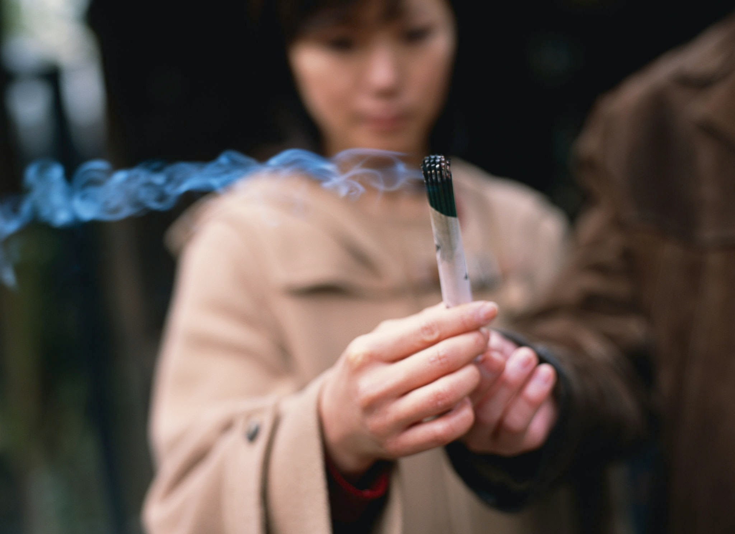
Underage Smoking and Vaping Platform
Presented by Noemi
I choose underage vaping/smoking because I believe that we can make a difference in the health and futures of the 5th Graders in our state!
My 3 point platform:
1 - Spread Awareness by putting up Vaping/Smoking Awareness posters
2-Limit the age to purchase smoking and vaping items to 21
3-Share Tobacco/Vaping programs about how this activity is a detriment to the health of our young people.
What I learned through the Kid Governor Program is that we all worked together and helped each other through our ups and downs! I learned the value of supporting my friends in all that they do!

Slide 8

Anxiety Platform
Presented by Nana
Balance, Believe, Breathe
I chose anxiety as my platform because many kids and adults struggle with anxiety and this affects their ability to learn and grow.
The three points to my platform are:
Balance: I will encourage the 5th graders to create videos about how they can balance anxiety through physical activity.
Believe: I want everyone to make a safe calm place somewhere in their school where students are able to regulate and return to class, ready to learn.
Breathe: I will create videos on the symptoms of anxiety and how students can cope with challenge.
What I learned from participating in the Kid Governor Program was how to be a leader and the importance of people working together to create change..

Slide 9
