Slide 1
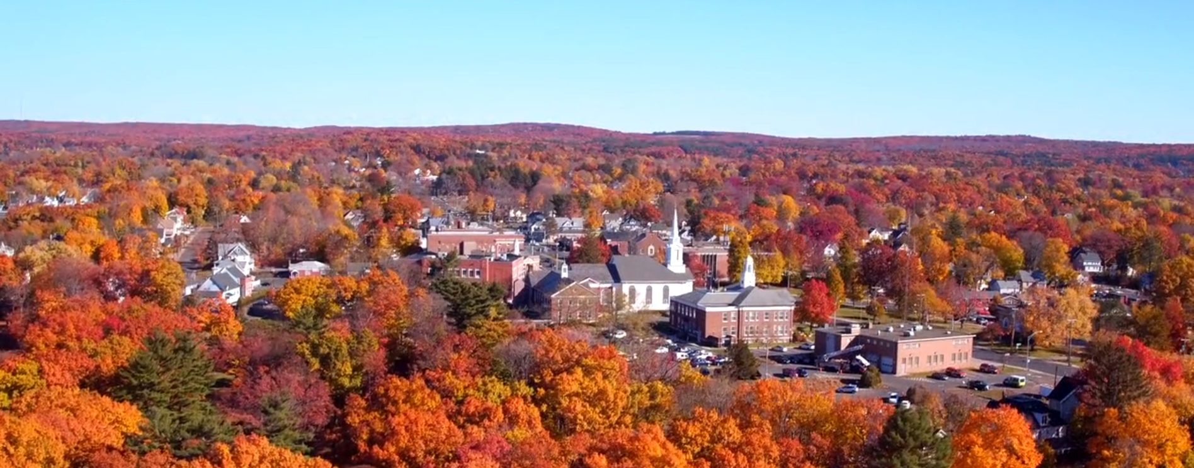

Shape a safer future, together
Manchester, CT
April 7, 2026
Notes:
Chief to intro
Kristen will provide background

Slide 2

12,000+
Total customers protected by Flock
2,800+
Crimes solved per day using Flock
Driven by a
shared mission
10%
Of reported crime in the US solved using Flock*
Eliminate crime and shape a safer future, together.
1,500+
Businesses protected by Flock
*The calculation of this figure follows the methodology outlined in the TCU study, applied to continuously updated data from our customers. The statistics presented in this document are based on proprietary data and may not be fully representative of the market as a whole. Due to the confidential nature of this information, certain details have been aggregated and cannot be disclosed.
Notes:
Kristen

Slide 3
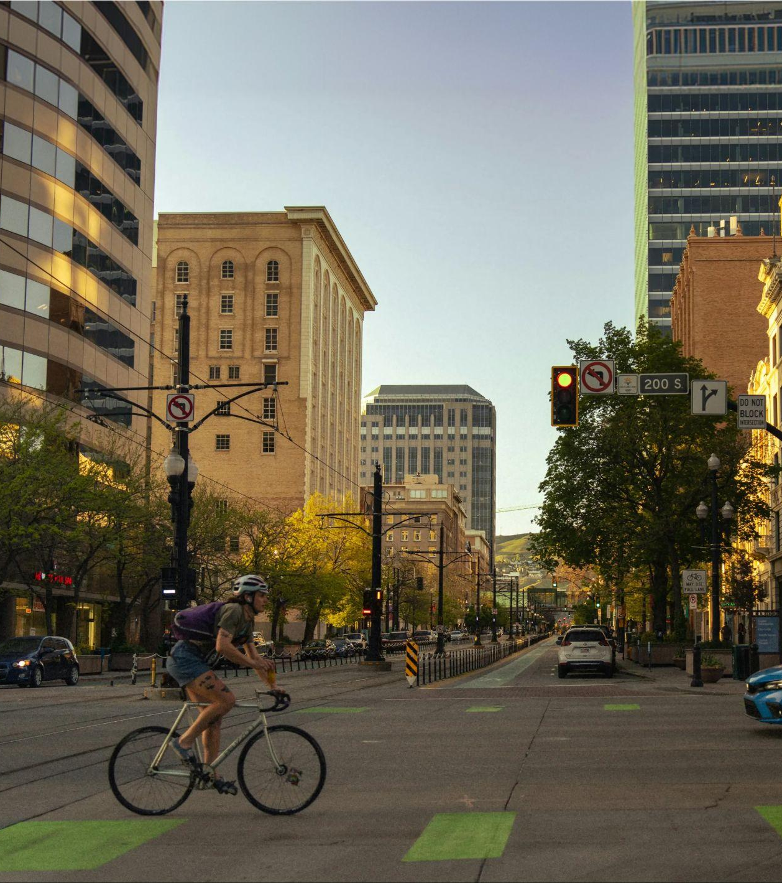
With persistent staffing shortages, agencies are seeking new strategies to maximize efficiency
of Americans are afraid to walk home at night — most in 3 decades
40%
The Challenge
of agencies are experiencing officer shortages
85%
Sources:
New PERF survey shows police agencies are losing officers faster than they can hire new ones. April, 2023
Personal Safety Fears at Three-Decade High in U.S. November, 2023
Notes:
Kristen
Low staffing levels are putting law enforcement agencies in a difficult position nationwide. Recruiting challenges, increasing retirements, and overwhelming demands have left 85% of agencies understaffed, with many operating at or below minimum levels.
Meanwhile, public safety concerns are rising. Forty percent of Americans now report feeling unsafe walking home at night—a level of fear we haven’t seen in 30 years.
In the past, when communities felt less safe, the solution was to hire more officers. But with today’s staffing shortages, that’s just not realistic for most agencies. Now more than ever, agencies are turning to technology to find smarter ways to get more done with fewer resources.

Slide 4
Manchester +
Flock Safety
Notes:
SG

Slide 5
History of Flock Safety in Manchester CT PD
2023
Addition of Falcon Flex camera for long term focused investigations
2022
2022
Introduction
To Flock
6 LPR Falcons
Deployed on town roadways
2022
2022
2025
First LPR installed on Main St. Evading accident with Main St. building solved within first hour
6 LPR Falcons installed on state roadways
5 LPR Falcons deployed

Slide 6
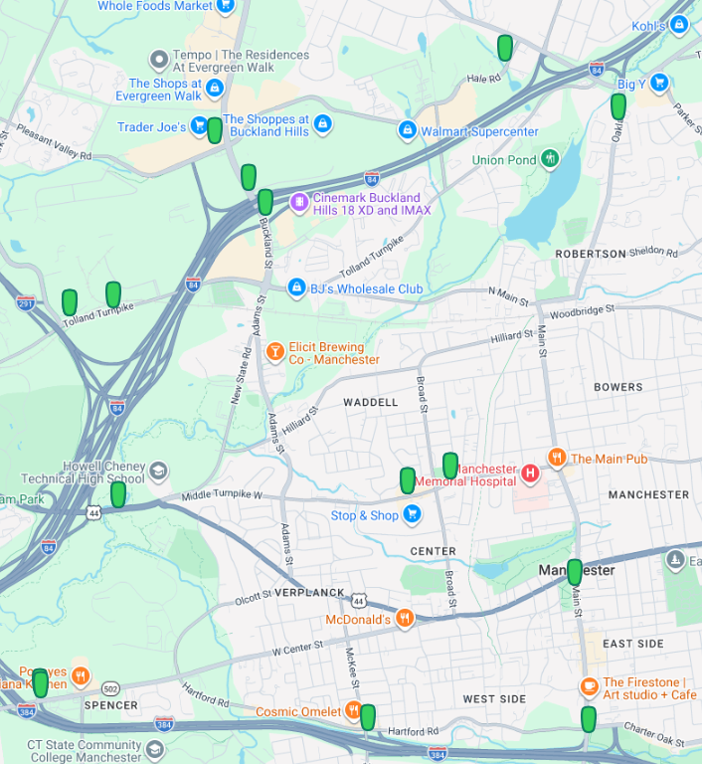
OPTIONAL/as appropriate: Insert map of city with general camera locations

Slide 7
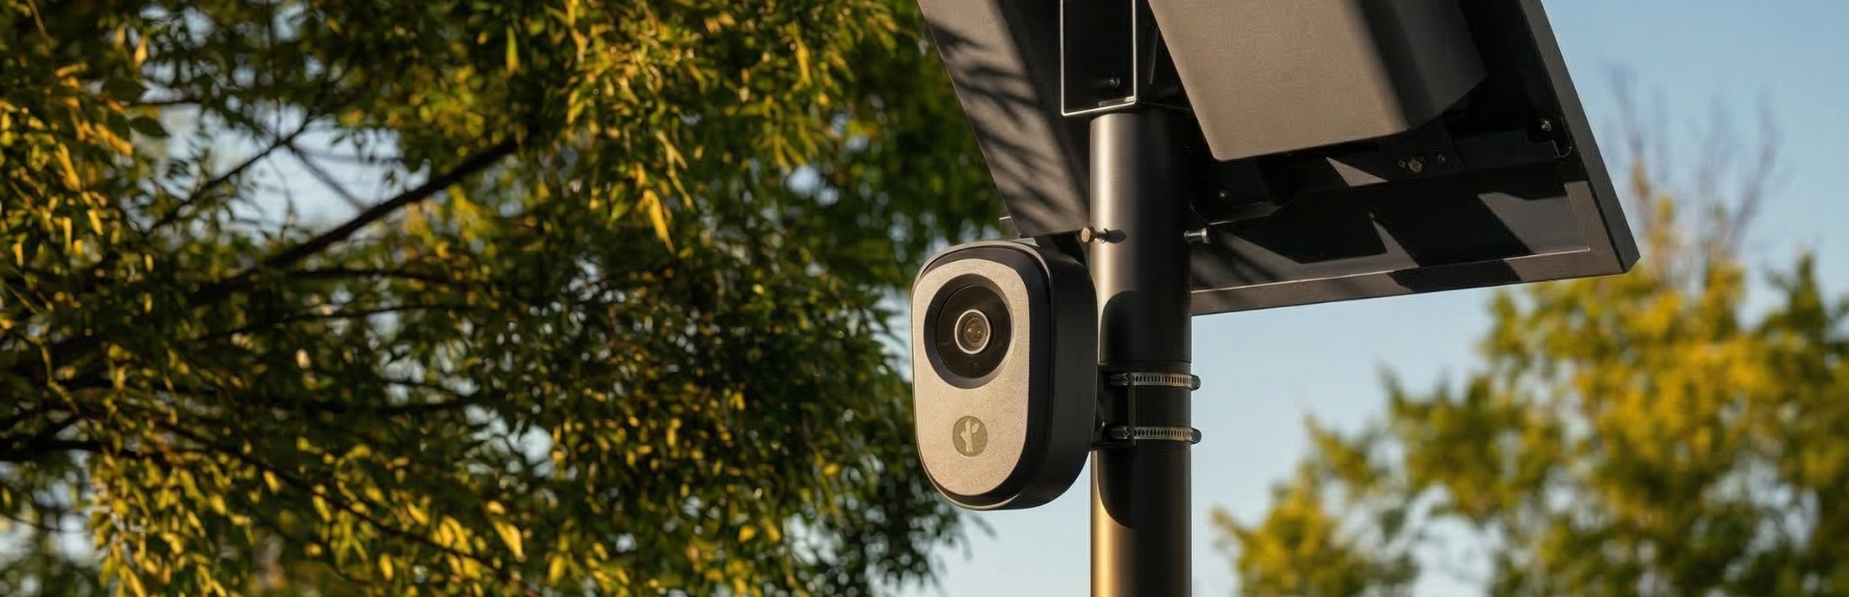

License Plate Readers (LPR)

Slide 8




Infrastructure-Free
Reduce time to value and utility costs with full-service deployment.
Real-Time Alerts
• NCIC
• NCMEC (Amber Alert)
• Custom Hot Lists
With Flock Safety, you get:
Flock Safety LPR provides your police department with indiscriminate evidence from fixed locations.
We provide all of the maintenance so that your police department and city staff can focus on keeping your city safe and prosperous.
24/7 Coverage
Capture objective vehicle data around the clock to multiply your force.
Ethically Built
• No facial recognition
• No speed tracking
• Indiscriminate evidence
Notes:
Flock LPR cameras take point-in-time images focused on the rear of vehicles from public roadways. Either alerts to wanted vehicles or provides limited (30 days) of historical information that your PD can search for critical investigative leads when a crime has occurred or someone is missing. Ethically built–no facial recognition, no speed tracking.

Slide 9

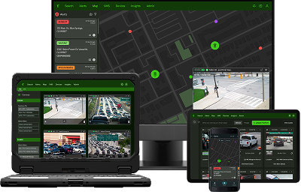
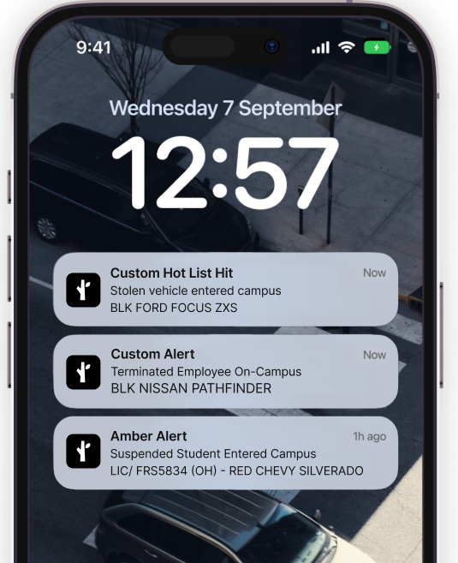

Detect
LPR
Live Video
Community Cameras
Mobile Security Trailer
FlockOS
Precision policing with real-time alerts
Officers can receive alerts when vehicles entered into NCIC, NCMEC (Amber Alerts), COLLECT, or custom Hot Lists pass by a Flock camera in your community.

Slide 10


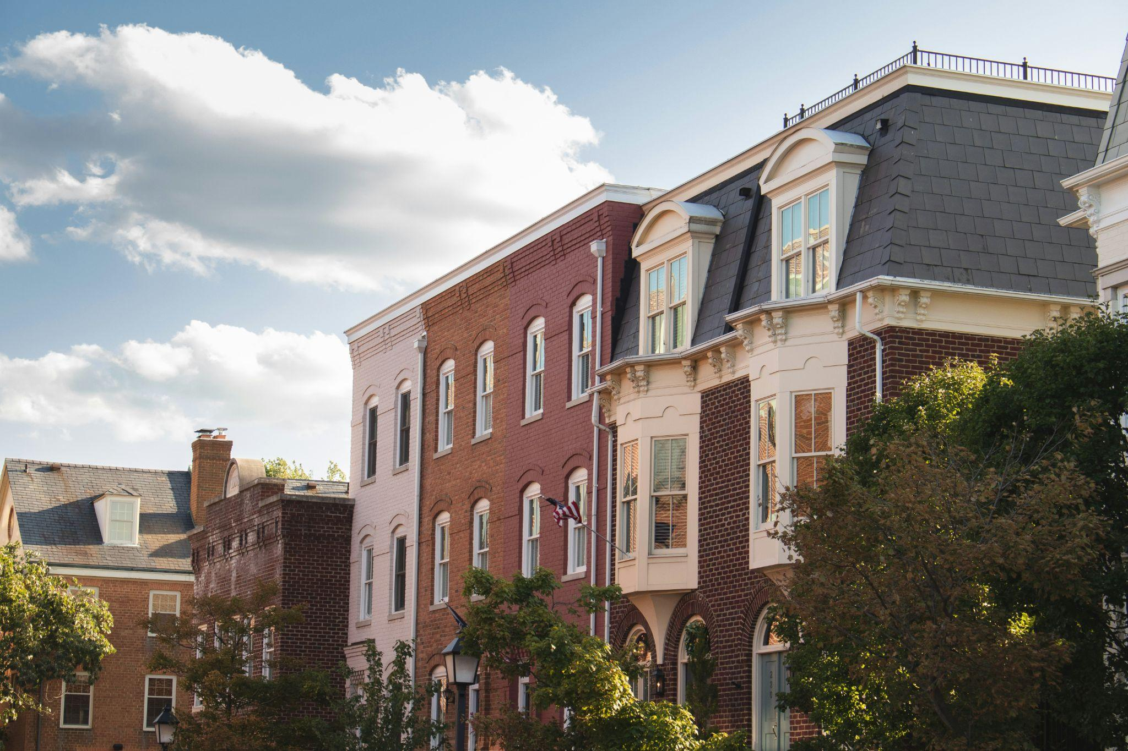
Vision
Success and Impact

Slide 11

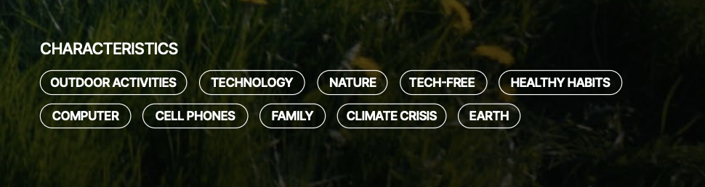

Local Success
Crime hurts communities
Real results
10/4/22 Armed Robbery
Vehicle identified by FLOCK reader. Several arrests made
8/9/23 Evading responsibility
Vehicle identified as suspect in Evading accident shown to not have been involved due to FLOCK License plate showing it in different area of town than the accident.
Detect
LPR
Live Video
Community Cameras
Mobile Security Trailer
FlockOS
Investigate
Flock Nova
Enhanced LPR
FreeForm
Traffic Analytics
9/25/23 Indecent exposure
Vehicle involved in indecent exposure located by FLOCK in area of occurrence. Arrest made.
5/23/24 Missing person
Reported adult missing. Located vehicle on FLOCK and located individual who was safe.
Notes:
May also add outline of how agency will measure success/ROI and commitment to providing those insights publicly, if applicable

Slide 12
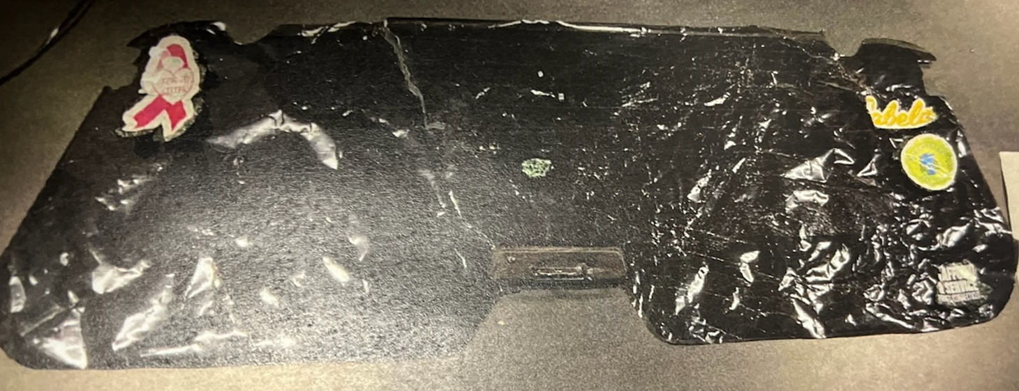
Following an evading accident where a building was struck, causing significant damage, the suspect vehicle’s rear windshield was left behind on scene depicted below.

Slide 13
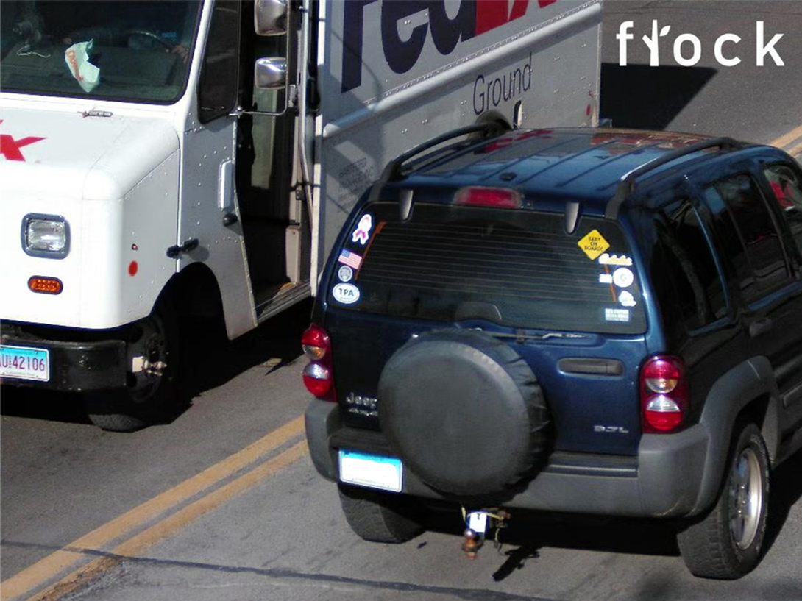
A Flock query was conducted for
“window stickers” which resulted
in the depicted vehicle being identified.

Slide 14
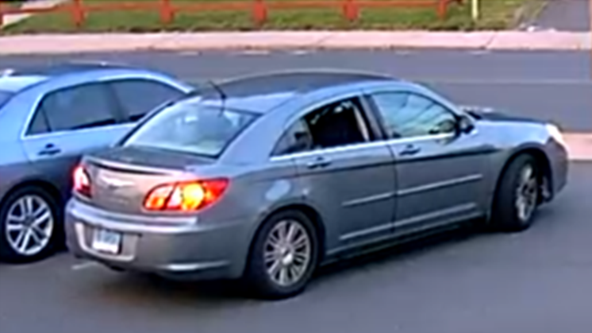
The below suspect vehicle was captured on video surveillance arriving/leaving the scene of a shots fired incident in Manchester. A Flock search was conducted for “Chrysler sedans”.
Suspect vehicle from video surveillance on scene

Slide 15
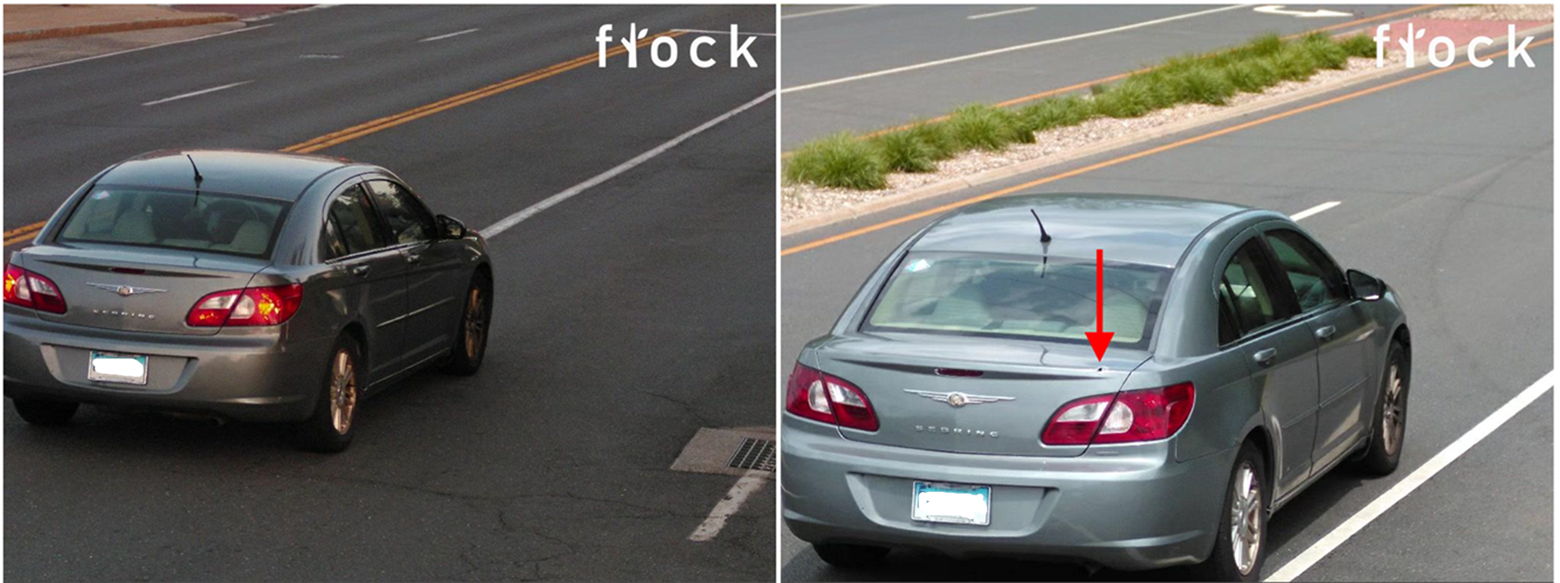
Roughly a half hour prior to the incident, the image on the left was captured of the Chrysler entering Manchester. When a
secondary query was conducted on this particular registration in the time following the incident, an apparent projectile hole
was observed in its trunk – confirming the vehicle’s suspicion of its involvement.
LPR capture prior to shooting incident
LPR capture after shooting incident

Slide 16
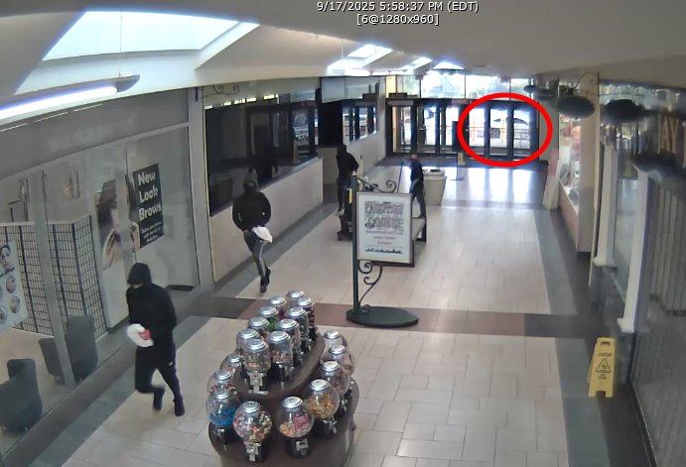
Several suspects involved in a smash and grab where $250k~ in gold was stolen had arrived/fled in the vehicle parked outside of the mall – this was the only camera view available of the suspect vehicle involved in this incident.

Slide 17
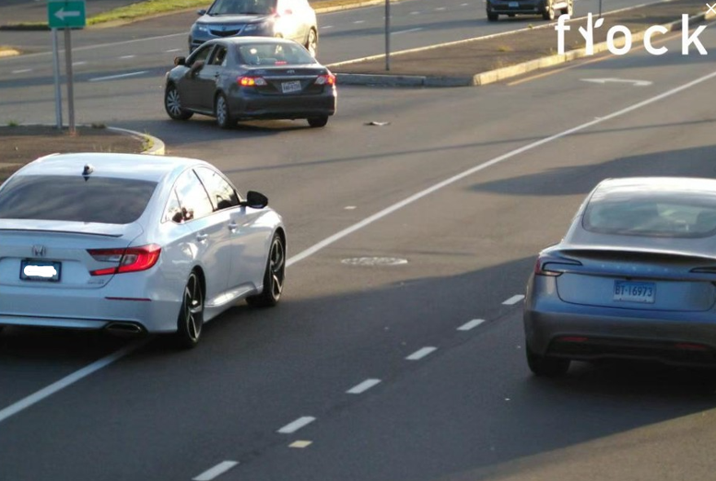
A Flock search of an LPR fixed nearby the mall captured the depicted suspect Honda, which was determined through additional Flock queries to be the arriving vehicle 5 days prior to the incident when the victim’s jewelry store was cased by the suspects. The vehicle identification and additional video obtainment ultimately led to arrest warrants being granted for 2 individuals involved.

Slide 18
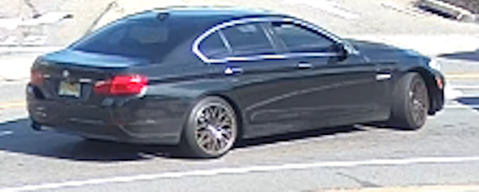
The depicted sedan was identified as the arriving suspect vehicle in a scheme where an elderly victim was deceived into giving over $600k~ to the suspects involved in the form of gold bars.

Slide 19
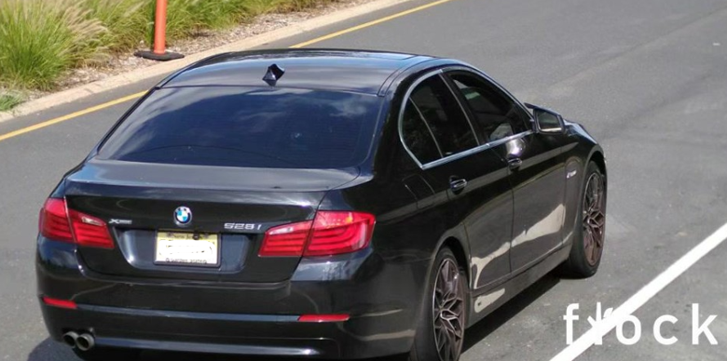
A Flock query was conducted for “black sedans” with an “out-of-state registration” which resulted in the depicted vehicle being captured in the minutes leading up to the incident. The vehicle’s identification led to its seizure in New Jersey and its owner being subsequently identified – who was determined through investigative efforts to be involved in the incident and an arrest warrant being granted.

Slide 20
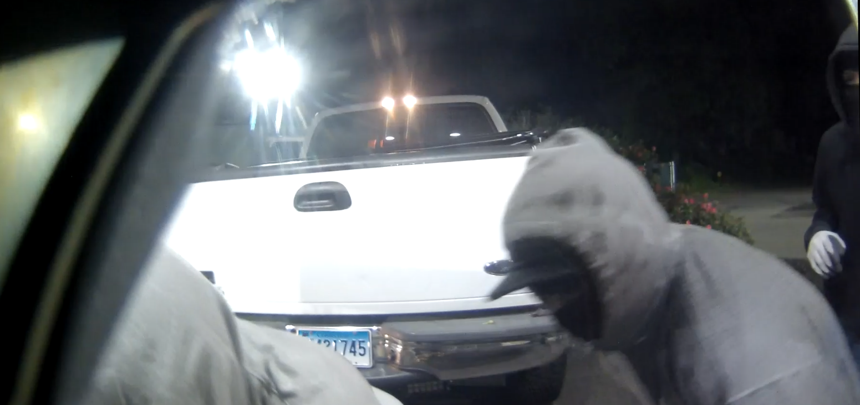
Video evidence from a camera affixed to an ATM that was stolen captured the involved stolen truck depicted below, which was later abandoned following the incident.

Slide 21
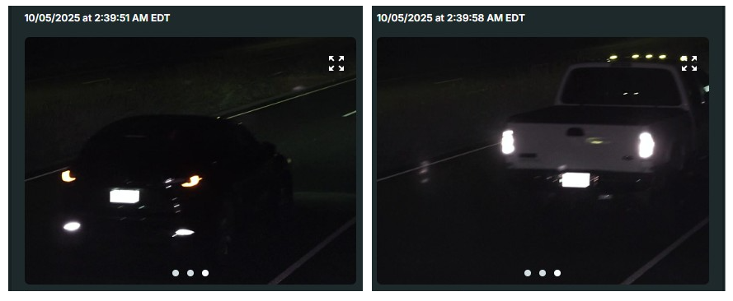
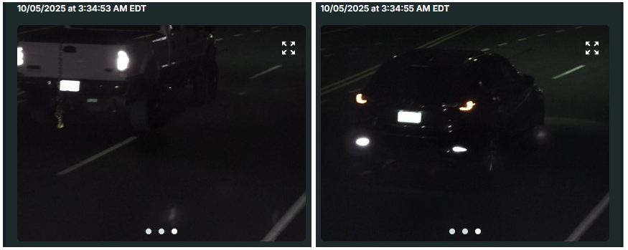
LPR captures prior to the ATM theft
Historical LPR history of the stolen truck’s registration captured the depicted vehicle traveling with the truck prior to and after the incident – ultimately leading to the identification of one of the involved suspects and an arrest warrant later being granted in the investigation that followed.
LPR captures after the ATM theft

Slide 22

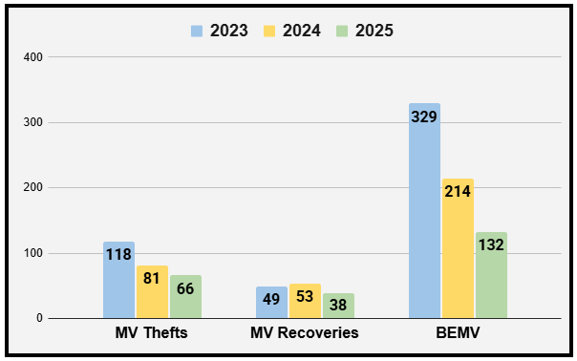
Challenges Facing Manchester
Flock cameras have been a game changer for connecting suspects to crimes and locating missing persons. With staffing and budget challenges facing our agency, Flock cameras have become a force multiplier, enabling us to increase our operational effectiveness.
Flock stolen vehicle alerts from 2023-2025
• 31 occupied stolen vehicles recovered
• 49 arrests from vehicles which were occupied
• 6 firearms recovered

Slide 23
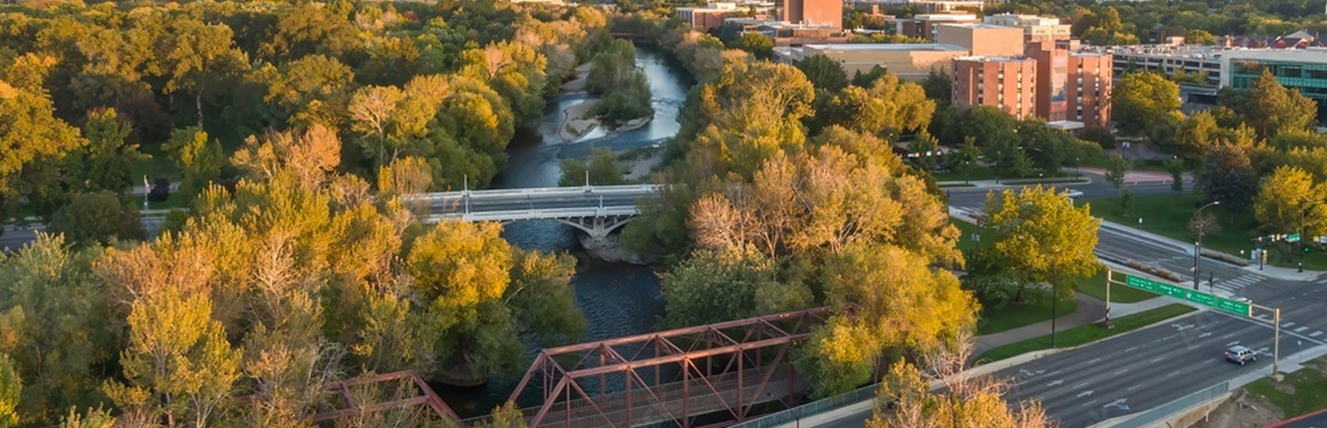
A Commitment to
Your Community

Slide 24


Built with Privacy in Mind
Protecting privacy by design
All data is stored with end-to-end encryption including:
FBI (CJIS)
NDAA
SOC2 (Type II)
ISO 27001 (Data Security)
ISO 27701 (Data Privacy)
ISO 42001 (AI)
Higher Education Community Vendor Assessment Tool (HECVAT)
We are also aligned with the security protocols established by NIST Cybersecurity as well as the Cloud Security Alliance CAIQ framework.
Data is 100% owned by customers and will never be sold.
Private customers never have access to government data or hotlists.
Flock automatically deletes data after 30 days by default.
Flock LPR only take images of publicly available information.
Only your agency decides who to share with, not Flock.
Notes:
Only sharing w/ WI municipal and state LE agencies and adjoining state’s agencies.

Slide 25


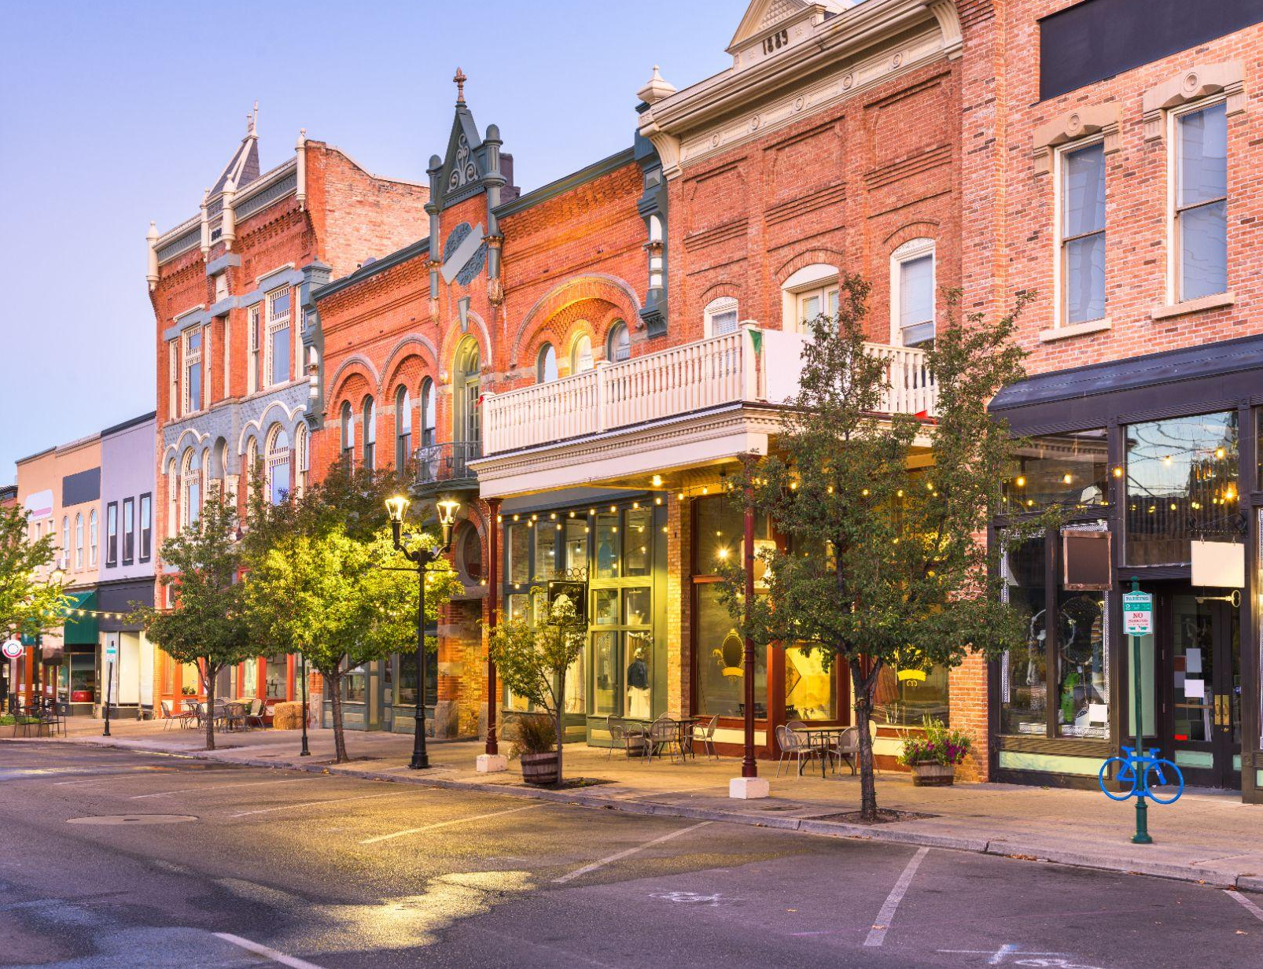

What We All Agree On
Everyone deserves to feel safe.

Slide 26


Bipartisan Support
"Backed by a plethora of legal precedent, we can simultaneously establish and enforce strict protections to prevent abuse, ensure transparency and limit data retention.
While the path forward requires a balanced approach, it is more than evident that the benefits of LPR technology should be utilized nationwide to further enhance public safety,"
Delivering Accountability: A Plan To Stop
Crime in Our Communities
“Increase access to automated license plate readers…help catch carjackers and recover stolen vehicles”
“By integrating information from multiple sources—such as…license plate readers—investigators can identify crime patterns, connect related incidents, and generate strong cases against those driving violence.”

Slide 27




Search Filters
Prevents searches related to immigration or reproductive care at the request of a community.
Federal Limitations
No federal access to nationwide or state wide lookup. Only agencies can share their data, not Flock.
Community Safety,
Community Values
Industry Leading Compliance Features
Permanent Audit Logs
Communities can require both search reason and
case number be included in any search.
Legal Response
Our contract mandates we alert you to any legal request for your data.

Slide 28
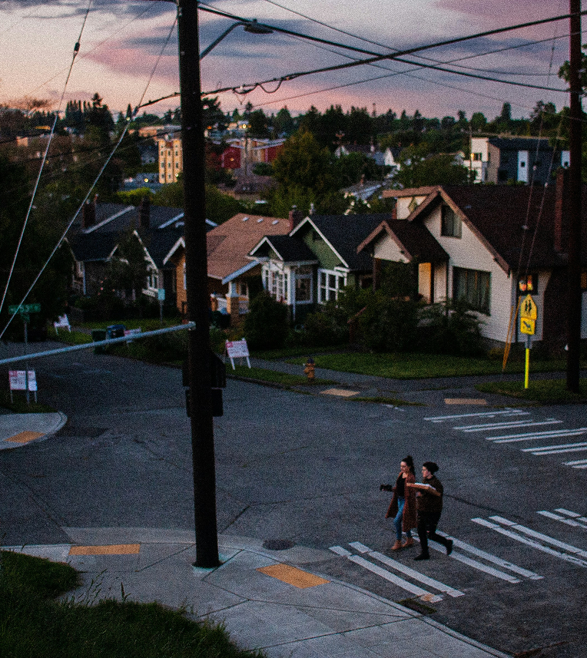
Safer Communities
Community values do not have to be compromised in order to achieve public safety goals
LPR Transparency Portal
-Customizable for each agency
-Display technology policies
-Publish usage metrics
Every search requires a registered ID with an offense type
Offense type and user ID are saved in a permanent audit trail.
Flock encourages all agencies to conduct regular audits to ensure proper usage.
Coming Soon: Proactive Auditing to flag to potential misuse.
Transparency + Accountability = Trust
Notes:
May also add outline of how agency will measure success/ROI and commitment to providing those insights publicly, if applicable

Slide 29
General Notice 26-01
POSTC Automatic License Plate Readers (ALPR) Model Policy
February 26, 2026
Prohibited Uses - Clearly state that ALPR systems and data are intended solely for official law enforcement purposes. They must not be used for personal reasons, shared with unauthorized individuals or organizations, or employed to violate any local, state, or federal laws, including but not limited to the General Statutes § 54- 192h (Trust Act), and the General Statutes § 54-155b (Prohibition on use of public resources in furtherance of interstate investigation or proceeding concerning the provision, seeking or receipt of or assistance with reproductive health care services or gender-affirming health care services).
Privacy & Civil Liberties – Educating Officers on protecting First Amendment Rights, ensuring that ALPRs are not used to target persons solely based upon protected characteristics, or to knowingly and intentionally infringe on a person's First Amendment Rights.
Penalties for Misuse: Any person who knowingly engages in impermissible use of the ALPR system or its data may be subject to administrative sanctions, including termination, civil liability, and possibly criminal prosecution.
Notes:
May also add outline of how agency will measure success/ROI and commitment to providing those insights publicly, if applicable

Slide 30

Key Takeaways
Communities THRIVE when people feel safe
Flock technology assists communities by providing ethical tools to help achieve public safety goals
Manchester PD and Flock Safety are committed to transparency and accountability
Manchester PD and Flock Safety are committed to upholding your community values while delivering exceptional service for a safer Manchester
Sources: 1, 2, 3
Notes:
Can tailor points based on department/community and need i.e. “X department will not use this technology to assist the federal government with any kind of immigration enforcement activities”

