Slide 1
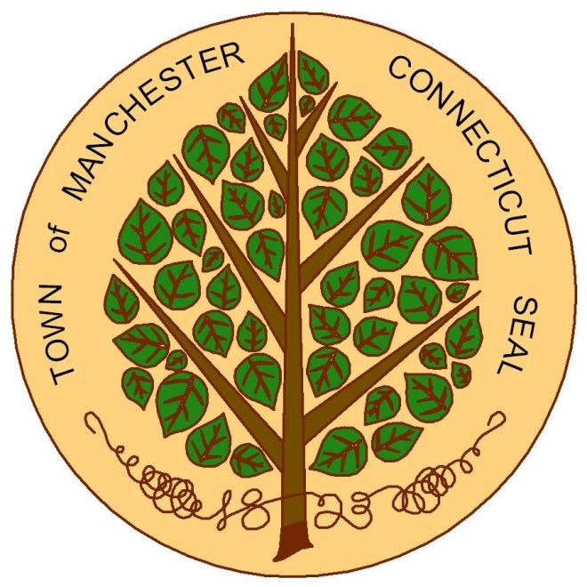
Town of Manchester
Community Development
Block Grant (CDBG) Program
Notes:
Good evening. My name is Heather Guerette and along with my coworker, Emma Petersen, we are going to present information about the Town’s Community Development Block Grant or CDBG Program.
Here to discuss….
~ General overview of funding and the related 5 and 1-year plan currently underway
~ Specifics on types of projects, what can/cannot be funded
~ Close with time for questions

Slide 2
Town of Manchester CDBG
Grant Overview
2025-2029 Consolidated Plan
2025-2026 Annual Action Plan
Next Steps
Notes:
General overview of the grant
Review both the 5 year and annual plan currently underway
Discuss next steps in the planning process for the upcoming program year

Slide 3

Community Development
Block Grant (CDBG)
  Activities must meet a national objective:
    Benefit low/moderate-income persons
    Aid in prevention or elimination of slum and blight
    Meet an urgent community development need for which no other funding exists
Notes:
CDBG funds come from the federal Department of Housing and Urban Development, or HUD, and any project funded through CDBG must meet one of 3 national objectives……
~ vast majority will pursue #1

Slide 4
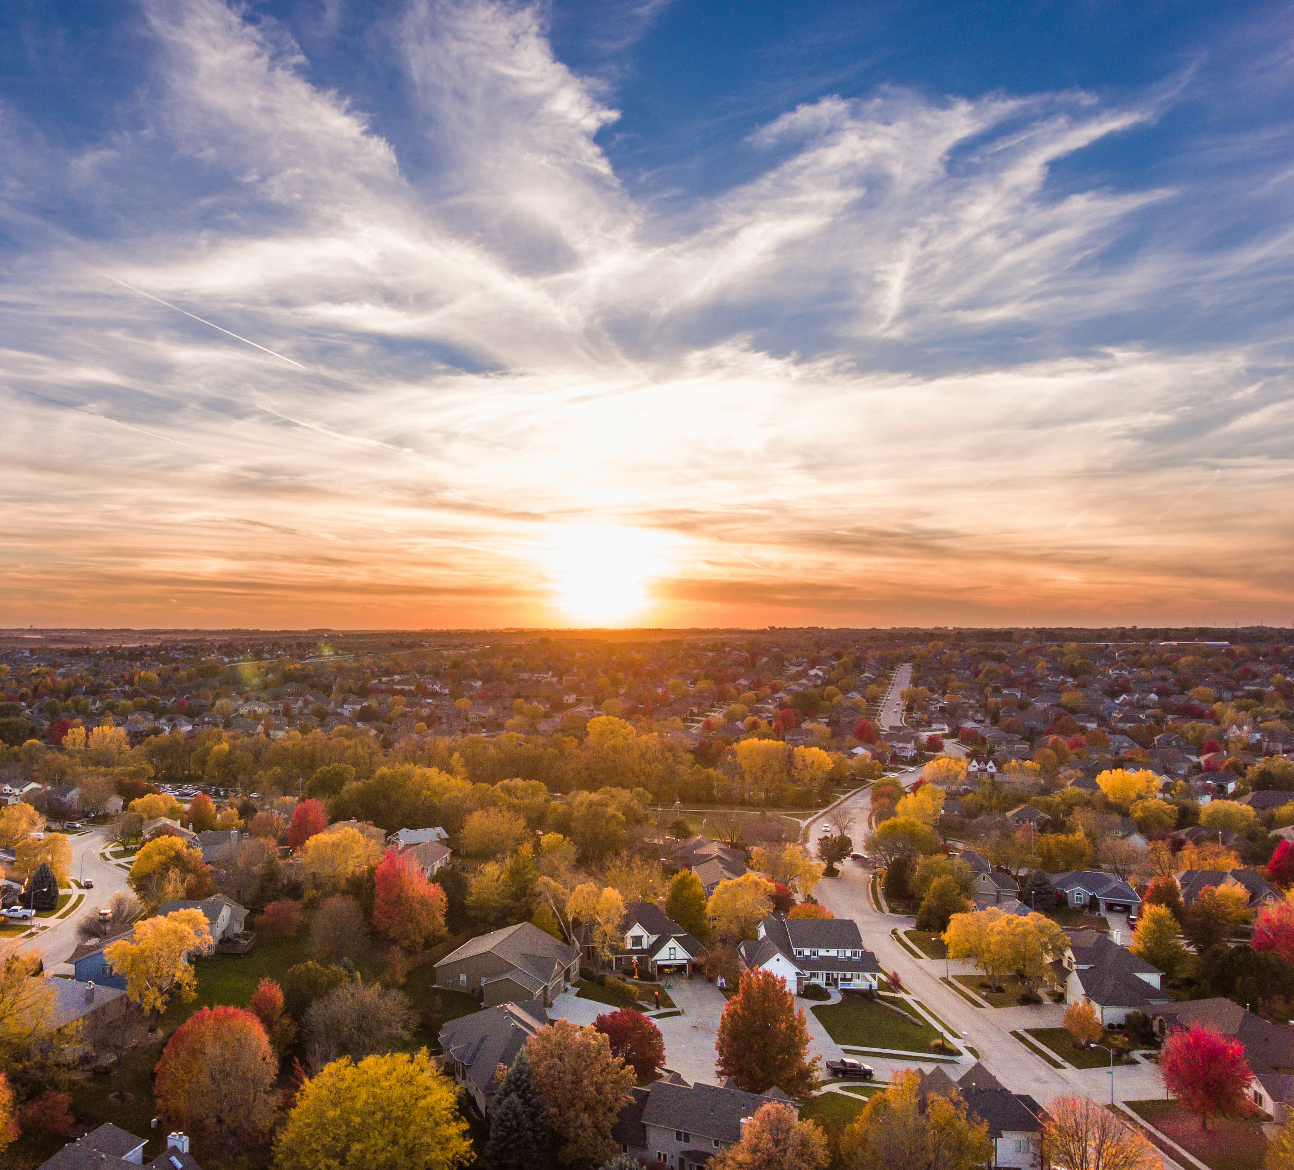
CDBG Goals
Help develop viable, healthy communities through:
Decent housing
Suitable living environment
Expanded economic opportunities
Primarily intended to benefit
low- and moderate-income residents

Slide 5
Consolidated Plan (Con Plan)
5 years
Town Data
Housing & Community Development Needs
Priority Goals and Objectives
How Funds Will Address Needs
Action Plan
Year 1
Action Plan
Year 2
Action Plan
Year 3
Action Plan
Year 4
Action Plan
Year 5
Notes:
I now want to pause and give a quick overview of the larger planning process that guides the use of CDBG funds. Every five years, HUD requires the town to develop a Consolidated Plan—a strategic roadmap that identifies the town’s top housing and community development needs and outlines how we’ll use our CDBG funds to address them. This plan is shaped by local data analysis, public input, and consultations with town departments, service providers, and community groups that contribute to community development in Manchester.
From this, town staff develops five Annual Action Plans—one for each year in the cycle. The plan Heather is presenting tonight is Year 1 of the new five-year strategy. I supported program administration this year by conducting the planning of the 5-year Consolidated Plan which provides the relevant local assessment to form the basis of these annual action plans.

Slide 6
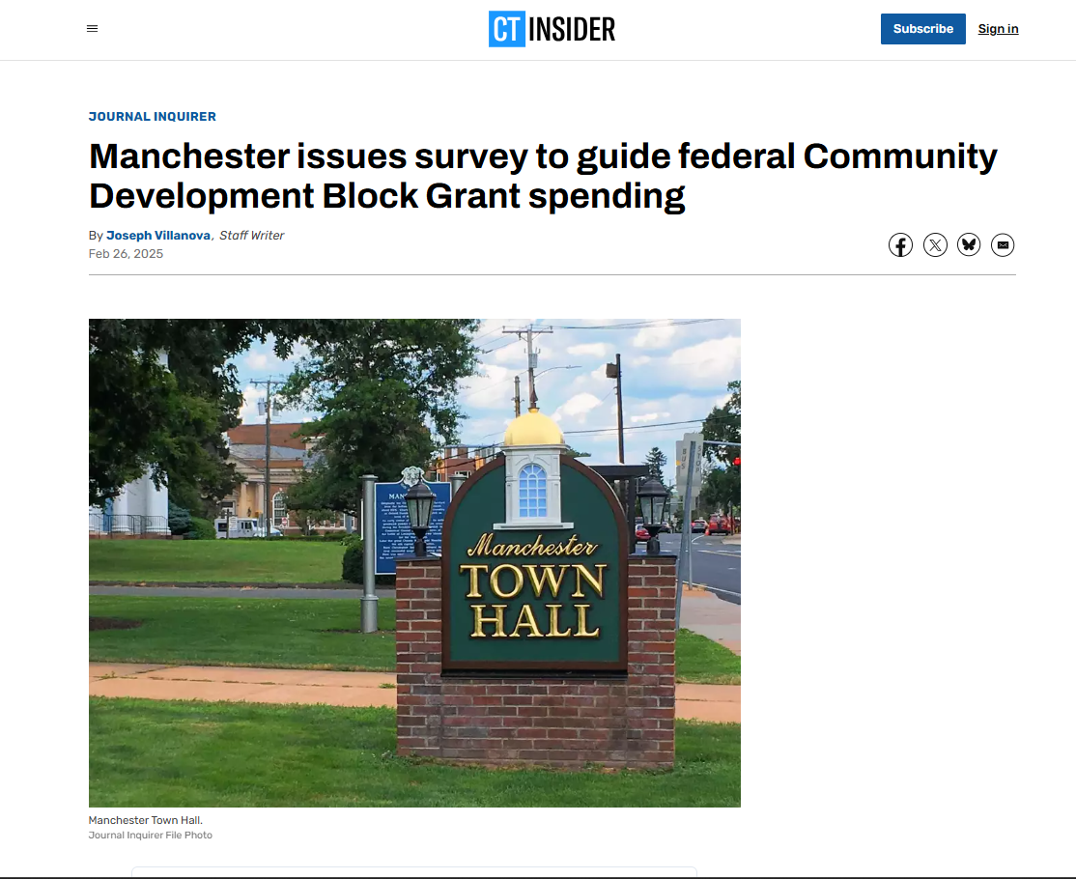

Resident Engagement
305 Survey Responses
12 Consultations
4 Public Hearings
YourVoiceMatters Site
Notes:
As I mentioned, public input is a key part of this planning effort. Feedback gathered from public hearings, a community survey, and consultations with service providers helped to both validate the data analysis and shape the goals for the next five years.
Early in the process, Heather and I held two public hearings to introduce the plan and invite community input. We also launched a “Your Voice Matters” webpage to maintain transparency and provide ongoing updates. To reach a wide audience, we used a mix of outreach methods—including social media, town communication channels, physical flyers—and even received coverage in the Journal Inquirer, which helped boost survey participation.
As a result, we received over 300 survey responses and conducted 12 group consultations with over 40 participants with service providers, nonprofits, and advisory councils. These conversations grounded the plan in the real-world experiences of those delivering public services. Finally, we made sure this plan aligns with existing town strategies—such as the Manchester Housing Authority’s Strategic Plan and the Affordable Housing Plan—so that all efforts are coordinated and complementary.

Slide 7
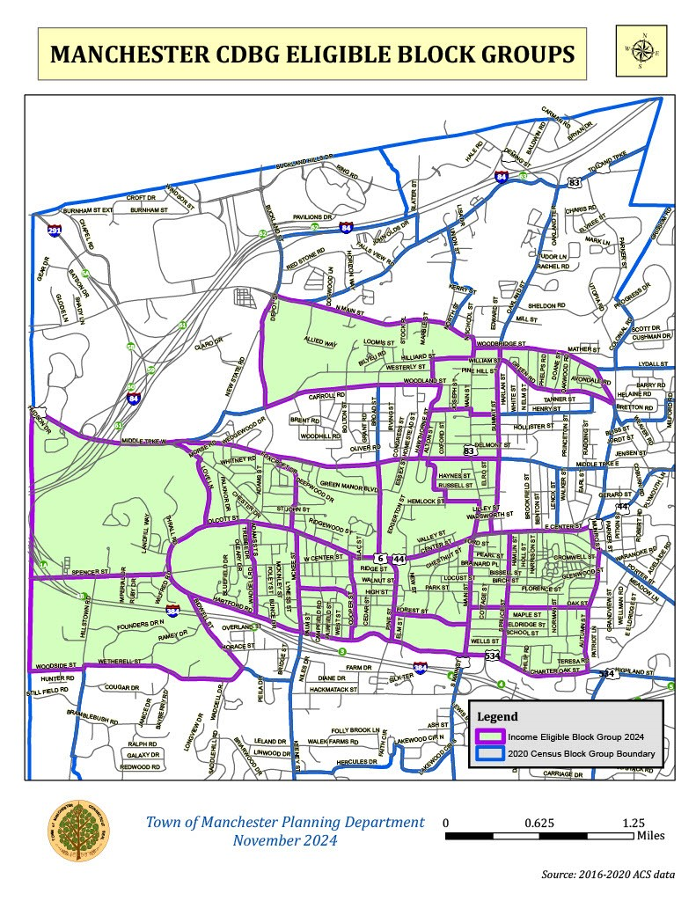
Overview of Priority Needs
Housing
Public Services
Public Facilities
Public Improvements
Economic Development
Notes:
Based on everything we heard—from residents, service providers, and what the data is telling us—we’ve identified a few clear priorities for the next five years:
First, housing. People really emphasized the need to improve both the quality and availability of affordable units.
Second, public services that support folks who are more vulnerable—especially mental health supports, help for older adults, and resources that promote economic stability.
Third, public facilities and parks. We want to make sure these spaces are accessible, welcoming, and actually meet the needs of the people using them.
Fourth, infrastructure upgrades—like ADA improvements, better sidewalks, and more inviting streetscapes. These are the kinds of things that help make neighborhoods safer and more connected for everyone.
And finally, economic development. While it didn’t rise to the very top, it’s still important—especially when it comes to access to jobs and breathing new life into underused commercial areas.
All of these priorities shaped the goals you’ll see in our Consolidated Plan. And just as a reminder, the map on the left shows the parts of town eligible for CDBG funding—so that’s where most of these efforts will be focused.
Now Heather’s going to walk us through how those big-picture goals are being put into action in this year’s plan.

Slide 8


ANNUAL ACTION PLAN
Describes how funds will be spent
Projects: funding, goals
Identifies sub-recipients
Other town actions that support CDBG goals
Notes:
The Action Plan is a report we have to submit to HUD each year. The report provides information on how we intend to spend that year’s CDBG grant – what projects will be funded and at what level and describe the intended goals of each project. It also identifies the sub-recipients (town departments or area nonprofits) that will run the projects. The report also details other town actions planned over the upcoming year that will support the goals of CDBG.

Slide 9
Manchester’s Annual
CDBG Grant
Notes:
As you can see, there has been fluctuation in Manchester’s funding over the last few years.
I am happy to report that next year’s grant will be a slight increase of about $1,700 over the current program year’s grant.
(Funding based on population, age of housing stock, poverty statistics, etc)

Slide 10
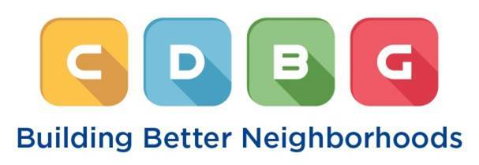
2025-2026 Program Year
Annual Action Plan
October 1, 2025 – September 30, 2026
12 eligible applications received
Funding requests totaled $1,135,677
Total funding: $612,284.13

Slide 11
2025-2026
Town Manager’s
Recommended CDBG Budget
TOWN MANAGER’S FUNDING RECOMMENDATION
The Health Collective: Senior Denture Program | $31,016
Youth Service Bureau: Empowering Youth Program | $10,000
Partnership to End Human Trafficking: Transitional Residential Program | $27,000
Interval House: Community Programs | $10,000
Program Administration | $113,386
MHA: Westhill Gardens Emergency Generator | $63,729
Planning Department: Housing Rehab Program | $101,400
Rebuilding Together: Roofing Program | $185,000
Water Dept: Leaded Water Line Replacement Program | $70,753
PY51 HUD Allocation $566,960.00
PY46 Funds to Reprogram $ 45,324.13
Total Available Funds $612,284.13
Notes:
[Note the breakdown of funding sources before detailing the Town Manager’s recommendation….]

Slide 12
2025-2026 Town Manager’s
Recommended CDBG Budget
TOWN MANAGER’S FUNDING RECOMMENDATION |  | PY51 HUD Allocation $566,960.00 PY46 Funds to Reprogram $ 45,324.13 Total Available Funds $612,284.13
The Health Collective: Senior Denture Program | $31,016 | CD032 HUD Allocation $573,392 CD026 Reprogrammed Funds $24,789 Total Available Funds $598,181
Youth Service Bureau: Empowering Youth Program | $10,000
Partnership to End Human Trafficking: Transitional Residential Program | $27,000 | Not Included in Recommendation
Interval House: Community Programs | $10,000 | The Health Collective: Community Health Worker Program
Program Administration | $113,386 | TLC: Diyeso-Lewis House Bathroom Renovation
MHA: Westhill Gardens Emergency Generator | $63,729 | MHA: Mayfair Gardens Emergency Generator
Planning Department: Housing Rehab Program | $101,400 | Dept of Leisure, Family & Recreation: Nathan Hale Playground
Rebuilding Together: Roofing Program | $185,000
Water Dept: Leaded Water Line Replacement Program | $70,753
Notes:
[Note the breakdown of funding sources before detailing the Town Manager’s recommendation….]

Slide 13
PROGRAM YEAR 51: Consolidated plan & ACTION PLAN TIMELINE
Review Town Manager’s Recommendation.
July 8th
BoD Meeting
Public hearing on Board’s Draft Action Plan and Consolidated Plan. Revisions to plans are only allowed if based on public comment.
August 2025
If needed, adoption of plans and appropriation of funds can be postponed until August 12th meeting.
Board makes any changes to budget before finalizing draft Action Plan.
Not recommended unless necessary.
Action Plan must be submitted to HUD before August 16th statutory deadline.
Board adopts Action Plan and Consolidated Plan, appropriates Action Plan funds.
June 3rd BoD Meeting
Approve draft Consolidated Plan and Action Plan.

