Slide 1
MYC Annual Report 2024-2025

Slide 2
Table of contents
01
02
03
Introduction
Successes
Grants
04
05
06
Challenges
Goals & Recommendation
Closing

Slide 3
01
Introduction

Slide 4
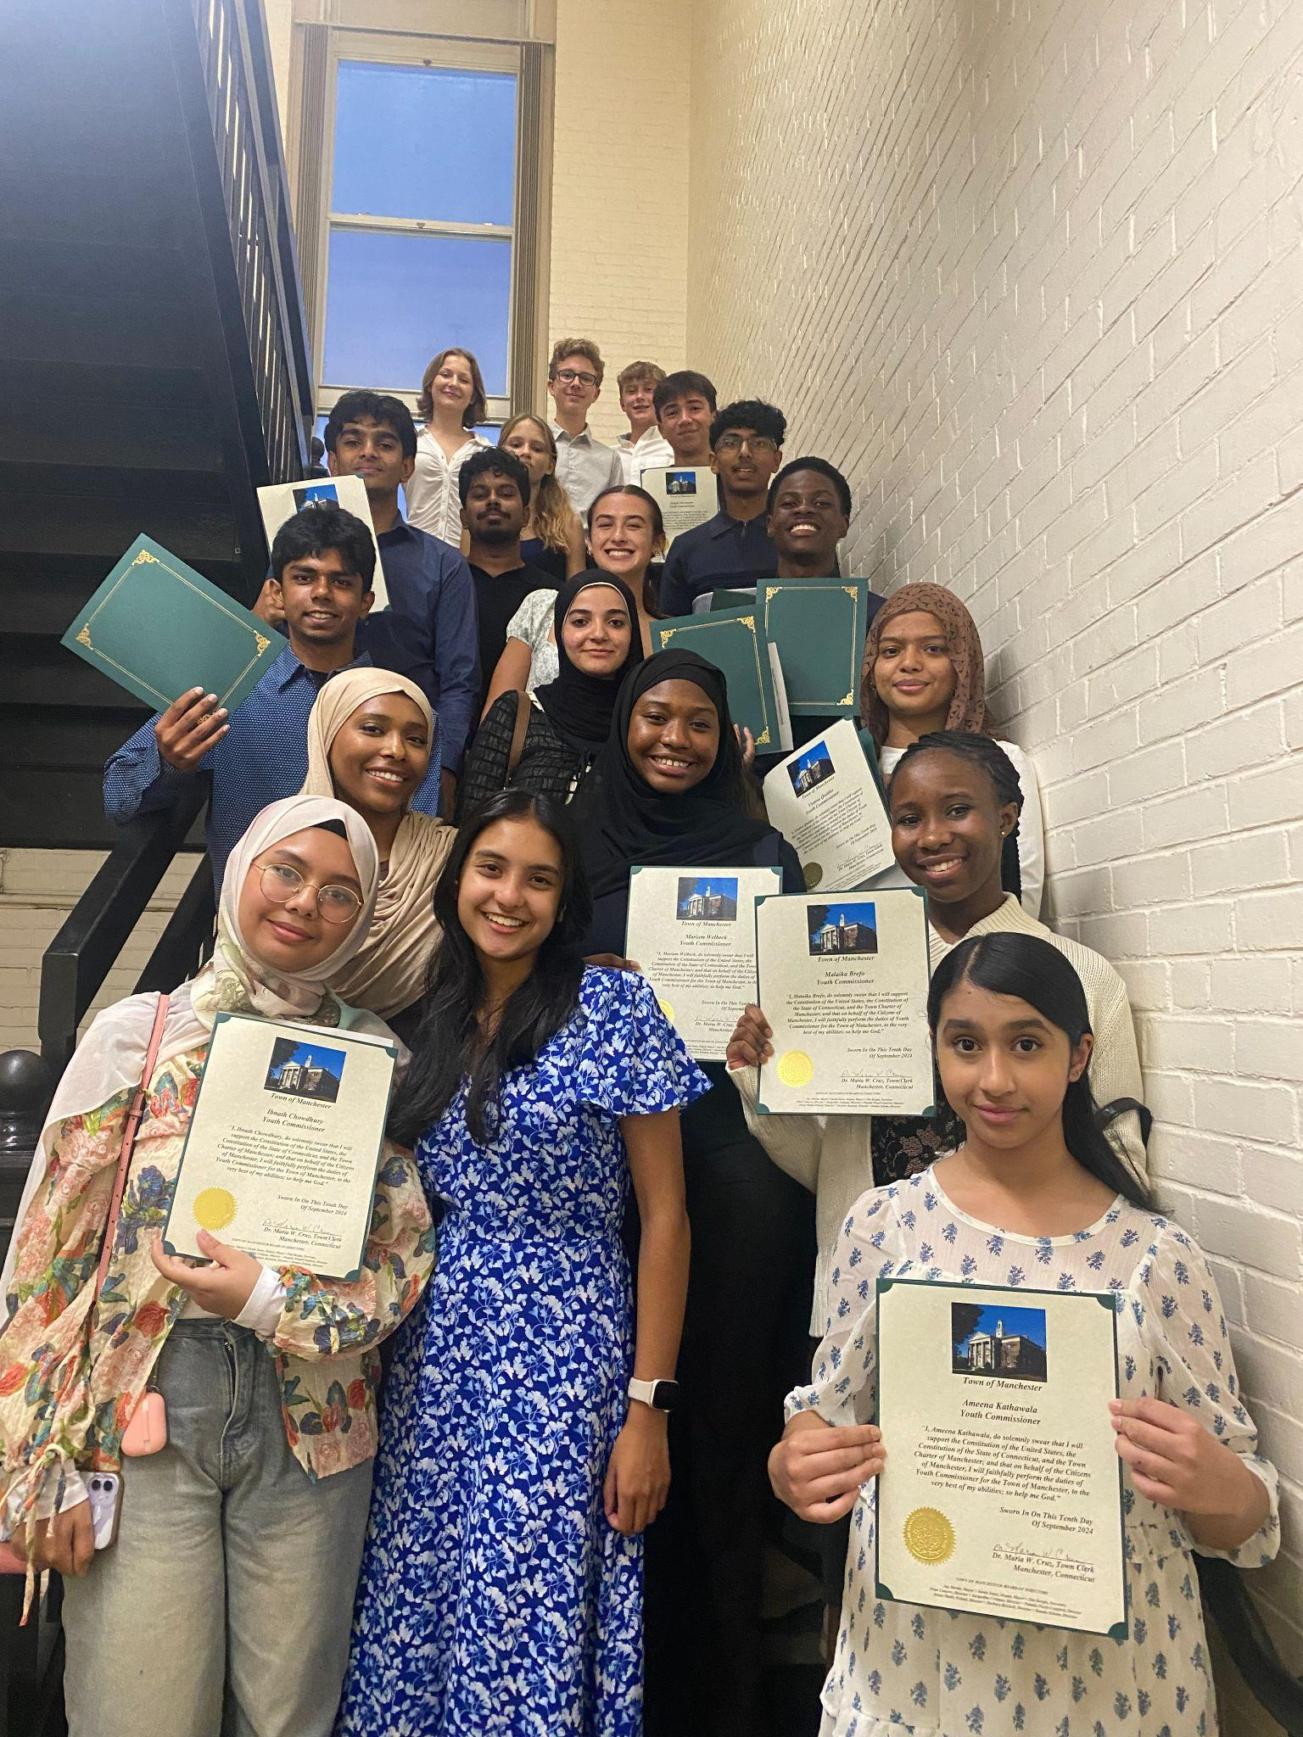
Introduction:
Welcomed 11 new commissioners for the 2024-2025 term
Nine seniors are graduating from the commission this term
Commission has successfully grown and endured complicated challenges throughout the year.

Slide 5
02
Successes

Slide 6
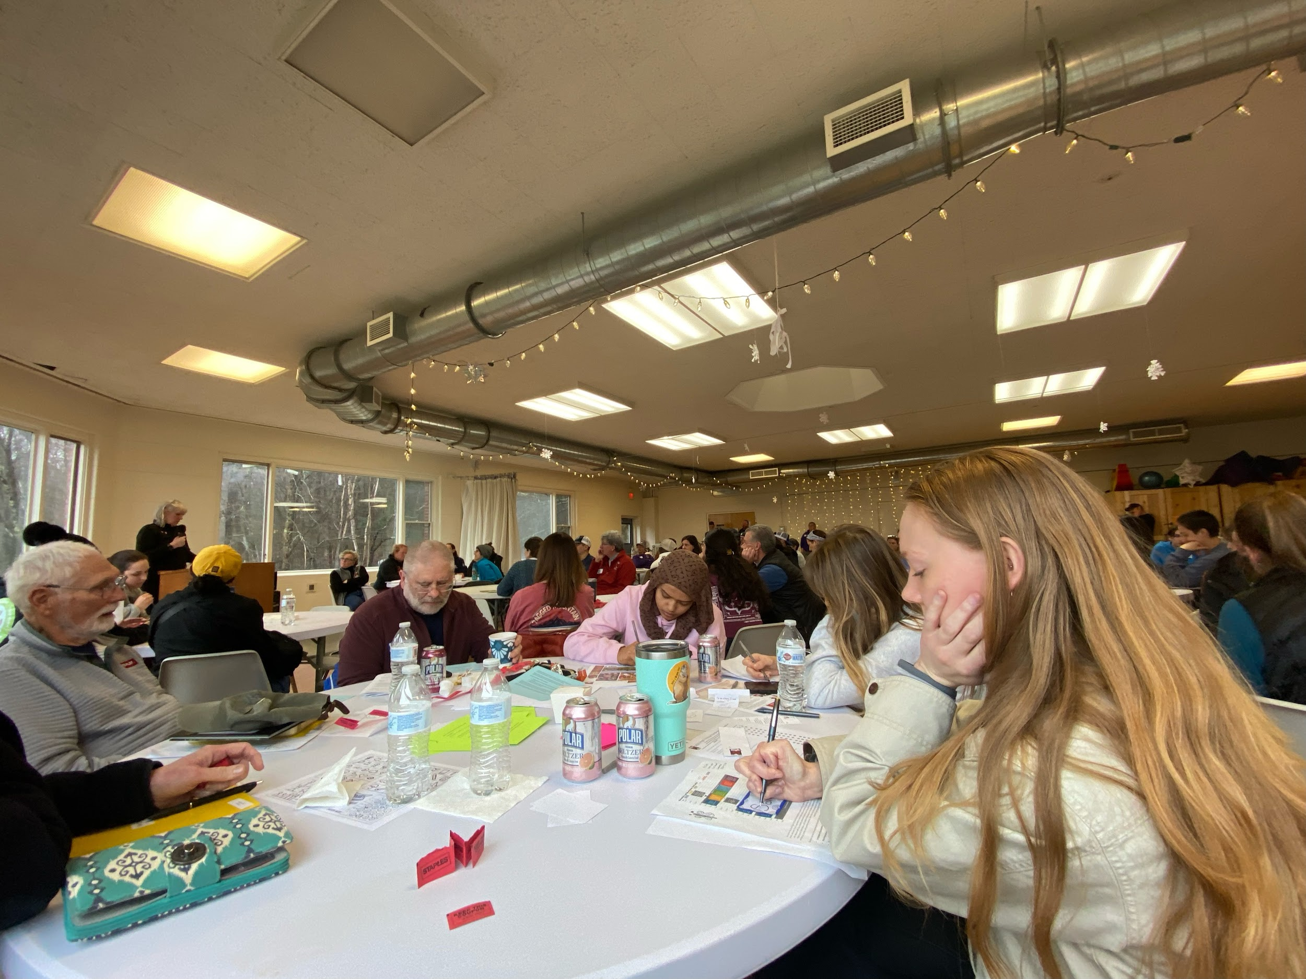
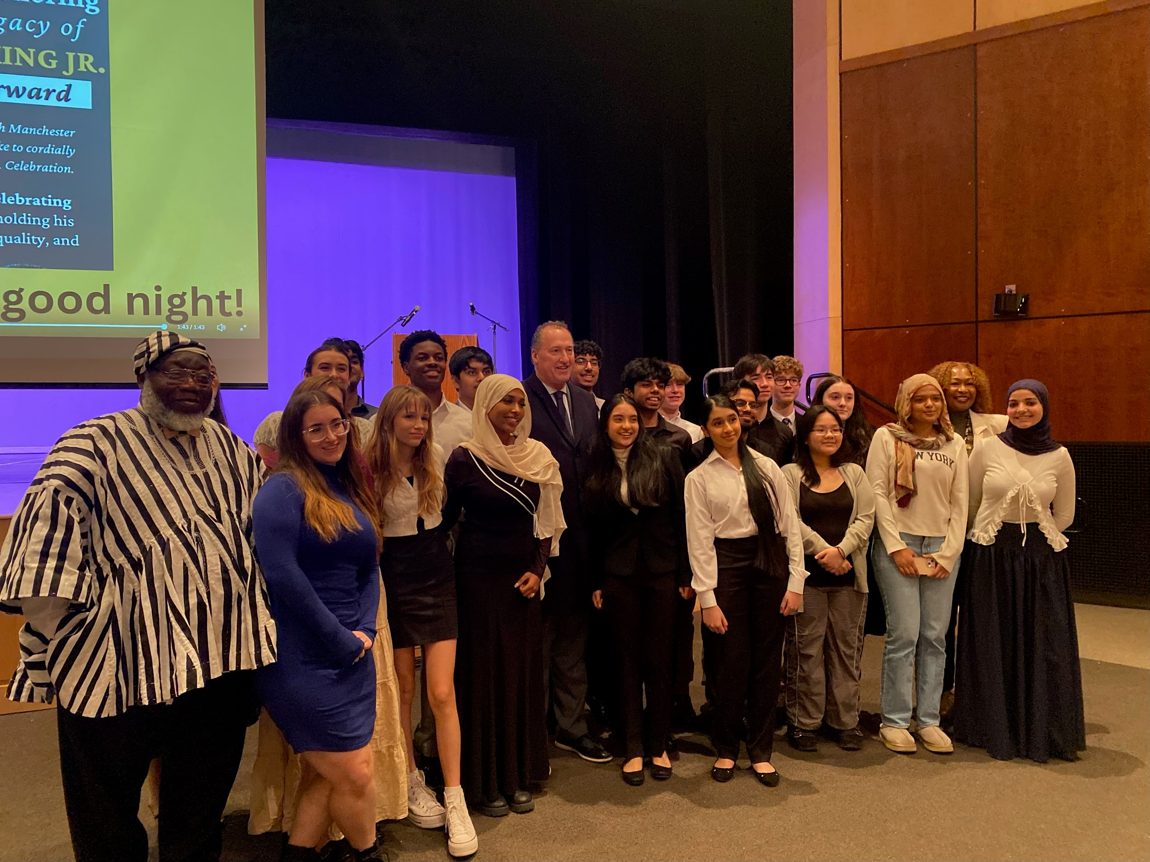
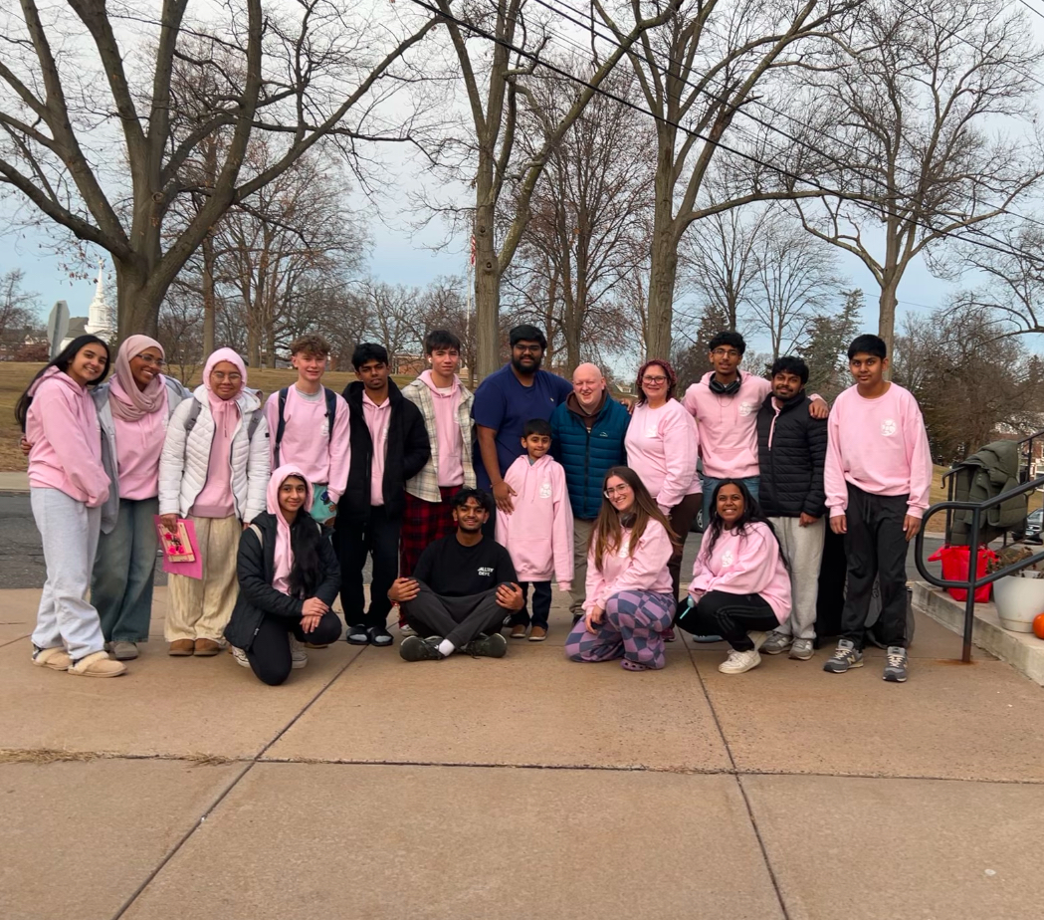
Successes:
Special Orders
The commission received special orders from the Recreation Department and Mary Cheney Library.
Annual Retreat- December 13, 2024
Commissioners bonded through nature walks, scavenger hunts, and other group activities.
Commissioners read and scored 14 grant applications.
Dr. Martin Luther King Jr. Celebration
Youth Commissioners honored Dr. King by recognizing students who reflect his values, writing speeches, and hosting the ceremony.

Slide 7
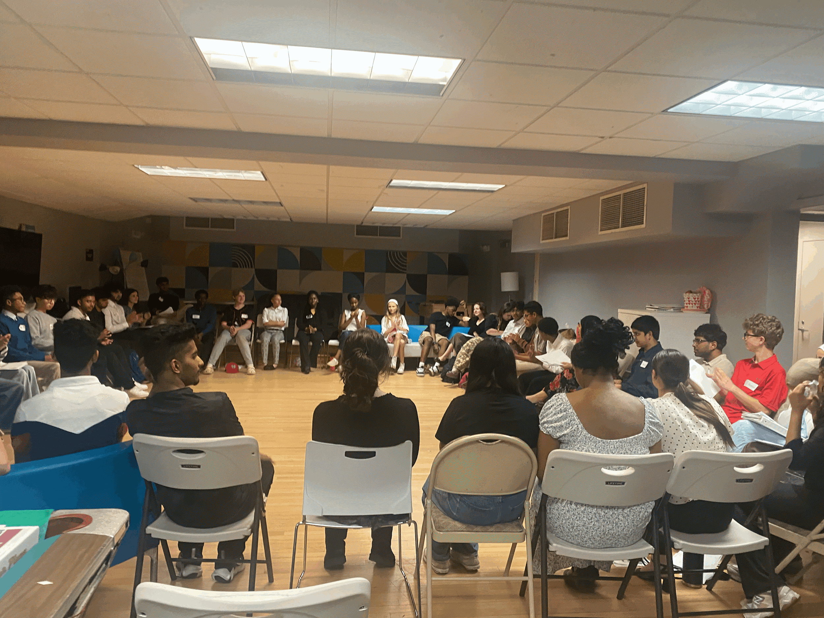
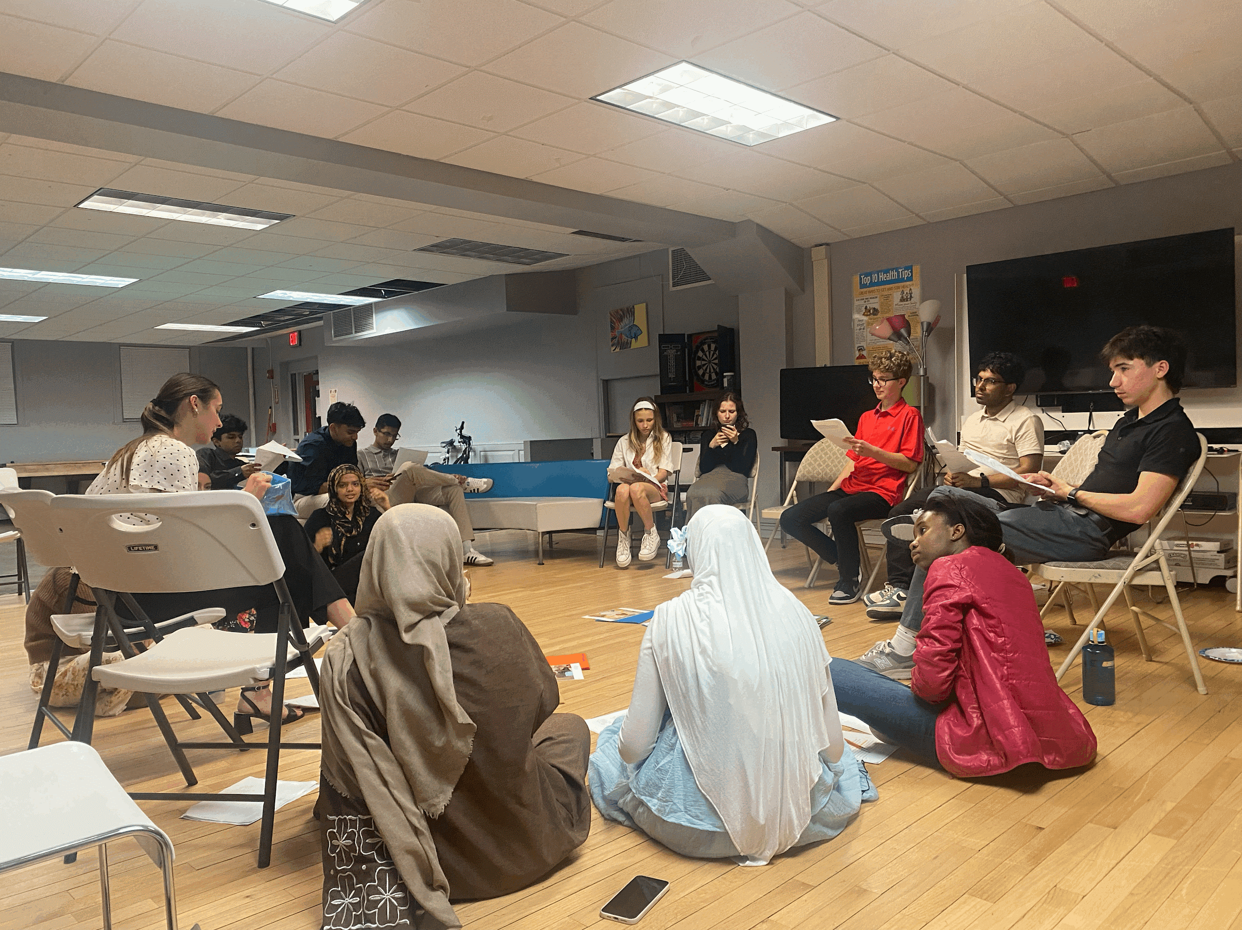
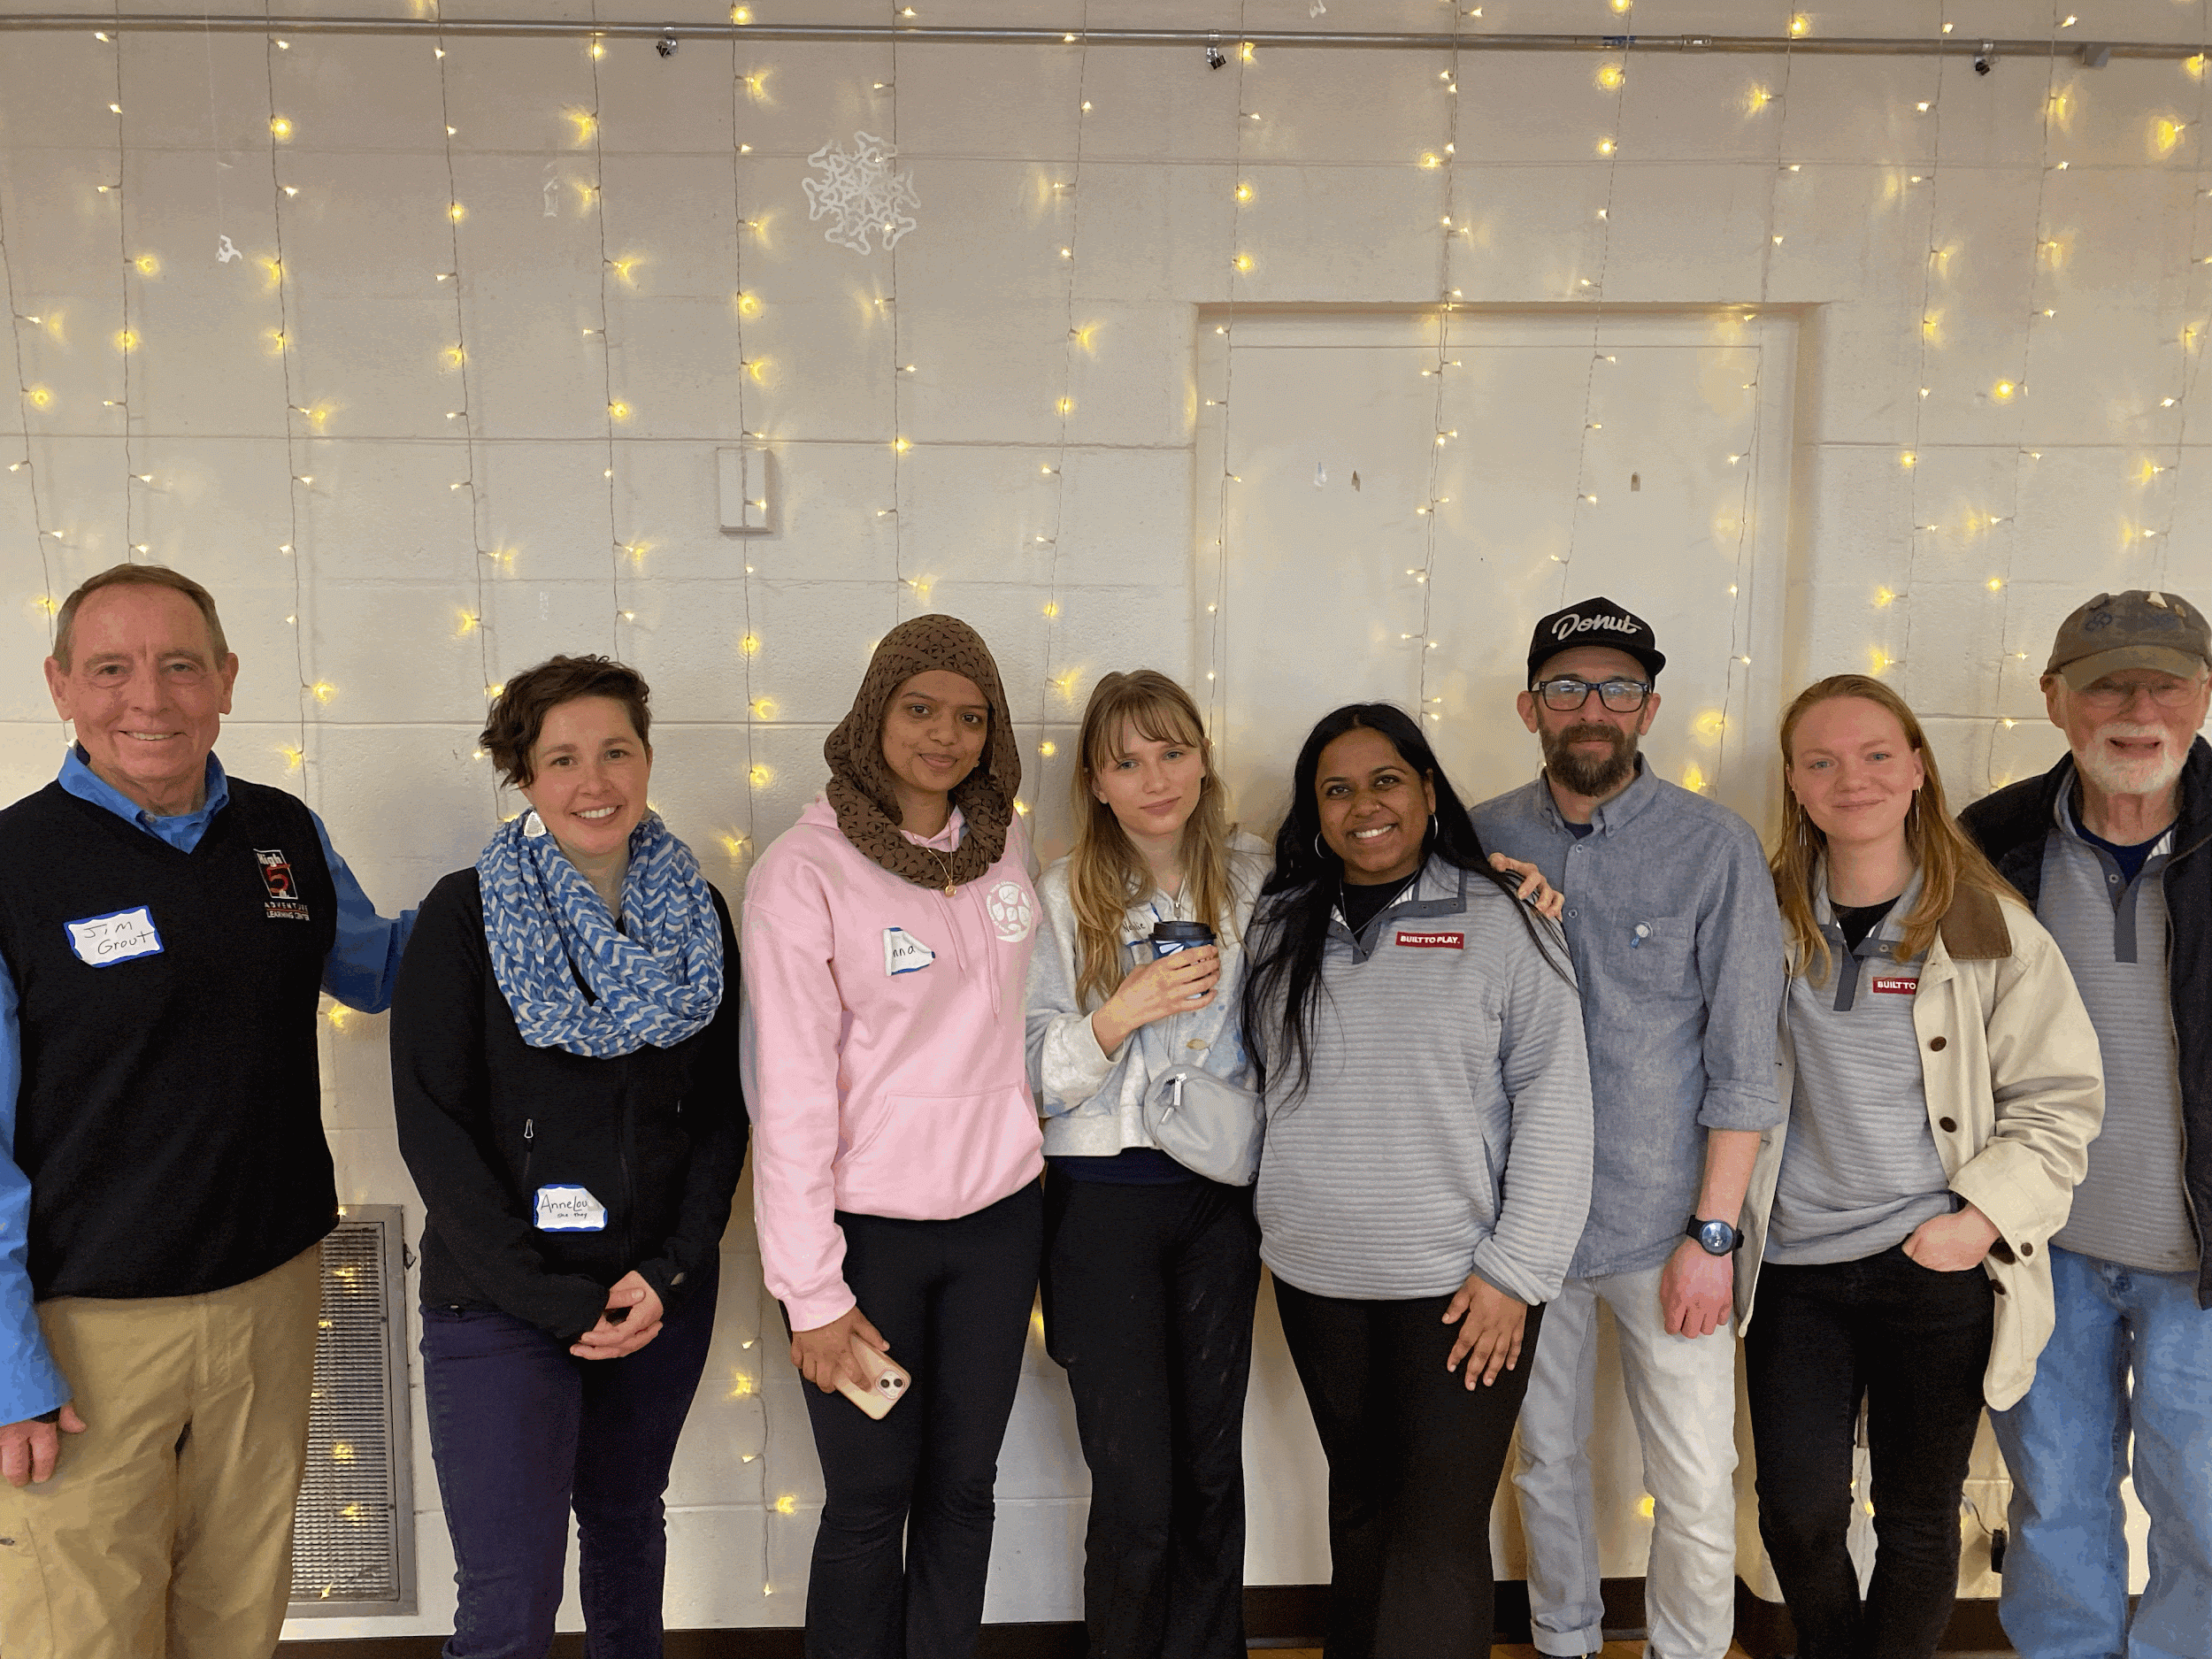
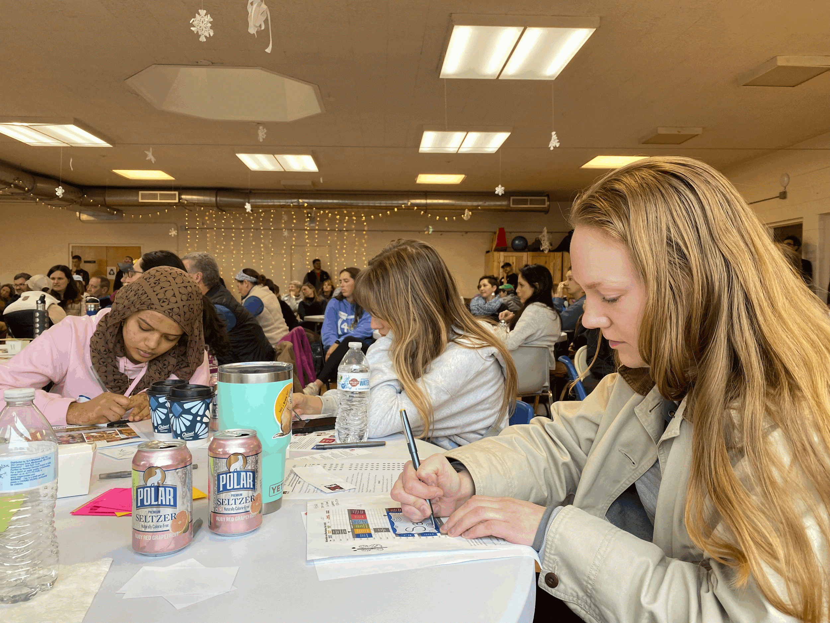
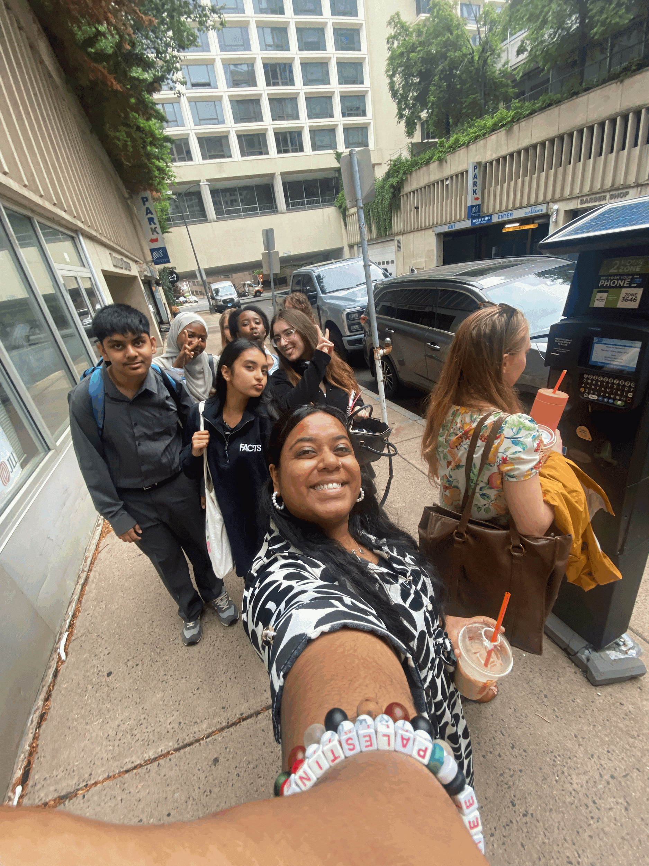
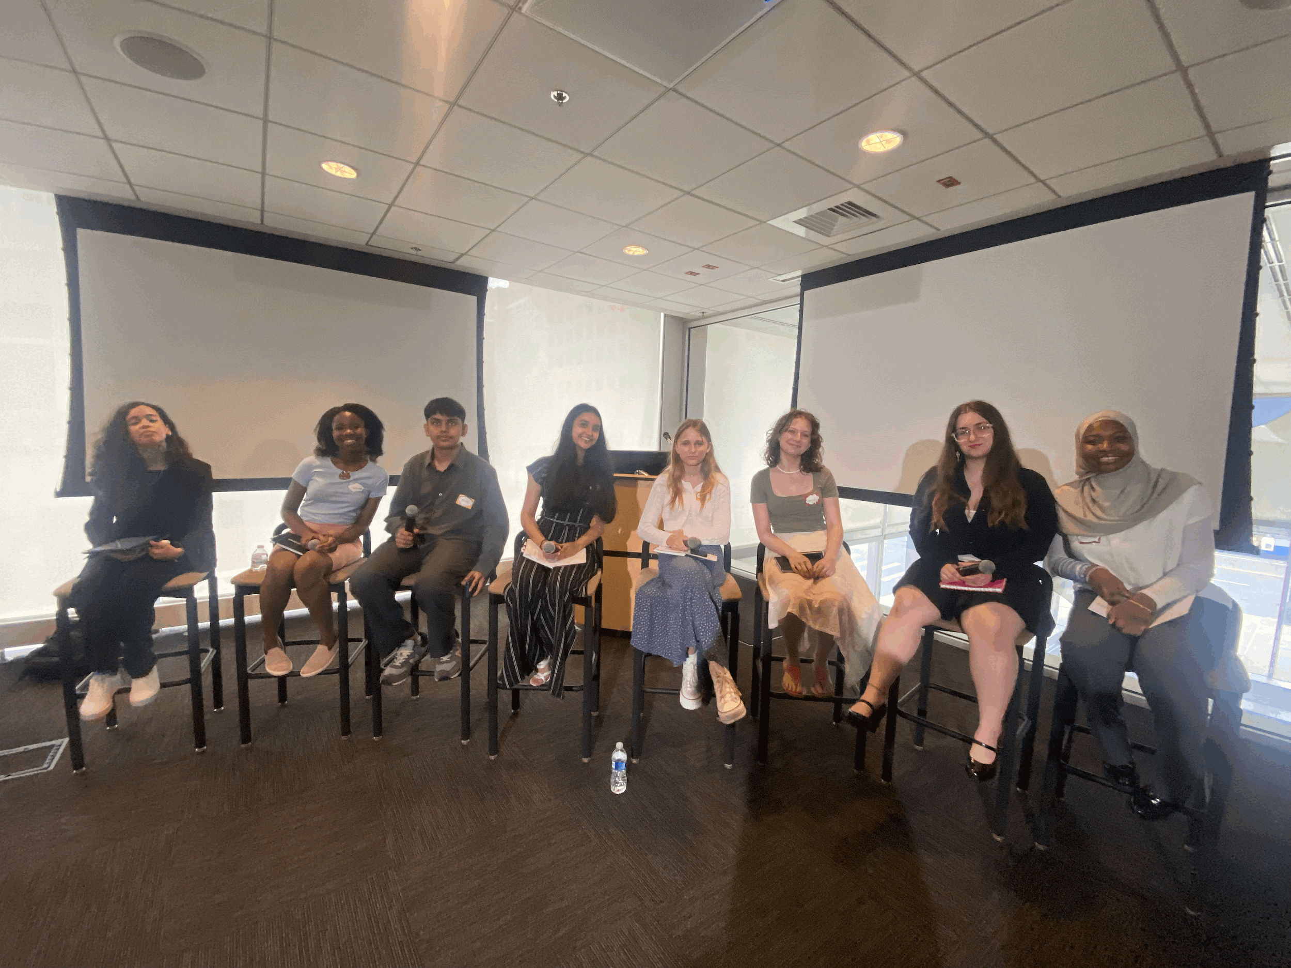
Successes:
Recruitment & Onboarding
14 applications received this year. Commissioners interviewed, reviewed, and discussed each applicant.
Public Speaking Engagements & Professional Development
Commissioners participated in Government Academy, the High-Five Symposium, and UConn Adolescent Literacy Summit.

Slide 8
03
Grants

Slide 9
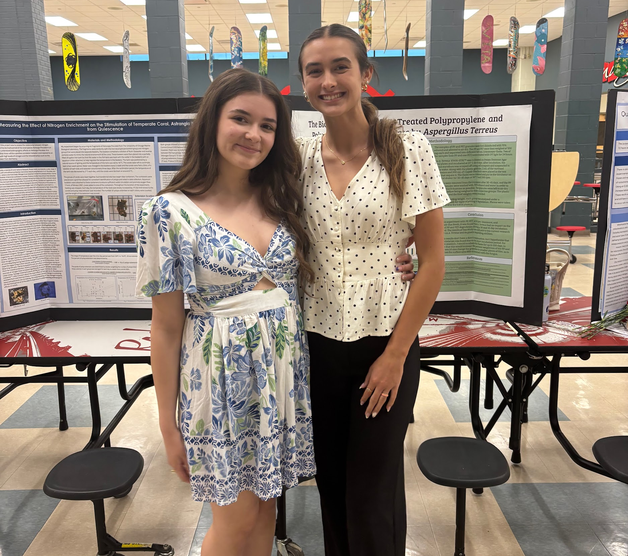
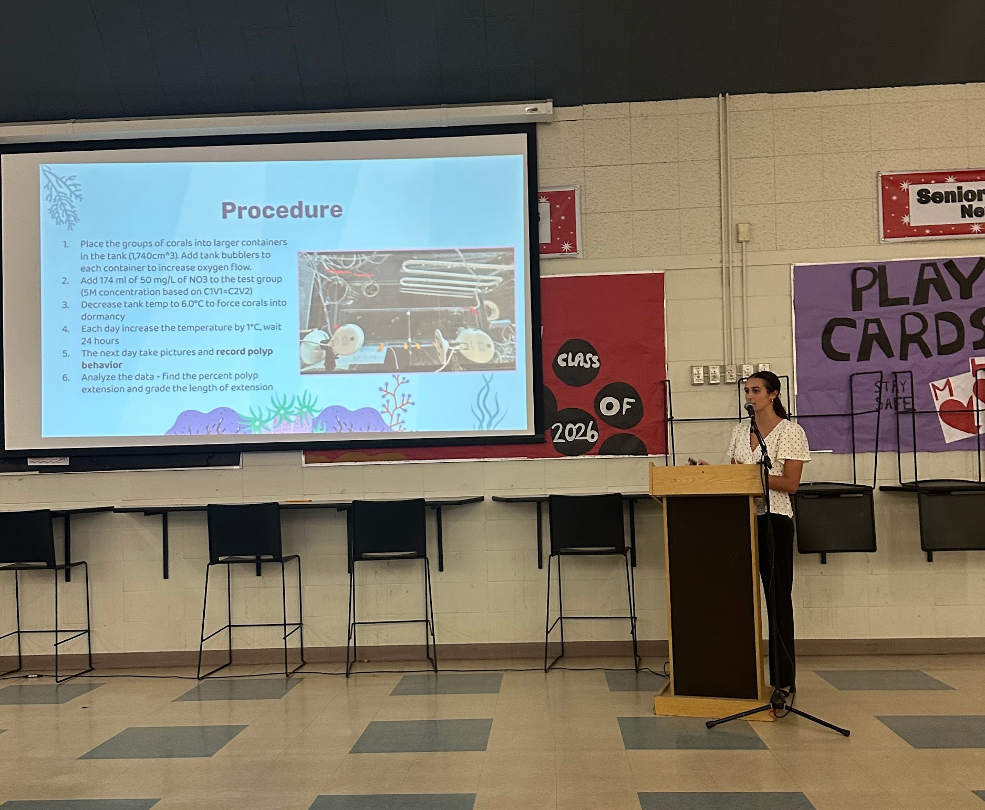
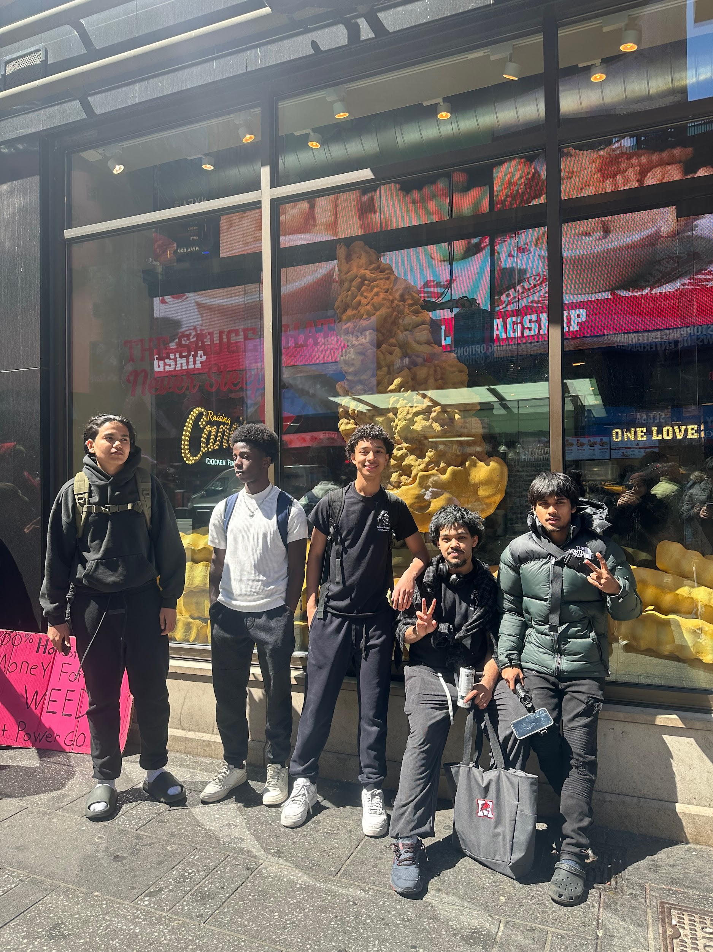
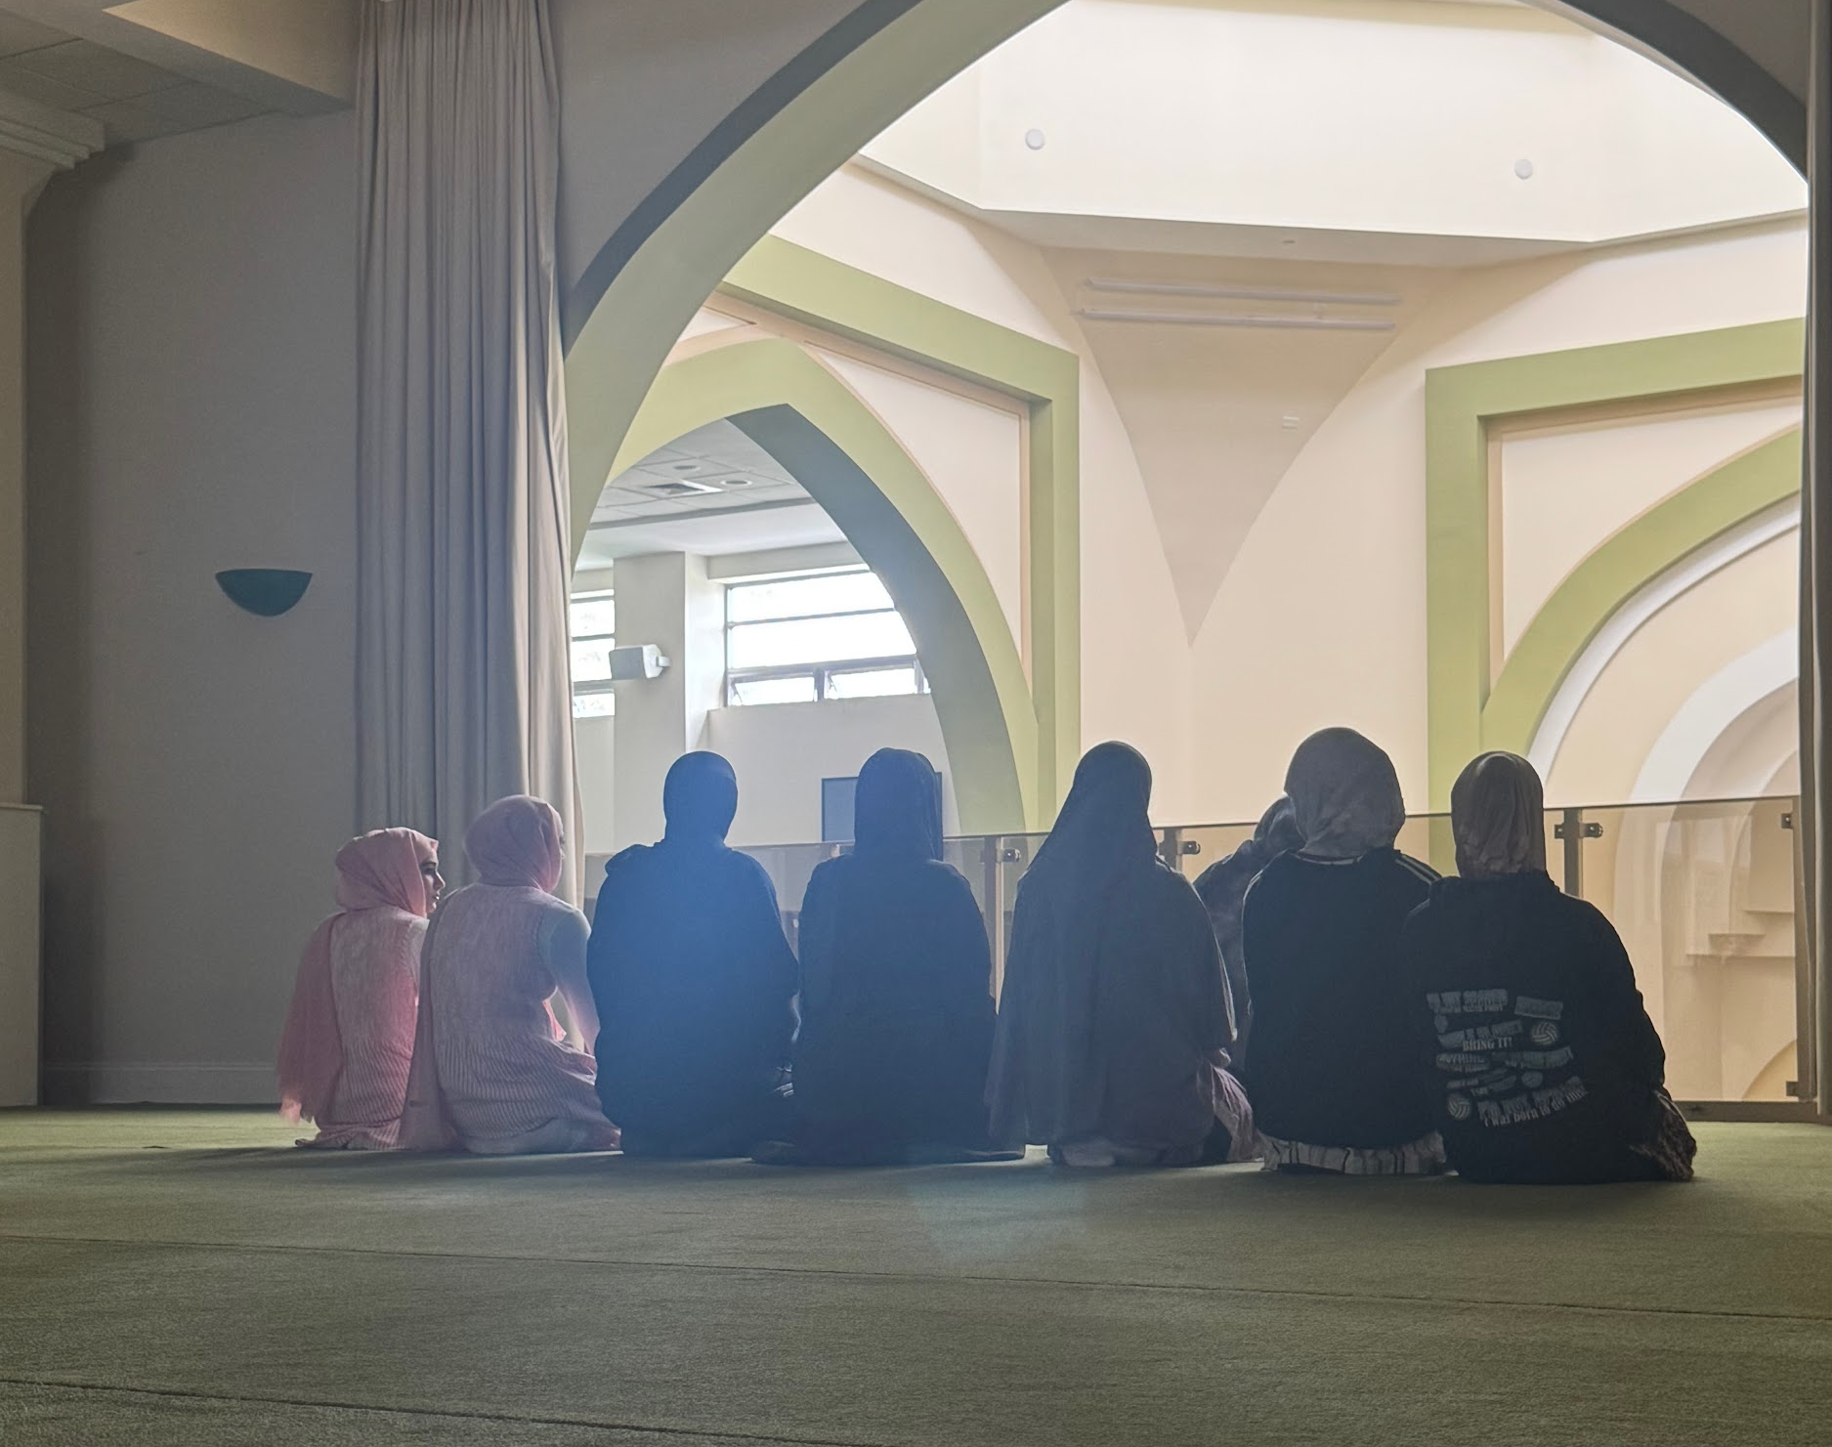
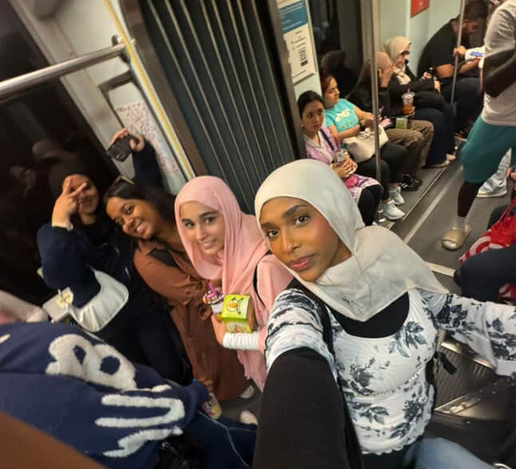
Fully Funded Grants
These grants were accepted as they showed leadership among youth and also would have a positive impact on youth lives
Manchester Youth Service Bureau: After School Artist Circle – $974.00
Manchester High School Research Program: Science Research Supply Fund – $1000
Manchester High School Asian Student Union: Exploration of Asian Tapestry in New York City – $1000
Muslim Students Association: Islamic Cultural Appreciation: Exploring History, Art, and Community – $500
Office of Neighborhoods & Families: Town of Manchester’s Farmers Market Series - Power of Produce – $1000

Slide 10
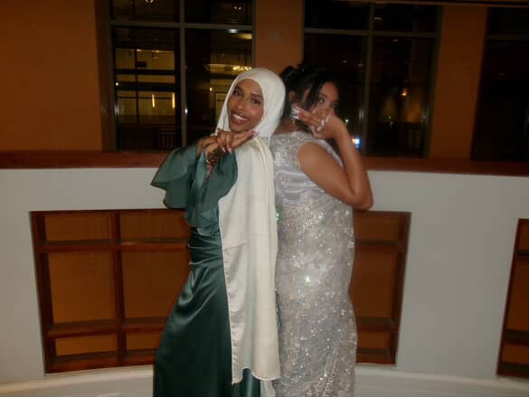
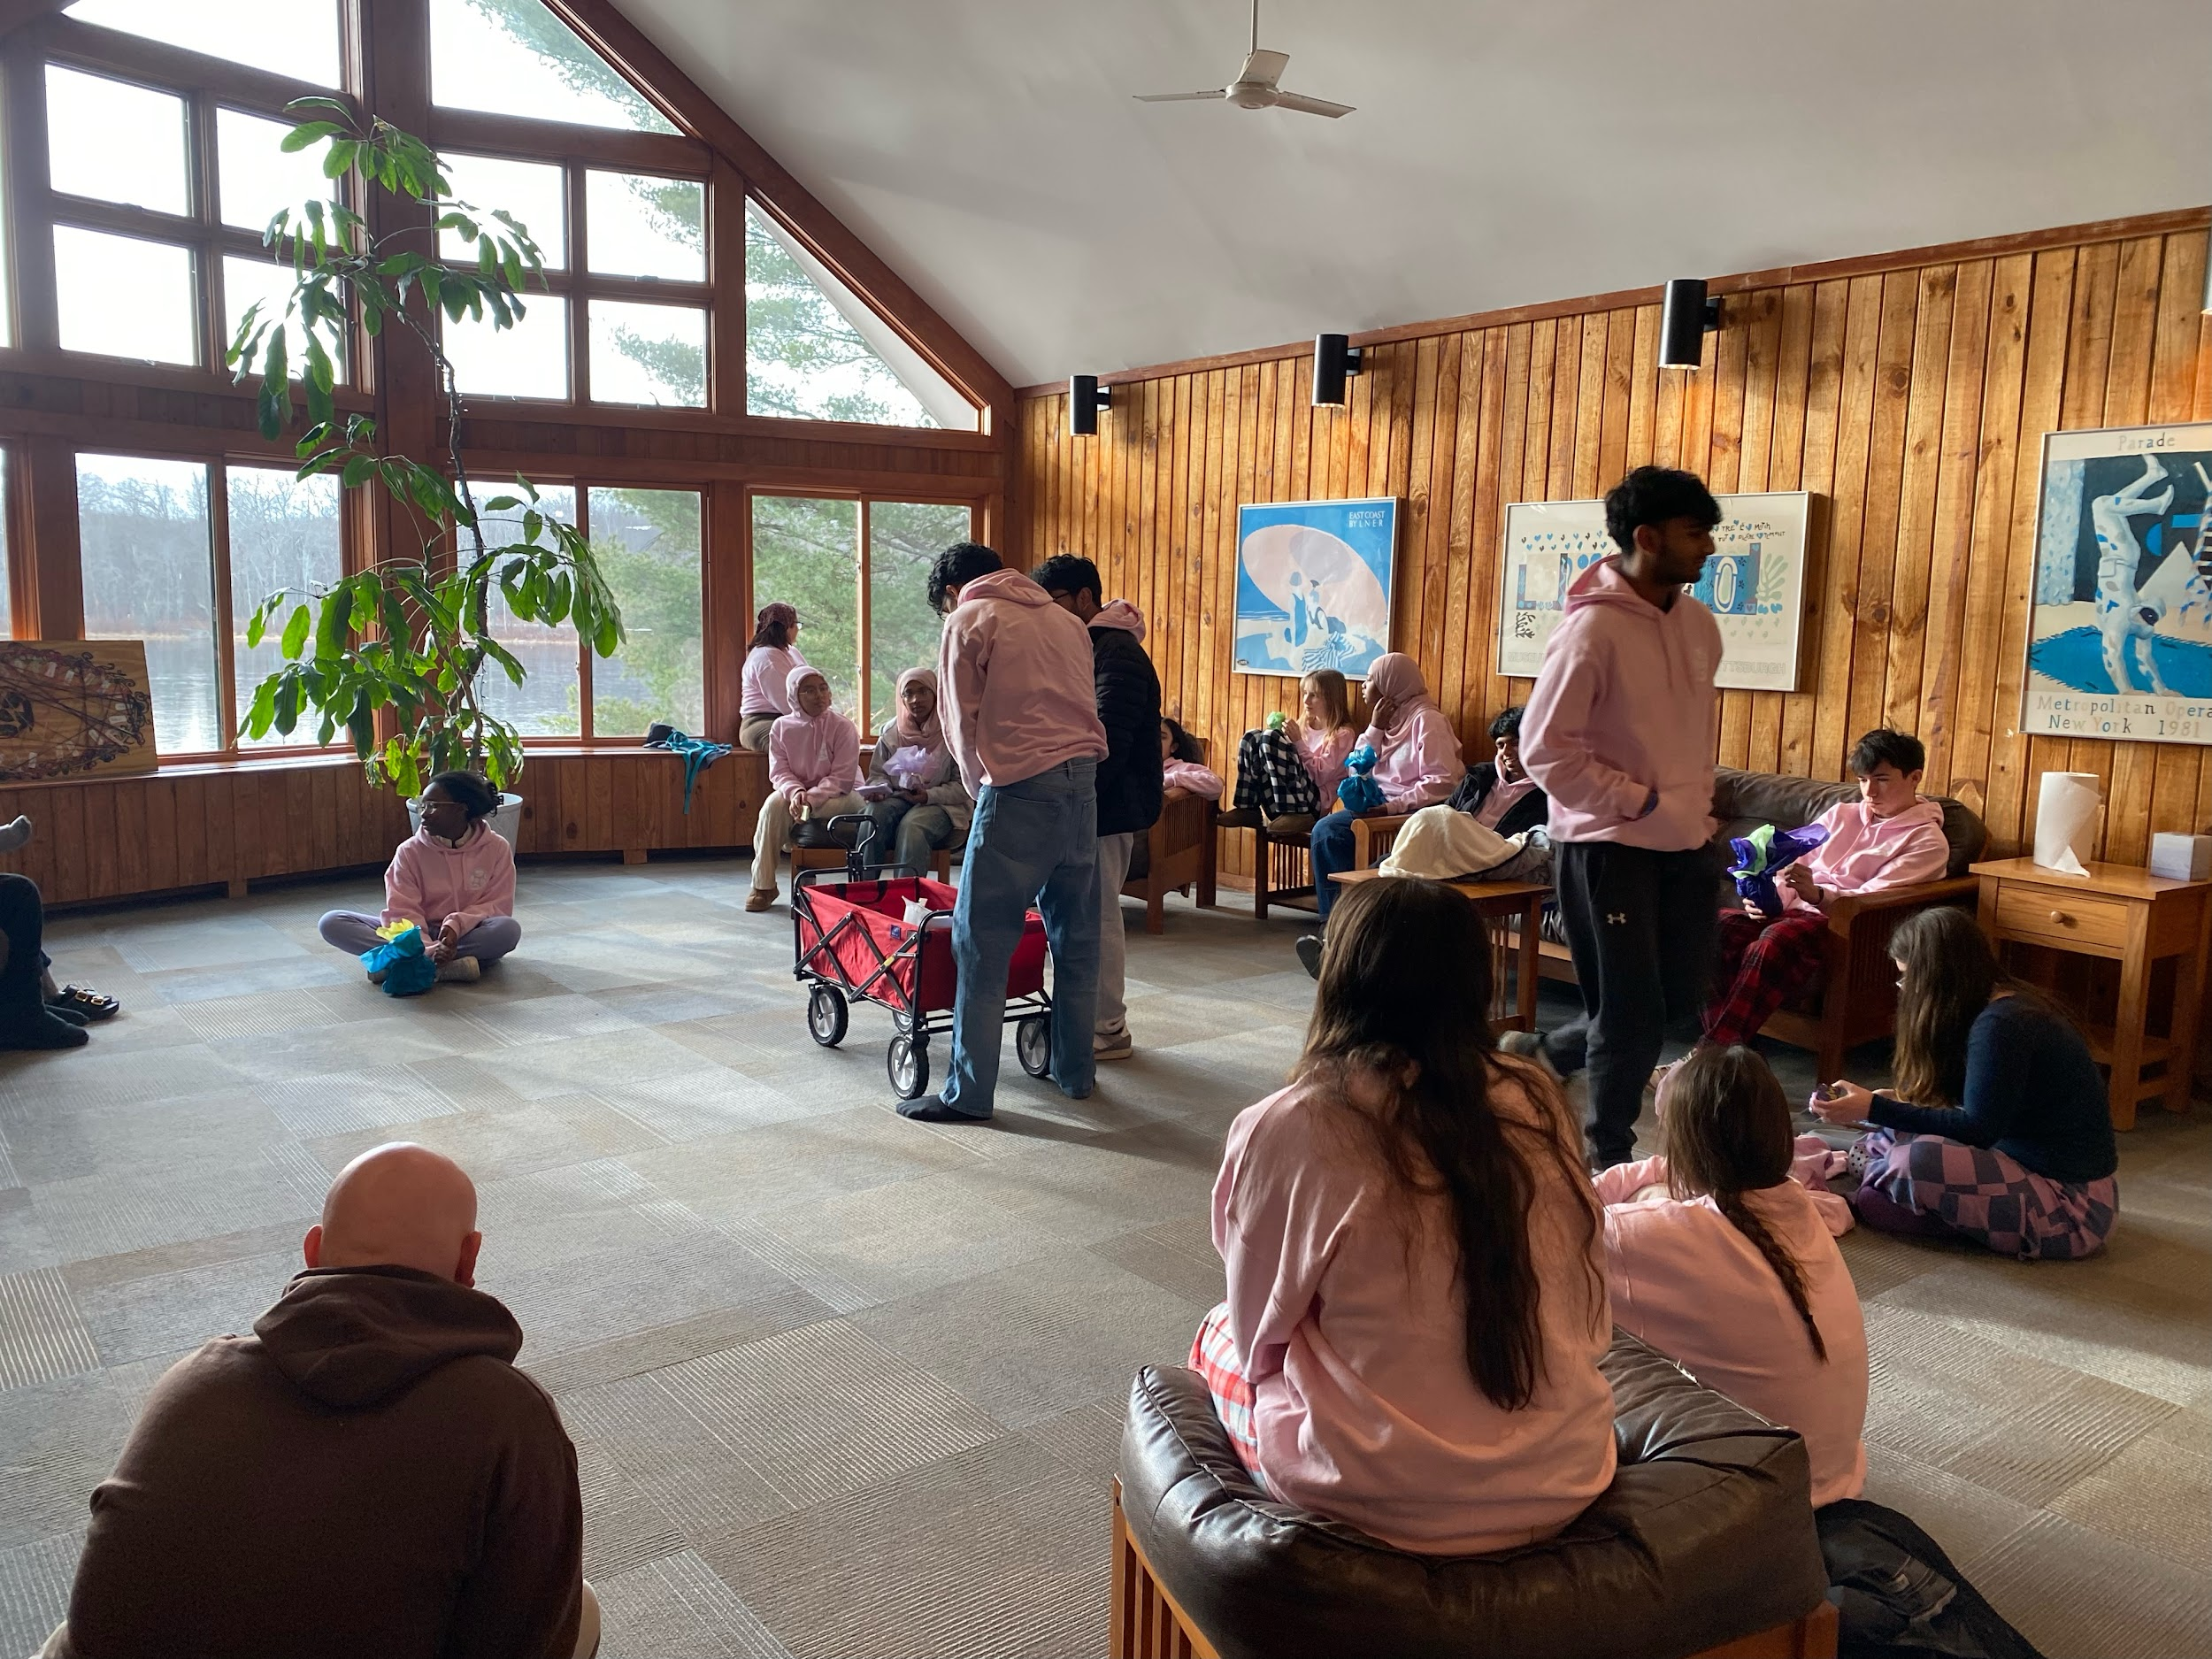
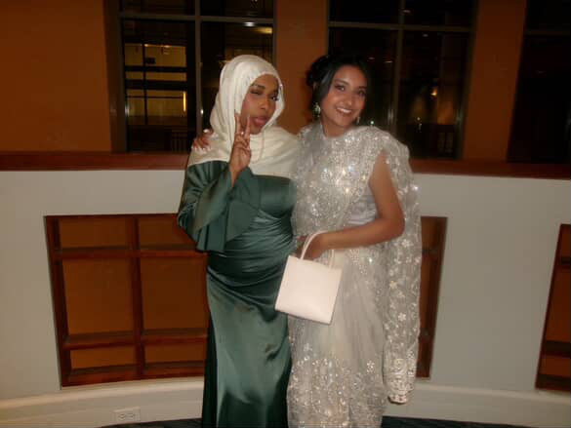
Partially Funded Grants
Manchester High School Class of 2025: Class of 2025 Senior Picnic and Prom – $526
We believed that this grant was youth led and would benefit other youth

Slide 11
04
Challenges

Slide 12
Challenges:
Internal Challenges
Attendance: Challenges with attendance lead to canceled meetings and delayed agenda items, which impacted productivity.
Time Management: Not all topics were covered, and some tasks were deprioritized due to time management issues during meetings.
Professionalism: There were concerns about professionalism, with lower engagement during meetings and events.
Structure: Unclear protocols and roles hindered efficiency, especially in grant deliberations.

Slide 13
Challenges:
External Challenges
Youth Voice Not Amplified: Youth felt their voices were not adequately amplified, with limited opportunities to provide input on key decisions.
Commission Treated As A Volunteer Group Rather Than An Advisory Body: undermines the commission’s intended role in shaping youth-related policies and discussions.

Slide 14
05
Goals & Recommendations

Slide 15
Goals
Update officer roles and responsibilities
Increase collaboration between other Commissions
Build stronger ties with other town groups.
Meet and plan events with other commissions.
Raise awareness of the Youth Commission to the community
As a commission we want the public to know what we stand for and publicize what we do.
Conduct an interview with local media programs.
Practice Sessions
Hold a session to prepare commissioners on professional expectations ahead of key events.

Slide 16
Recommendations
Quarterly Board of Director Meeting
We would like to have quarterly meetings with the BOD to ensure a strong level of communication.
Liaison to the Board of Directors
We would like to appoint a new officer position with the main role being to communicate with the BOD.
Bylaw Realignment/Revision
Our bylaws were created when we were formed in 2008 and have still yet to be updated. They are outdated and and do not fully fit our current commission structure.

Slide 17
06
Closing

Slide 18
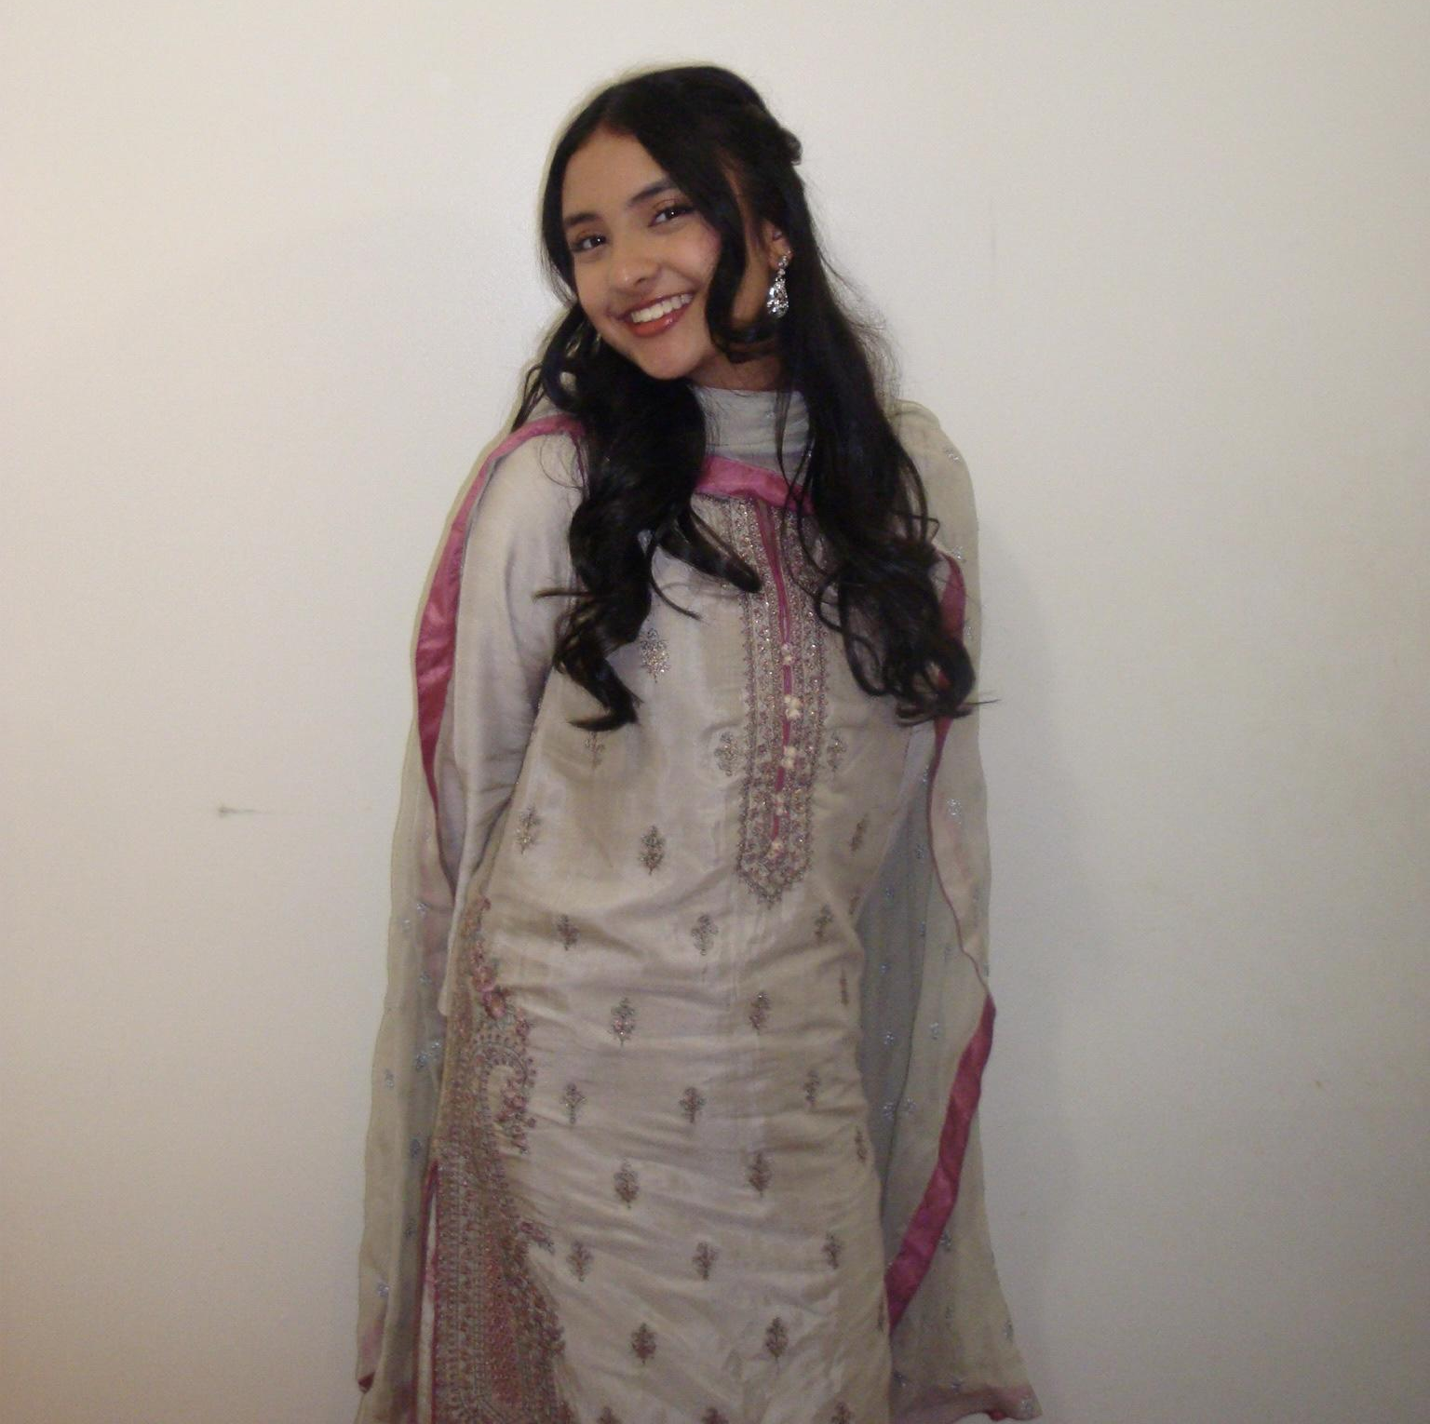
Final Words From The Chair

