Slide 1
MANCHESTER
DEPARTMENT
Senior Center Space Needs Analysis Project Overview
December 6, 2022

Slide 2
Overview of Project
The Manchester Senior Center is an existing facility located at 549 Middle Turnpike East, Manchester, CT. The structure was built in 1921 with the original purpose of housing an elementary school. The building was repurposed for use as the Senior Center in 1980.
The Town operates a number of programs at the Senior Center that benefit the community. These activities include a wide array of programs and services aimed at increasing the overall social, emotional and physical well-being of Manchester’s older adults. Programs and services include, but are not limited to: fitness, recreation and leisure, transportation and meals.
In early 2021, and RFP was released soliciting vendors for a Senior Center Space Needs Analysis. The intent of the study was to analyze the present and future facility needs of the Manchester Senior Center and the residents it serves and to prepare a comprehensive report that will aid the Town in both it’s long and short term planning efforts related to facility needs.
The intent of the project was not to design or identify a space, nor was it to specifically meant to evaluate the current space. Instead, the purpose was to offer the Town informed guidance as to what a space for a thriving, modern senior center space in Manchester might require.
LifeSpan Design Studios was chosen due to their extensive and proven track record of Senior Center planning and design services to over 100 communities. The study was completed late summer in 2022.

Slide 3
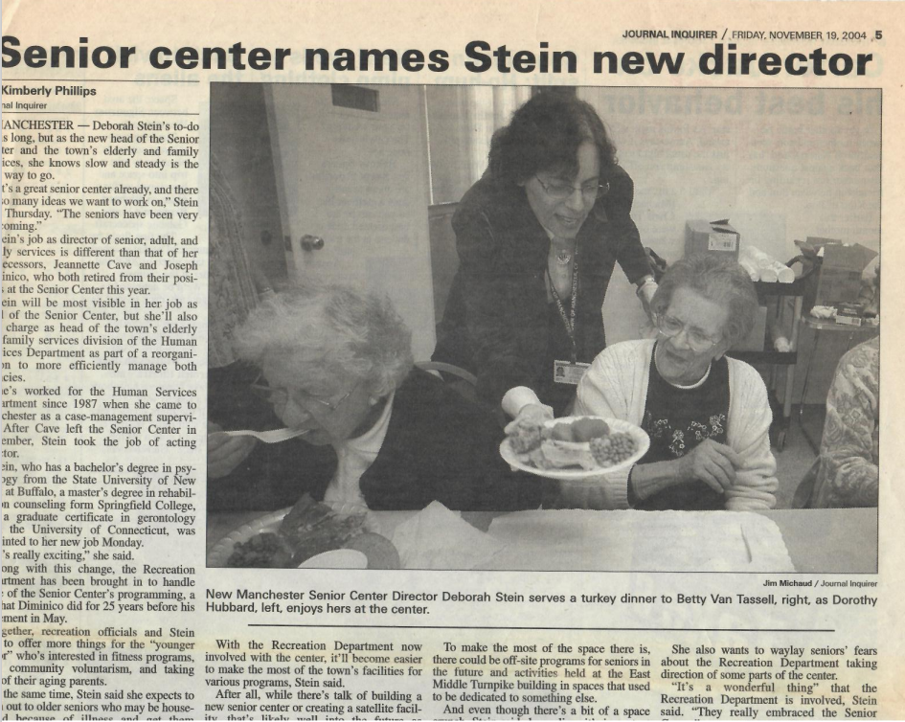
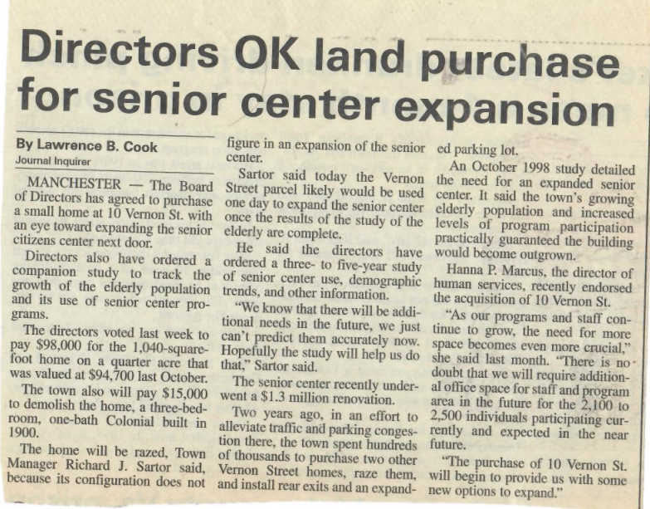
“A Bit of A Space Crunch…” “... a 1998 Study detailed the need for an expanded senior center.”
2004 and 2000 articles from the Journal Inquirer

Slide 4
Tonight’s presentation provided by:
Doug Gallow, FAIA
Lifespan Design Studio

