Slide 1
Manchester, CT Board of Directors
December 6, 2022
Affordable Housing Plan

Slide 2
Affordable Housing Plan (8-30j)
Public Act 17-170 established requirement that Connecticut municipalities adopt Affordable Housing Plans.
Manchester:
Meets the 10% minimum requirement for Affordable Housing for CT Municipalities
Completes various planning documents for affordable housing production- Comprehensive Plan, Analysis of Impediments to Affordable Housing, Plan of Conservation and Development, etc.
Still required to produce an Affordable Housing Plan every 5 years.

Slide 3
Public Engagement Process
Annual Action Plan
5 Year Consolidated Plan
Analysis of Impediments to Fair Housing Choice
Plan of Conservation and Development (POCD)
Sustainable Connecticut
Municipal Learning Collaborative Affordable Housing Pilot
Housing and Fair Rent Commission Review

Slide 4
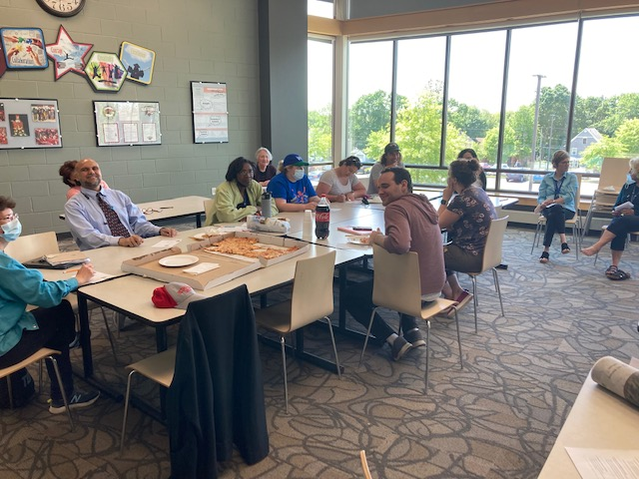
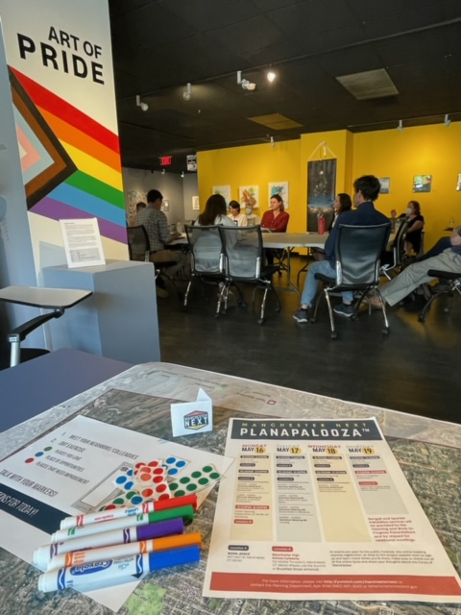
Public Engagement Process

Slide 5
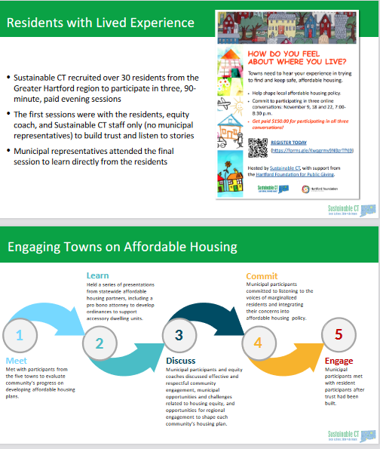
Public Engagement Process

Slide 6
Value Statement
Manchester has long been a regional leader in supplying diverse housing stock, in order to create a welcoming community that meets the needs of existing and new residents regardless of age, ability, race or ethnicity, income, or household type. As a dynamic, evolving community Manchester will continue to support housing policies that foster inclusivity, affordability, and innovation. Our housing stock will continue to provide housing choices for all people within the community and provide affordable housing choices for all residents and the Town’s workforce.
Manchester will pursue policies and strategies that support reinvestment in existing housing, promote new development and redevelopment of underutilized properties, pathways to affordable home ownership and affordable housing choice through diverse available housing stock. Promoting a diverse Manchester will improve the quality of life for Manchester’s existing and new residents.

Slide 7
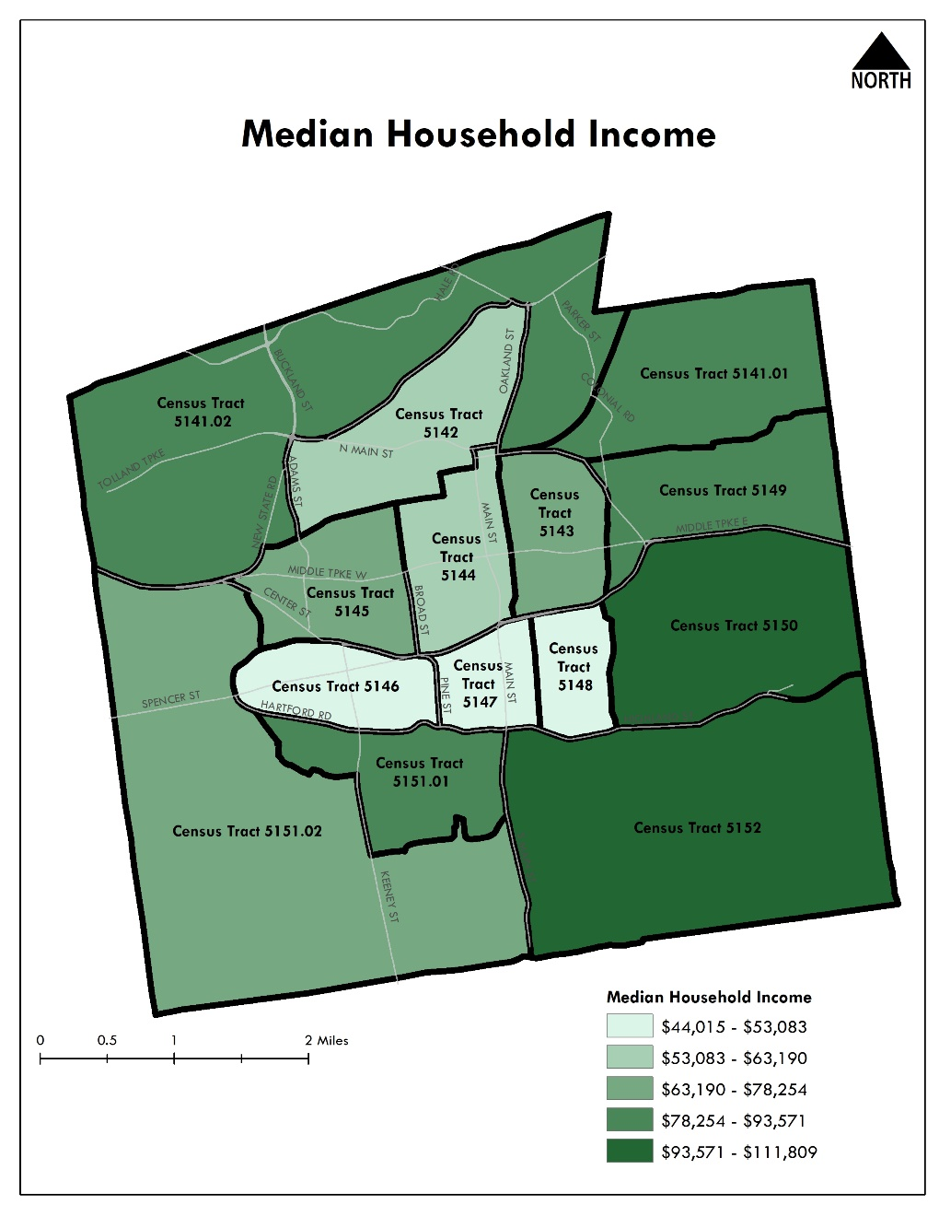
Data
Median Household Income
Connecticut | Hartford County | Manchester
$78,444 | $75,148 | $74,503

Slide 8
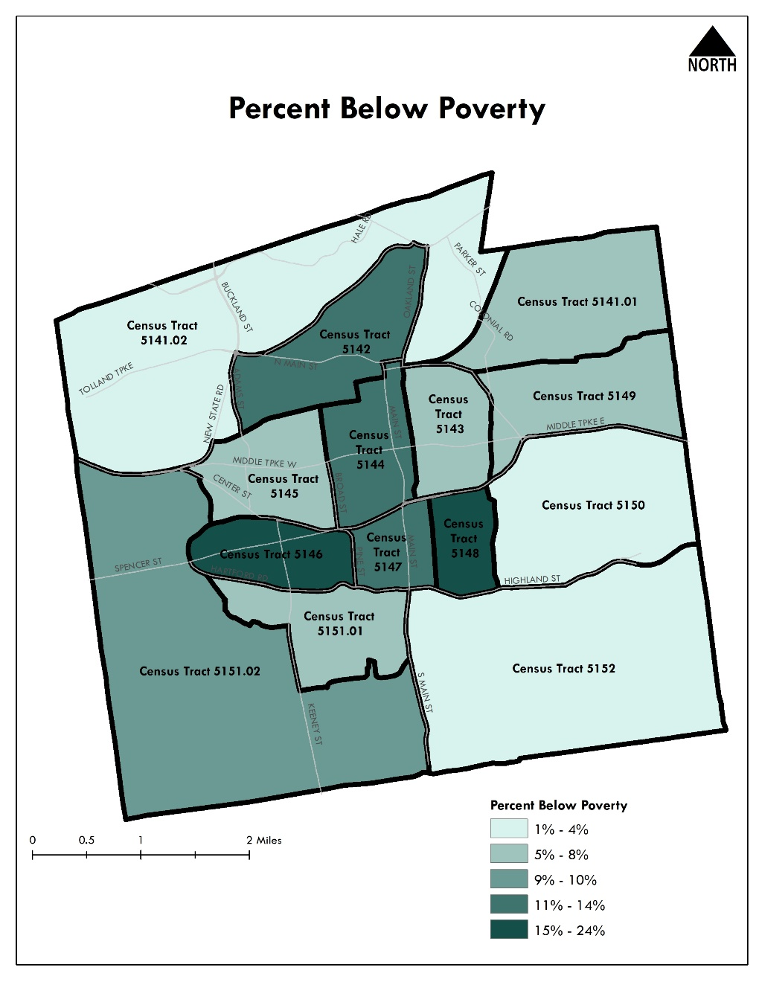
Poverty

Slide 9
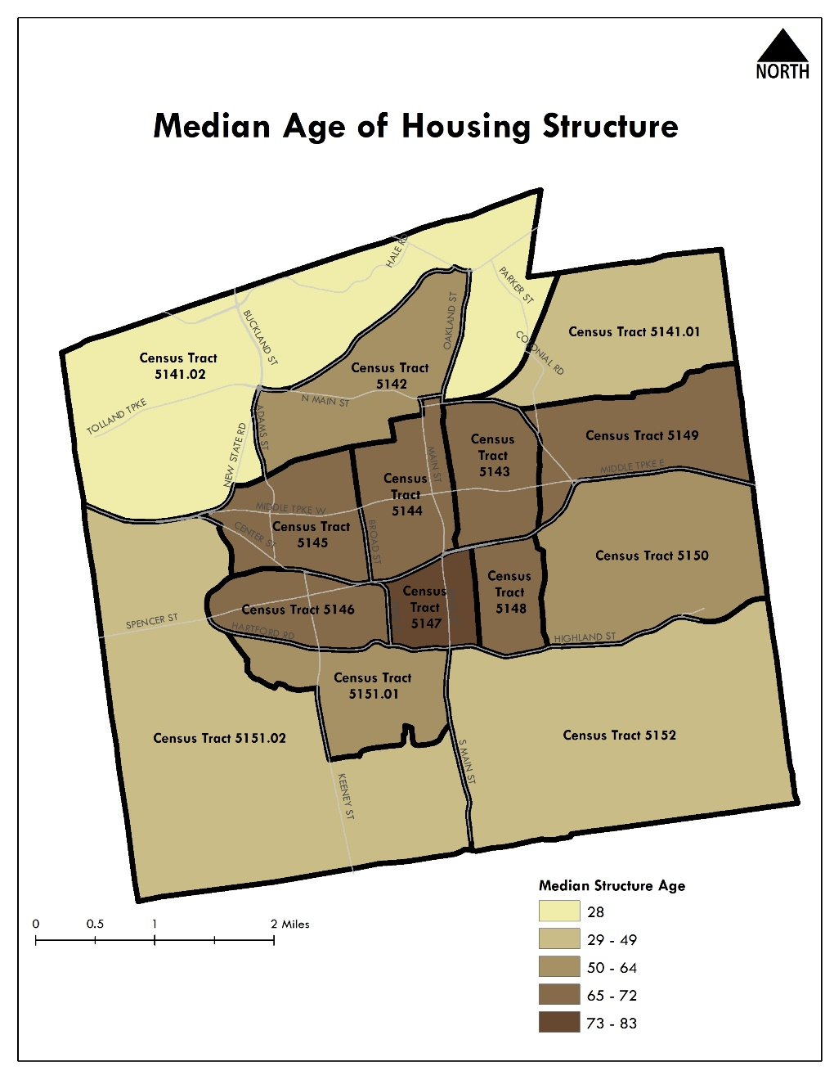
Housing Age

Slide 10
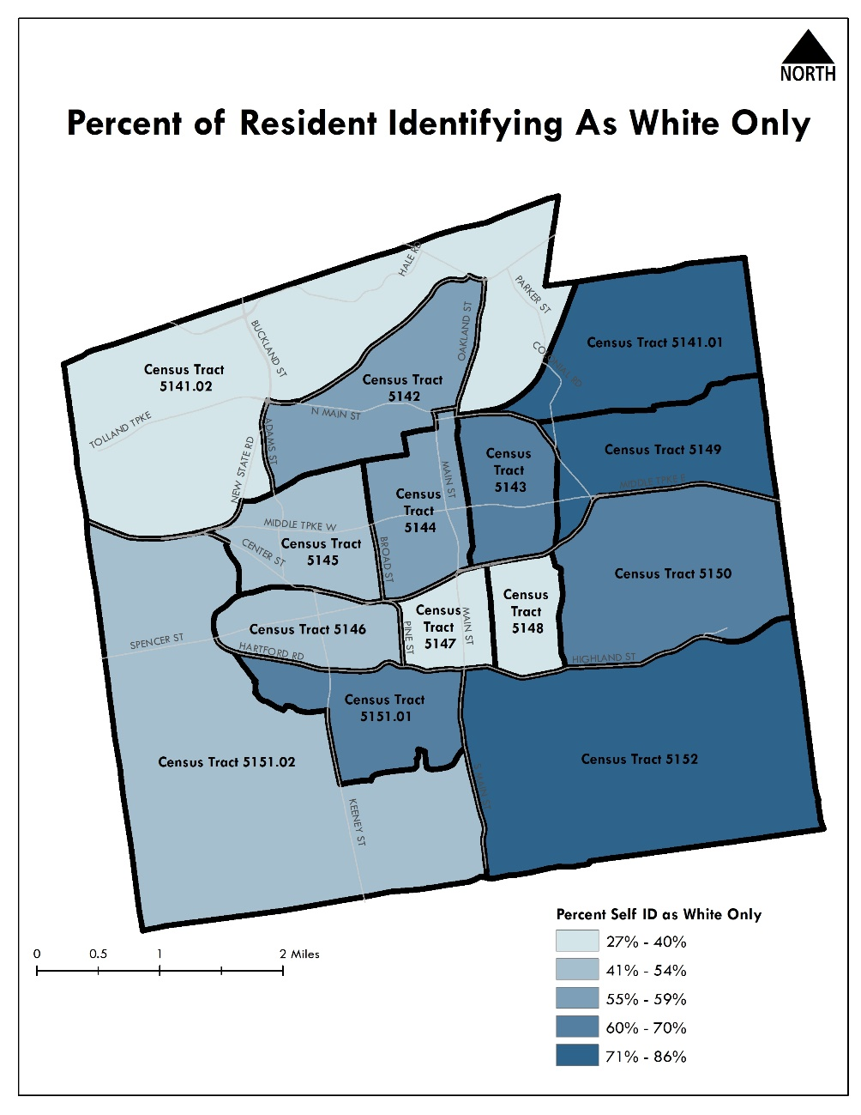
Race and Ethnicity

Slide 11
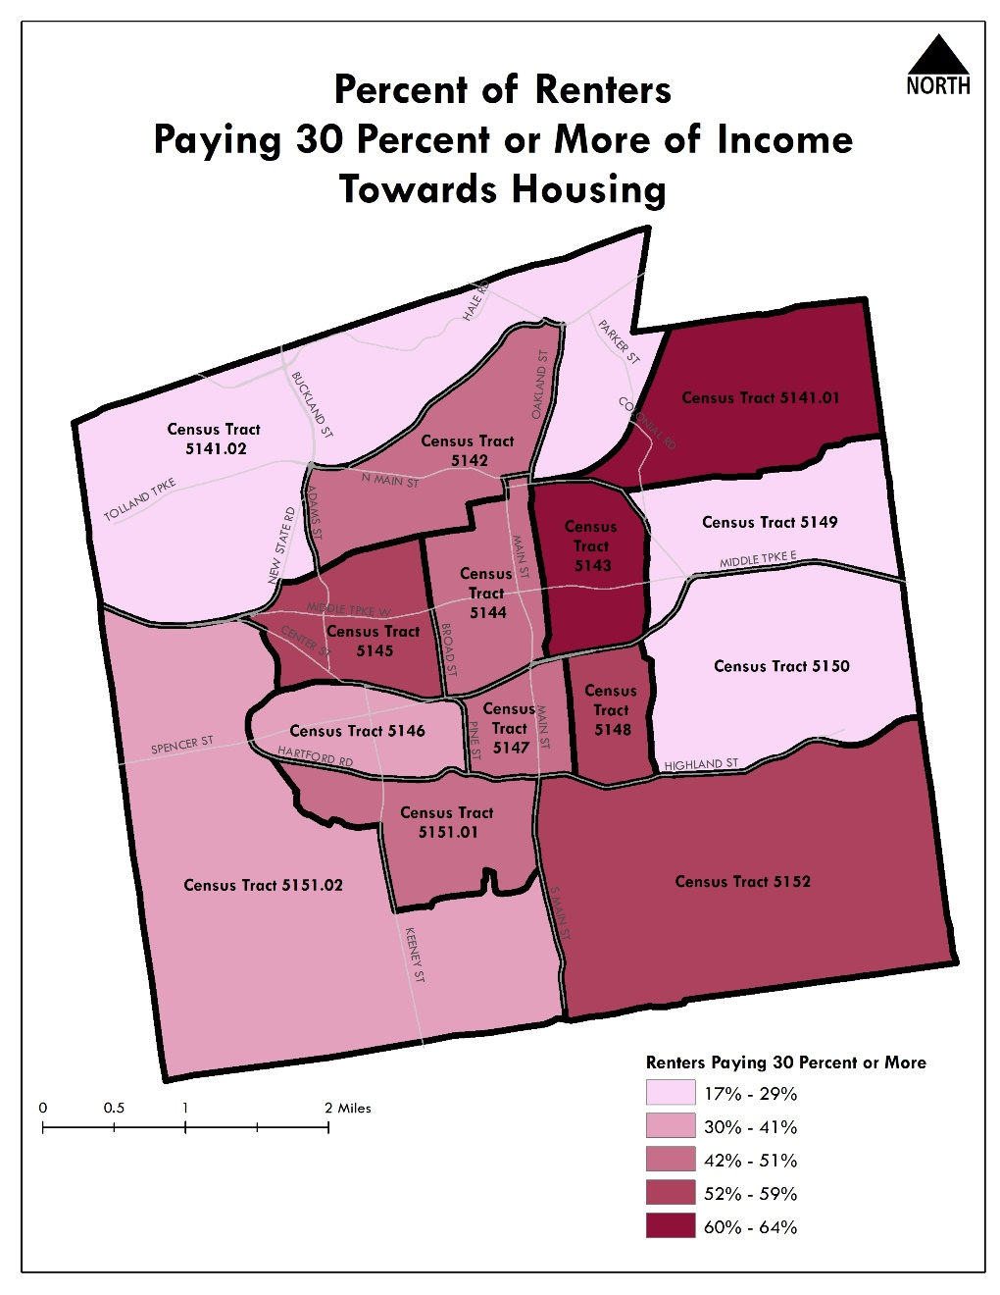
Housing Insecurity

Slide 12
HUD Fair Market Rents
Type | FY 2021 | FY 2022 | % Change | FY 2023 | % Change
Efficiency | $889 | $865 | -2.7% | $1,002 | 15.8%
1 Bedroom | $1,091 | $1,054 | -3.4% | $1,207 | 14.5%
2 Bedrooms | $1,347 | $1,302 | -3.3% | $1,499 | 15.1%
3 Bedrooms | $1,675 | $1,609 | -3.9% | $1,824 | 13.4%
4 Bedrooms | $1,958 | $1,907 | -2.6% | $2,226 | 16.7%

Slide 13
HUD Fair Market Rents
 | Efficiency | 1 BR | 2 BR | 3 BR | 4 BR
FY 2023 FMR | $1,002 | $1,207 | $1,499 | $1,824 | $2,226
Increase from previous year | $137 | $153 | $197 | $215 | $319
Notes:
FMRs significantly increased for every unit size this year.

Slide 14
Current/Recent Housing Developments
Promise House*- 13 units
Spencer’s Landing- 130 age-restricted units
Planned Residence Districts- 53 total units
Bayberry Crossing- 44 single family homes
Downtown Projects
2-4 Pearl- 8 units
893 Main – 6 units
*Deed-restricted affordable

Slide 15
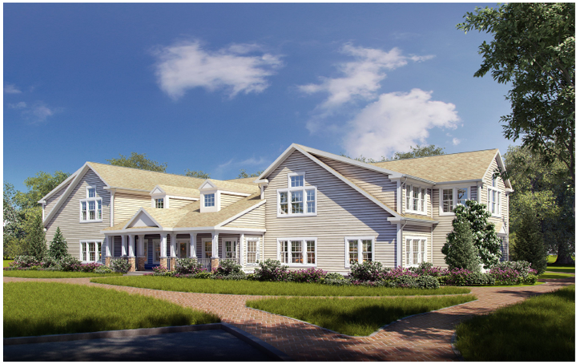
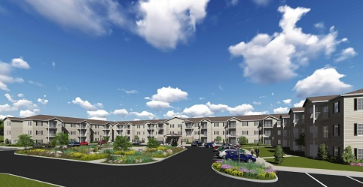
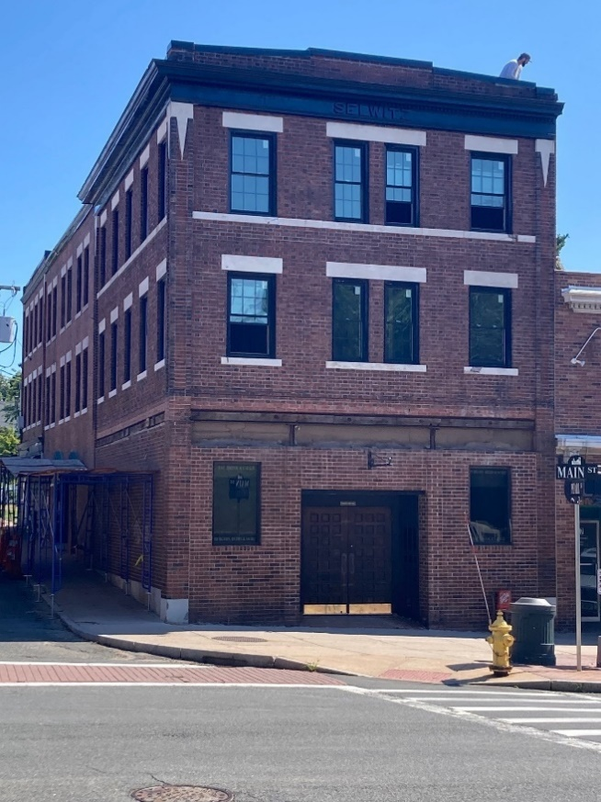
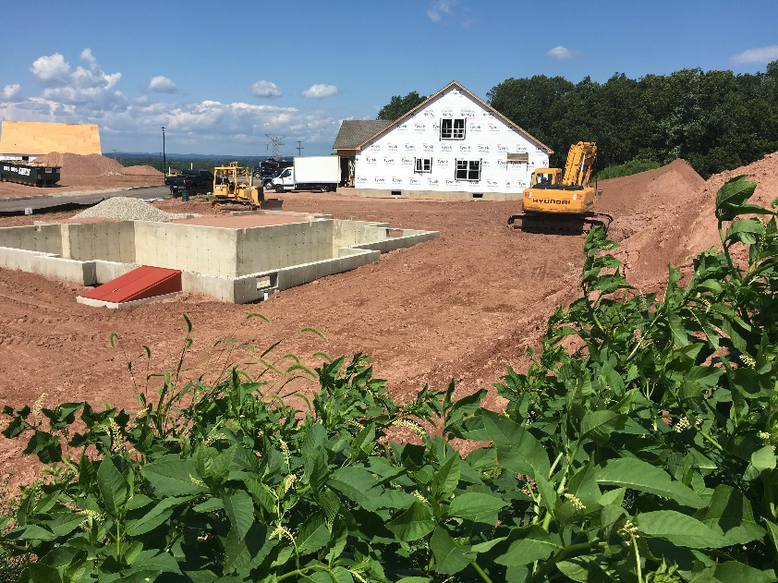
Current/Recent Developments
Notes:
HUD FMRs dropped across the board this year, though the reductions were small.

Slide 16
Goals- Production
Goal | Strategy/Action | Priority | Responsible Party
Production | Prioritize housing as a tool for redeveloping underutilized or vacant properties and Downtown revitalization | High | Planning Department Planning & Zoning Commission Board of Directors
 | Consider incentives for affordable accessory apartments | Medium | Board of Directors Housing and Fair Rent Commission
 | Consider density bonuses | Medium | Planning & Zoning Commission
 | Pursue and cultivate partnerships to support affordable home construction | Medium | Planning Department
 | Explore the viability of a Community Land Trust | Lower | Planning Department
 | Review parking requirements for new proposed affordable housing development | Lower | Planning & Zoning Commission

Slide 17
Goals- Preservation
Goal | Strategy/Action | Priority | Responsible Party
Preservation | Identify deed-restricted units at risk of expiration and incentivize their extension | High | Planning Department Board of Directors
 | Expand the Town’s existing Housing Rehabilitation Program | High | Planning Department Board of Directors
 | Support existing public housing – Work with the Manchester Housing Authority on capital repairs, improvements, and redevelopment for the long-term preservation of local affordable housing | Medium | Board of Directors Housing and Fair Rent Commission

Slide 18
Plan Adoption Timeline
Approval by Housing Commission
November 16, 2022
Adoption of Board of Directors
December 6, 2022
Plan is Effective for a Five Year Period

Slide 19
Manchester, CT Board of Directors
December 6, 2022
Affordable Housing Plan

