Slide 1
2023 BOD Health Equity Update
September 5th,
Precious Edwards, CHW – Health Equity Specialist

Slide 2
Introductions

Slide 3
Timeline of health equity in Manchester
Board of Directors unanimously voted 9-0 to declare racism a public health crisis in Manchester.
Through COVID grant funding, two positions centered in Health Equity were brought on (COVID Health Equity Coordinator, COVID Community Outreach Worker). The following temporary part-time positions were brought on to increase accessibility, access, and awareness regarding COVID-19 to underserved populations.
With the idea of sustaining health equity within our efforts as a department with recognition from the Board of Directors, a full time Health Equity Specialist was brought on in December 2022.
Through ARPA funding, a part-time Health Equity Worker was brought on in August 2023 to solidify an equity team within Human Services.

Slide 4
What is health equity? How do we approach it?
Health Equity means the attainment of the highest level of health for all people. This means that no matter your socioeconomic status, race, ethnicity, disability, sexual orientation, gender identity, geography, language, etc. everyone has a fair, just opportunity to attain their optimal health.
We had to ask ourselves this question…
As Human Services how do we define this? Better yet, how do we craft our capacity to engage with the community and our partners through the lens of Health Equity?

Slide 5
Health Equity in Human Services
There was a problem we identified: we lacked a formal framework within the department that allowed us to engage outward. We recognized that we needed to intuitively develop a framework that integrates the core values of Health Equity within our everyday programming. Specifically, addressing the social determinants of health in programming, policy development, and establishing a standard set of equity analysis during our day-to-day processes.
Achieving Health Equity is a marathon and a team effort. Every department employee should have the opportunity to be involved in the process of framework development – as we all engage with residents in different ways AND function as our own stakeholders. We then decided to create an internal Health Equity Skills Assessment to gather important feedback.

Slide 6
2023 Health Equity Skills Assessment
In May 2023, we rolled out the Health Equity Skills Assessment to Human Services employees. The survey was anonymous and optional. We created this assessment with the following goals:
Assessing existing knowledge on social determinants of health, barriers to care, implicit & unconscious biases, & cultural humility. This was not a test, but a tool for measuring data (for future use).
Crafting a department health equity commitment statement (mission), vision, and values statement that will be visible on our website.
Fostering a transparent transition to minor systems changes towards integrating health equity within our programming.
Understanding what our staff may need to foster a better environment to include equitable practices. This may lead to future department-wide trainings that promote competency skills.
Create a baseline, sustainable and inclusive approach to health equity that may be useful in other departments in town.

Slide 7
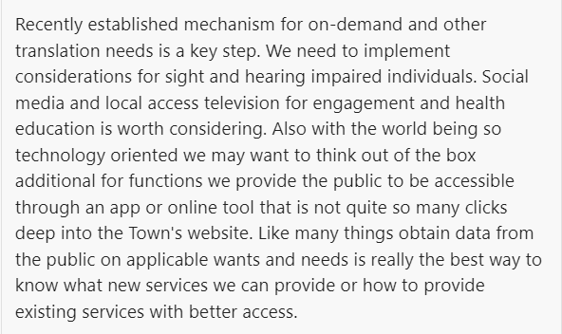

Slide 8
Maternal Health Pilot Program August 2023
Human Services recently received $100,000 from our Board of Directors to target Maternal Health Gaps with aims to create an initiative that has similarities to the Finnish and Brooklyn programs that is centered in equity and aims to achieve:
Easing the burden on new mothers (and their families) by providing a little bit of support
Baby and postpartum supplies can be pricey
Childbirth and parenting are difficult emotionally and physically.
Creating and strengthening pathways to connect new parents and their children to support, with a focus on communities with historically disparate maternal health outcomes
Strengthen connections between less traditional supports and services and the larger network of care.
Through the collaborative design and implementation process, identify:
areas for improvement and strengths to capitalize on
ongoing projects/focuses
-via Maternal and Infant Health Project PowerPoint
(Joel Cox)

Slide 9
Currently…
Health Equity Team act as facilitators and lead of the project
Designing of framework, planning and development of the project is centered in Health Equity
Maternal Health Workgroup
Involvement from multiple stakeholders (Providers, parents, healthcare, leadership)
Collaborative process (participants will also be involved with planning and development)
Sign-up is currently ongoing – hoping to establish a meeting date within the next 2-3 weeks.

Slide 10
Ongoing Equity Efforts
Standard Human Services Health Equity Framework with:
Mission, Vision, and Values Statement
Data from Health Equity Skills Assessment
Shared Language & Capacity for Community Engagement commitment
Maternal Health Pilot “Baby Box” Program
Facilitated by Health Equity Team
Multi-Sector
Assessing, researching, and understanding the needs of the community for future programs

Slide 11
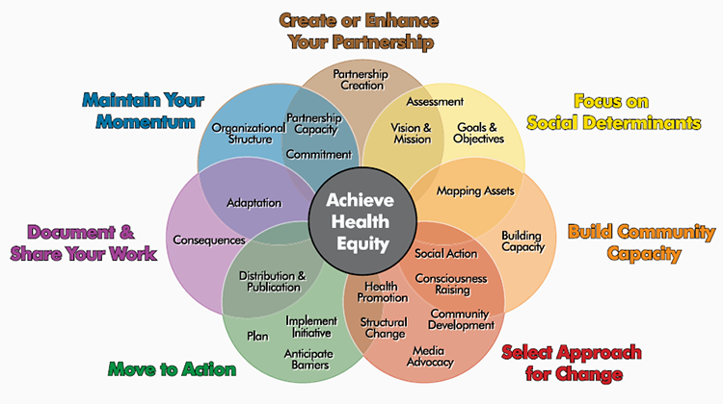
Health Equity is Continuous Work

Slide 12
The end!
Thank you!
Questions?

