Slide 1
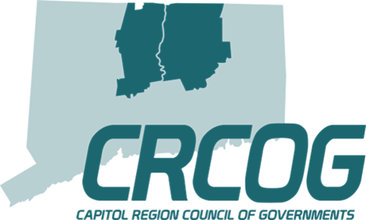
Capitol Region Council of Governments
Matt Hart | Executive Director

Slide 2
Discussion Topics
What is CRCOG?
Current Initiatives
Benefits for Manchester
Questions?

Slide 3
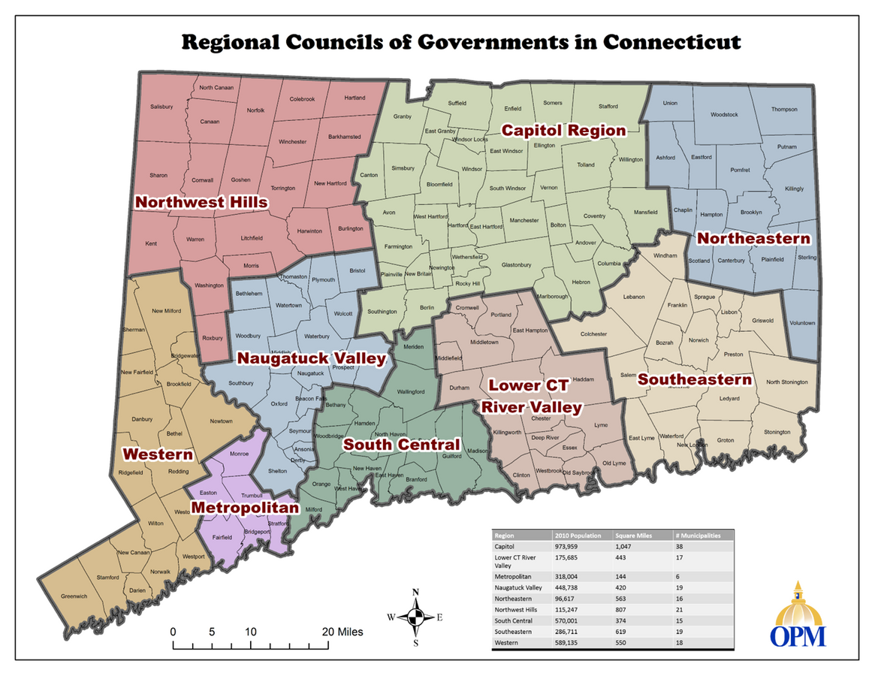
Regional Councils of Governments
(COGs)
• Regional Councils of Governments (COGs) provide a geographic framework for municipalities to jointly address interests, and coordinate the delivery of federal, state, & local programs.
• COGs can also function as the Metropolitan Planning Organization (MPO) which oversees regional planning and implementation of federal transportation funding.

Slide 4
CRCOG Structure
Largest of state’s 9 COGs, serving 38 municipalities with a population of almost 1M residents. Approx. 34 employees in 4 departments.
Municipal Services & Administration - supports Municipal Services Committee (MSC) and purchasing coalition. Conducts special projects & legislative advocacy.
Regional Planning & Development - staffs Regional Planning Commission. Administers Brownfields, land use & economic development programs.

Slide 5
CRCOG Structure
Transportation Planning - supports Transportation Committee and MPO with administration of federal & state transportation funds (TIP, LOTCIP). Conducts planning studies & projects that can become the basis for design & construction.
Public Safety & Homeland Security – supports CREPC and administers federal & state grants providing funds for public safety, emergency management & public health. Staffs CRCOPA.

Slide 6
Policy Board
Transportation Committee
Regional Planning Committee
Mayor Jay Moran
Stephen Stephanou,
Town Manager as Alternate
Jeff LaMalva, Town Engineer
Bonnie Potocki
Municipal Services Committee
Capitol Region Emergency Planning Council (CREPC)
Kasia Purciello, Assistant Town Manager
Kim Lord, Director of Finance
Don Janelle, Assistant EMD
William Darby, Police Chief
Daniel French, Fire Chief
CRCOG Committees
Notes:
Verify Steve on TC

Slide 7
Current Initiatives
Regional performance incentive program (animal control, assessment, code enforcement/building inspection)
Federal infrastructure funding
Bipartisan Infrastructure Law (BIL)
Waste management project and Central CT Solid Waste Authority (CCSWA)

Slide 8
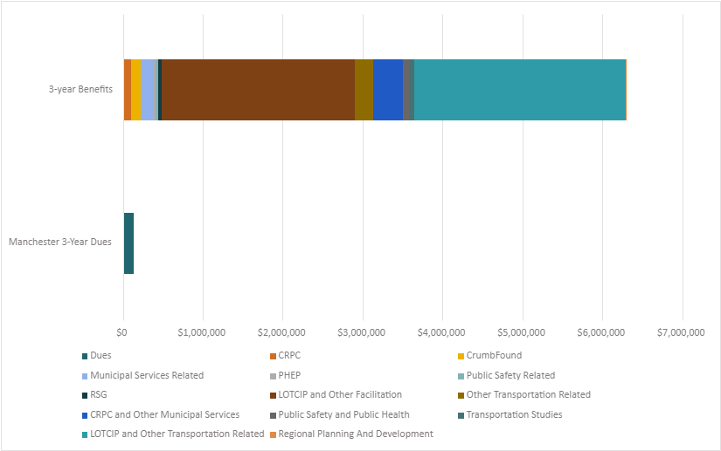
Tolland Turnpike Sidewalk
Installation: $613,893
CT83 & Oakland Street Roundabout Construction: $1,800,00
Manchester
Three-Year Membership Benefits FY 2018 - 2022
3-yearBenefits:
Over $6M
3-year Dues: $131,121

Slide 9
SUPPORTING PUBLIC SAFETY, HOMELAND SECURITY AND PUBLIC SAFETY
Completed our 20th year managing State Homeland Security Grant Program funds on behalf of our region while training and equipping our Emergency Support Functions and Regional Response Teams.
Managed fourteen local public health department/district subcontracts for the Public Health Emergency Preparedness Program grant funds totaling over 1.2 million dollars.
Hosted the inaugural regional Community Emergency Response Team (CERT) training classes at CRCOG with plan to continue to provide these sessions twice a year. ​
LEVERAGING STATE AND FEDERAL FUNDING
$958,000 in Safe Streets and Roads for All (SS4A) Grant funds to update and improve Regional Transportation Safety Plan.
Selected $36.3 million of LOTCIP projects for funding and delivered over $35.9 million of LOTCIP construction funding for 14 projects.
Completed required FHWA core documents including Unified Planning Work Program (UPWP) for FY24- FY25 and new Metropolitan Transportation Plan (CONNECT2050).​
MAKES AN IMPACT
Use visual charts to communicate info more effectively.
Notes:
Pull from annual mtg pres

Slide 10
CONDUCTING PLANNING STUDIES
SAVING TIME AND MONEY
Special Studies: completed 2 (inc. Transit Priority Corridors Study), advanced 5, initiated 1.
Begin implementation of CEDS and make progress on Climate Pollution Reduction Grant program.
Initiated multiple new regional projects including Plan of Conservation and Development, Natural Hazards Mitigation Plan, and $1 million Climate Pollution Reduction Grant. ​
​
CRPC saved members $1.83 Million and Job Order Contracting program (ezIQC) began work for $34.2MM in projects.
Added staff resources to assist members with federal infrastructure grant programs.
Completed Phase I & II of Waste Management Study and re-convened CCSWA.
Executed first assistance agreement under CRCOG’s Brownfield Revolving Loan Fund.

Slide 11
CRCOG What?
CRCOG Who?
The Capitol Region Council of Governments (CRCOG) has initiated and implements regional programs of benefit to 38 metro Hartford municipalities for more than 50 years.
CRCOG Why?
DID YOU
KNOW?

Slide 12
QUESTIONS
THANK YOU
MHART@CRCOG.ORG

