Slide 1
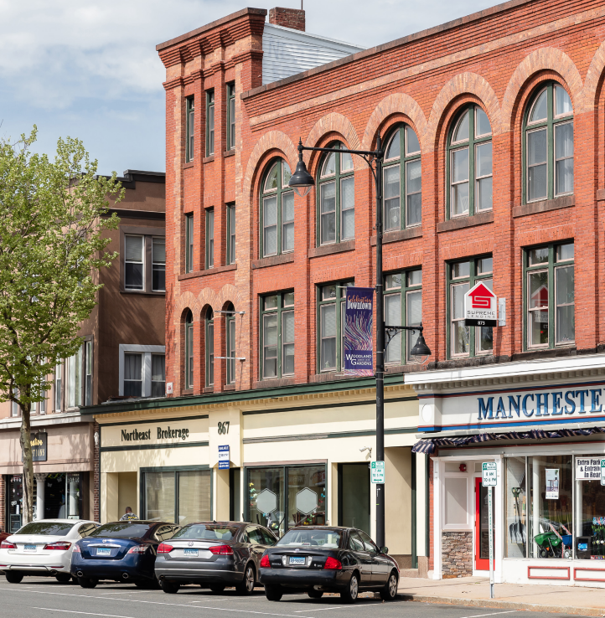


Town of Manchester
Flood Resiliency Plan
july 7, 2026
Board of Directors Meeting
MANCHESTER NEXT PLAN OF CONSERVATION AND DEVELOPMENT

Slide 2



introduction
Jeff LaMalva
Town Engineer –
Town of Manchester
Dmitrijs Obolevics
Project Manager –
Thornton Tomasetti

Slide 3
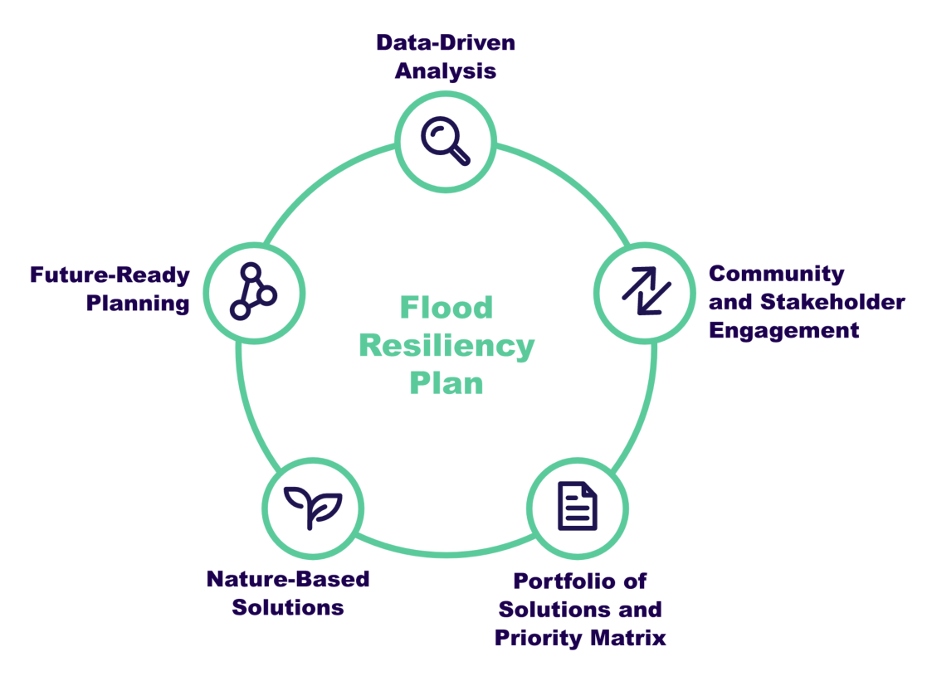
What is a Flood Resiliency Plan?
The Flood Resiliency Plan is a comprehensive, data and community-driven initiative that will guide the Town in development of effective strategies to reduce flood risk across Manchester and protect properties, infrastructure, and vital community assets.

Slide 4
What is the purpose of the Flood Resiliency Plan?
Flood risk analysis
Recommended flood mitigation strategies
Future grant funding applications
The Flood Resiliency Plan will serve as a planning framework to assist the Town in adapting to future extreme weather events.
It includes a flood risk analysis across Manchester and identify the Town’s most flood-prone locations.
It includes recommended flood mitigation strategies developed for the Town’s most vulnerable locations, informed by community input and technical analysis.
Recommended project profiles will support future grant funding applications, helping the Town secure resources needed to implement flood resiliency efforts.

Slide 5
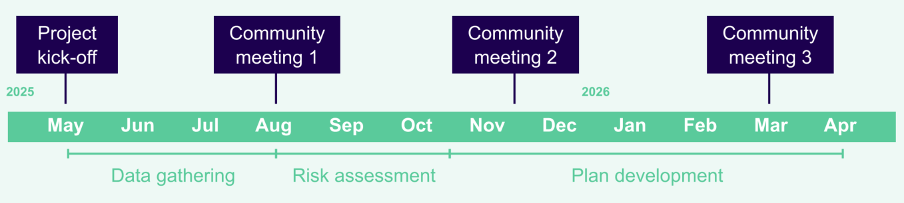
Timeline

Slide 6
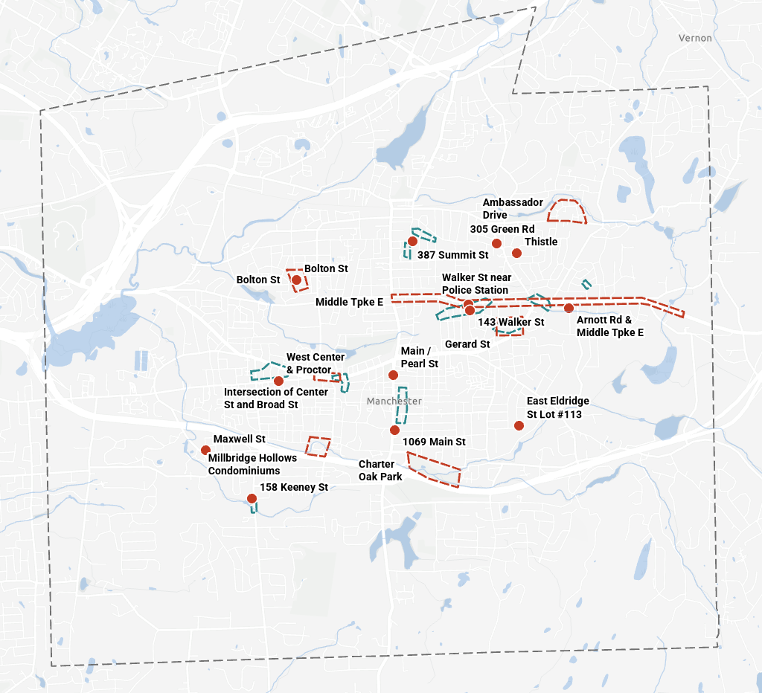
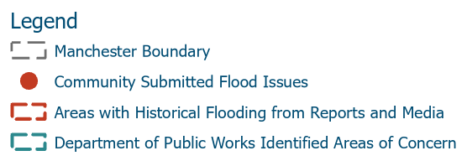
Historic flood locations
Information about historic flood locations was gathered from various sources:
  Community Meeting #1 and information received via email
  Additional information provided by the Department of Public Works
  Additional information obtained from the media

Slide 7
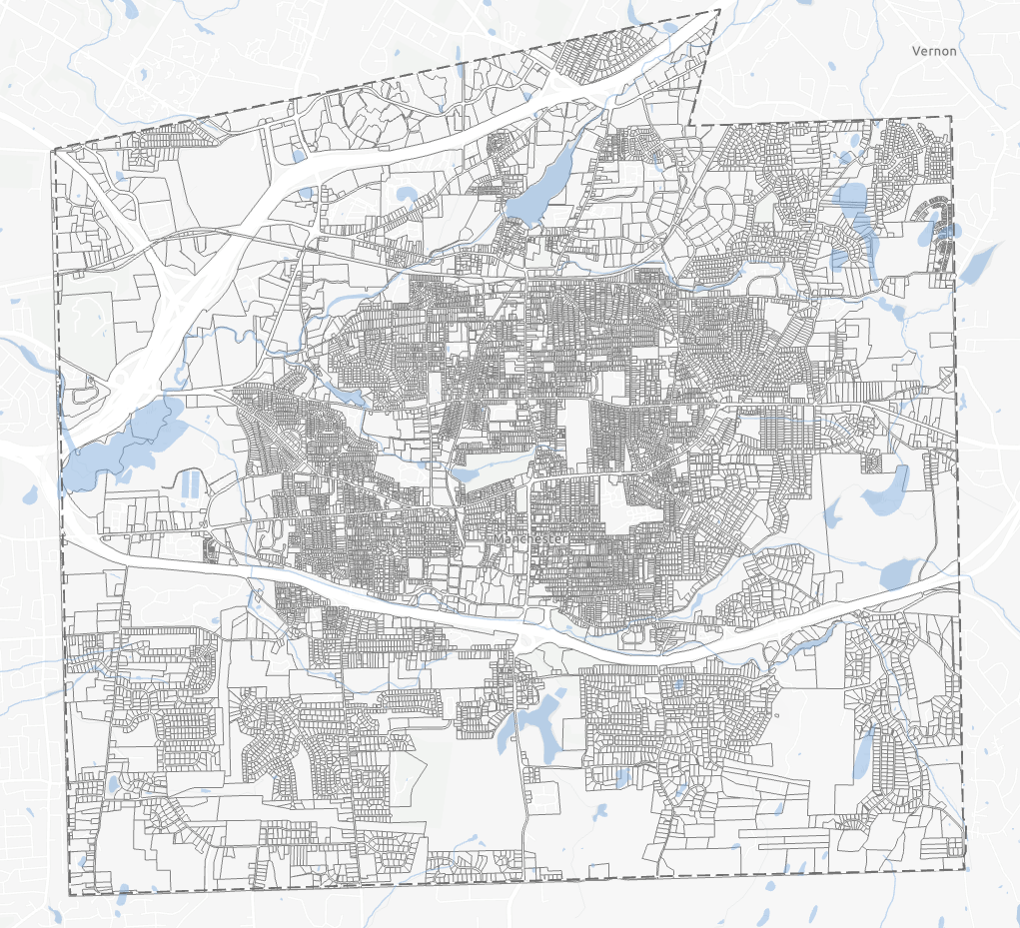
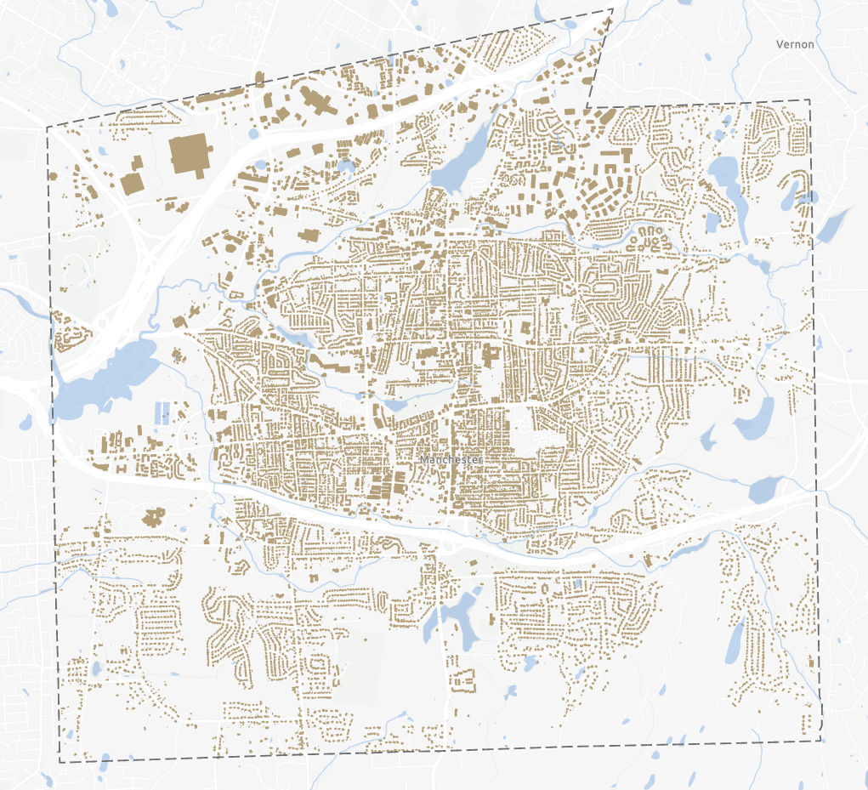
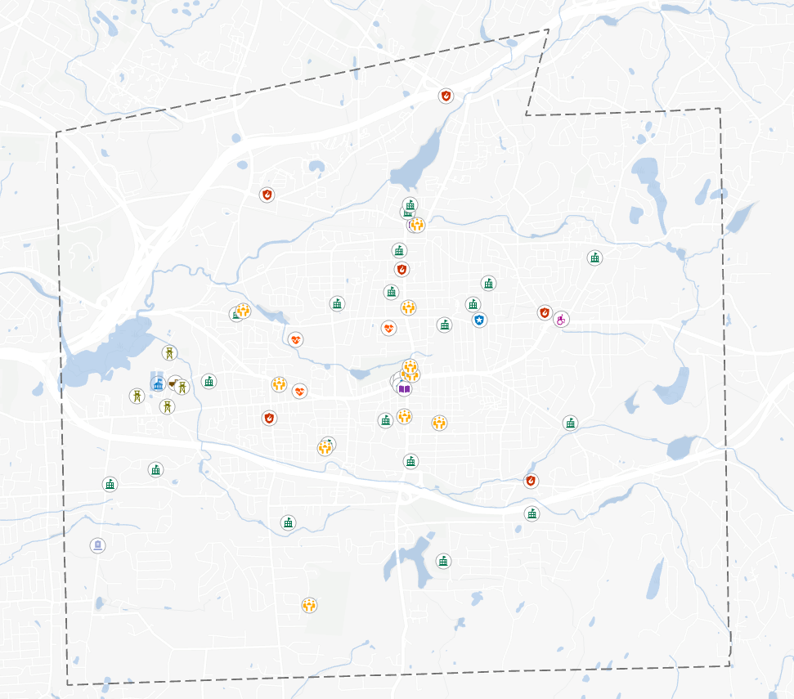
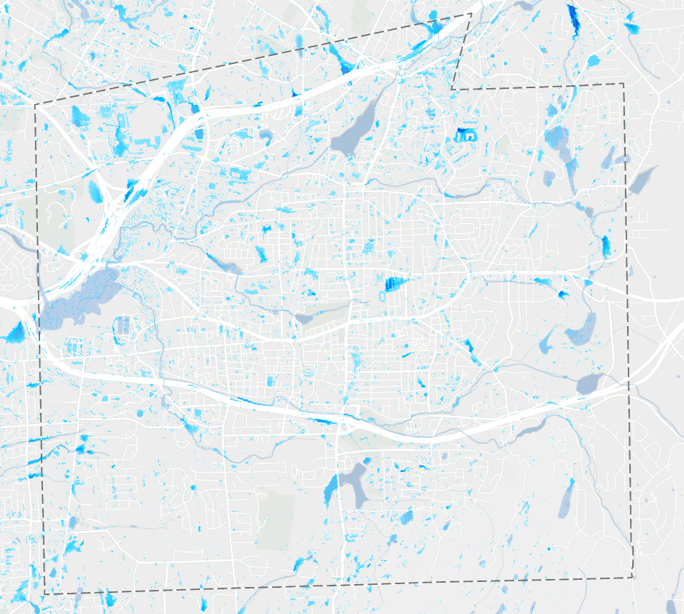
Input data
Current and future climate data
Flood risk data
Land cover and soil data
Town infrastructure data
Social-vulnerability data
These inputs were integrated to develop a comprehensive understanding of where flooding occurs and the mechanisms driving it.
Land Parcels
Buildings
Critical facilities
Flood risk data

Slide 8
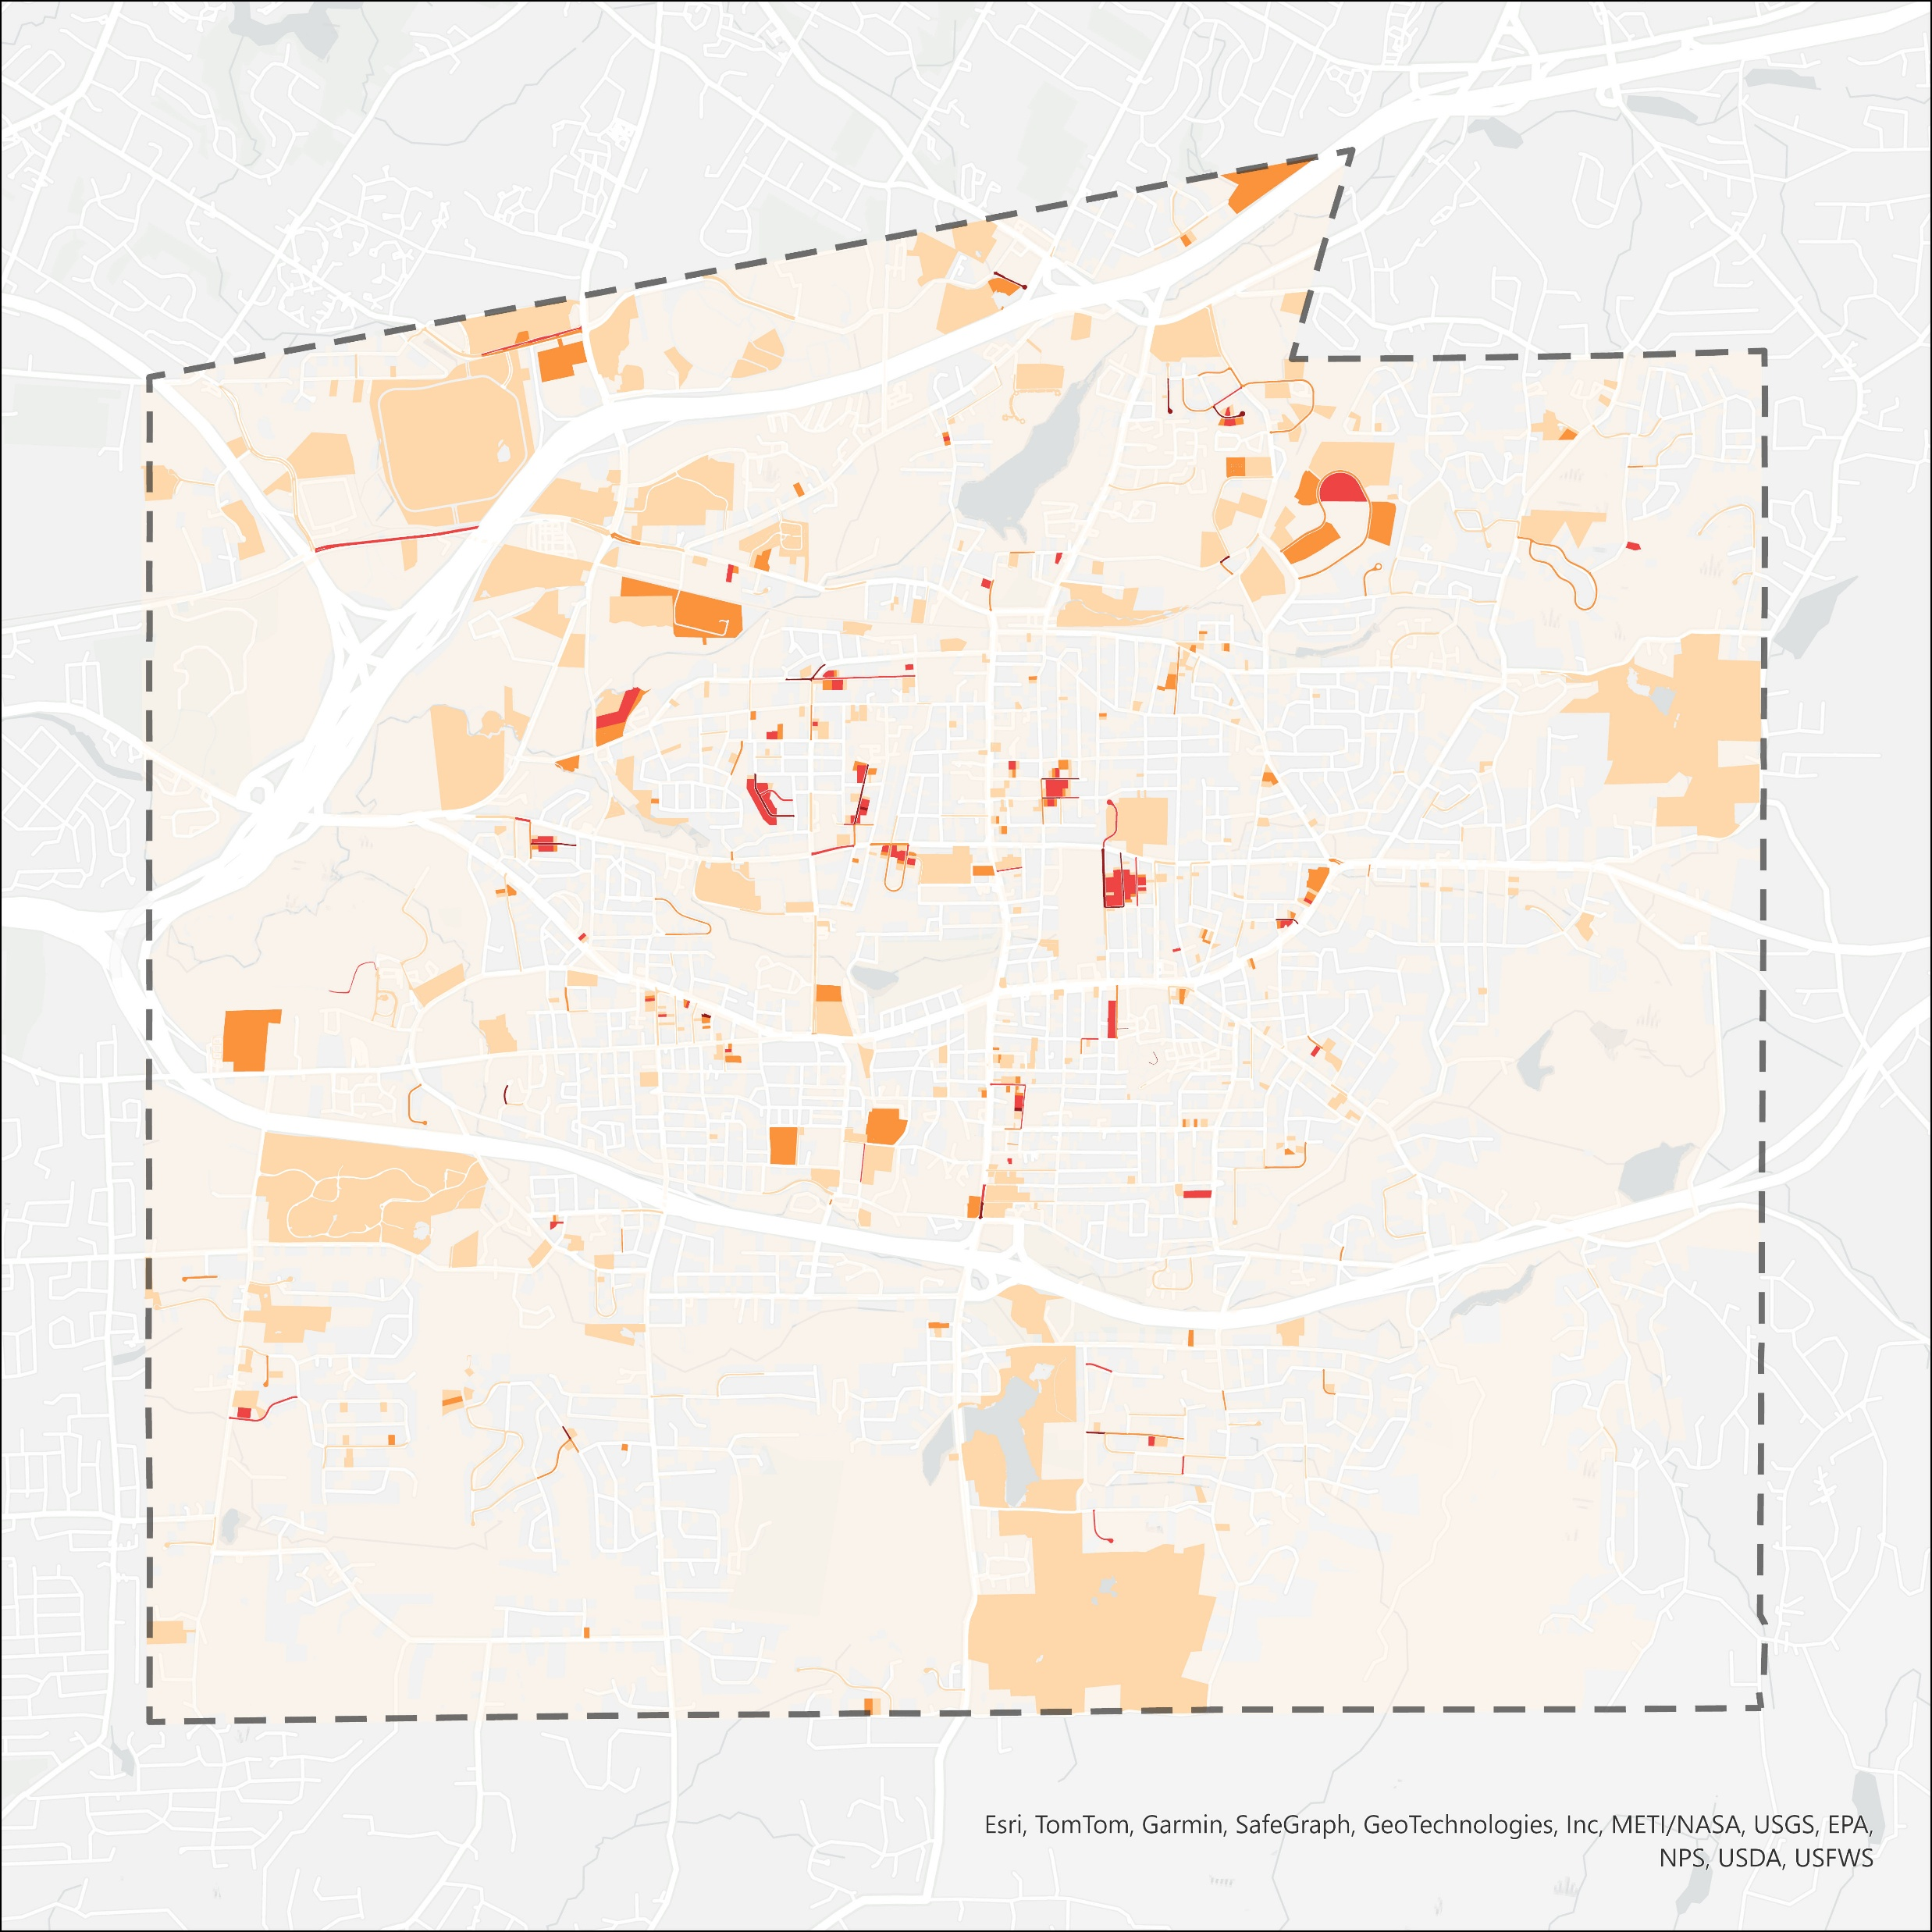
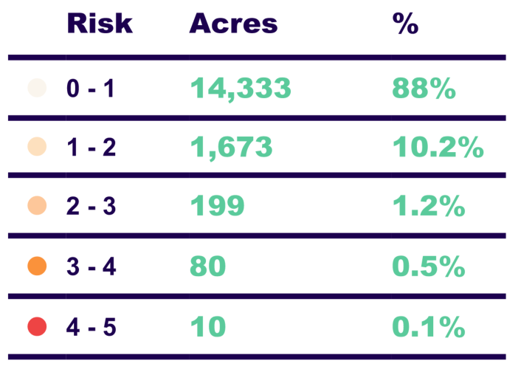
Current climate conditions
Approximately 12% of Manchester’s land area faces measurable flood risk, while the highest-risk areas - scoring 3 to 5 represent only about 0.6% of the town’s land area. The highest-risk areas align with historical flood locations.

Slide 9

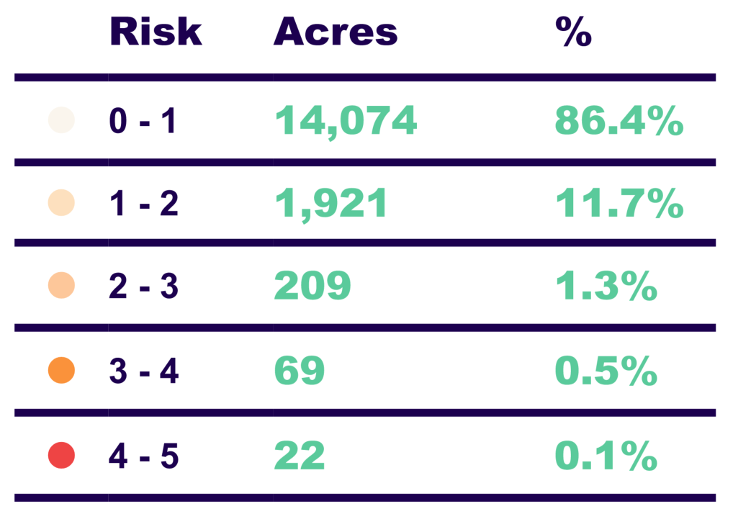
Future climate conditions
Under future climate conditions, approximately 13.6% of Manchester’s land area is projected to face measurable flood risk, with the highest-risk areas - scoring 4 to 5 - approximately double compared to current conditions.

Slide 10
PRIORITY CLUSTERS

Slide 11
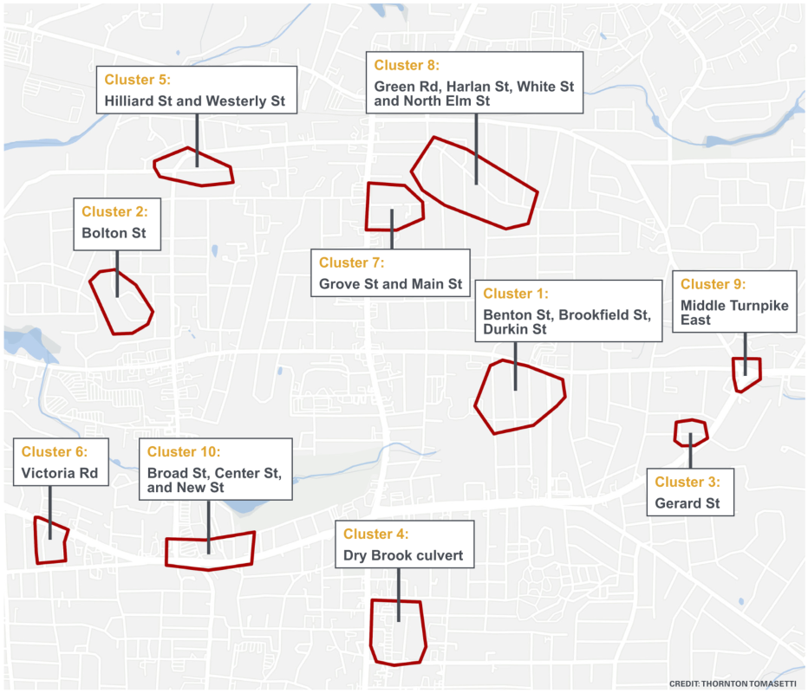
Priority clusters
In coordination with the Town, the Top 10 Priority Clusters most vulnerable to flooding were identified, and concept mitigation measures were developed for each.

Slide 12
Concept solutions

Slide 13
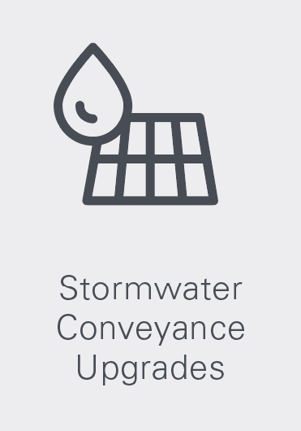

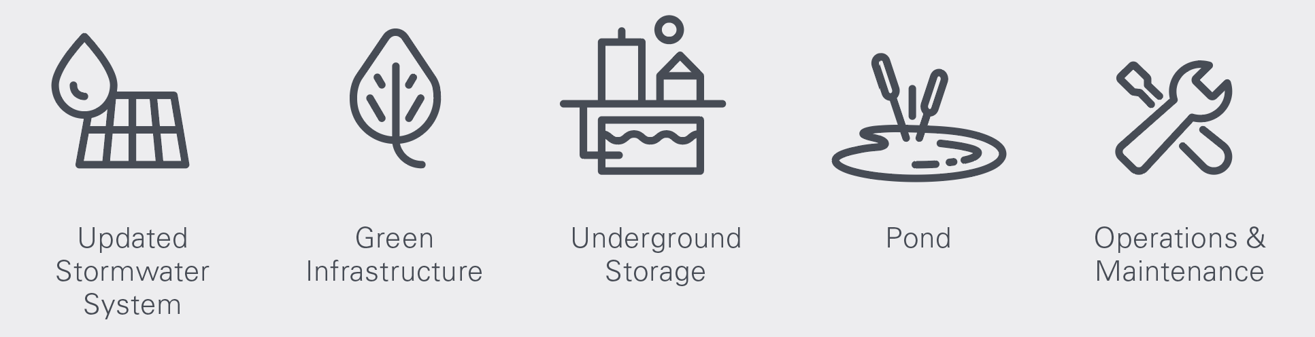
FLOOD MITIGATION SOLUTIONS
Improvements to pipes, catch basins, and culverts to help convey stormwater more efficiently and reduce surface flooding.
Nature-based solutions that use natural or restored features, such as wetlands, ponds, and low-lying open space, to hold and manage runoff during storm events.
Nature-based solutions such as rain gardens, permeable pavement, and tree plantings that help infiltrate, slow down, and filter runoff.
Routine actions such as cleaning catch basins, clearing debris, inspecting drainage infrastructure, and maintaining systems so they continue to work effectively over time.
Underground tanks, chambers, or oversized pipes that temporarily store runoff during heavy rain and release it slowly to reduce flooding.

Slide 14
Flood resiliency plan

Slide 15
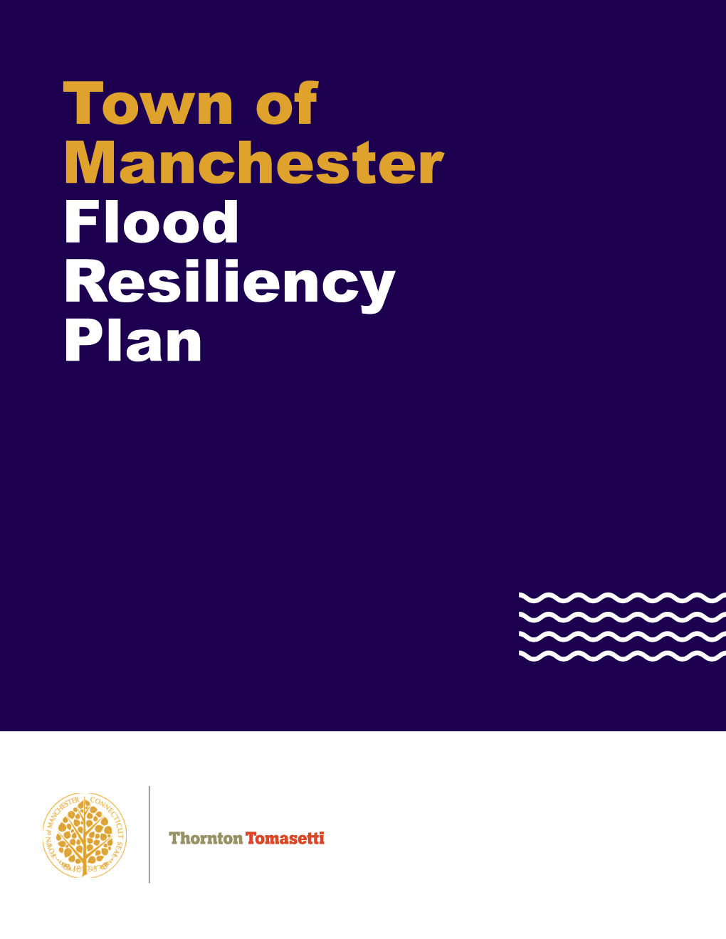
Flood resiliency plan
Planning framework to assist the Town in adapting to future extreme weather events.
Includes:
  Town Profile
  Discussion about community engagement
  Town’s Flood Risk Profile
  Flood Resiliency Recommendations (including cost estimates and permitting requirements)

Slide 16
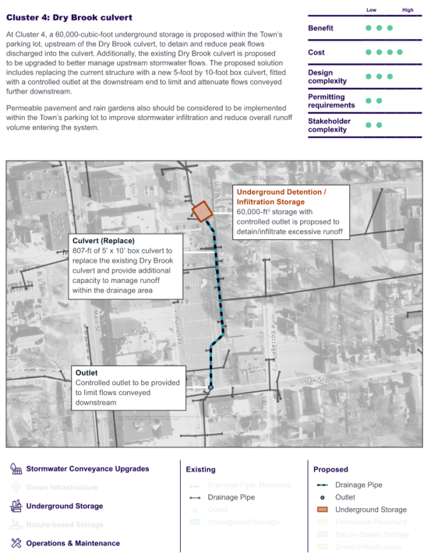
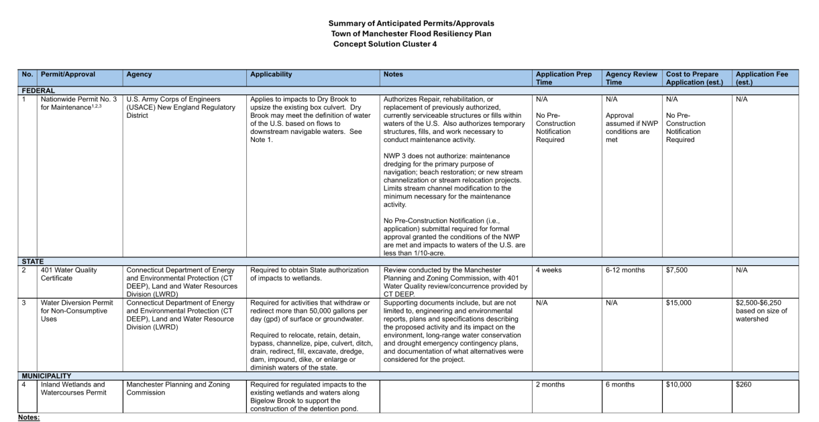
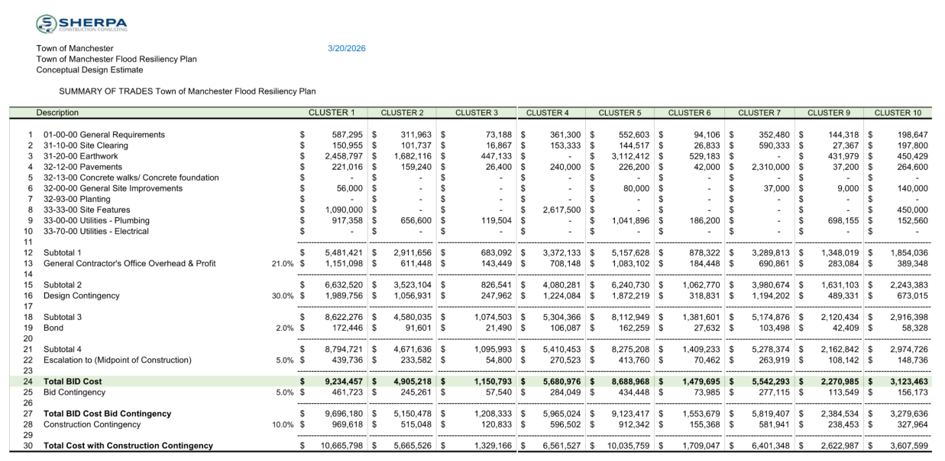

Slide 17
Thank you!

Slide 18
Appendix – proposed solutions

Slide 19
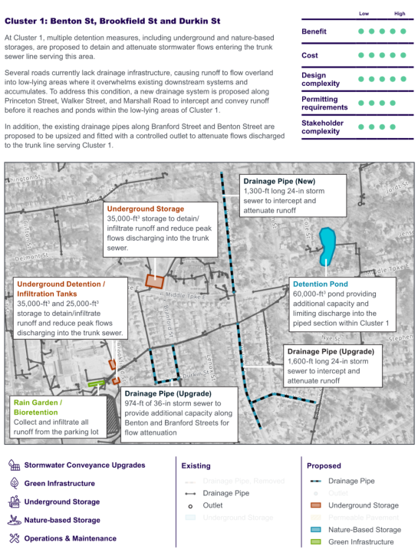
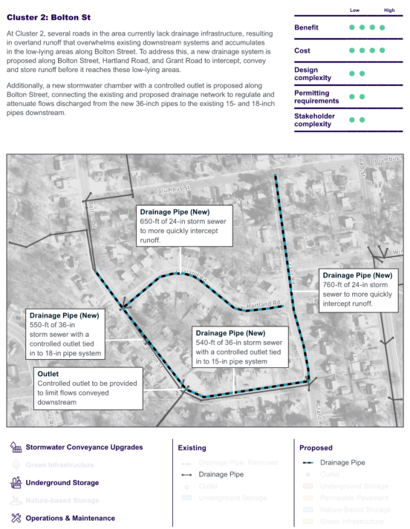

Slide 20
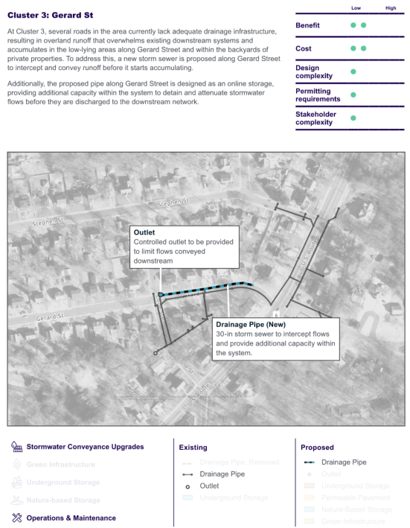

Slide 21
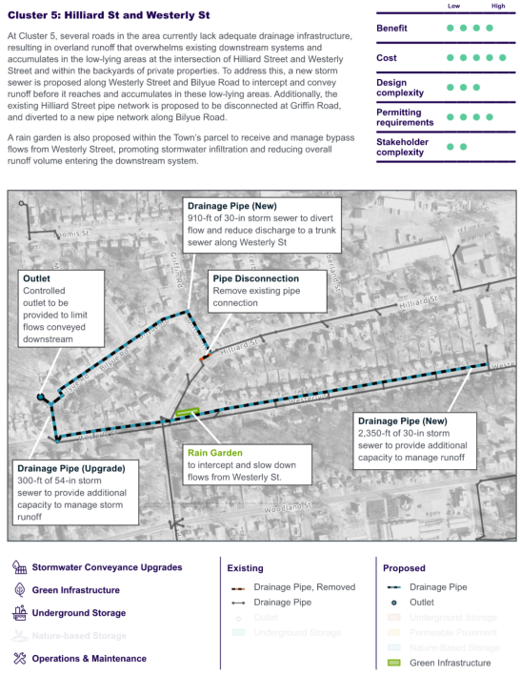
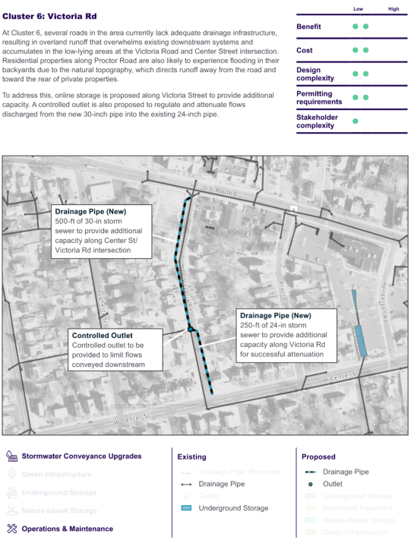

Slide 22
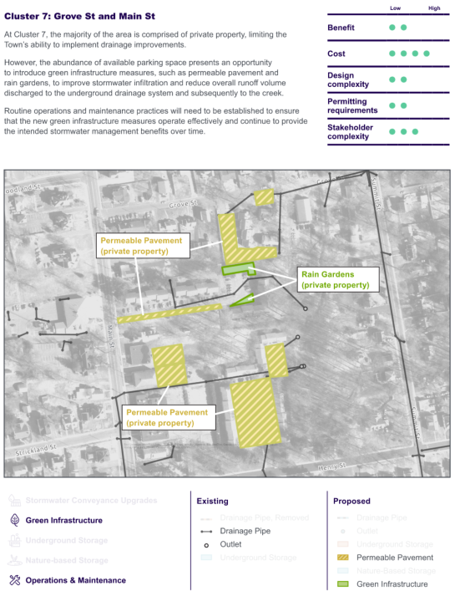
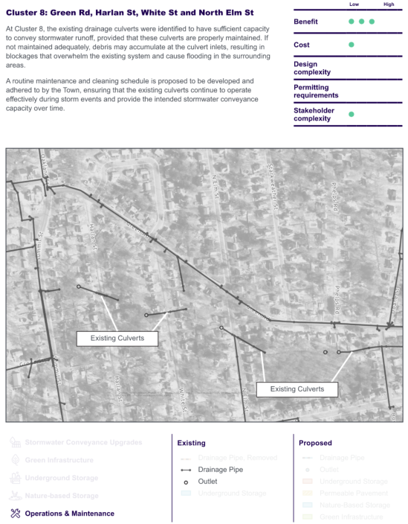

Slide 23
