Slide 1
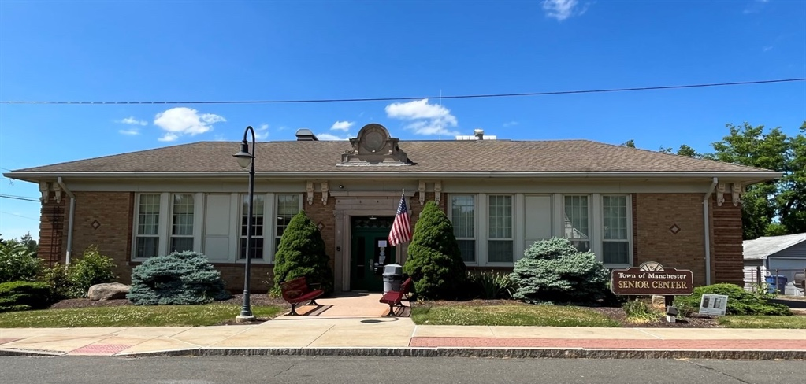
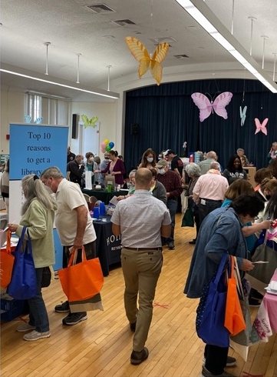
Manchester Senior Center
Facility Needs Analysis
Presentation of Findings
December 6, 2022

Slide 2
The Study Team
Lifespan Design Studio – Project Lead
Senior Center Planning & Design Specialists
Doug Gallow, FAIA & Ellen Gallow, CAPS
Worked with 100+ communities throughout New England & US since 2006
Planning & feasibility studies, design for renovations, adaptive reuse & new facilities
Team with local architects for appropriate mix of specialized expertise & local experience/responsiveness
EDM Architecture & Engineering
Chris Wante, AIA (Unionville, CT office)
Worked with Lifespan on numerous senior center studies & design projects in CT & MA since 2011
Toured and documented local facilities including the Manchester Senior Center
Jill Jackson Ledford, MSW
Senior Services Specialist
Has teamed with Lifespan on several projects
Supported demographic analysis & future visioning

Slide 3
Motivating factors
(The Town has expressed the understanding that)
The current facility impedes necessary growth in program/service delivery
The physical environment is neither use-friendly or functionally effective for the uses it accommodates
The size and configuration of the building and site significantly limit options for addressing these issues through renovation/addition.
Over-arching goal for the study
Develop tools for use in options evaluation (new construction or possible adaptive reuse of another building, both requiring location & site analysis)
Tasks included
Explore local and national trends in program & service delivery
Review local demographics for perspective
Gather input from current and prospective patrons
Articulate a vision for a new facility and the functions it will accommodate
Determine space needs for the building and site

Slide 4
Step 1: Demographic Trends & Issues Review
Key indicators point to the need for increased services and more space
Nearly 12,000 Manchester residents were age 60+ in 2021
Another 7,500 are 50+ (The remaining Boomers & Gen X)
Gen Y, the largest segment of the Manchester population, will join this “age wave” in 14 years
Life expectancy in CT is 80.9 years and rising*
Significant rates of obesity and debilitating health and mental health conditions have been documented among older adults in Manchester*
*CT Healthy Aging Data Report 2021
“Research shows that compared to their peers senior center participants have higher levels of health, social interaction, and life satisfaction.”
National Council on Aging

Slide 5
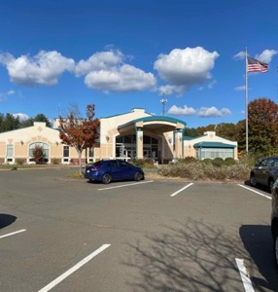
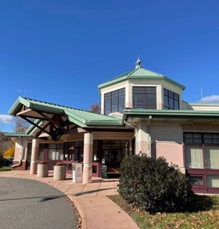
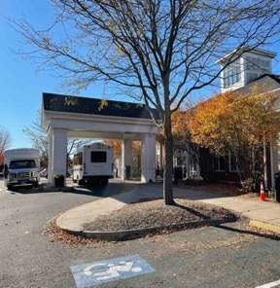
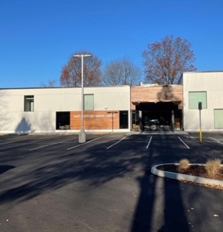
Step 2: Center Tours & Program/Service Review
Wallingford
Glastonbury
Enfield
East Hartford
The study team toured several area centers with Eileen Faust and Joel Cox for perspective, ideas, and reference points to support the discussion of Manchester needs and options
Although each facility is unique, the programs & services offered are largely consistent with prevailing practices and trends in the industry as a whole and in Manchester, with some variation from center to center
~20,000 square feet is the average size, with no clear tie to the size of the community
Detailed information, photos and floor plans for each center are provided in the Appendix of our final report
Enfield
Glastonbury
Wallingford
East Hartford

Slide 6
Step 3: Community Interest Survey
A survey conducted this spring focused on gauging the level of interest in various types of programs, services and/or drop-in activities, and the physical environment in which they would be staged
Targeted those approaching and above the Center’s age of eligibility (55+)
Offered online & hard copy, widely publicized, 400 responses received
Responses were consistent with national and regional trends:
Exercise and fitness programs & amenities got the strongest response
Strong interest was expressed in educational, arts, and social/recreational opportunities offered in appropriate settings
Strong support was voiced for the daily lunch program and expansion of a spectrum of social, legal, health & mental health services
More than 2/3 said they would like to visit the Center to work out on exercise equipment, make use of an indoor walking track, to eat and socialize in a lobby café, and/or to enjoy performances.
Full survey results are included in the Final Report Appendix

Slide 7
Step 4: Current & Future Offerings Review
The study team met with Senior Center, Adult and Family Services, Health Department, and Emergency Management administrators & staff to gather information that helps to define space needs associated with current and potential future uses of the center
The initial focus was on the functions to be accommodated
Current Manchester Senior Center Programs and Services include:
Card, tile and board games
Misc. games & recreational activities (bingo, billiards, virtual gaming, cornhole, bocce)
Art & handcrafts (woodshop, ceramics, painting, sewing & needlework)
Fitness & meditation (broad spectrum of exercise classes, tai chi, yoga, etc.)
Educational & cultural (memoir writing, book club, driver safety, cooking demonstrations, topical presentations, workshops & classes)
Entertainment & socialization-focused activities (broad variety of clubs & groups, movies, seasonal and holiday celebrations)
Health & Personal Services (Daily lunch program, various health screenings and services, support groups, social worker consultations and case management, transportation, etc.)
Drop-in use of the facility, which is currently very limited due to space and space layout issues

Slide 8
Step 4, continued: Current & Future Offerings Review
Our review continued with the discussion of additional programs, services, drop-in activities and staffing considerations that should be considered for a new facility (based in the projected needs and interests of the growing target population, staff observations, and survey results).
We talked about outdoor activities and amenities of interest and other site-related issues including parking, which is critical to the success of a facility of this type
We reviewed current practices and a future vision for use of the Senior Center as an Emergency Shelter, with up to 60 individuals of all ages potentially accommodated for stays of limited duration during applicable emergencies
All of these discussions are reflected in the Vision Statement and Program of Requirements for a future facility that we’ll talk about in a moment

Slide 9
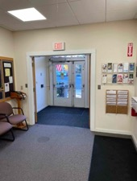
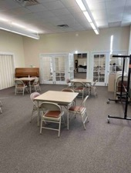
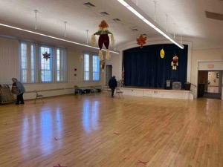
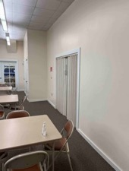
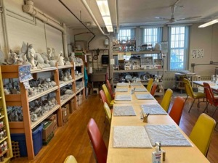
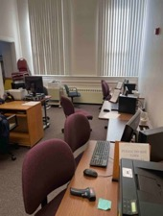
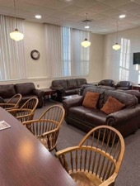
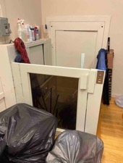
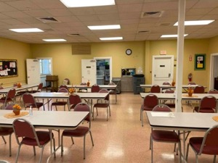
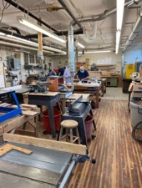
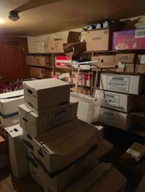
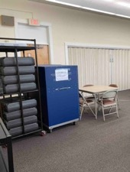
Step 5: Existing Conditions Review and Future Vision Development
The study team toured the building and site with the Center Director, discussed how it is used, and identified issues that negatively impact program and service delivery, staff, and patrons.
Goals and parameters to be incorporated in the vision (and the evaluation of options) for a new facility were developed as a result of this analysis.
A detailed list of observations and goals is included in the full report.

Slide 10
Vision for a Future Center: Recurrent Themes in Input from all Sources
The design of the new center should:
Include the right mix of flexible- and dedicated-use rooms for optimal space use without compromising on the quality of the experience
Incorporate amenities that support professional-caliber fitness and wellness experiences
Offer welcoming social spaces to motivate people to “drop in and hang out”
Facilitate an expanded spectrum of health & personal services
Be easy and intuitive for anyone to navigate, and operationally efficient
“The intent is to express the energy and vitality of an active adult lifestyle in a purpose-built facility that encourages social interaction, generates civic pride and indicates the community’s commitment to lifelong health. The design should surprise those who may expect less from a municipal facility of this type.”

Slide 11
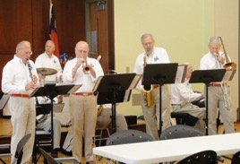
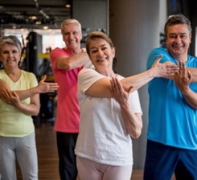
Vision for a Future Center: Essential Characteristics
To the extent possible:
The new location should be equitably accessible and favorably regarded by older adults throughout the Manchester community.
The outward appearance of the building should have ageless appeal and be perceived as a community focal point
The main entrance should be easily accessed from a pedestrian-friendly parking lot, with a passenger drop-off zone that offers protection from the elements, and a vestibule with automatic doors
The lobby should be a vibrant social hub with a hospitality ambiance and easy access to information and staff
Activity rooms should be grouped functionally and accessed from generously wide intuitively arranged corridors
Staff offices and the rooms used for personal services should be grouped to support efficient collaboration while respecting patron comfort and privacy.

Slide 12
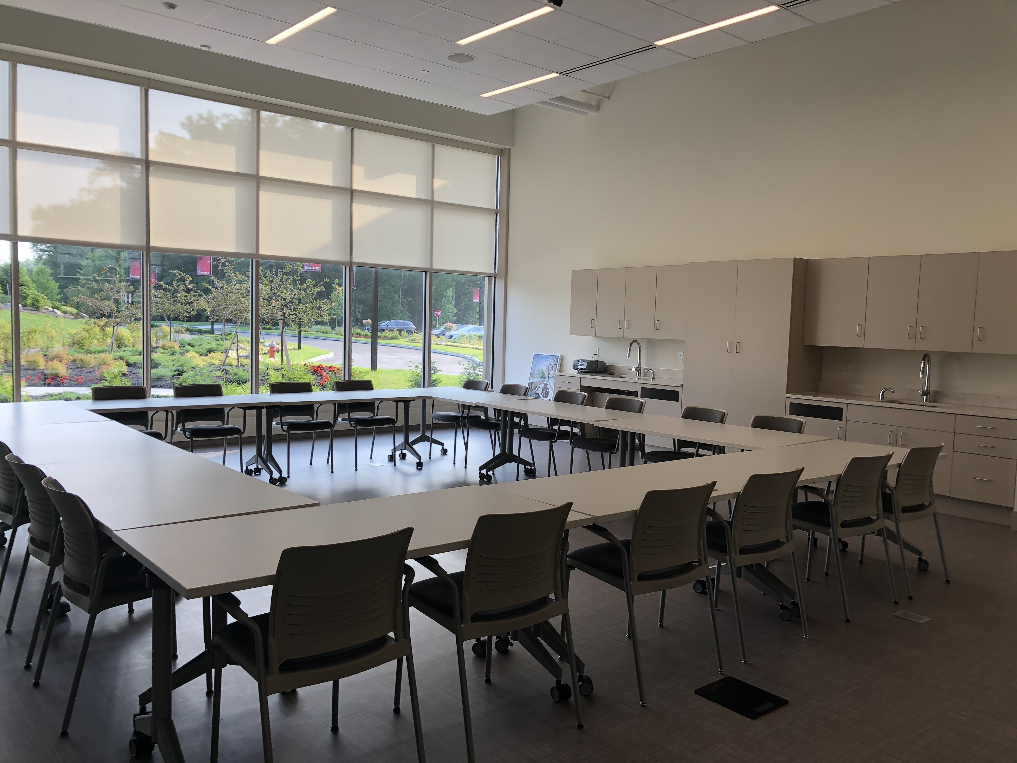
The Program of Requirements
Drawing on this vision and detailed information gathered from staff, a list of rooms and spaces to be incorporated in a new facility was drafted.
Determinations about the size of each room or space were based in numerous considerations, including:
The anticipated use (or uses if not dedicated to one purpose)
Target group sizes
Equipment needs
Preferred types of furniture, arrangement, and clearances
Supply and storage needs associated with the anticipated use/s
Any special infrastructure needs (plumbing, electricity, technology, etc.)

Slide 13
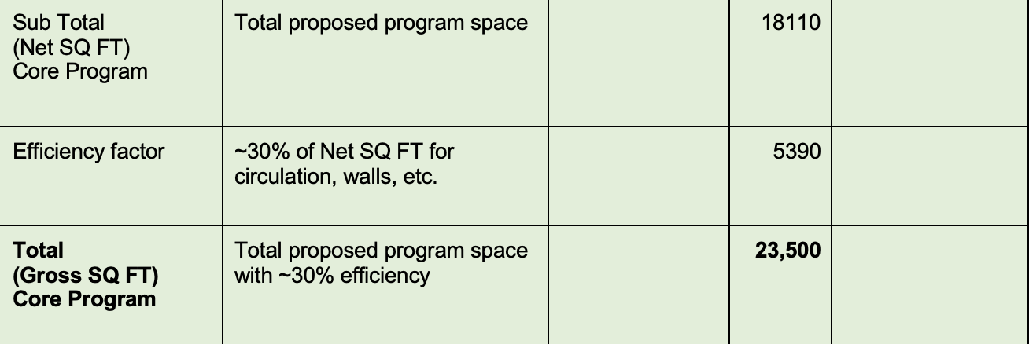
The Program of Requirements
The chart on pages 33-44 of the report describes more than 50 rooms and spaces totaling about 18,000 square feet proposed to accommodate the vision and functional goals established for the new facility.
We added 30% to that sub-total to arrive at a projection of approximately 23,500 square feet for the entire facility including corridors, wall thicknesses, and other things not included in the itemized list of requirements. As noted previously, this is consistent with the sizing of other centers in the area.

Slide 14
Key Program Elements
To give you a sense of the kinds of rooms and amenities that are envisioned for the new facility, we’ve listed some of the most compelling here. These are absolutely on trend with what we’re observing in this industry nation-wide.
Generous lobby lounge space plus a quieter library-lounge
Lobby “café” counter and seating (product offerings TBD)
Flex-use dining and assembly room with motorized partition (so it can be used as 2 separate rooms)
Class 4 licensed commercial kitchen to support the daily meal program and other uses
Appropriately appointed Exercise/Dance studio
Equipped Fitness room with ~12 pieces of senior-friendly stationary equipment
Dedicated Arts & Crafts and Pottery/Ceramics studios
Woodshop
Flex-use Meeting Rooms at various size points for classes, discussion groups, etc.
Flex-use Game Room and dedicated use Pool Room with 3 tables
Senior Center Office Suite and connected Health & Social Services Suite
Dedicated Emergency Shelter storage and 2 shower rooms

Slide 15
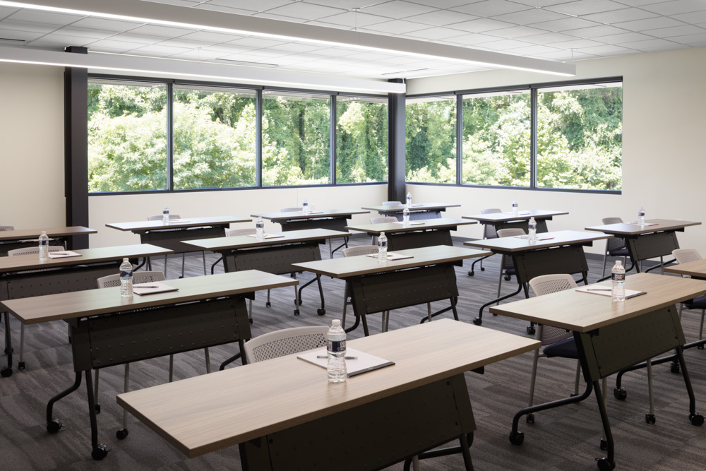
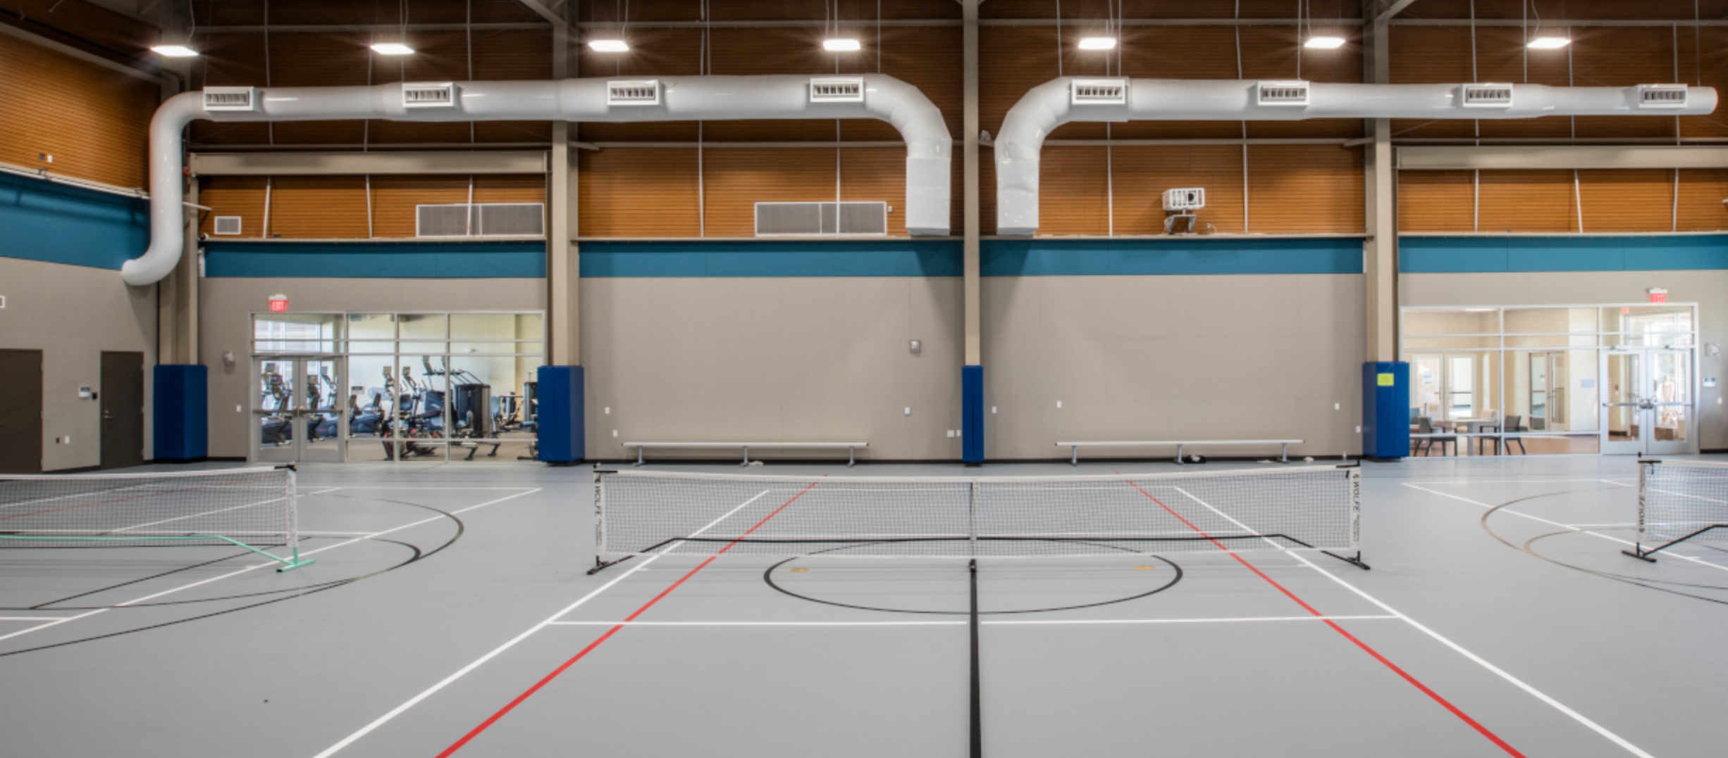
Optional Program Elements for Consideration
In review of the core program with departmental staff, it was agreed that input received from the public (and staff perception of emerging needs and interests) suggest that (although not top priorities) these additional amenities would be heavily utilized community assets if provided:
A generously sized Flex-use Classroom allowing for the expansion of adult education and cultural enrichment programming, possibly offered in partnership with others (+1,000 gross square feet).
A separate or attached building with Multi-sport Gymnasium (basketball, volleyball, pickleball, and misc. other uses), a perimeter or elevated walking track, lobby, staff office, and basic locker rooms. Approximately 10,630 gross square feet would be required for a one-level building, or 15,000 for a building with an upper-level walking track.

Slide 16
Options Evaluation
As planning for a new facility continues, the evaluation of options for the location of the new center and the form it will take will introduce multiple criteria not yet established by the Town.
Will this be a new stand-alone facility, or will it be combined in some way on-site with other amenities?
Will adaptive renovation of an existing building be considered?
Where will it be located?
How will design, construction, equipment & furnishings for the new facility be funded? When and how will funding limits for the project be determined, and when will funds be available?
How will staffing and operations of the new facility be funded, and at what levels?
Although the primary focus of this study was on the articulation of a vision and space needs for a new facility, key considerations in location & site evaluation and evaluation of properties that may come under consideration for adaptive reuse were provided at the end of the report to support the ongoing planning effort.

Slide 17
Manchester Senior Center
Facility Needs Analysis
Presentation of Findings
December 6, 2022

